Slide 1
IBM University Engagement Project Submission
“Exploring the Power of Agentic AI with IBM Granite and IBM Bob” AudioSense AI – Audio Signal Processing Assistant

Slide 2


Project Title – AudioSense AI: IBM Granite Powered Audio Signal Processing Assistant
Domain of Project – [ like Agriculture / Education / Healthcare / … ]
Student Name | Recent Passport Photo | Email ID | Mobile number [WhatsApp]
Balaji M
Email ID and Mobile/WhatsApp: Please fill these fields before submission. Recommended font: Arial Heading: 28 pt | Content: 20 pt

Slide 3
Problem Statement – Audio Signal Processing Assistant Agent
The Challenge Audio preamplifiers, filters and amplifiers can suffer from hum, noise, distortion, low gain, oscillation and incorrect filter settings. Troubleshooting often requires checking several circuit conditions and component choices. The Objective Build an AI-powered Audio Signal Processing Assistant Agent that helps Electronics and Telecommunications Engineering students: • Diagnose common audio amplifier and preamplifier problems. • Suggest filter designs and calculate RC cutoff frequency. • Explain grounding, shielding, noise and distortion causes. • Provide systematic diagnostic checks and practical recommendations. • Use IBM Granite and IBM Bob as core project technologies.

Slide 4
Proposed Solution – AudioSense AI
AudioSense AI is a Streamlit-based engineering assistant developed with IBM Bob. Workflow: 1. User describes an audio-circuit problem. 2. Query analyzer identifies the problem type. 3. Local audio-engineering knowledge base supplies relevant guidance. 4. Engineering logic provides structured diagnosis/calculation. 5. IBM Granite 4 H Small is validated through the watsonx.ai demo for audio-engineering prompts. 6. The application presents probable causes, diagnostic checks and recommended actions. Main modules: • Noise Troubleshooter • Filter Assistant • Amplifier Troubleshooter • Circuit Advisor • Quick Diagnosis • Knowledge Base • RC cutoff-frequency calculator

Slide 5
Technology Used
• IBM Bob – used to create, edit, test and troubleshoot the AudioSense AI project. • IBM Granite 4 H Small – used for AI validation through IBM watsonx.ai demo. • IBM watsonx.ai – used to validate Granite responses for audio-engineering prompts. • Python – application and engineering logic. • Streamlit – interactive web interface. • RAG-style local knowledge retrieval – audio engineering reference content. • Automated tests – 96 tests passed with 0 failures. • RC filter calculation – fc = 1 / (2πRC).

Slide 6
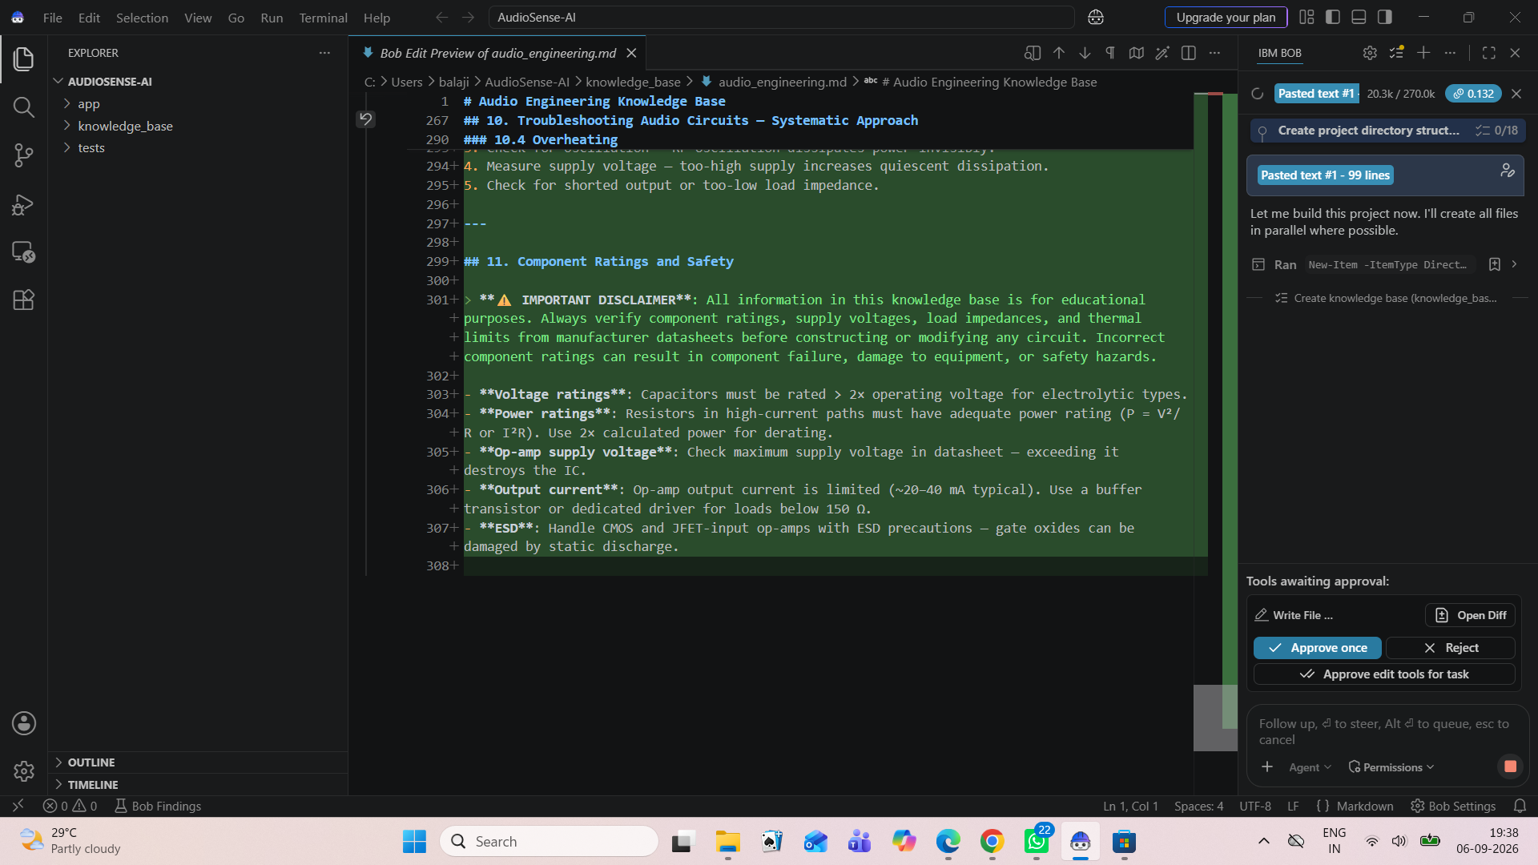
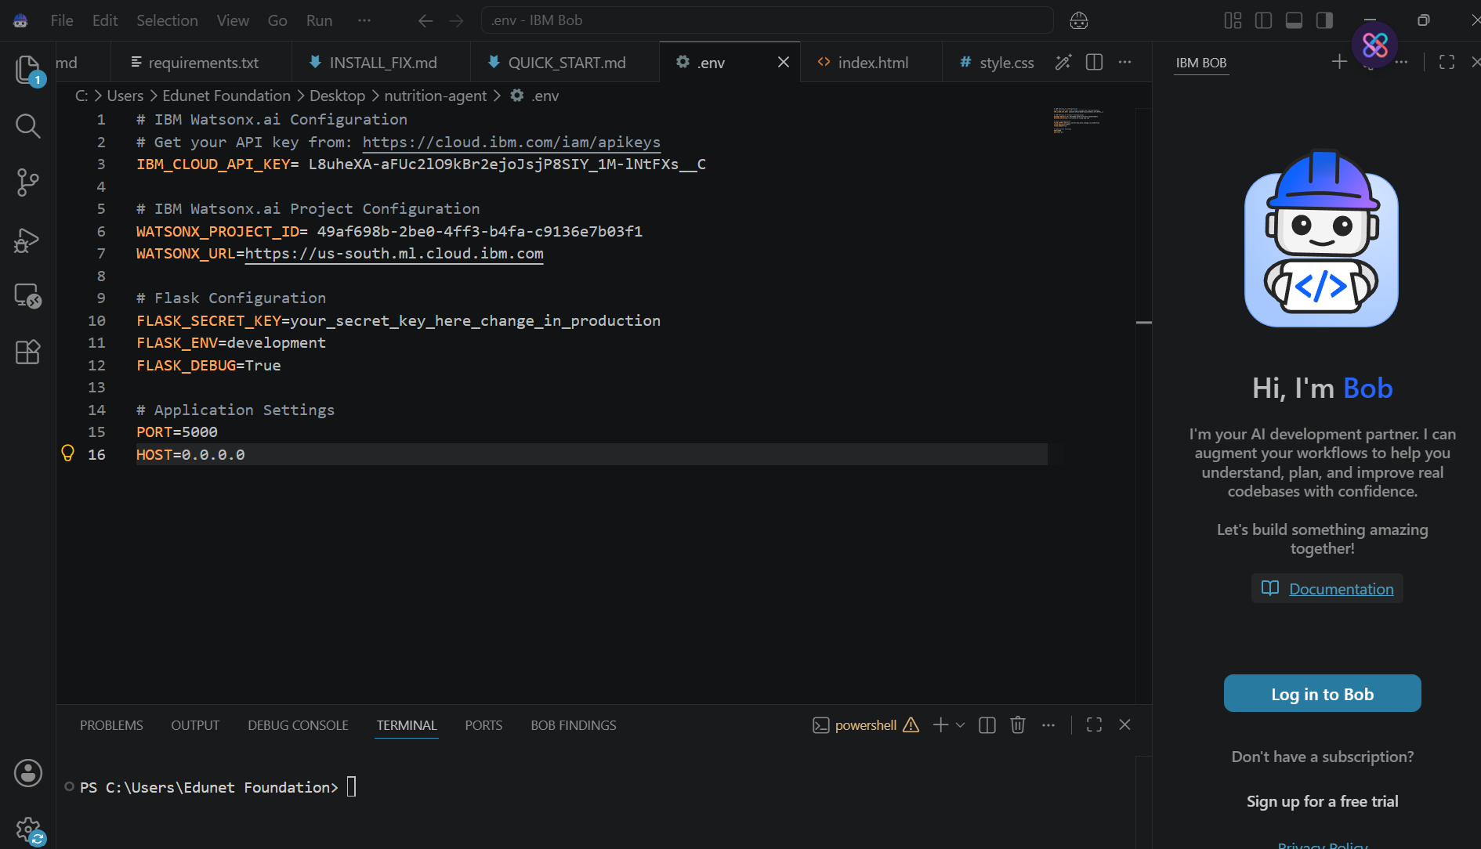
Required Files Created Using IBM Bob
AudioSense-AI/ ├── app/ │ ├── main.py │ ├── granite_service.py │ ├── query_analyzer.py │ ├── knowledge_retriever.py │ ├── calculator.py │ └── ui.py ├── knowledge_base/ │ └── audio_engineering.md ├── tests/ ├── README.md ├── requirements.txt ├── .env.example ├── .gitignore └── LICENSE
IBM Bob workspace showing the AudioSense AI knowledge base and project files

Slide 7
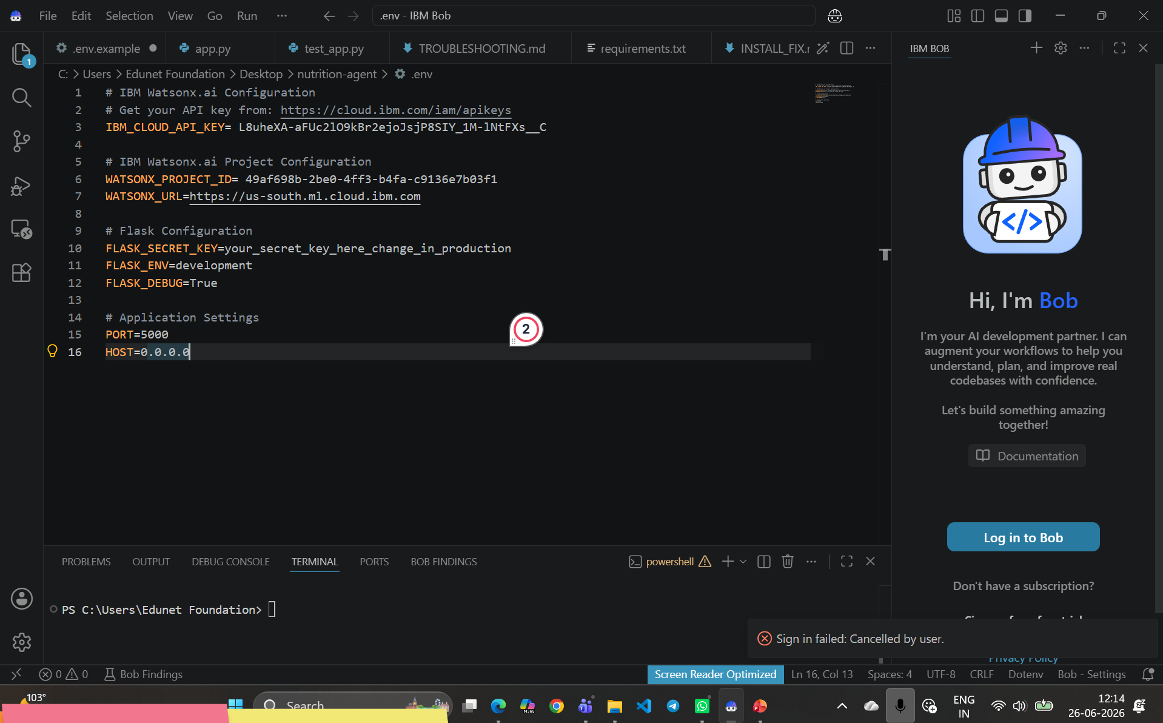
IBM Bob – Project Development Screenshot
IBM Bob was used to build and review the AudioSense AI engineering knowledge base.

Slide 8
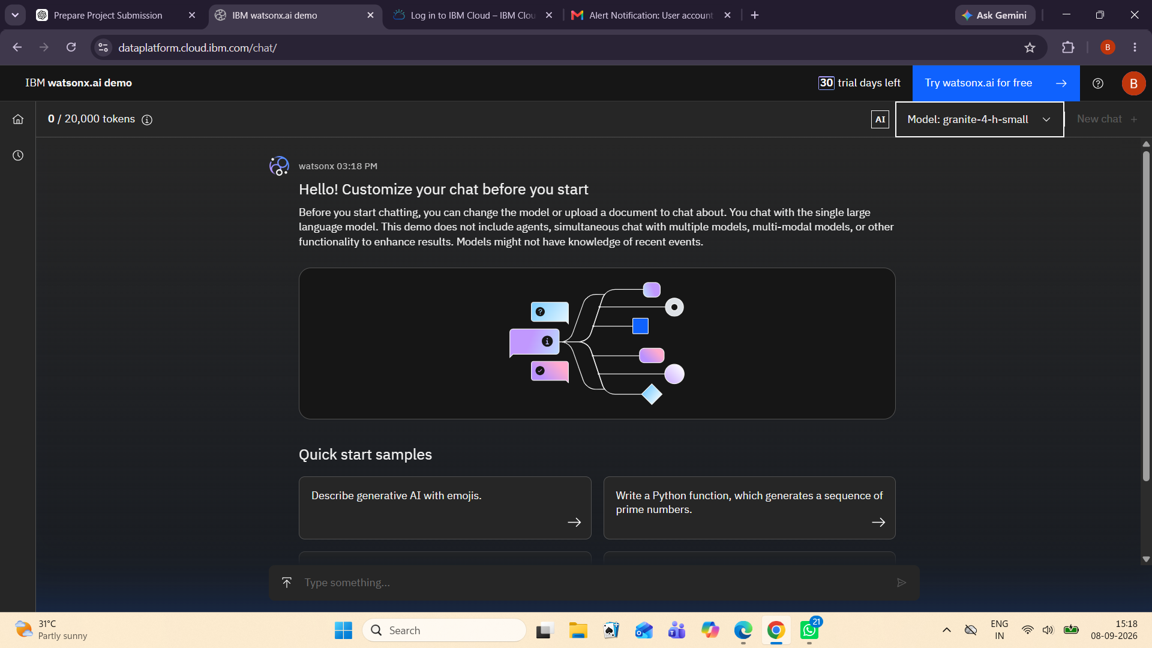
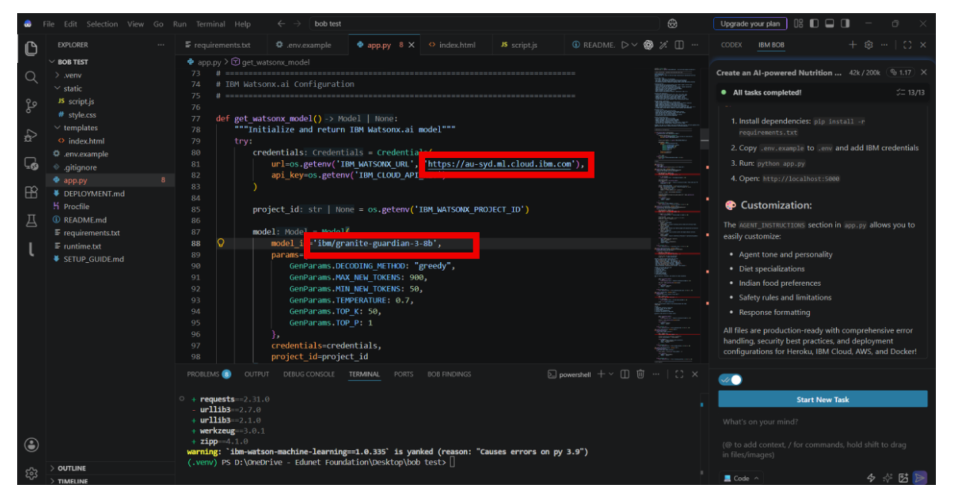
IBM watsonx.ai – Granite 4 H Small Model Validation
Model selected: granite-4-h-small. The demo was used to validate AI responses for audio-engineering prompts.

Slide 9

Architecture Blueprint for AudioSense AI
Query Analyzer + Problem Type
IBM Granite 4 H Small*
USER
Streamlit Web Interface
Diagnosis / Filter Recommendation
Knowledge Base + Retrieval
Engineering Logic + Calculator
* Granite 4 H Small is validated in the IBM watsonx.ai demo; the local application remains in Demo Mode without live API credentials.

Slide 10

Role of Agentic AI in the Solution
AudioSense AI applies agent-style task routing rather than treating every query as the same request. • Context awareness – identifies whether the user needs noise, filter, amplifier or general circuit guidance. • Specialized tasks – separate troubleshooters and calculator logic handle different engineering problems. • Retrieval – relevant audio-engineering knowledge is selected before presenting the result. • Tool-like calculation – RC cutoff frequency is calculated from R and C values. • Structured output – probable causes, diagnostic checks and recommendations are shown clearly. • Human verification – results are educational guidance and circuit conditions/component ratings must be verified before hardware changes.

Slide 11
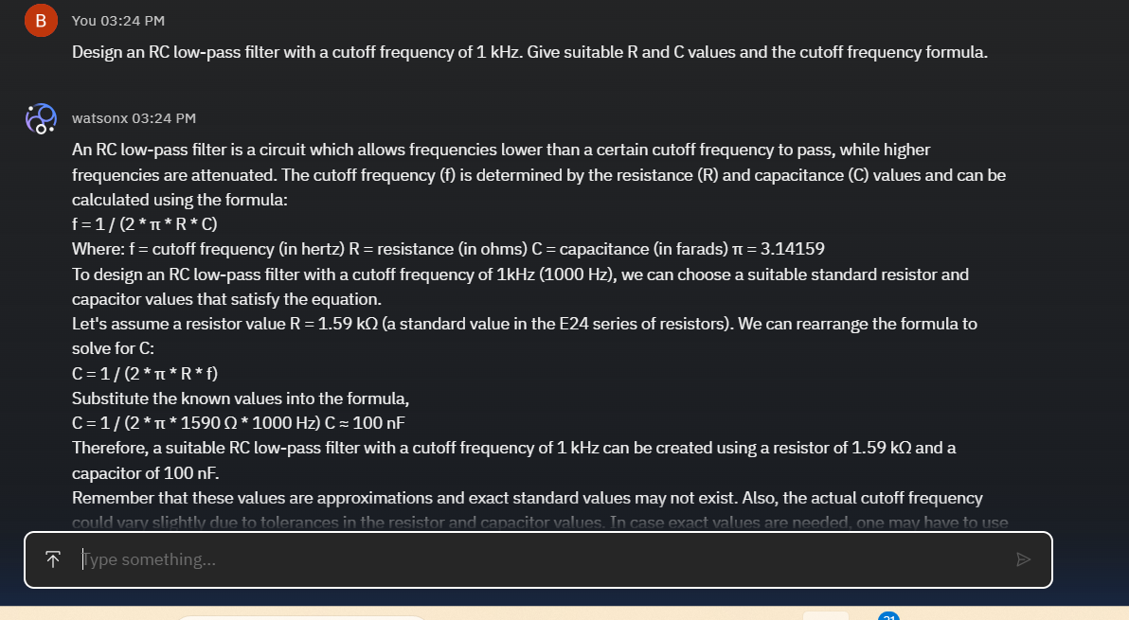


Granite Demo Token Usage & Validation
1,823 / 20,000 tokens used during Granite demo validation
Granite model selected
Engineering prompt response
·
·
·
Model selection screen
RC low-pass filter prompt and Granite response

Slide 12
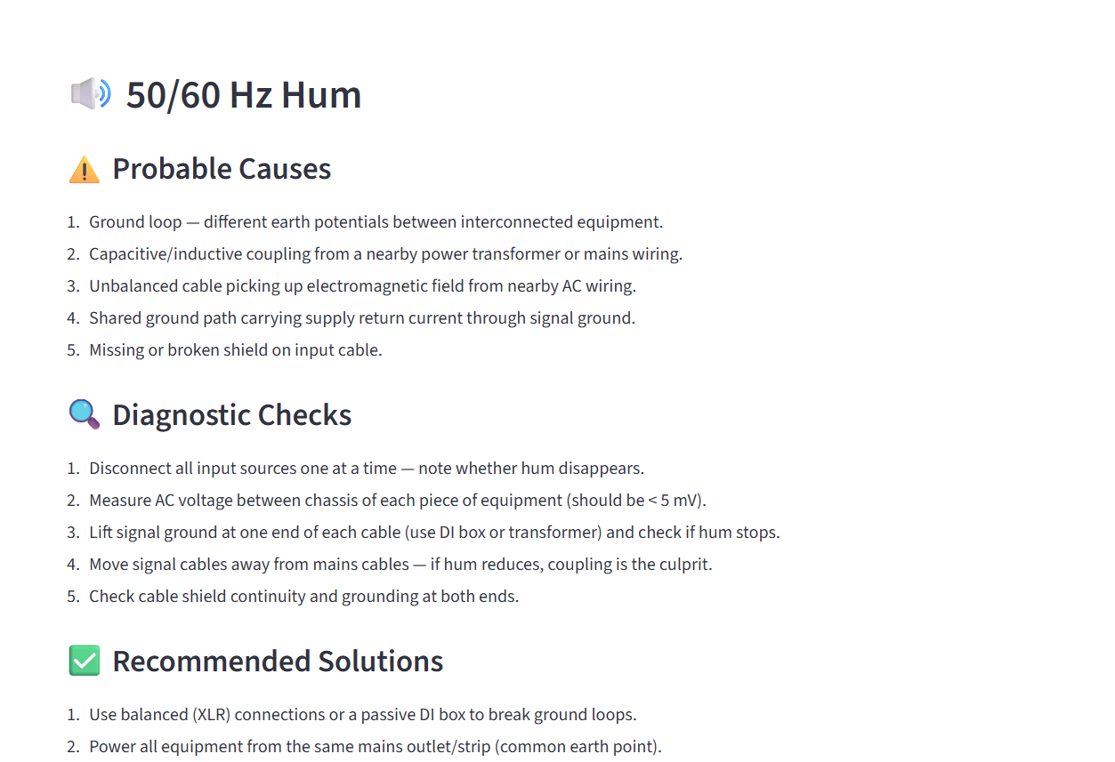
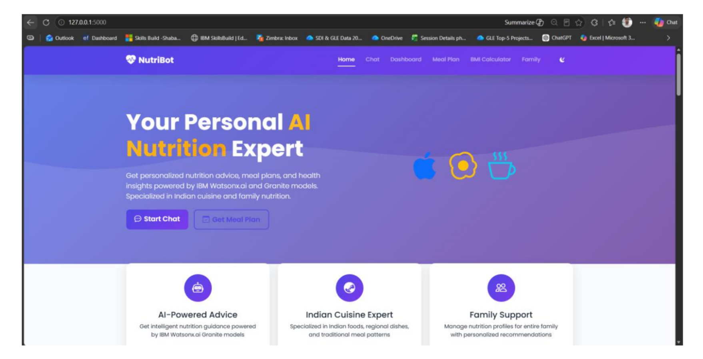
Project Output Screenshot – Noise Troubleshooter
Prompt: “My audio amplifier has a 50 Hz hum in the output. What could be causing it and how can I troubleshoot and reduce it?”
·
·
·

Slide 13
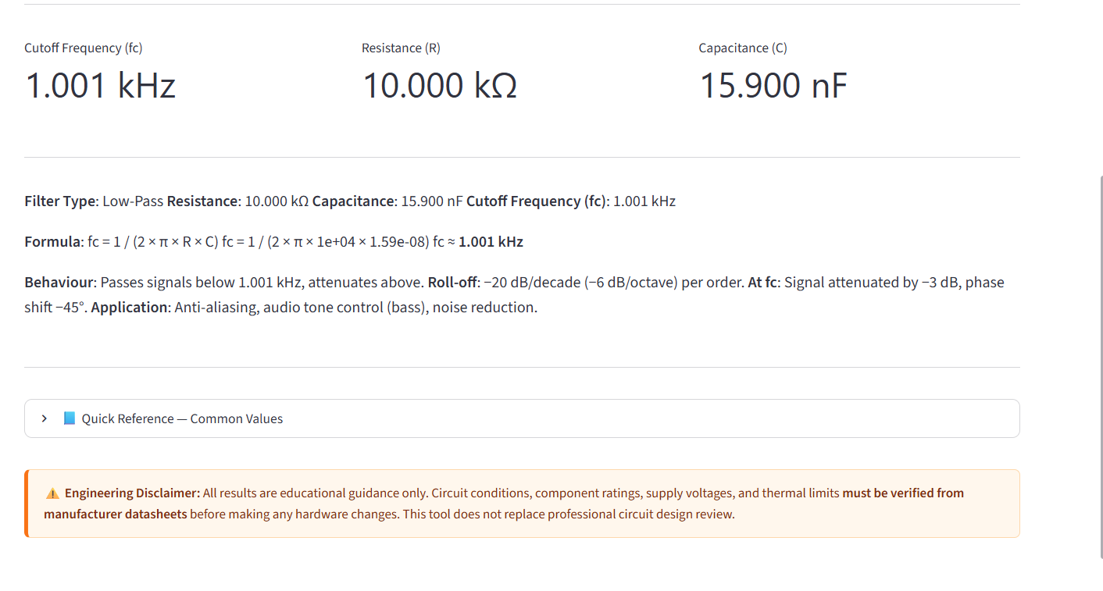
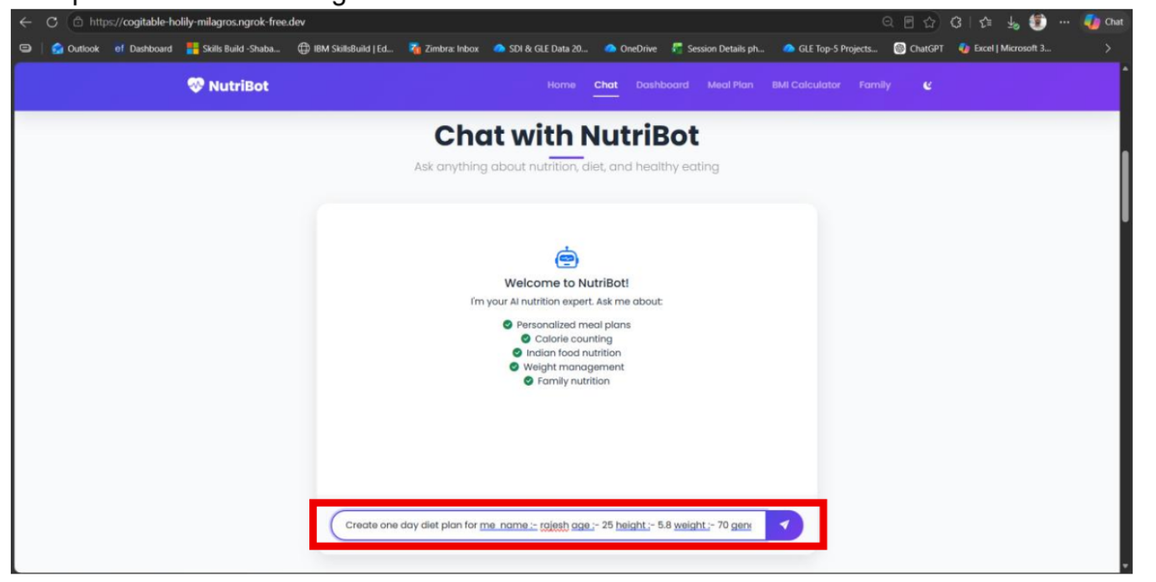
Project Output Screenshot – Filter Assistant
Prompt: “Design an RC low-pass filter with a cutoff frequency of 1 kHz.”
·
·
·

Slide 14
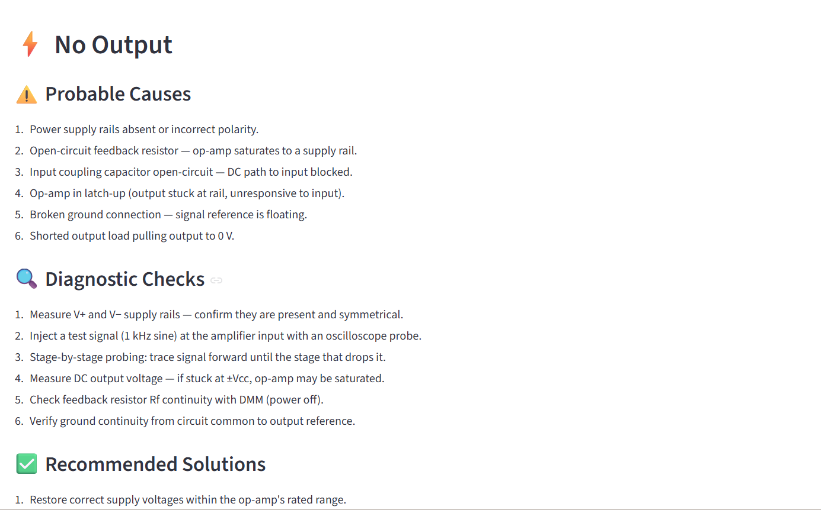
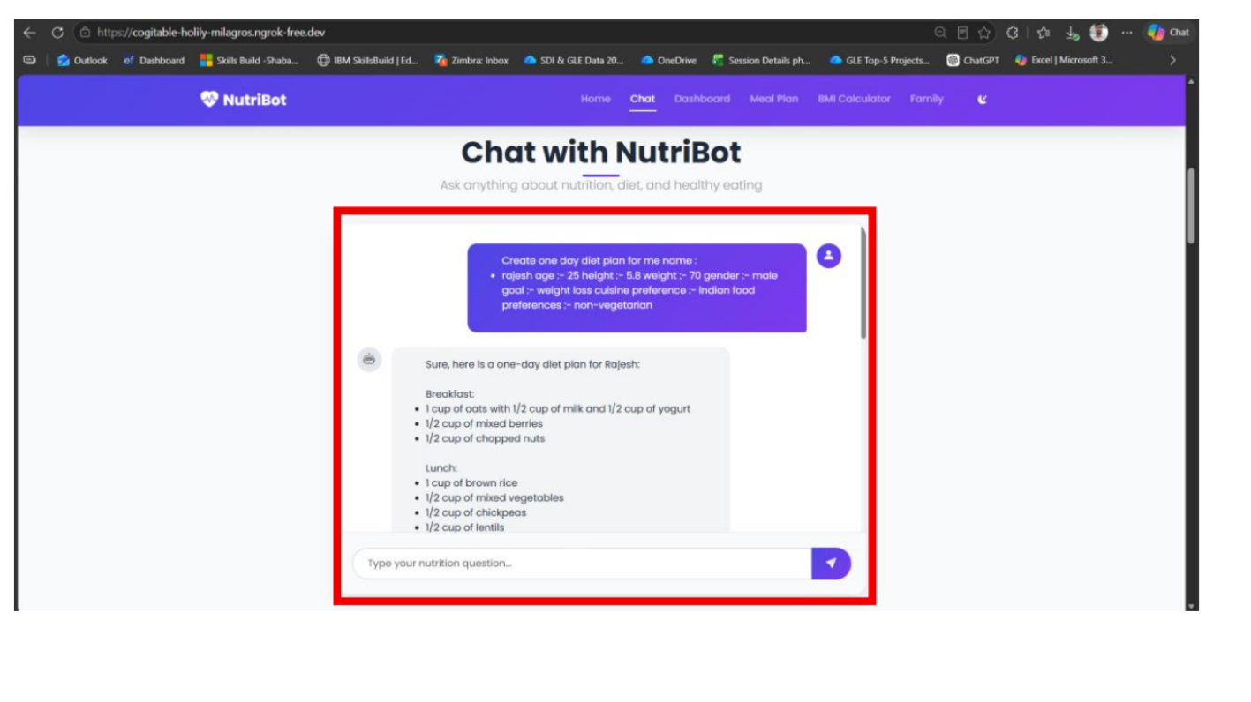
Project Output Screenshot – Amplifier Troubleshooter
Prompt: “My audio amplifier has no output. What should I check?”
·
·
·

Slide 15
Novelty and Uniqueness
AudioSense AI combines practical audio-engineering troubleshooting with an AI-assisted interface. • Engineering-focused – designed specifically for preamps, filters, op-amps and audio amplifiers. • Multiple specialist modules – noise, filters, amplifiers, circuit advice and quick diagnosis. • Explainable results – probable causes, diagnostic checks and recommended solutions are shown. • Calculation support – RC cutoff frequency is calculated directly from component values. • Knowledge retrieval – uses a dedicated audio-engineering reference base. • Granite validation – IBM Granite 4 H Small was tested with audio-engineering prompts in watsonx.ai. • Student-friendly – provides structured guidance that can be followed during circuit debugging. • Safety-aware – results are educational guidance with verification/disclaimer messaging.

Slide 16
GitHub Link
Public repository to contain: 1. All AudioSense AI source files and IBM Bob project files 2. requirements.txt and configuration examples 3. Audio engineering knowledge base 4. Tests 5. Problem statement PDF 6. Final project presentation GitHub URL: https://github.com/balajirock242-hue/AudioSense-AI. Repository should be tested before submission.
·
·
·

Slide 17
Future Scope
1. Live IBM Granite API Integration Connect the deployed application to IBM watsonx.ai Runtime when eligible API credentials are available. 2. Audio File / Microphone Analysis Accept recorded audio and estimate hum frequency, clipping and spectral noise. 3. Automatic Filter Design Generate candidate R, C and active-filter values for requested cutoff and response targets. 4. Circuit Diagram Understanding Allow users to upload a schematic and identify likely signal-path problems. 5. Oscilloscope / Measurement Integration Import measured waveforms and use them as additional diagnostic evidence. 6. Expanded RAG Knowledge Base Add verified datasheets, application notes and audio design references.
·
·
·

Slide 18
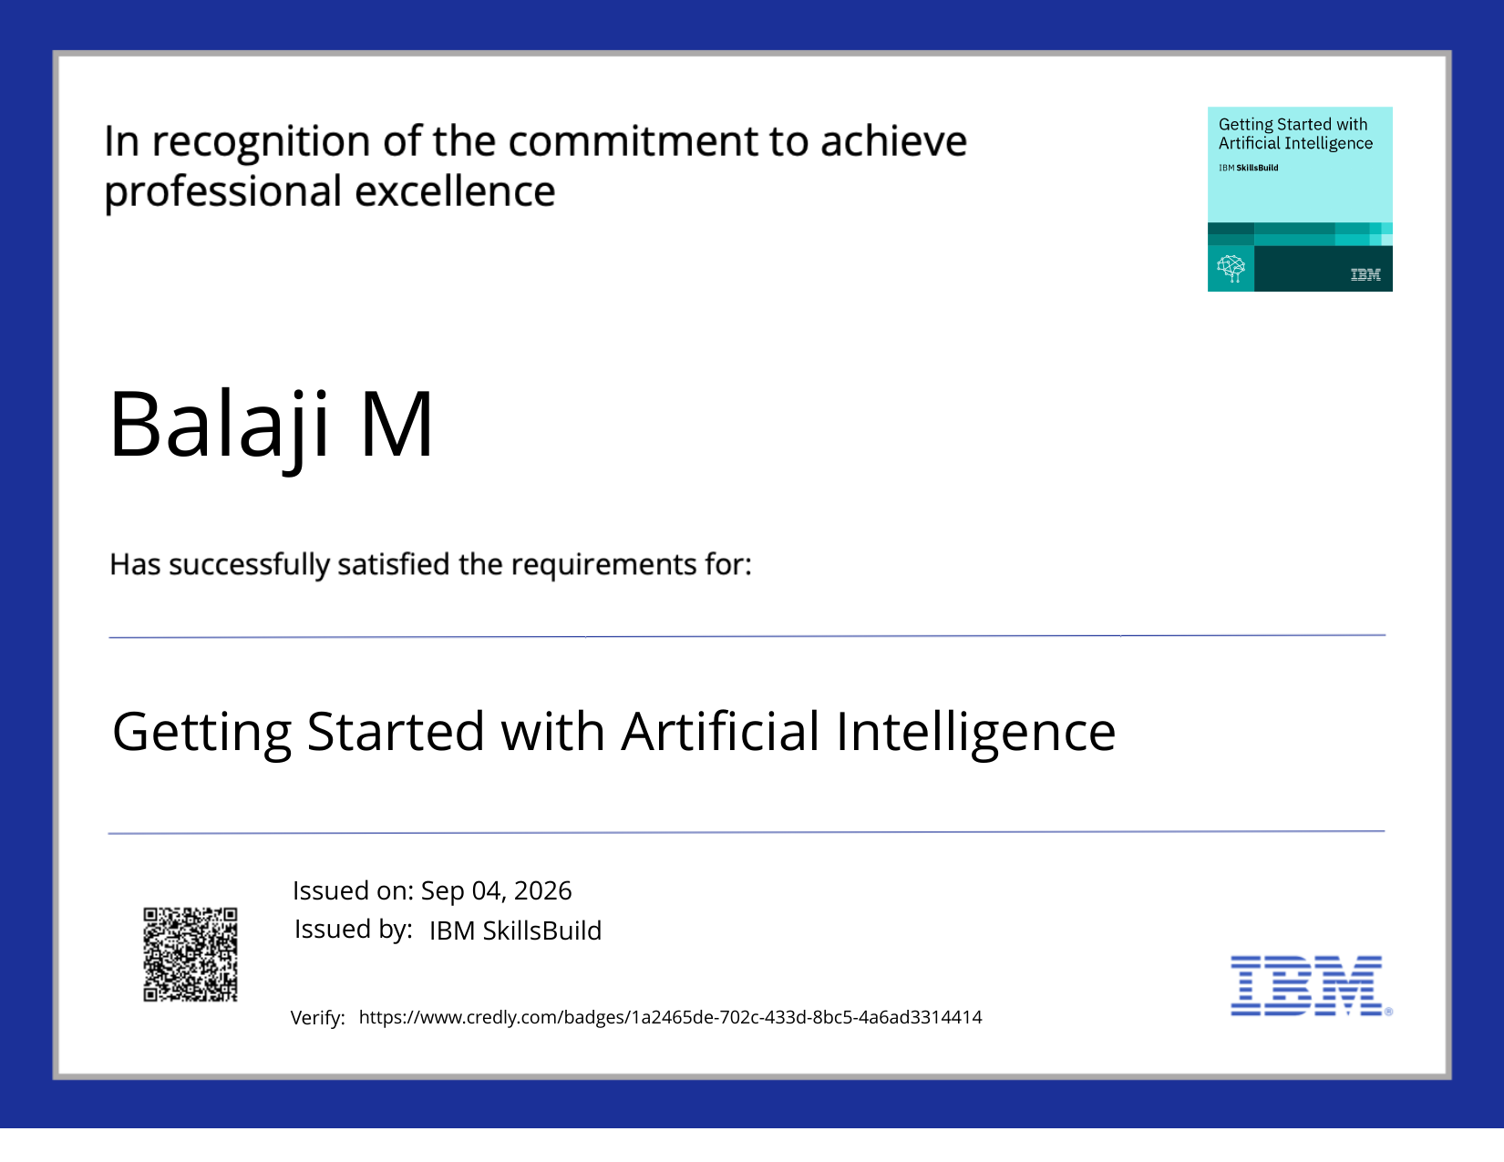
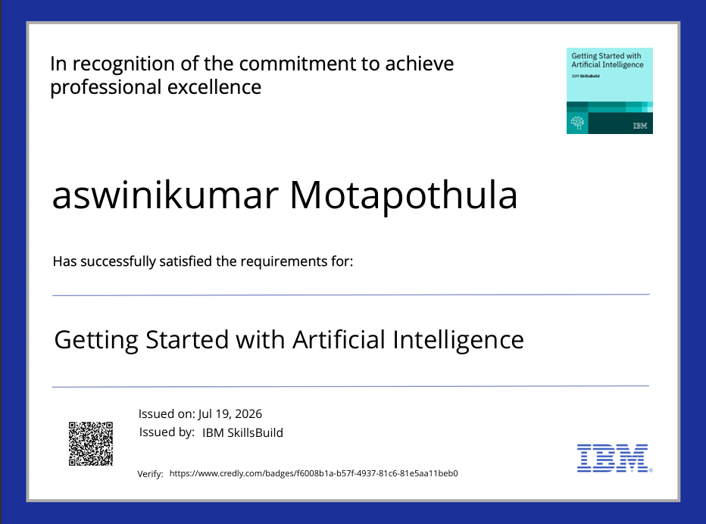
Certificates Earned
Please add your credly certificate(Getting Started with Artificial Intelligence)
Issued to Balaji M on Sep 04, 2026

Slide 19

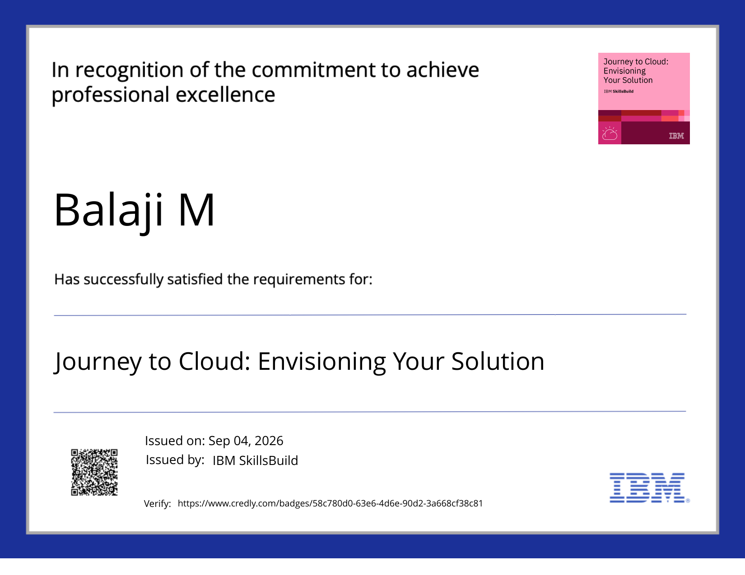
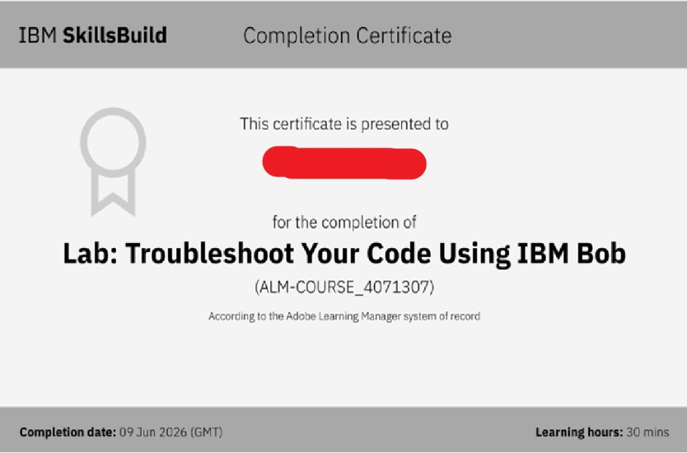
Additional IBM SkillsBuild Certificates
Additional certificates earned by Balaji M
Getting Started with Cybersecurity
Journey to Cloud: Envisioning Your Solution

Slide 20


