Slide 1
HETEROGENEOUS MULTI-CORE SOC ARCHITECTURE FOR REAL-TIME BIOMEDICAL DATA ANALYSIS
Presented by : BALAJI S 22EC019
MANIKANDAN L 22EC070
Guided By : Ms.SUBBULAKSHMI M.E.,
Notes:
Manikandan

Slide 2
PROBLEM DEFINITION
Current systems for real-time biomedical data analysis are inefficient and pose security risks.
Computational Inefficiency: General-purpose processors (GPPs) are slow and power-hungry for crucial tasks like signal filtering, causing unacceptable delays in real-time applications.
Latency & Security: Relying on the cloud for data processing introduces delays and exposes sensitive patient data to security risks.
Fixed Hardware: Existing solutions use pre-built processors that can't be modified. This prevents us from creating specialized hardware for our specific needs.
Inaccurate Diagnosis: Calculation errors in bio-signals often occur due to the inefficient and incomplete removal of noise, affecting diagnostic accuracy.
Notes:
Manikandan

Slide 3
EXISTING SOLUTION
General-Purpose Microcontrollers: These are not designed for computationally intensive tasks, making them slow and power-hungry for complex signal processing.
Off-the-Shelf DSP Processors: DSP processors are fast, but they have a fixed Instruction Set Architecture (ISA) that cannot be modified with application-specific instructions.
Cloud-Based Solutions: They offer powerful processing but introduce unacceptable latency and significant privacy risks for sensitive data.
Existing Hardware Accelerators: These often focus on a single task, such as a CNN accelerator, but are not integrated into a complete System-on-Chip (SoC) that also includes general processing cores and peripherals.
Notes:
Manikandan

Slide 4
LITERATURE REVIEW
S.No | Paper Title/Year | Authors name | Discussion
1. | A Real-Time QRS Detection Algorithm (1985) | J. Pan & W.J. Tompkins | This classic paper presents a real-time, software-based algorithm for detecting QRS complexes in ECG signals. While influential, it relies on a general-purpose processor computational power. The algorithm is effective for its time but would be inefficient and power-hungry for continuous monitoring on a battery-powered device compared to a hardware-accelerated solution.
2. | Eyeriss: A Spatial Architecture for Energy-Efficient Dataflow for Convolutional Neural Networks (2016) | V. Sze, et al. | This work proposes a specialized hardware accelerator for CNNs. The discussion focuses on a dedicated architecture for deep learning. However, it is a standalone accelerator, not a complete SoC with a general-purpose core, DSP capabilities, and peripherals. Your project combines these elements, offering a more complete solution.
Notes:
Balaji

Slide 5
LITERATURE REVIEW
S.No | Paper Title/Year | Authors name | Discussion
3. | ARM System-on-Chip Architecture (2015) | S. Furber | This book, while a key reference for SoC design, discusses a commercial, off-the-shelf architecture (ARM). ARM cores are powerful but have a fixed Instruction Set Architecture (ISA). Your project's unique value is its custom, extensible RISC-V ISA, which allows for application-specific instructions and a deeper level of hardware-software co-design.
4. | A wireless system for real-time human pose detection" (2015) | F. Adib, et al. | This paper demonstrates the use of a system for real-time signal processing in a non-ECG context. While it highlights the need for real-time processing, the hardware solution is often based on standard chips. Your project's core innovation is the custom silicon design, which provides a level of optimization that cannot be achieved with off-the-shelf components.
Notes:
Balaji

Slide 6
OBSERVATIONS FROM EXISTING METHODOLOGIES
Hardware-Level Optimization: We must use custom hardware to solve the inefficiency of general-purpose processors.
Noise Removal combined with Accelerated Analysis: A single platform is needed that can both clean the raw signal and then run advanced analysis on it at high speed.
Full System Integration: The entire system—including processing, memory, and peripherals—must be integrated on a single chip to reduce latency and power consumption.
Notes:
Balaji

Slide 7
PROPOSED SOLUTION
A custom System-on-a-Chip (SoC) built on a heterogeneous multi-core RISC-V architecture.
Dual-Core Design:
General-Purpose Core: Manages system control and peripherals.
Dedicated DSP Core: Handles all intensive signal processing tasks.
Hardware Acceleration:
  Custom Instructions: Our DSP core features a Vector Multiply-Accumulate (VMAC) instruction for ultra-fast filtering.
  Dedicated Accelerators: A DMA controller automates data transfer, and a specialized AI/ML accelerator handles on-device CNN analysis.
Notes:
Manikandan

Slide 8
FIR FILTER (V-MAC)
Raw ECG signals are too noisy for accurate analysis. We need to remove noise efficiently.
We use a FIR filter because it's stable and effective at removing noise.
We designed a custom V-MAC instruction for our processor. This instruction is the key to accelerating the FIR filter.
The V-MAC instruction makes our SoC significantly faster and more power-efficient than a standard processor for this specific task.
Notes:
Manikandan

Slide 9
FAST FOURIER TRANSFORM (FFT)
ECG signals contain hidden noise frequencies that are hard to remove with simple filtering.
We use FFT to analyze the signal's frequency content and precisely locate noise.
We designed a custom Bit-Reversal instruction to accelerate the FFT algorithm.
Our SoC can perform frequency analysis and prepare data for AI with greater speed and efficiency than a standard processor.
Notes:
Manikandan

Slide 10
HARDWARE ACCELERATOR(CNN)
It performs automated diagnosis by running a pre-trained CNN model on the data.
It accelerates the core mathematical computations of the CNN, such as convolutions, far more efficiently than a CPU.
It enables on-device intelligence, allowing the system to make a diagnosis in real time without a network connection.
It ensures data privacy and security by processing all sensitive information locally on the chip.
Notes:
Manikandan

Slide 11
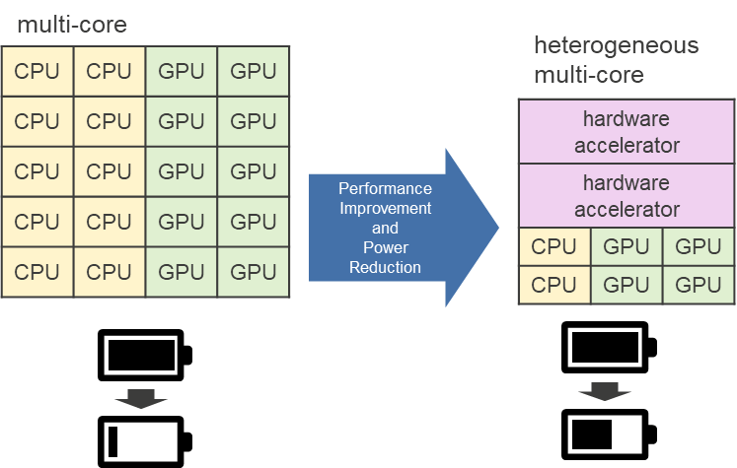
HETEROGENEOUS MULTI-CORE
The heterogeneous multi-core architecture is designed to divide labor between two specialized cores.
General-Purpose Core:Manages all high-level system control and peripherals.
DSP Core:Handles the intensive signal processing and data analysis tasks.
This division ensures that the system is both highly responsive and extremely efficient at its core functions.
Notes:
Balaji

Slide 12
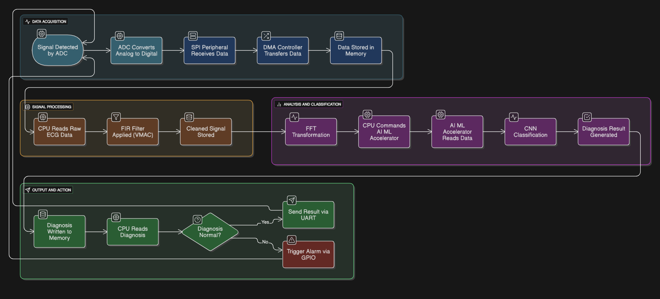
PROPOSED METHODOLOGY OVERVIEW
Notes:
Balaji

Slide 13
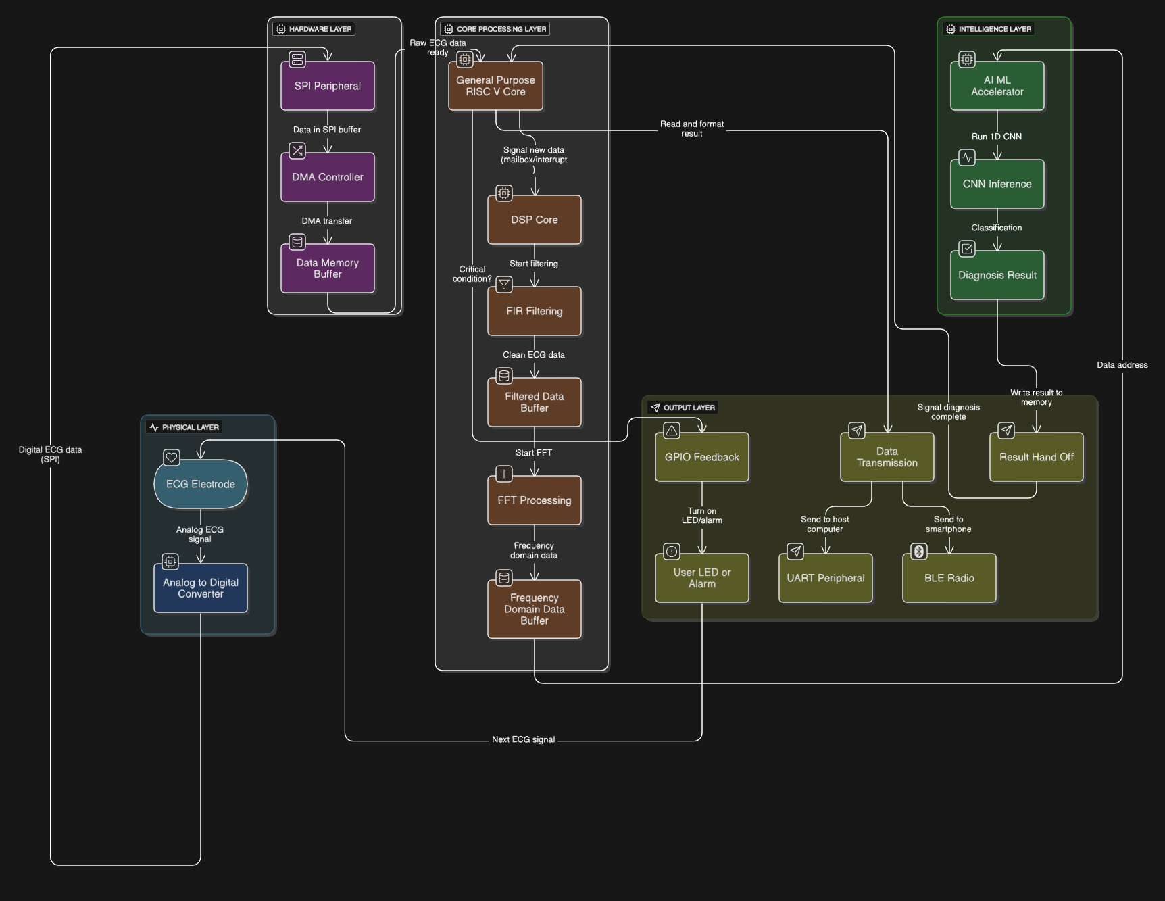
SOC EXECUTION LAYERS
Notes:
Balaji

Slide 14
COMPONENTS REQUIRED:
Hardware Design Tools:
HDL Language: SystemVerilog
HDL Simulator: Synopsys VCS & Verdi
Synthesis Tool: Synopsys Design Compiler
Software Development Tools:
RISC-V GCC Toolchain
Verification Environment:
UVM (Universal Verification Methodology)
Assertions and Coverages
Notes:
Manikandan

Slide 15
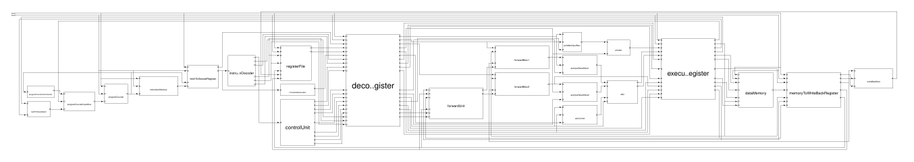
PROGRESS
Current Project Status:
We have successfully completed the design of the RISC-V RV32I pipelined processor, which is the foundational core of our SoC.
The core is now ready for the next phase, which involves integrating our custom hardware, peripherals, and the second core to create the full System-on-a-Chip.
Extracted Processor Architecture from Synopsys VCS:
Notes:
Manikandan

Slide 16
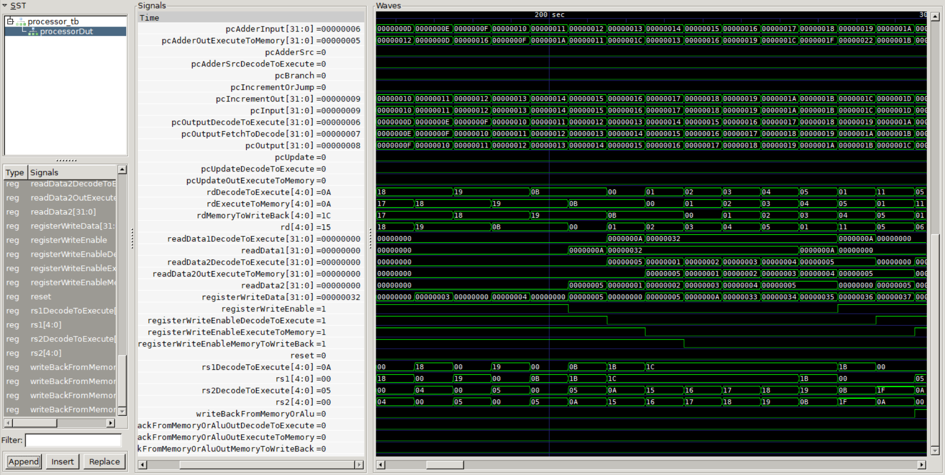
PROGRESS
Simulated Waveform of Pipelined Processor:
Notes:
Manikandan

Slide 17
TESTING PLAN
Systematic Functional Testing: We used a rigorous verification plan to systematically test the functionality of every component and every custom instruction.
Full System-Level Verification: We performed an end-to-end test of the entire data flow, from the simulated sensor to the final diagnosis.
Performance Analysis: We ran tests to quantify our improvements by comparing the clock cycle count of our custom SoC against a standard processor.
Corner-Case Coverage: Our testing included a variety of scenarios to ensure that the system works correctly even under non-ideal or unexpected conditions.
Notes:
Manikandan

Slide 18
CONCLUSION
Architectural Innovation: We designed and built a custom RISC-V SoC with Vector MAC (V-MAC) and Bit-Reversal instructions to accelerate signal processing.
Performance & Efficiency: Our design delivers superior speed and power efficiency by performing complex calculations in a single clock cycle.
On-Device Intelligence: The SoC enables real-time diagnosis using an on-chip CNN, keeping sensitive data secure and private.
Key Achievement: We proved that a custom hardware-software solution is a superior approach for specialized applications compared to general-purpose or fixed, proprietary platforms.
Notes:
Manikandan

Slide 19
REFERENCES
Patterson, D. A., & Hennessy, J. L. (2018). Computer Organization and Design RISC-V Edition: The Hardware/Software Interface. Morgan Kaufmann. (Covers RISC-V architecture, pipelining, and basic hardware design).
Mano, M. M., & Ciletti, M. D. (2012). Digital Design: With an Introduction to the Verilog HDL. Pearson. (Fundamental concepts of digital logic design and Verilog).
Weste, N. H. E., & Harris, D. (2010). CMOS VLSI Design: A Circuits and Systems Perspective. Pearson. (Deep dive into chip design, including physical layout and performance analysis).
Oppenheim, A. V., & Schafer, R. W. (2014). Discrete-Time Signal Processing. Pearson. (The bible for DSP concepts like FIR filters and FFT).
RISC-V Foundation. (2019). The RISC-V Instruction Set Manual, Volume I: Unprivileged ISA. (Official specification for the RISC-V instruction set, including the custom opcode space).
Waterman, A., & Asanovic, K. (2019). The RISC-V Reader: An Open Architecture Atlas. (A great summary of the RISC-V ISA and its philosophy).
Sutherland, S., et al. (2012). SystemVerilog for Verification: A Guide to Learning the Testbench Language Features. Synopsys Press. (The foundational text for SystemVerilog and its use in verification).
Notes:
Manikandan

Slide 20
REFERENCES
8. Spear, J. (2008). SystemVerilog for Verification: A Guide to Learning the Testbench Language Features. Springer. (A comprehensive guide to UVM methodology).
9. Accellera Systems Initiative. (2017). Universal Verification Methodology (UVM) 1.2 User's Guide. (The official UVM standard and documentation).
10. Goodfellow, I., Bengio, Y., & Courville, A. (2016). Deep Learning. MIT Press. (Foundational text on deep learning, including CNNs).
11. Sze, V., et al. (2017). "Hardware for AI: An Overview." Journal of Parallel and Distributed Computing. (Provides an overview of hardware accelerators for AI/ML).
12. Chen, T., et al. (2016). "Eyeriss: A Spatial Architecture for Energy-Efficient Dataflow for Convolutional Neural Networks." Proceedings of the 43rd International Symposium on Computer Architecture (ISCA). (A seminal paper on a low-power hardware accelerator for CNNs).
13. Furber, S. (2015). ARM System-on-Chip Architecture. Pearson. (While ARM-centric, this book provides excellent general knowledge on SoC design, including bus protocols).
Notes:
Manikandan

Slide 21
THANK YOU
Notes:
Both

