Slide 1
FIR FILTER WITH CORE ARCHITECTURE
FIR FILTER
COEFFICIENT
[ROM]
PROCESSOR CORE
ALU
VMAC
BAUGH-WOOLEY
SIGNED MULTIPLIER
FIR INPUT BUFFER
[RAM]

Slide 2
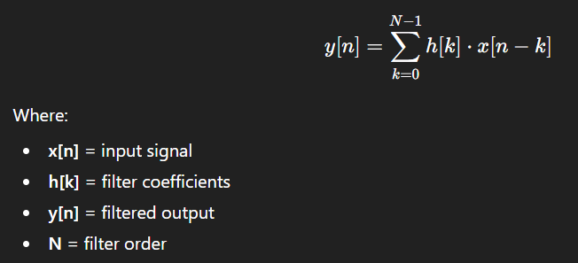

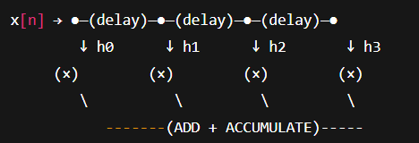
FIR FILTER V-MAC INSTRUCTION
FIR FILTER [MATHEMATICAL DEFINITION]:
MAC INSTRUCTION:
[7 Clock Cycles Needed]
V-MAC INSTRUCTION:
[7 Clock Cycles Needed]

