Slide 1
HETEROGENEOUS MULTI-CORE SOC ARCHITECTURE FOR REAL-TIME BIOMEDICAL DATA ANALYSIS
Presented by : BALAJI S 22EC019
MANIKANDAN L 22EC070
Guided By : Ms. A. SUBBULAKSHMI M.E.,
Notes:
Manikandan

Slide 2
PROBLEM DEFINITION
Current systems for real-time biomedical data analysis are inefficient and pose security risks.
Computational Inefficiency: General-purpose processors (GPPs) are slow and power-hungry for crucial tasks like signal filtering, causing unacceptable delays in real-time applications.
Latency & Security: Relying on the cloud for data processing introduces delays and exposes sensitive patient data to security risks.
Fixed Hardware: Existing solutions use pre-built processors that can't be modified. This prevents us from creating specialized hardware for our specific needs.
Inaccurate Diagnosis: Calculation errors in bio-signals often occur due to the inefficient and incomplete removal of noise, affecting diagnostic accuracy.
Notes:
Manikandan

Slide 3
EXISTING SOLUTION
General-Purpose Microcontrollers: These are not designed for computationally intensive tasks, making them slow and power-hungry for complex signal processing.
Off-the-Shelf DSP Processors: DSP processors are fast, but they have a fixed Instruction Set Architecture (ISA) that cannot be modified with application-specific instructions.
Cloud-Based Solutions: They offer powerful processing but introduce unacceptable latency and significant privacy risks for sensitive data.
Existing Hardware Accelerators: These often focus on a single task, such as a CNN accelerator, but are not integrated into a complete System-on-Chip (SoC) that also includes general processing cores and peripherals.
Notes:
Manikandan

Slide 4
LITERATURE REVIEW
S.No | Paper Title/Year | Authors name | Discussion
1. | Design and Implementation of a RISC‑V SoC for Real‑Time Epilepsy Detection (2023) | J. He, H. Wang, X. Li, and Y. Zhang | The paper proposes a RISC‑V‑based SoC that directly acquires EEG signals, processes them on‑chip, and automatically detects epileptic seizures in real time. The SoC integrates an analog front‑end (for EEG acquisition), digital processing, and an embedded epilepsy detection program, enabling low‑latency, continuous monitoring without relying on cloud processing.
2. | A RISC‑V Based Medical Implantable SoC for High Voltage and Current Tissue Stimulus (2020) | R. Rimolo‑Donadio et al. | This work presents a RISC‑V‑based SoC called “Siwa” implemented in 0.18 μm HV‑CMOS, designed specifically for implantable medical devices that must deliver high‑voltage, high‑current electrical stimulation to biological tissue. The chip combines a RV32I RISC‑V microcontroller core (with SRAM, SPI, UART, GPIO, and a packet‑based bus) with analog stimulus and sensing circuits, focusing on very low energy per cycle (below about 50 pJ/cycle) and high reliability/safety for implantable use.
Notes:
Balaji

Slide 5
OBSERVATIONS FROM EXISTING METHODOLOGIES
Hardware-Level Optimization: We must use custom hardware to solve the inefficiency of general-purpose processors.
Noise Removal combined with Accelerated Analysis: A single platform is needed that can both clean the raw signal and then run advanced analysis on it at high speed.
Full System Integration: The entire system—including processing, memory, and peripherals—must be integrated on a single chip to reduce latency and power consumption.
Notes:
Balaji

Slide 6
PROPOSED SOLUTION
A custom System-on-a-Chip (SoC) built on a heterogeneous multi-core RISC-V architecture.
Dual-Core Design:
General-Purpose Core: Manages system control and peripherals.
Dedicated DSP Core: Handles all intensive signal processing tasks.
Hardware Acceleration:
Custom Instructions: Our DSP core features a Vector Multiply-Accumulate (VMAC) instruction for ultra-fast filtering.
Dedicated Accelerators: A DMA controller automates data transfer, and a specialized AI/ML accelerator handles on-device CNN analysis.
Notes:
Manikandan

Slide 7
FIR FILTER (V-MAC)
Raw ECG signals are too noisy for accurate analysis. We need to remove noise efficiently.
We use a FIR filter because it's stable and effective at removing noise.
We designed a custom V-MAC instruction for our processor. This instruction is the key to accelerating the FIR filter.
The V-MAC instruction makes our SoC significantly faster and more power-efficient than a standard processor for this specific task.
Notes:
Manikandan

Slide 8
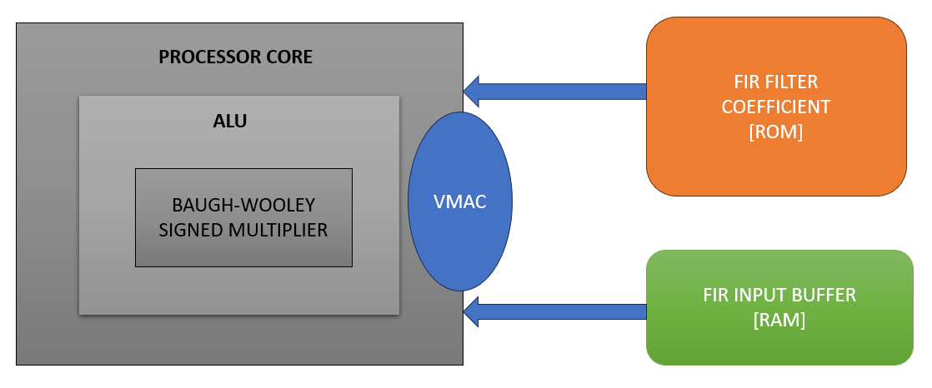


FIR FILTER (CUSTOM V-MAC)
MAC INSTRUCTION:
[7 Clock Cycles Needed]
V-MAC INSTRUCTION:
[1 Clock Cycles Needed]
Notes:
Manikandan

Slide 9
FAST FOURIER TRANSFORM (FFT)
ECG signals contain hidden noise frequencies that are hard to remove with simple filtering.
We use FFT to analyze the signal's frequency content and precisely locate noise.
We designed a custom Bit-Reversal instruction to accelerate the FFT algorithm.
Our SoC can perform frequency analysis and prepare data for AI with greater speed and efficiency than a standard processor.
Notes:
Manikandan

Slide 10
HARDWARE ACCELERATOR(CNN)
It performs automated diagnosis by running a pre-trained CNN model on the data.
It accelerates the core mathematical computations of the CNN, such as convolutions, far more efficiently than a CPU.
It enables on-device intelligence, allowing the system to make a diagnosis in real time without a network connection.
It ensures data privacy and security by processing all sensitive information locally on the chip.
Notes:
Manikandan

Slide 11
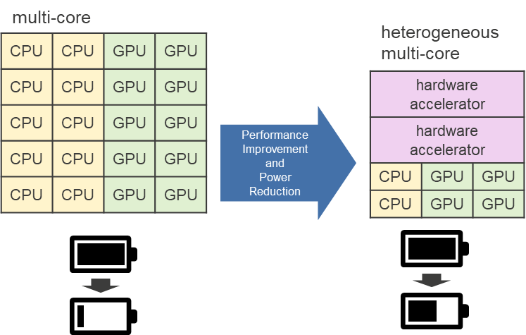
HETEROGENEOUS MULTI-CORE
The heterogeneous multi-core architecture is designed to divide labor between two specialized cores.
General-Purpose Core: Manages all high-level system control and peripherals.
DSP Core: Handles the intensive signal processing and data analysis tasks.
This division ensures that the system is both highly responsive and extremely efficient at its core functions.
Notes:
Balaji

Slide 12
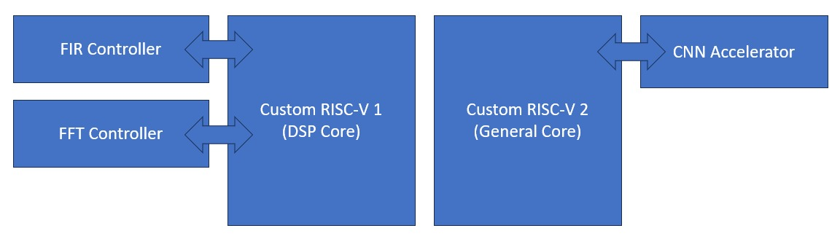
OVERALL SOC ARCHITECTURE
Notes:
Balaji

Slide 13
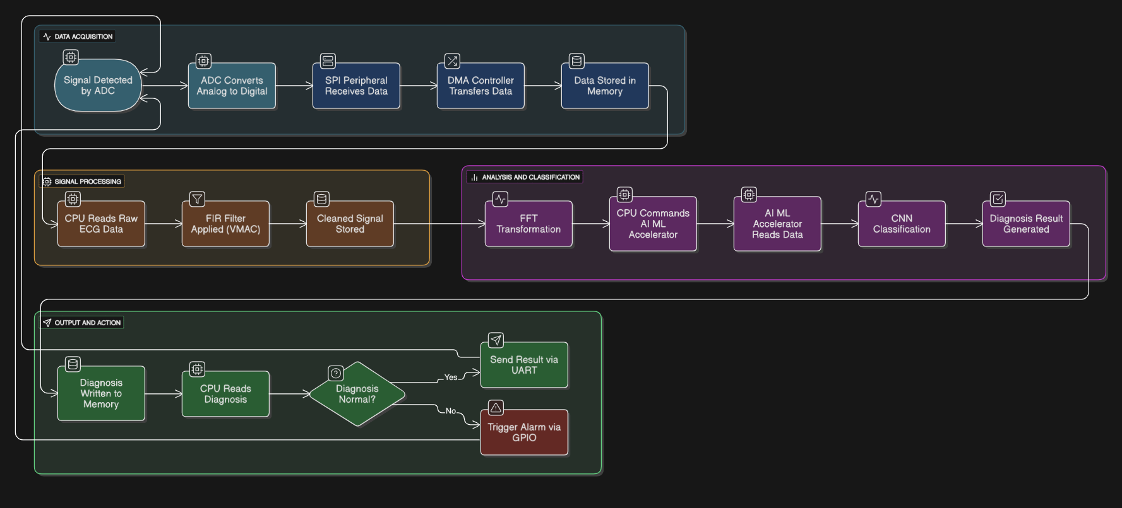
PROPOSED METHODOLOGY OVERVIEW
Notes:
Balaji

Slide 14
COMPONENTS REQUIRED:
Hardware Design Tools:
HDL Language: Verilog, System Verilog
HDL Simulator: Synopsys VCS & Verdi
Synthesis Tool: Synopsys Design Compiler
Software Development Tools:
RISC-V GCC Toolchain
Verification Environment:
System Verilog
Assertions and Coverages
Notes:
Manikandan

Slide 15
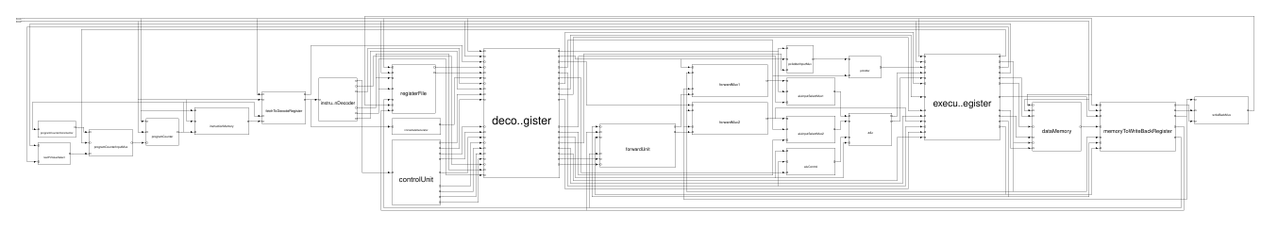
RESULT – PROCESSOR
We have successfully completed the design of the RISC-V RV32I pipelined processor, which is the foundational core of our SoC.
The core is now ready for the next phase, which involves integrating our custom hardware, peripherals, and the second core to create the full System-on-a-Chip.
Extracted Processor Architecture from Synopsys VCS:
Notes:
Manikandan

Slide 16
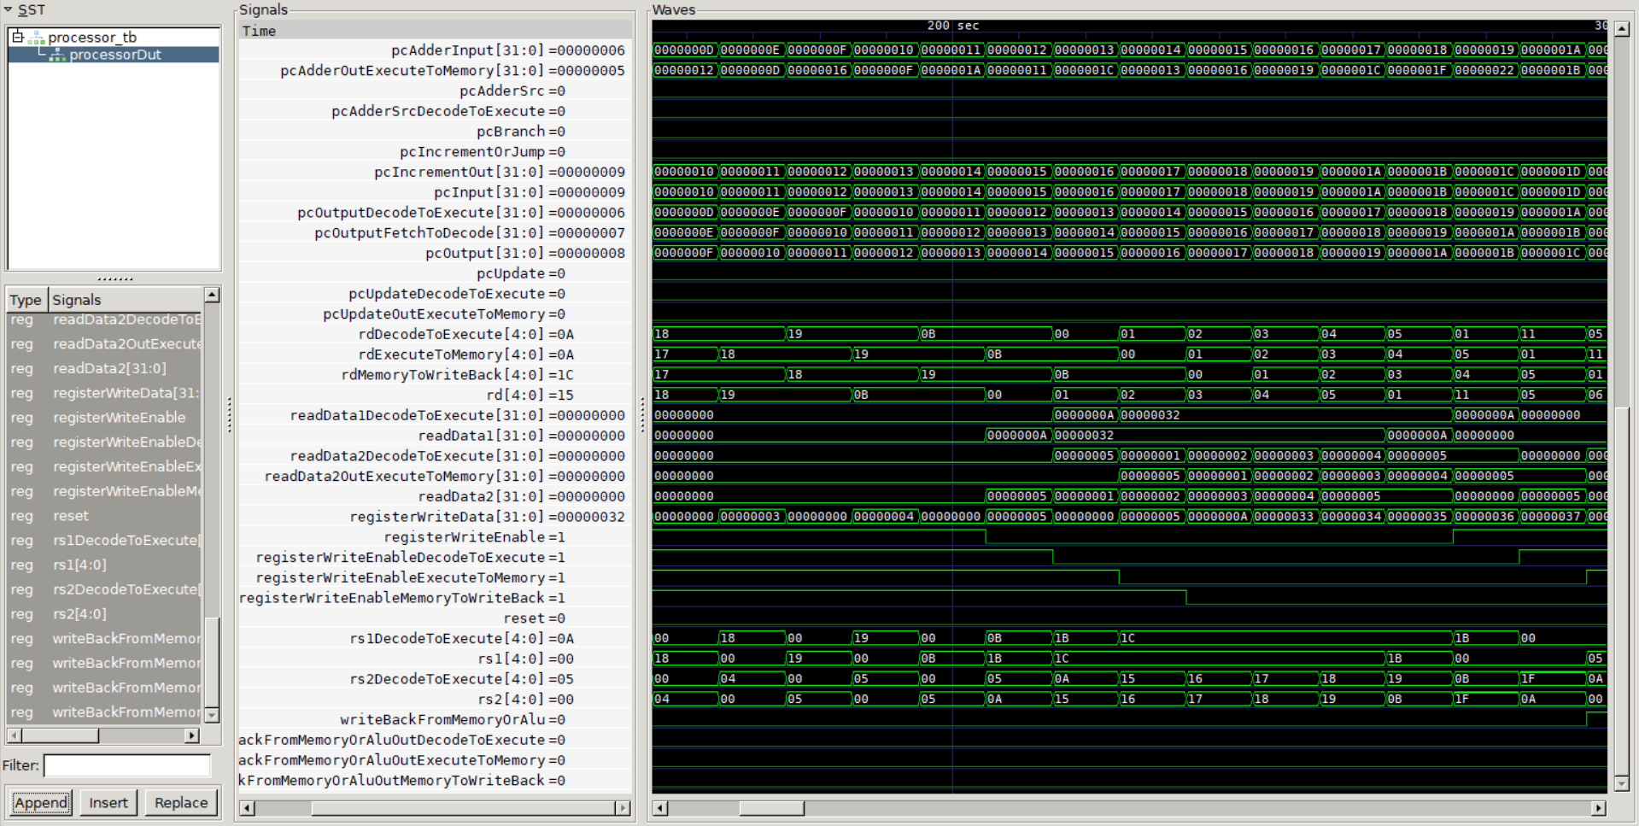
RESULT – PROCESSOR
Simulated Waveform of Pipelined Processor:
Notes:
Manikandan

Slide 17
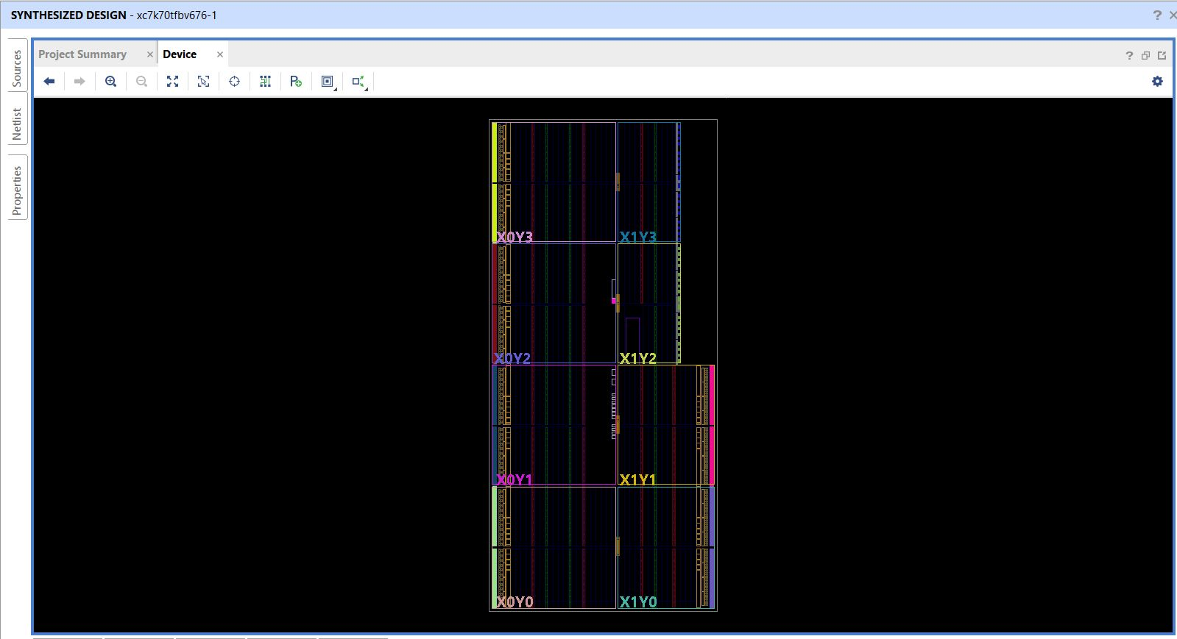
RESULT – PROCESSOR
Synthesized output of Pipelined Processor:
Notes:
Manikandan

Slide 18
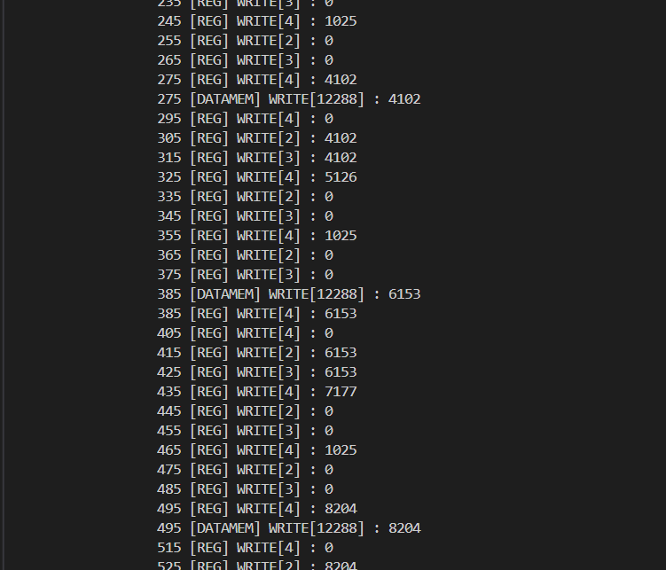
RESULT – FILTER PROCESS
FIR Program Log:
Notes:
Manikandan

Slide 19
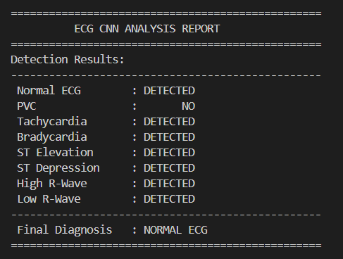
RESULT – CNN DETECTION
CNN Detection:
Notes:
Manikandan

Slide 20
CONCLUSION
Architectural Innovation: We designed and built a custom RISC-V SoC with Vector MAC (V-MAC) and Bit-Reversal instructions to accelerate signal processing.
Performance & Efficiency: Our design delivers superior speed and power efficiency by performing complex calculations in a single clock cycle.
On-Device Intelligence: The SoC enables real-time diagnosis using an on-chip CNN, keeping sensitive data secure and private.
Key Achievement: We proved that a custom hardware-software solution is a superior approach for specialized applications compared to general-purpose or fixed, proprietary platforms.
Notes:
Manikandan

Slide 21
REFERENCES
J. He et al., “Design and Implementation of a RISC‑V SoC for Real‑Time Epilepsy Detection,” in Proc. IEEE Int. Conf. (SSD), 2023.​
R. Rimolo‑Donadio et al., “A RISC‑V Based Medical Implantable SoC for High Voltage and Current Tissue Stimulus,” in Proc. IEEE Latin American Symp. Circuits and Systems (LASCAS), 2020.
L. Guo et al., “68‑Channel Neural Signal Processing System‑on‑Chip with Ultra‑Low Power RISC‑V Core and Hardware Accelerators,” IEEE, 2024.​
S. Schönle et al., “A Multi‑Sensor and Parallel Processing SoC for Miniaturized Medical Instrumentation,” IEEE J. Solid‑State Circuits, vol. 53, no. 7, Jul. 2018.​
Gamatié et al., “Towards Energy‑Efficient Heterogeneous Multicore Architectures for Embedded Systems,” IEEE Trans. Comput., vol. 68, no. 1, 2019.​
E. Choi et al., “Development of an Ultra‑Low Power RISC‑V Processor for Wearable Anomaly Detection,” J. Syst. Archit., vol. 154, 2024.
G. Leone et al., “SYNtzulu: A Tiny RISC‑V‑Controlled SNN Processor for Near‑Sensor Data Processing,” in Proc. IEEE Int. Symp. Circuits and Systems (ISCAS), 2024.
M. S. Islam et al., “A Low‑Cost Hardware Architecture of Convolutional Neural Network for ECG Signal Classification,” IEEE Access, vol. 9, 2021.
K. Balasubramanian et al., “A Clinically‑Grounded Survey Across EEG, ECG, and Other Biosignal CNN Hardware Platforms,” IEEE, 2025.
K. M. Awan et al., “A Hardware‑Efficient and Flexible Mini‑InceptionNet Accelerator for 1‑D CNN‑Based ECG Analysis,” in Proc. IEEE Conf., 2025
​
Notes:
Manikandan

Slide 22
THANK YOU
Notes:
Both

