Slide 1
MIMIC NLP assignment – HW3
Balaji Sethuraman – AI in Healthcare
Github location:
https://github.com/balajisethu03/ai-healthcare/tree/main/assignment-3

Slide 2
BACKGROUND
The analysis of clinical text data is a critical task in healthcare, as it enables the extraction of meaningful insights from unstructured medical notes. In this study, we leveraged several pre-trained models and natural language processing (NLP) techniques to process and analyze ECG (echocardiography) notes from the MIMIC-III database. The goal was to identify and extract named entities, build a corpus of relevant terms, and visualize the semantic relationships between these terms. To achieve this, we utilized a combination of NLP libraries, including SpaCy and SciSpacy, for named entity recognition (NER). These libraries were chosen for their ability to handle domain-specific terminology and their pre-trained models tailored for biomedical and clinical text. By applying these tools, we built a corpus of entities extracted from the notes, which served as the foundation for further analysis.
In addition to NER, we explored word embedding techniques to capture the semantic relationships between terms in the clinical notes. We employed Word2Vec, a widely used model for generating word embeddings, and the GloVe pre-trained model (glove-wiki-gigaword-50) to represent words in a continuous vector space. These embeddings were then visualized using t-SNE (t-Distributed Stochastic Neighbor Embedding), a dimensionality reduction technique that projects high-dimensional data into a 2D or 3D space for easier interpretation. The t-SNE plots provided insights into the clustering and relationships between medical terms, highlighting patterns that could be useful for clinical decision-making.
Finally, we incorporated ClinicalBERT, a pre-trained language model fine-tuned for clinical text, to further enhance our analysis. ClinicalBERT was used to generate contextual embeddings for the echocardiography notes, capturing the nuanced meaning of medical terms within their clinical context. These embeddings were also visualized using t-SNE, allowing us to compare the results with those obtained from Word2Vec and GloVe. By combining these approaches, we aimed to create a comprehensive pipeline for analyzing clinical text data, from entity extraction and corpus building to semantic visualization and contextual understanding. This multi-faceted approach demonstrates the potential of advanced NLP techniques in transforming unstructured clinical notes into actionable insights for healthcare applications.

Slide 3
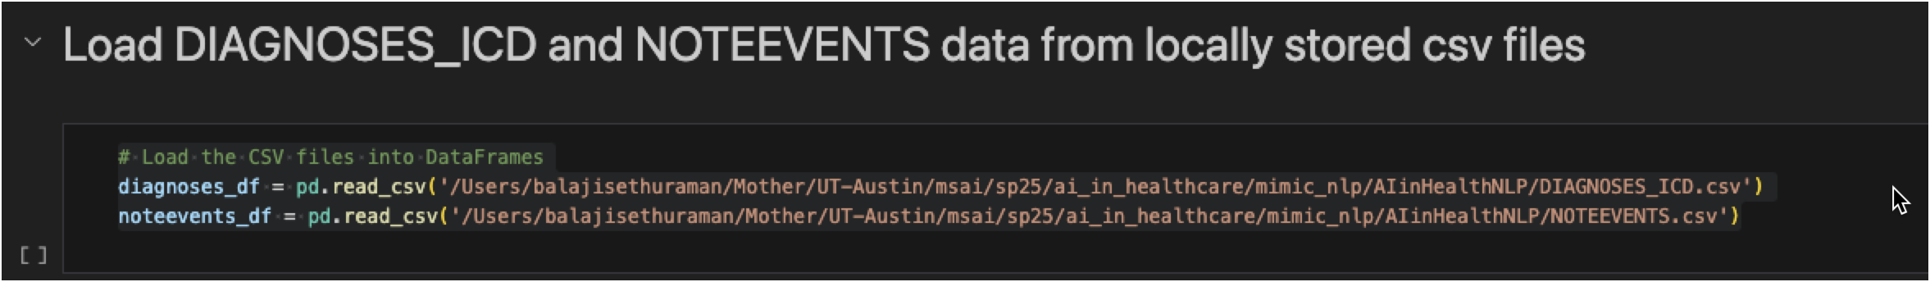
Dataset loading - DIAGNOSES_ICD and NOTEEVENTS data using Pandas
1. Data Loading
Loading DIAGNOSES_ICD:
The DIAGNOSES_ICD.csv file is loaded into a DataFrame (diagnoses_df).
This table contains diagnostic information for patients, including:
SUBJECT_ID: Unique identifier for each patient.
ICD9_CODE: Codes representing specific diagnoses (e.g., hypertension, heart failure).
Loading NOTEEVENTS:
The NOTEEVENTS.csv file is loaded into a DataFrame (noteevents_df).
This table contains clinical notes for patients, including:
SUBJECT_ID: Unique identifier for each patient.
CATEGORY: Type of clinical note (e.g., Echo, Radiology).
TEXT: The content of the clinical note.

Slide 4
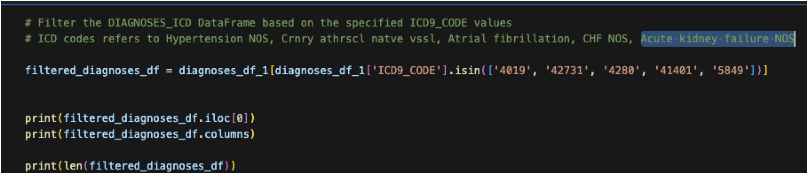
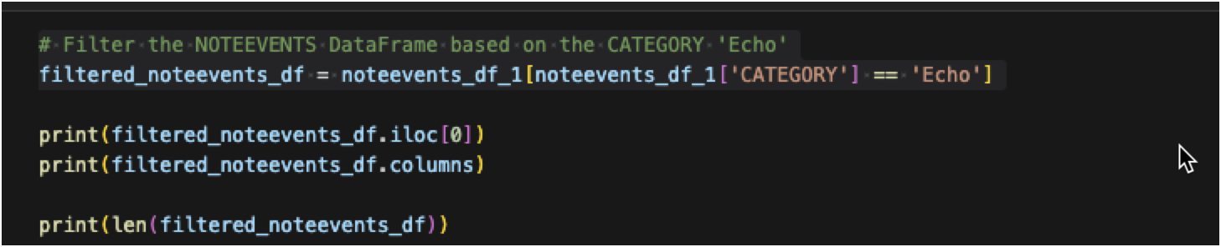
Dataset loading - DIAGNOSES_ICD and NOTEEVENTS data using Pandas
2. Filtering DIAGNOSES_ICD
The DIAGNOSES_ICD DataFrame is filtered to include only rows with specific ICD9_CODE values:
4019: Hypertension NOS.
42731: Crnry athrscl natve vssl.
4280: Atrial fibrillation.
41401: CHF NOS.
5849: Acute kidney failure NOS.
This step ensures that only relevant diagnoses are included in the analysis.
3. Filtering NOTEEVENTS
The NOTEEVENTS DataFrame is filtered to include only rows where the CATEGORY is 'Echo'.
This step ensures that only echocardiography notes are included in the analysis.

Slide 5
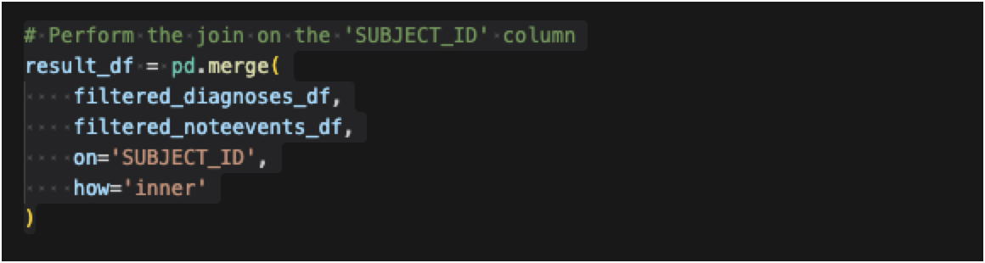
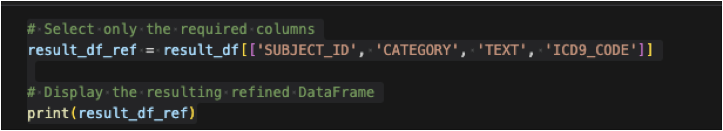
Dataset loading - DIAGNOSES_ICD and NOTEEVENTS data using Pandas
4. Data Merge
The filtered DIAGNOSES_ICD and NOTEEVENTS DataFrames are merged on the SUBJECT_ID column using an inner join.
This ensures that only patients with both:
A relevant diagnosis (from DIAGNOSES_ICD).
An echocardiography note (from NOTEEVENTS). are included in the resulting DataFrame.
5. Refining the Result
The merged DataFrame (result_df) is refined to include only the following columns:
SUBJECT_ID: Unique identifier for each patient.
CATEGORY: Type of clinical note (always 'Echo' in this case).
TEXT: The content of the echocardiography note.
ICD9_CODE: The diagnosis code associated with the patient.
The refined DataFrame (result_df_ref) is printed for further analysis.

Slide 6
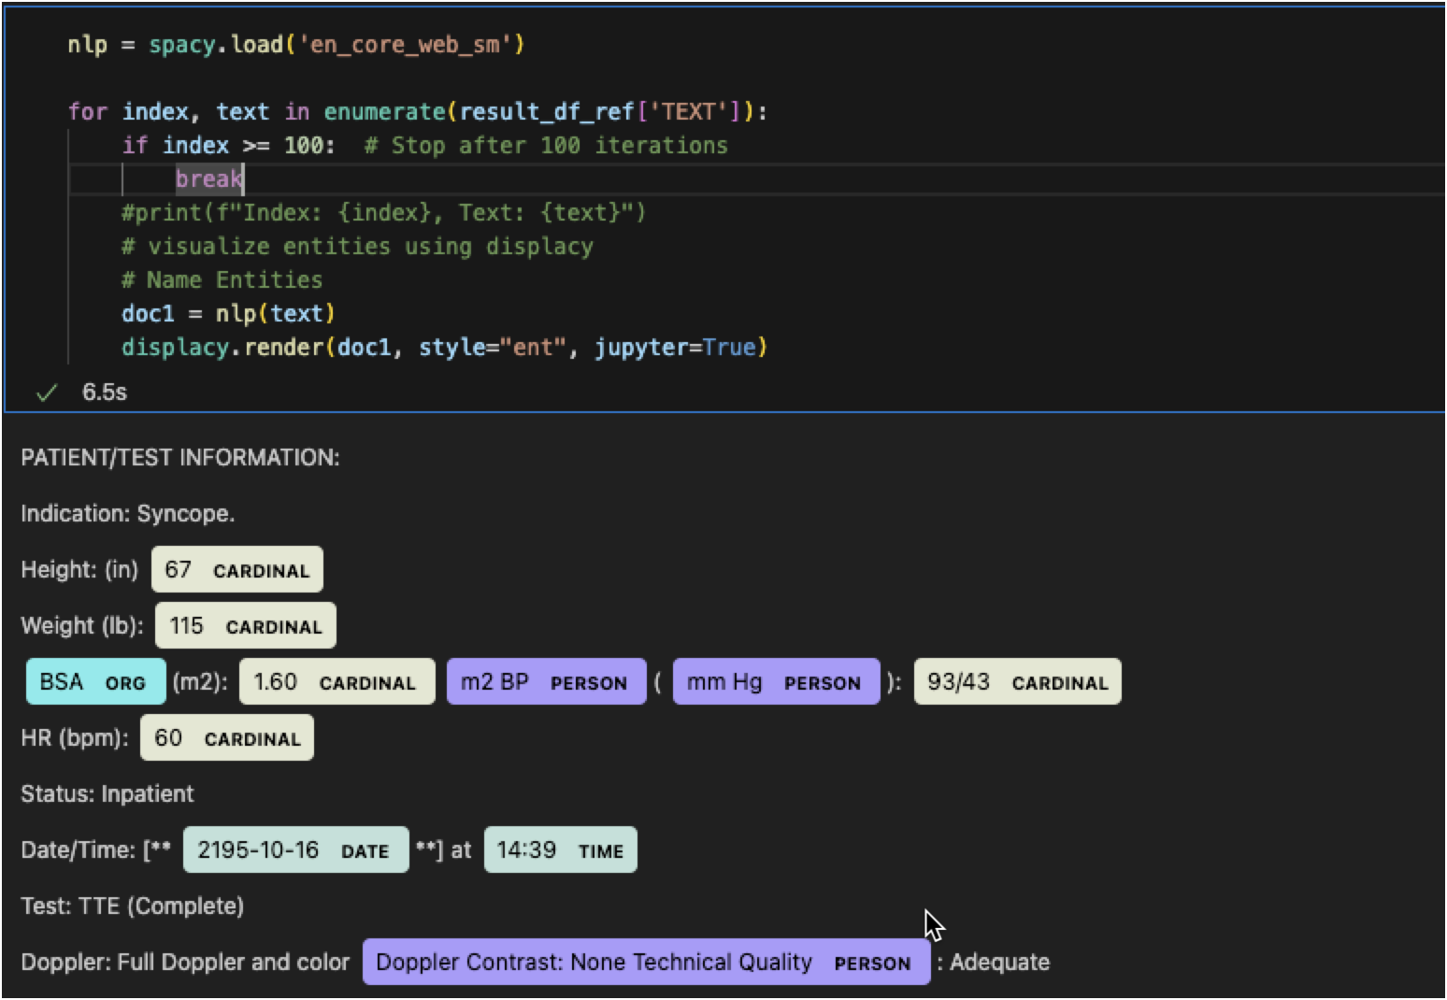
SpaCy Extract entities
Load SpaCy Model:
nlp = spacy.load('en_core_web_sm') loads the small English SpaCy model (en_core_web_sm), which includes pre-trained pipelines for tokenization, part-of-speech tagging, and named entity recognition (NER).
Iterate Over TEXT Column:
The for loop iterates over the TEXT column of the result_df_ref DataFrame.
enumerate is used to get both the index and the text value for each row.
Limit Iterations:
The loop stops after 100 iterations (if index >= 100: break), ensuring only the first 100 texts are processed. The loop is limited to 100 iterations for efficiency and practicality.
Process Text with SpaCy:
For each text, doc1 = nlp(text) processes the text using the SpaCy model, performing tokenization, part-of-speech tagging, and named entity recognition.
Visualize Named Entities:
displacy.render(doc1, style="ent", jupyter=True) uses SpaCy's displacy module to visualize the named entities in the text.
The style="ent" argument specifies that named entities should be highlighted.
The jupyter=True argument ensures the visualization is rendered correctly in a Jupyter notebook.

Slide 7
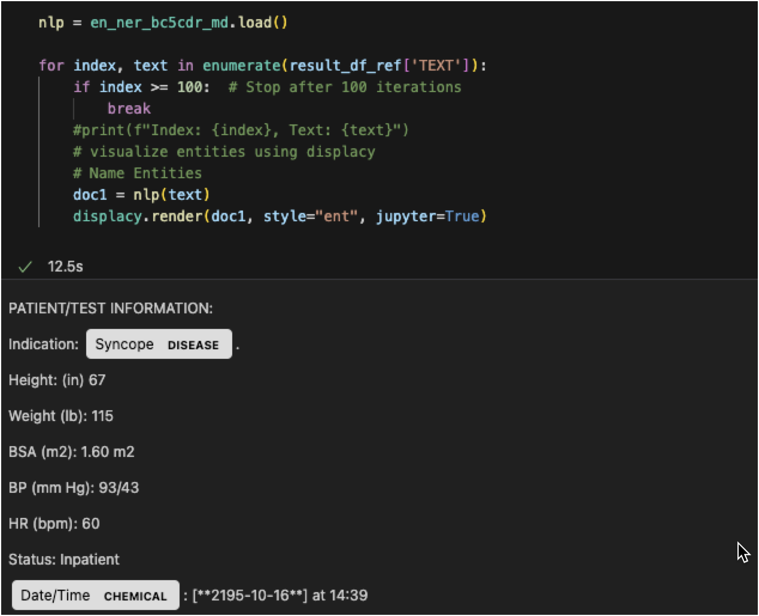
SciSpaCy Extract entities
Load SciSpacy Model:
nlp = en_ner_bc5cdr_md.load() loads the BC5CDR model from SciSpacy, which is specifically trained for biomedical named entity recognition (NER).
This model is designed to identify entities like diseases and chemicals in biomedical text.
Iterate Over TEXT Column:
The for loop iterates over the TEXT column of the result_df_ref DataFrame.
enumerate is used to get both the index and the text value for each row.
Limit Iterations:
The loop stops after 100 iterations (if index >= 100: break), ensuring only the first 100 texts are processed.
Process Text with SciSpacy:
For each text, doc1 = nlp(text) processes the text using the BC5CDR model, performing tokenization and named entity recognition specific to biomedical text.
Visualize Named Entities:
displacy.render(doc1, style="ent", jupyter=True) uses SpaCy's displacy module to visualize the named entities in the text.
The style="ent" argument specifies that named entities should be highlighted.
The jupyter=True argument ensures the visualization is rendered correctly in a Jupyter notebook.

Slide 8
Word2Vec Corpus of entities
Load DataFrame:
df = result_df_ref assigns the result_df_ref DataFrame to df for easier reference.
Load SpaCy Model:
nlp = spacy.load('en_ner_bc5cdr_md') loads the BC5CDR model from SciSpacy, which is specialized for biomedical named entity recognition (NER), identifying entities like diseases and chemicals.
Extract TEXT Column:
text_column = df['TEXT'] extracts the TEXT column from the DataFrame, which contains the clinical notes.
Build Corpus:
A corpus is created to store lists of entities extracted from each note.
The for loop iterates over the TEXT column, processing each note:
The loop stops after 1000 iterations (if index >= 1000: break).
tokens = nlp(text).ents processes the text using the SpaCy model and extracts named entities.
Each entity's text (token.text) is appended to str_tokens.
The list of entities (str_tokens) is added to the corpus.
Train Word2Vec Model:
The Word2Vec model from the gensim library is trained on the corpus:
min_count=40: Ignores words with a frequency lower than 40.
window=10: Specifies the maximum distance between the current and predicted word within a sentence.
workers=4: Uses 4 threads for training.
vector_size=100: Generates 100-dimensional word vectors.
Access Word Vectors:
model1.wv.key_to_index.keys() retrieves the vocabulary (unique words) from the trained Word2Vec model.

Slide 9
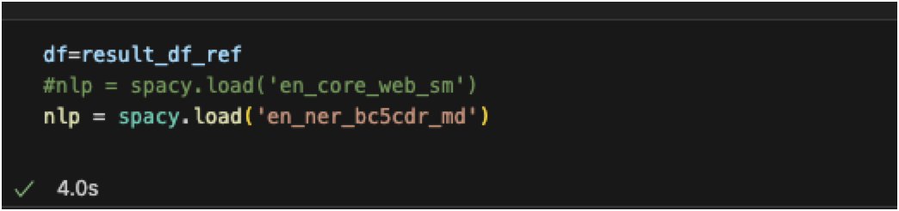
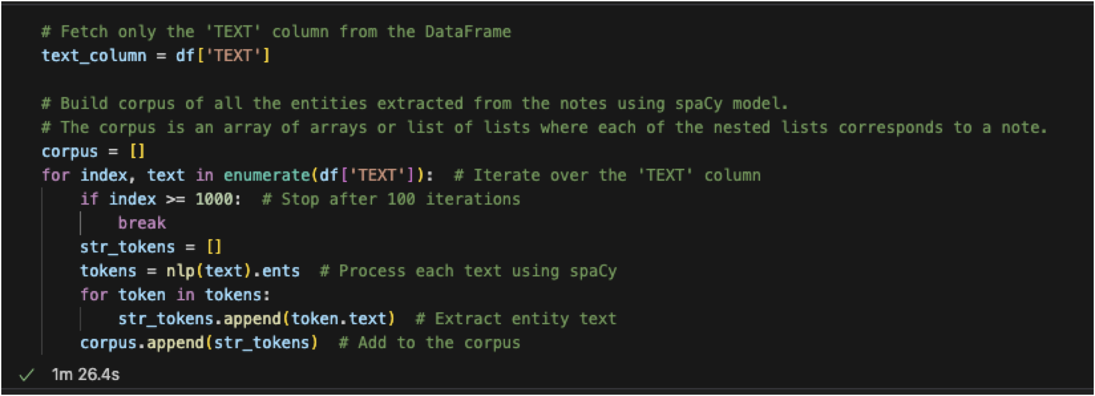
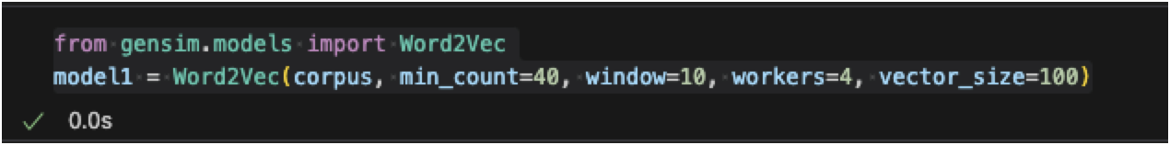
Word2Vec Corpus of entities - codebase

Slide 10
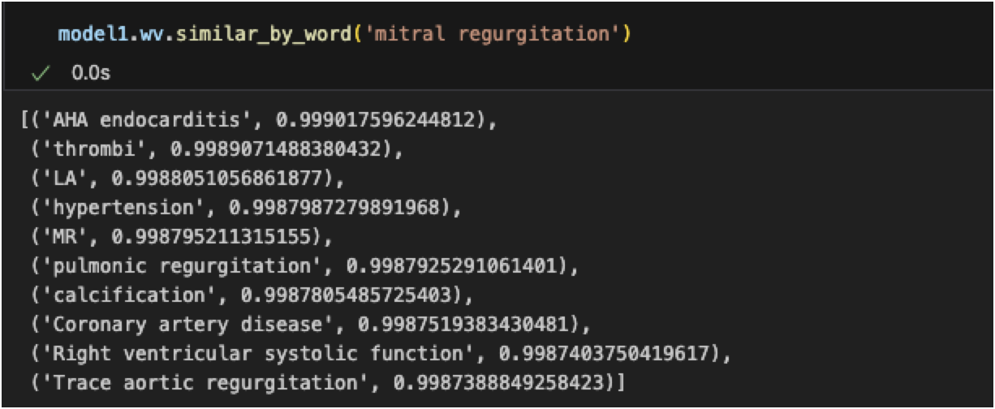
Word2Vec Corpus of entities – Keys / Similarity

Slide 11
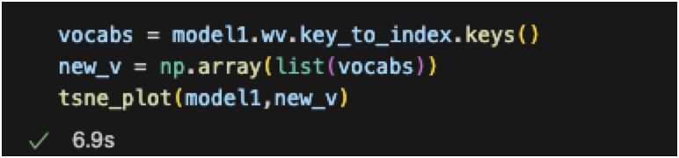
Word2Vec plot the results in t-SNE graphs
Extract Vocabulary:
vocabs = model1.wv.key_to_index.keys() retrieves the vocabulary (unique words) from the trained Word2Vec model (model1).
These are the words for which word embeddings have been learned.
Convert Vocabulary to NumPy Array:
new_v = np.array(list(vocabs)) converts the vocabulary (a list of words) into a NumPy array for easier manipulation and compatibility with the tsne_plot function.
Generate t-SNE Plot:
tsne_plot(model1, new_v) calls a custom function (tsne_plot) to visualize the word embeddings using t-SNE (t-Distributed Stochastic Neighbor Embedding).
The function likely performs the following steps:
Extracts the word vectors (embeddings) for the words in new_v from the Word2Vec model.
Applies t-SNE to reduce the high-dimensional word vectors to 2D or 3D for visualization.
Plots the reduced vectors, with each point representing a word and its position reflecting its semantic similarity to other words.
Key Points:
The code retrieves the vocabulary from the trained Word2Vec model and prepares it for visualization.
It uses a custom tsne_plot function to generate a t-SNE plot, which helps visualize the semantic relationships between words in a 2D or 3D space.
This visualization is useful for understanding how the Word2Vec model has captured the semantic similarities between words in the corpus.

Slide 12
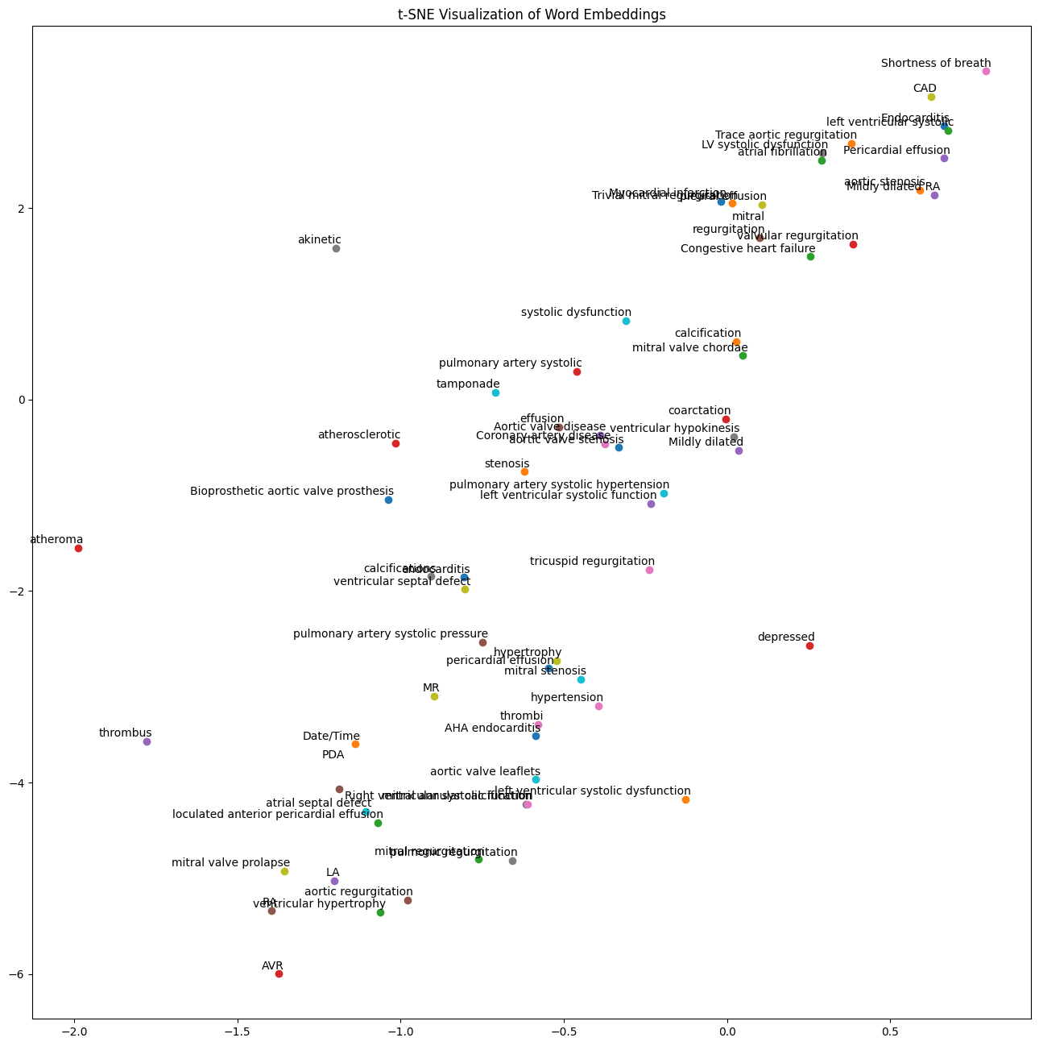
Word2Vec plot the results in t-SNE graphs

Slide 13
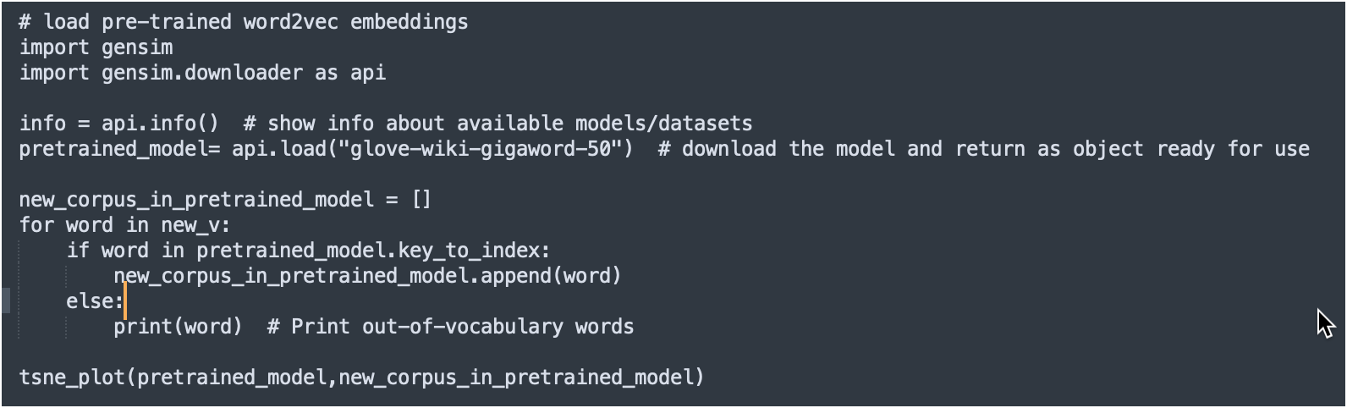
GloVe pretrained model
Load Pre-trained Word Embeddings:
The gensim.downloader module is used to load pre-trained word embeddings.
api.info() displays information about available pre-trained models and datasets.
api.load("glove-wiki-gigaword-50") loads the GloVe model trained on the Wikipedia and Gigaword datasets, with 50-dimensional word vectors.
Filter Vocabulary for Pre-trained Model:
A new list, new_corpus_in_pretrained_model, is created to store words from the vocabulary (new_v) that exist in the pre-trained model.
The for loop iterates over each word in new_v:
If the word exists in the pre-trained model (if word in pretrained_model.key_to_index), it is added to new_corpus_in_pretrained_model.
If the word is not in the pre-trained model, it is printed as an out-of-vocabulary (OOV) word.
Generate t-SNE Plot:
tsne_plot(pretrained_model, new_corpus_in_pretrained_model) calls a custom function (tsne_plot) to visualize the word embeddings from the pre-trained GloVe model.
The function likely performs the following steps:
Extracts the word vectors for the words in new_corpus_in_pretrained_model from the GloVe model.
Applies t-SNE to reduce the high-dimensional word vectors to 2D or 3D for visualization.
Plots the reduced vectors, with each point representing a word and its position reflecting its semantic similarity to other words.

Slide 14
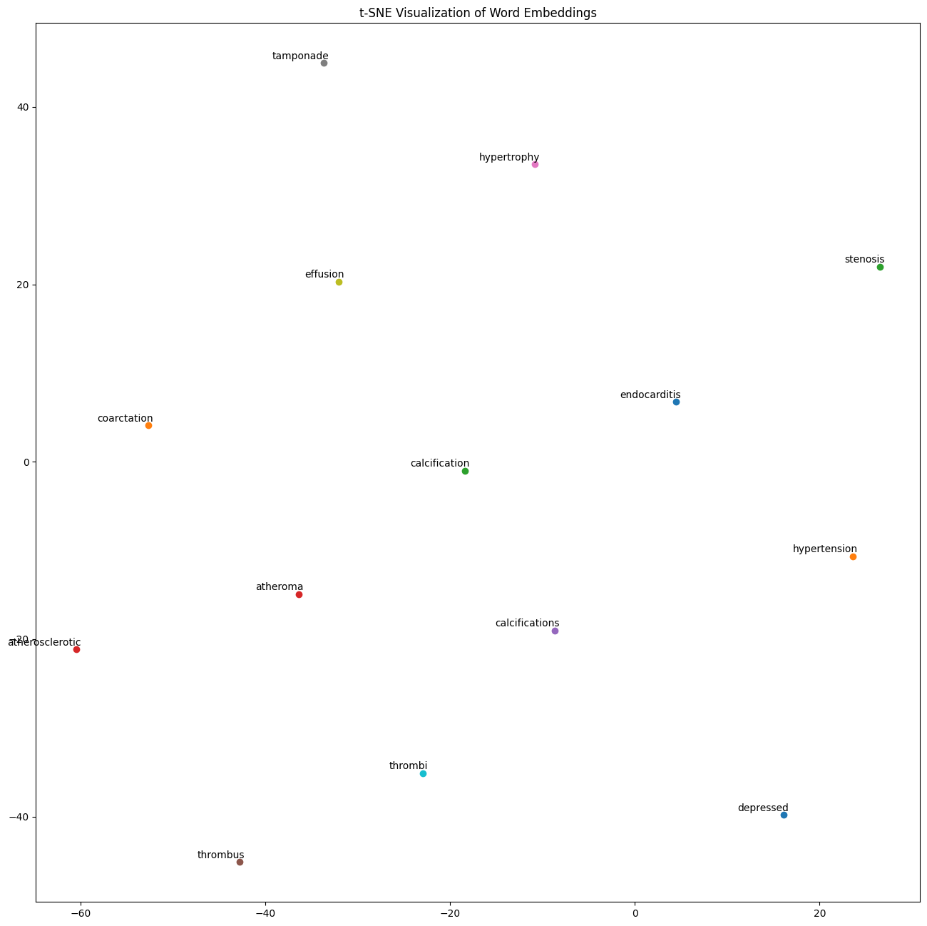
GloVe pretrained model - plot the results in t-SNE graphs

Slide 15
ClinicalBERT Analysis
Text Preprocessing
Download NLTK Resources:
Downloads necessary NLTK resources (stopwords, punkt, wordnet) for text preprocessing tasks like tokenization, stopword removal, and lemmatization.
Clean Text Function:
clean_text(text) performs the following steps:
Tokenizes the text into words.
Removes special characters and converts words to lowercase.
Removes stopwords (e.g., "the", "is") using NLTK's stopwords list.
Filters out words with fewer than 4 characters and numeric values to reduce noise.
Removes duplicate words and joins the remaining words into a cleaned text string.
Corpus Creation
Extract Entities Using SpaCy:
Iterates over the TEXT column of the DataFrame (df) and extracts named entities using the SpaCy model (nlp).
Limits processing to the first 20 rows (if index >= 20: break).
Stores the extracted entities in a corpus (a list of lists, where each sublist contains entities from a single note).
Combine All Entities:
Combines all entities from the corpus into a single list (notes_combined).
Joins the list into a single string for further processing.

Slide 16
ClinicalBERT Analysis
ClinicalBERT Embeddings
Load ClinicalBERT Model:
Loads the Bio_ClinicalBERT model and tokenizer using the transformers library.
This model is fine-tuned for clinical text and is used to generate contextual word embeddings.
Tokenize and Clean Text:
Cleans the combined text (notes_combined) using the clean_text function.
Splits the cleaned text into tokens for processing.
Generate Word Embeddings:
For each token, encodes it using ClinicalBERT and extracts its embedding.
Stores the embeddings in a list (word_embs).
t-SNE Visualization
Dimensionality Reduction:
Uses t-SNE (TSNE) to reduce the high-dimensional word embeddings to 2D for visualization.
Parameters:
n_components=2: Reduces embeddings to 2D.
perplexity=10: Controls the balance between local and global patterns.
random_state=42: Ensures reproducibility.
Plot Word Embeddings:
Creates a scatter plot of the 2D embeddings.
Annotates each point with the corresponding word for interpretability.
Displays the plot using matplotlib.

Slide 17
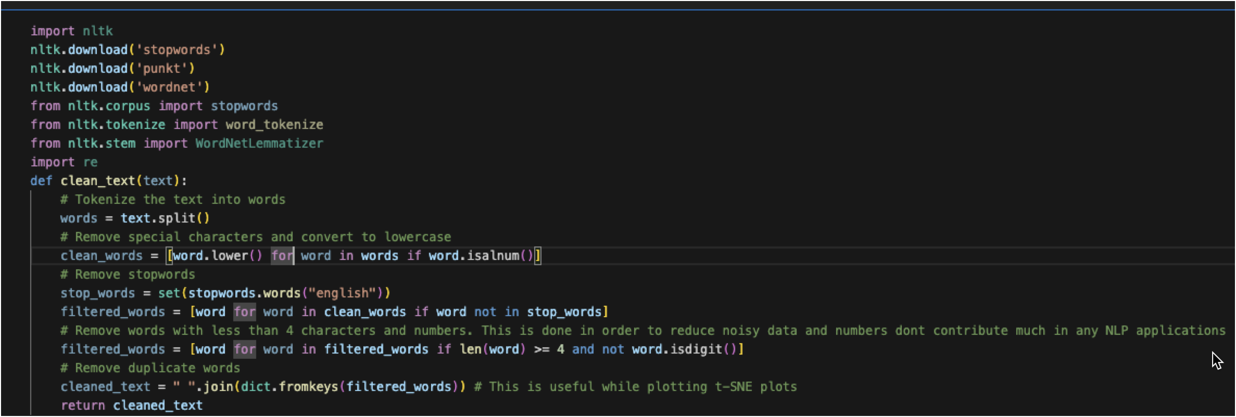
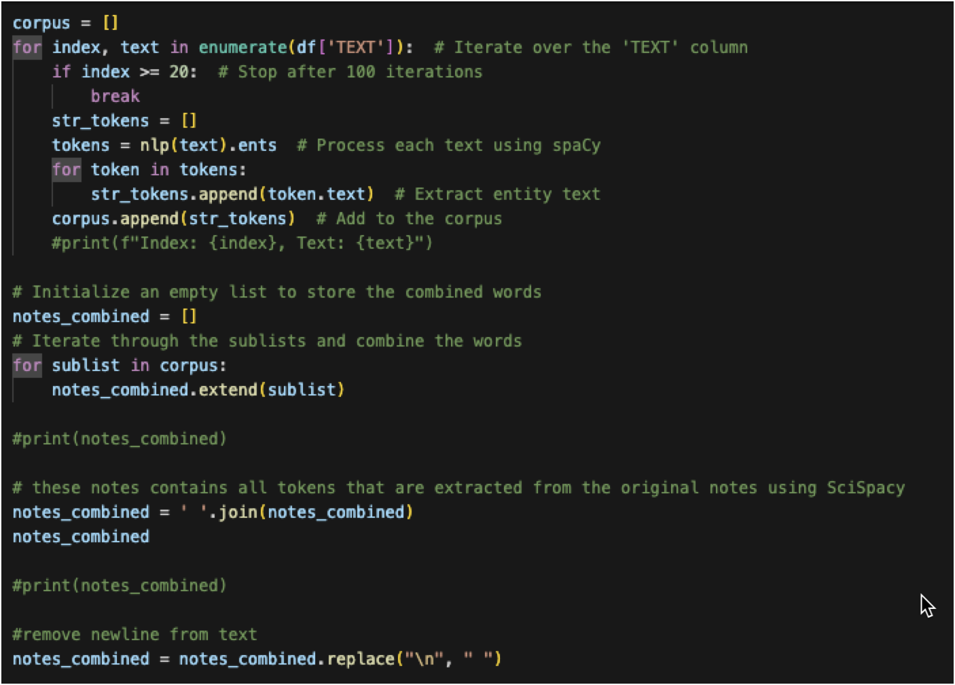
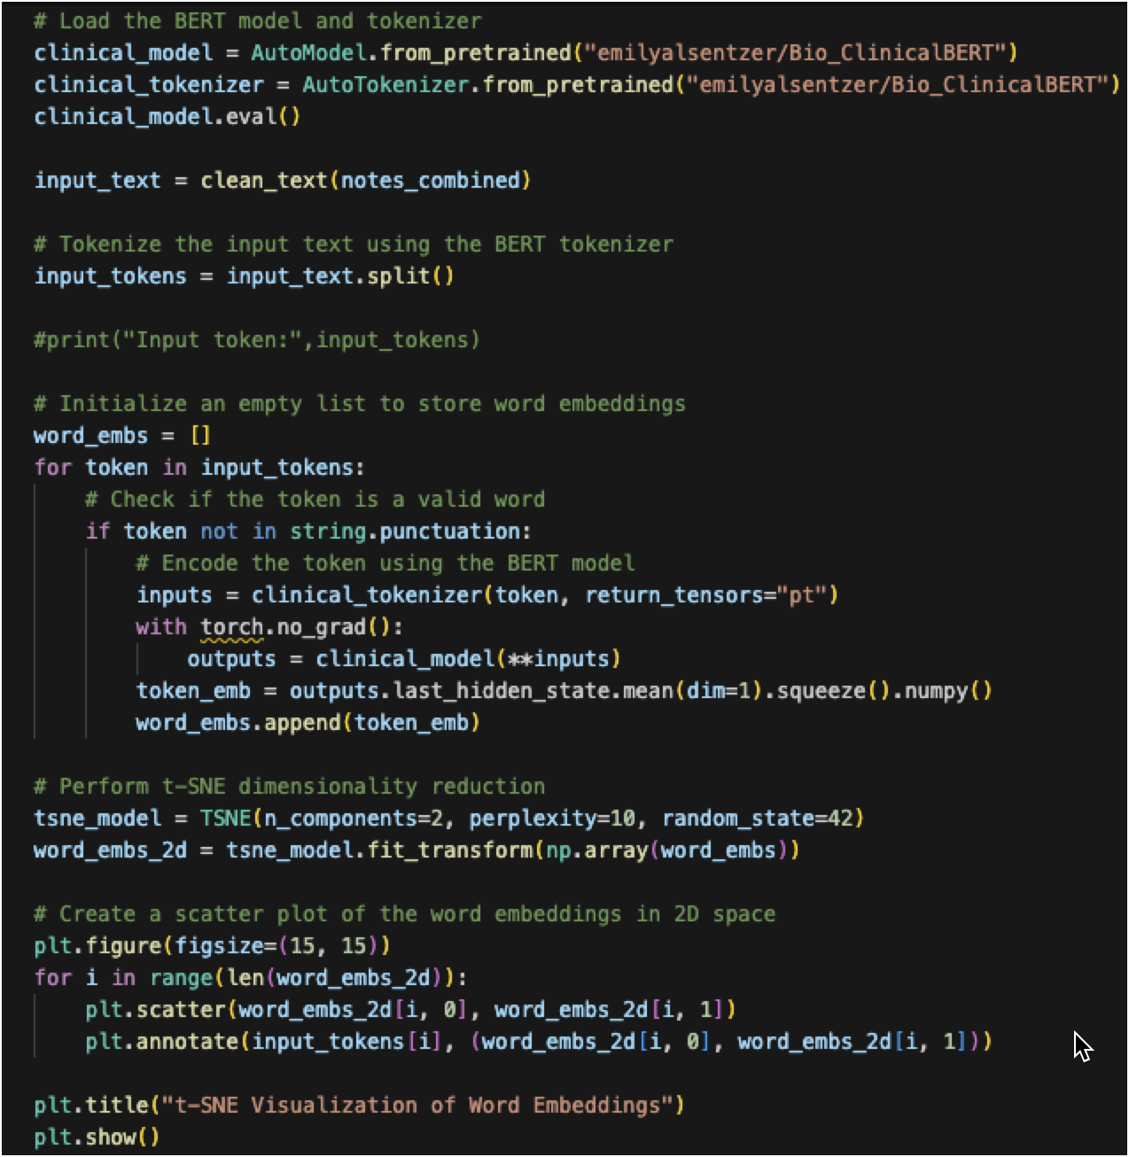
ClinicalBERT Analysis - codebase

Slide 18
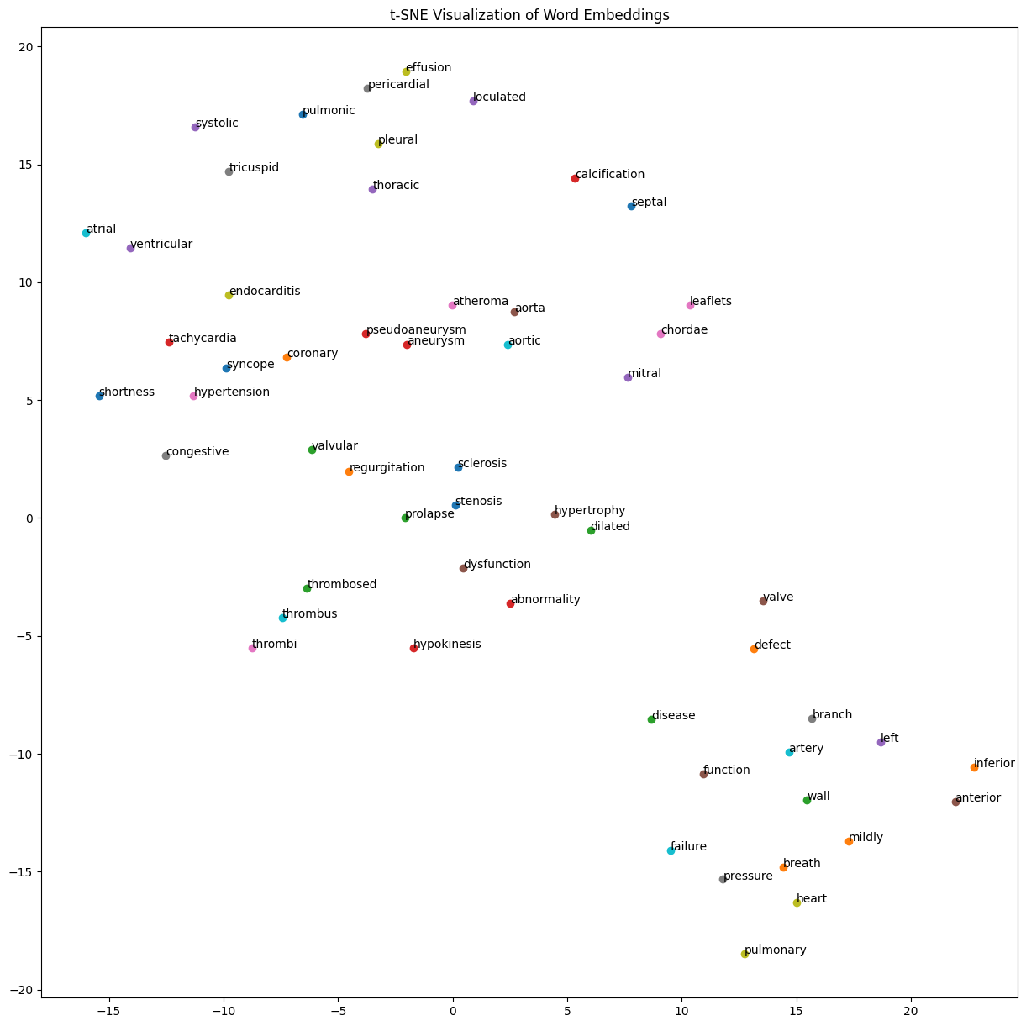
ClinicalBERT Analysis - plot the results in t-SNE graphs

