Slide 1
MIMIC Visualization – HW1
Balaji Sethuraman – AI in Healthcare
Github location:
https://github.com/balajisethu03/ai-healthcare/tree/main/assignment-1-resubmit

Slide 2
BACKGROUND
Healthcare generates vast amounts of complex data, but extracting meaningful insights requires careful processing and visualization. The MIMIC-III database, with its detailed records on patient demographics, prescriptions, and hospital transfers, offers a goldmine of information-yet analyzing it demands structured workflows. Our initial codebase tackles this challenge by loading and preprocessing three critical datasets: PATIENTS (demographics), PRESCRIPTIONS (medication orders), and TRANSFERS (care unit movements). By cleaning dates, calculating patient ages, and categorizing medications, we transform raw data into an analysis-ready format.
With the datasets prepared, we unlock their potential through exploratory visualizations. Seaborn’s distribution plots reveal patient age trends, while relational plots uncover connections between age and hospital stay duration. Interactive Plotly charts—such as pie/donut charts for medication distribution and a tornado chart for gender-based prescribing patterns—make the data intuitive for stakeholders. The gauge chart provides an at-a-glance view of average length of stay, a critical metric for hospital operations.
This initial analysis is just the beginning. By joining these tables and visualizing trends, we create a foundation for deeper dives—predicting readmissions, optimizing drug therapies, or identifying bottlenecks in patient flow. The NetworkX graph of transfers between hospital units, for example, could evolve into a tool for resource allocation. As we refine this codebase, we pave the way for data-driven clinical decision-making, demonstrating how structured analytics can improve both patient outcomes and operational efficiency.

Slide 3
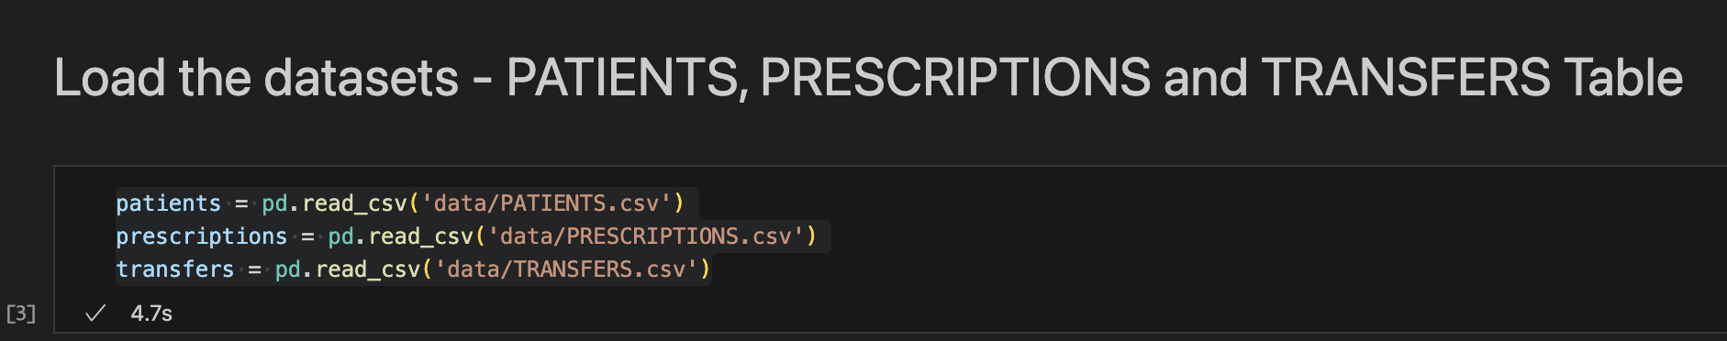
Dataset loading - PATIENTS, PRESCRIPTIONS and TRANSFERS data using Pandas
1. Imports patient data from PATIENTS.csv into a Pandas DataFrame called patients.
Contains demographic information (age, gender, etc.).
Key fields: SUBJECT_ID (unique patient identifier), DOB (date of birth), DOD (date of death).
2. Loads prescription records from PRESCRIPTIONS.csv into prescriptions.
Includes medication details (drug name, dosage, route, etc.).
Key fields: SUBJECT_ID (links to patients), DRUG (medication name), DOSE_VAL_RX (prescribed dose).
3. Loads transfer logs from TRANSFERS.csv into transfers.
Tracks patient movements between hospital units (ICU, ward, etc.).
Key fields: SUBJECT_ID, CURR_CAREUNIT (current unit), PREV_CAREUNIT (previous unit), INTIME/OUTTIME (timestamps).

Slide 4
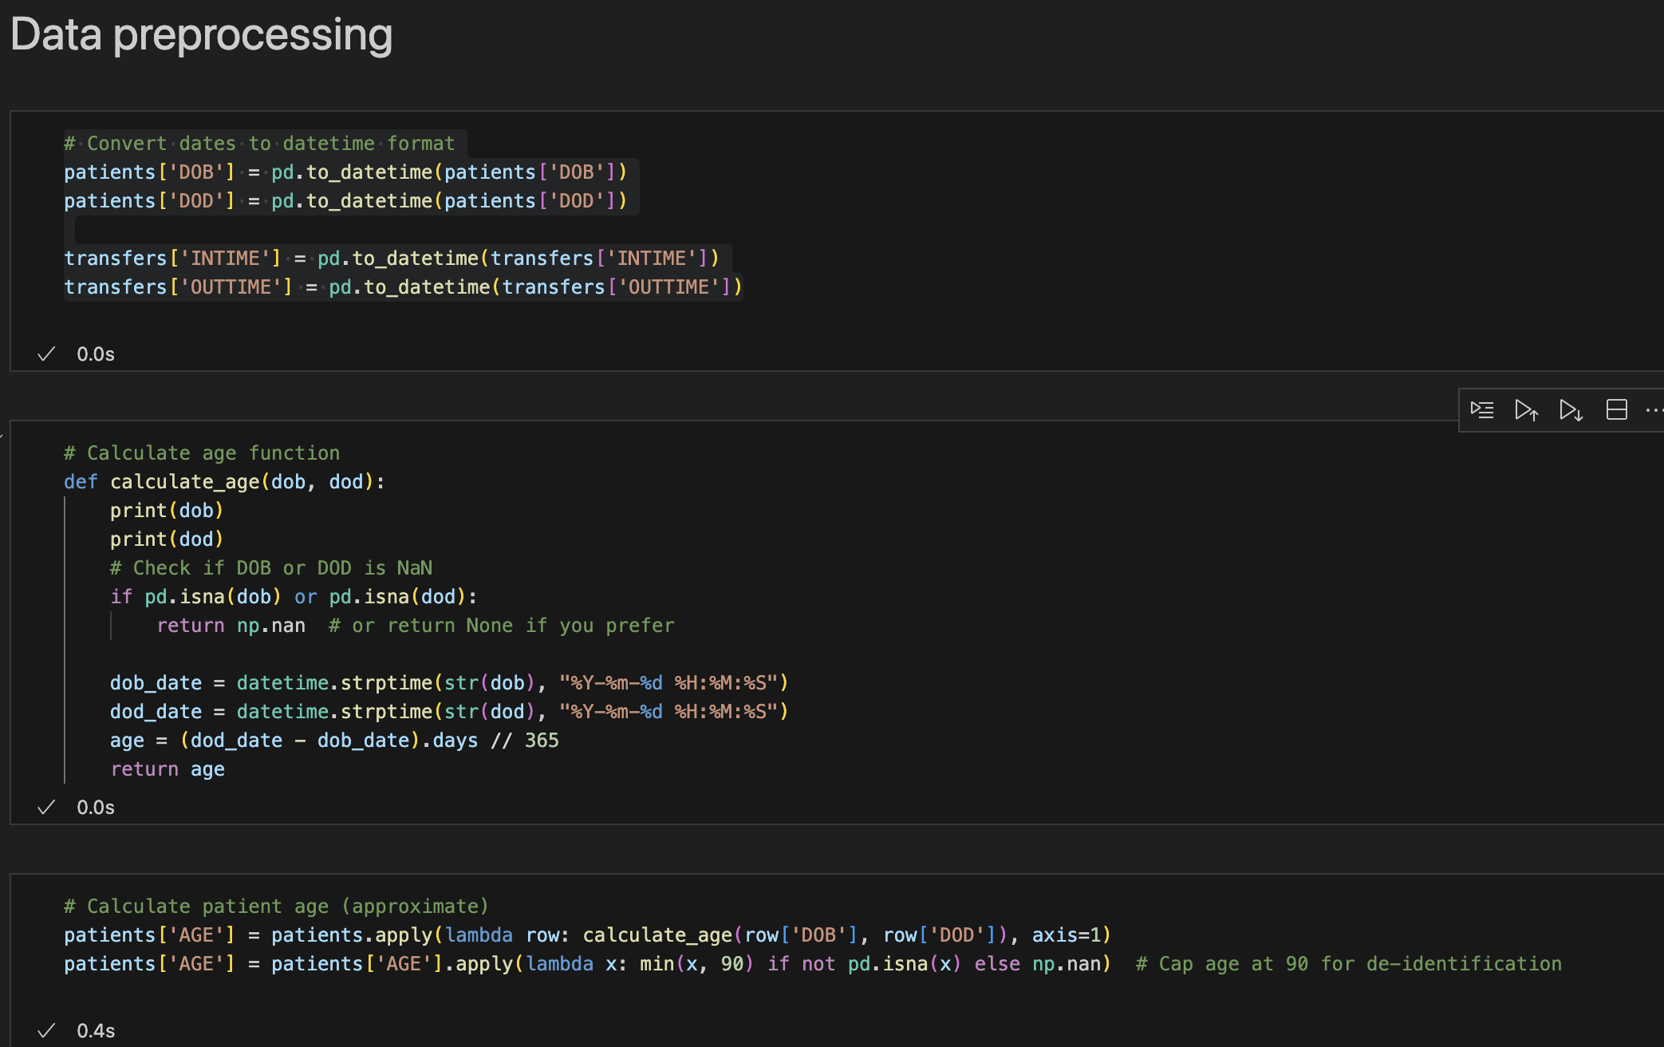
Data Preparation
Code Purpose:
Converts date columns (DOB, DOD, INTIME, OUTTIME) to Pandas datetime format for accurate time-based calculations.
Calculates patient ages by comparing dates of birth (DOB) and death (DOD), with safeguards for missing data.
Caps ages at 90
Key Steps:
pd.to_datetime(): Ensures dates are parsed correctly.
calculate_age(): Computes age in years, handles missing values (NaN).
Lambda functions: Apply calculations row-wise and enforce age capping.

Slide 5
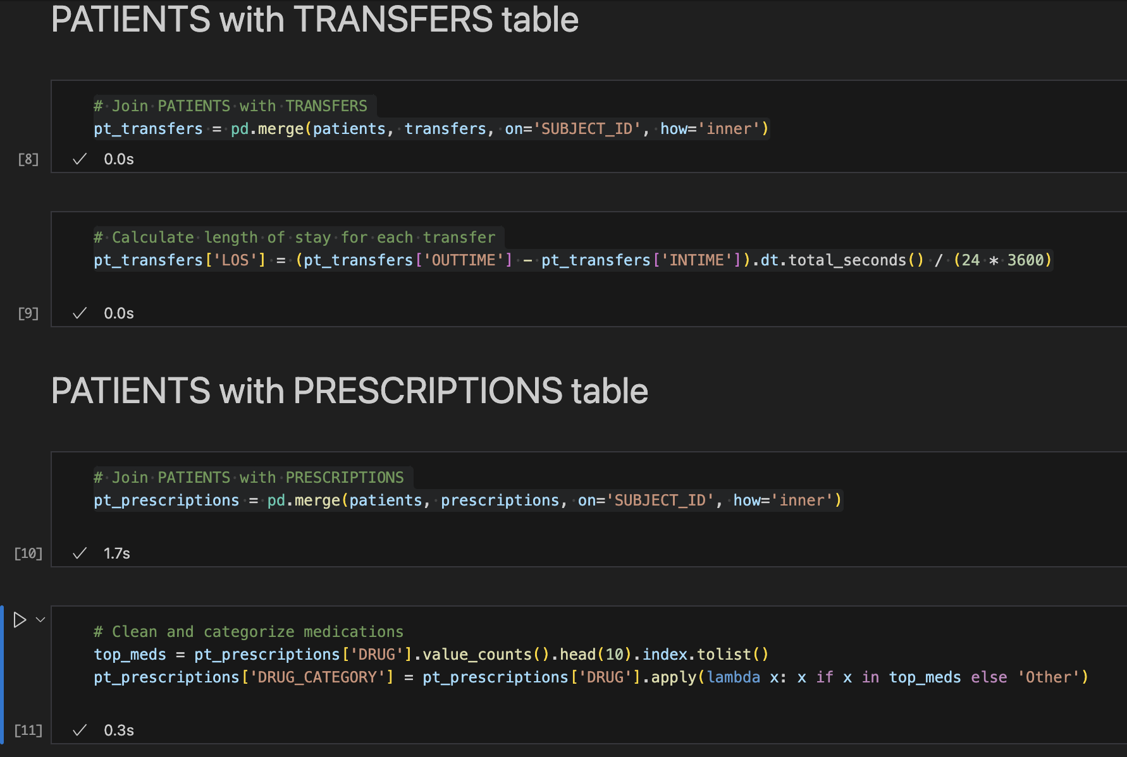
Data Integration & Feature Engineering
Merges Datasets:
Combines PATIENTS ↔ TRANSFERS (for stay duration analysis)
Joins PATIENTS ↔ PRESCRIPTIONS (for medication insights)
Creates Key Metrics:
LOS (Length of Stay): Calculated in days from OUTTIME - INTIME
DRUG_CATEGORY: Groups medications into top 10 + "Other" for simplified analysis
Focus:
Enables cross-dataset analysis (e.g., "Do older patients stay longer in ICUs?")
Simplifies medication trends by focusing on high-frequency drugs

Slide 6
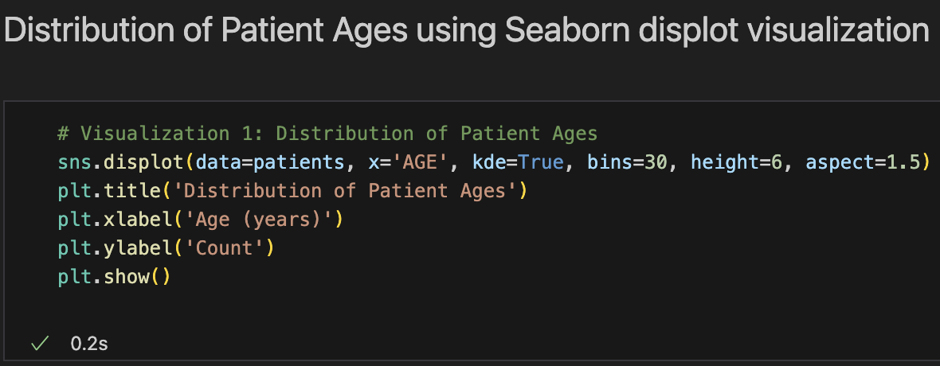
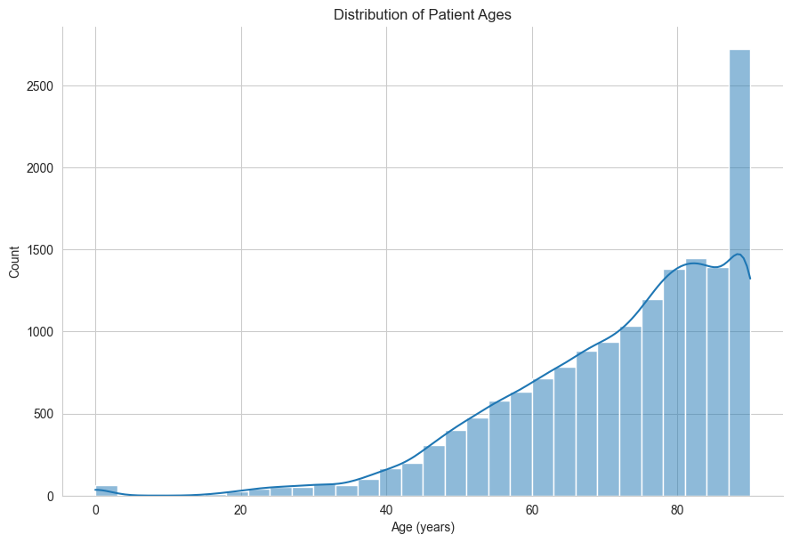
1. Distribution of Patient Ages using Seaborn displot visualization
Uses Seaborn’s displot to show the distribution of patient ages
Key Features:
kde=True: Adds a smooth curve (Kernel Density Estimate)
bins=30: Balances detail and readability
Custom titles/labels for clarity
Focus:
Reveals demographic trends (e.g., older/younger patient clusters)
Helps identify data quality issues (e.g., unexpected age gaps)

Slide 7
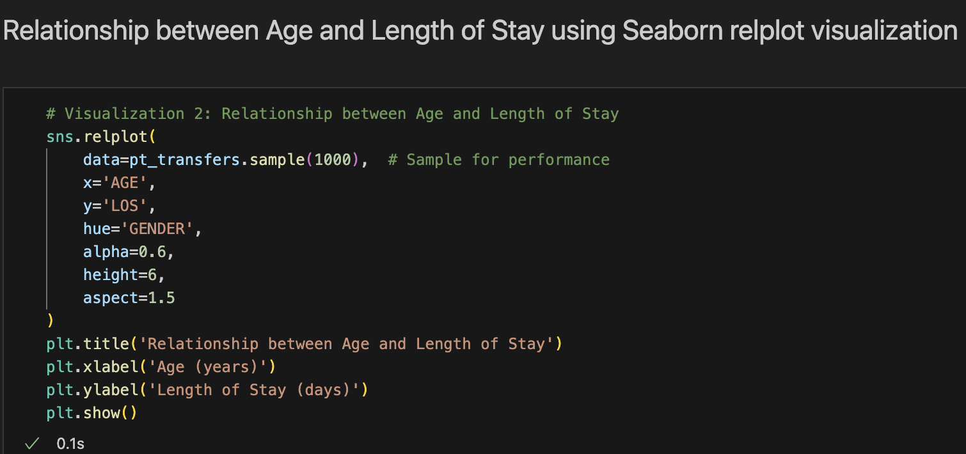
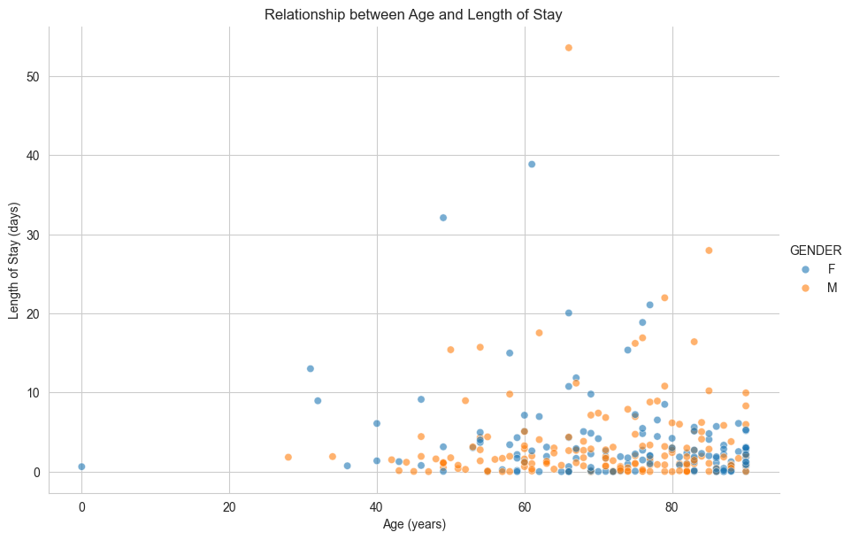
2. Relationship between Age and Length of Stay using Seaborn relplot visualization
Uses Seaborn's relplot to show correlation between patient age and hospital stay duration
Key features:
Samples 1,000 records for cleaner visualization
Color-coded by gender (hue='GENDER')
Semi-transparent points (alpha=0.6) to show density
Focus:
Identifies potential patterns (e.g., do older patients stay longer?)
Reveals gender differences in hospitalization duration
Helps optimize resource allocation by predicting stay lengths
The aspect ratio (1.5:1) ensures proper scaling of the relationship.

Slide 8
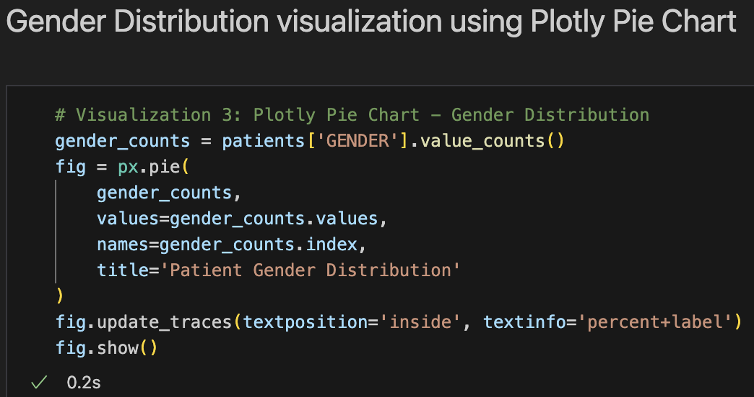
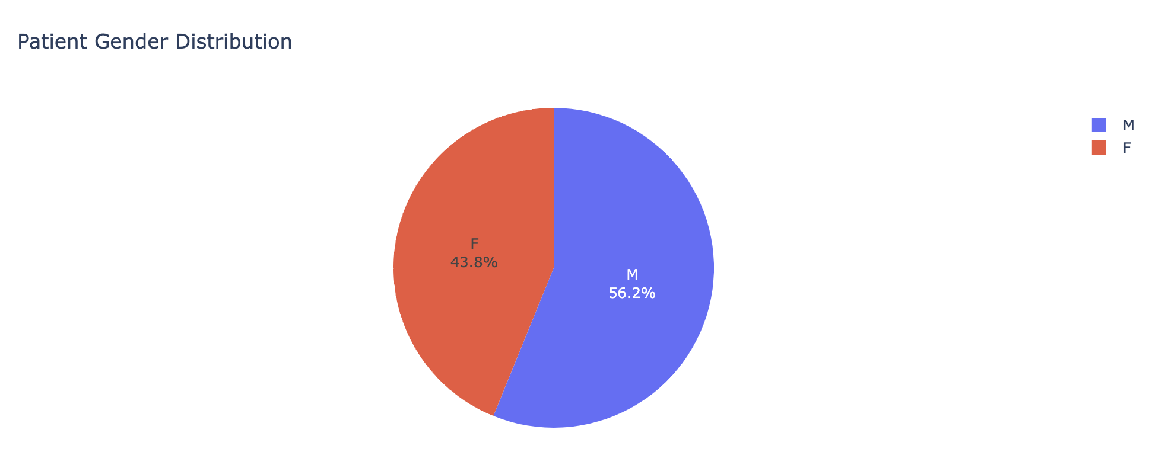
3. Gender Distribution visualization using Plotly Pie Chart
Creates an interactive pie chart showing gender breakdown using Plotly
Key features:
Auto-calculates percentages from value counts
Displays labels and percentages inside slices
Clean title for immediate understanding
Focus:
Reveals dataset composition at a glance
Helps identify potential gender imbalances in the patient population
Serves as baseline demographic information for further analysis

Slide 9
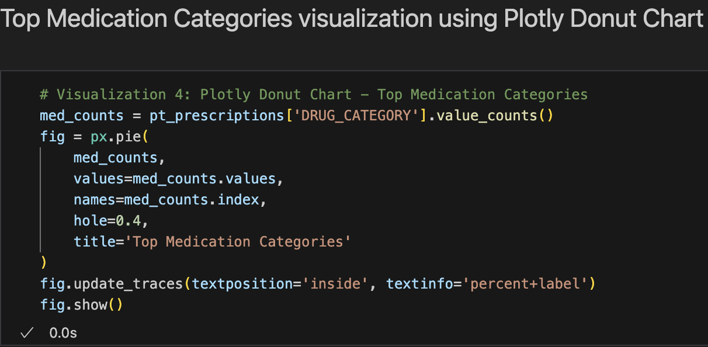
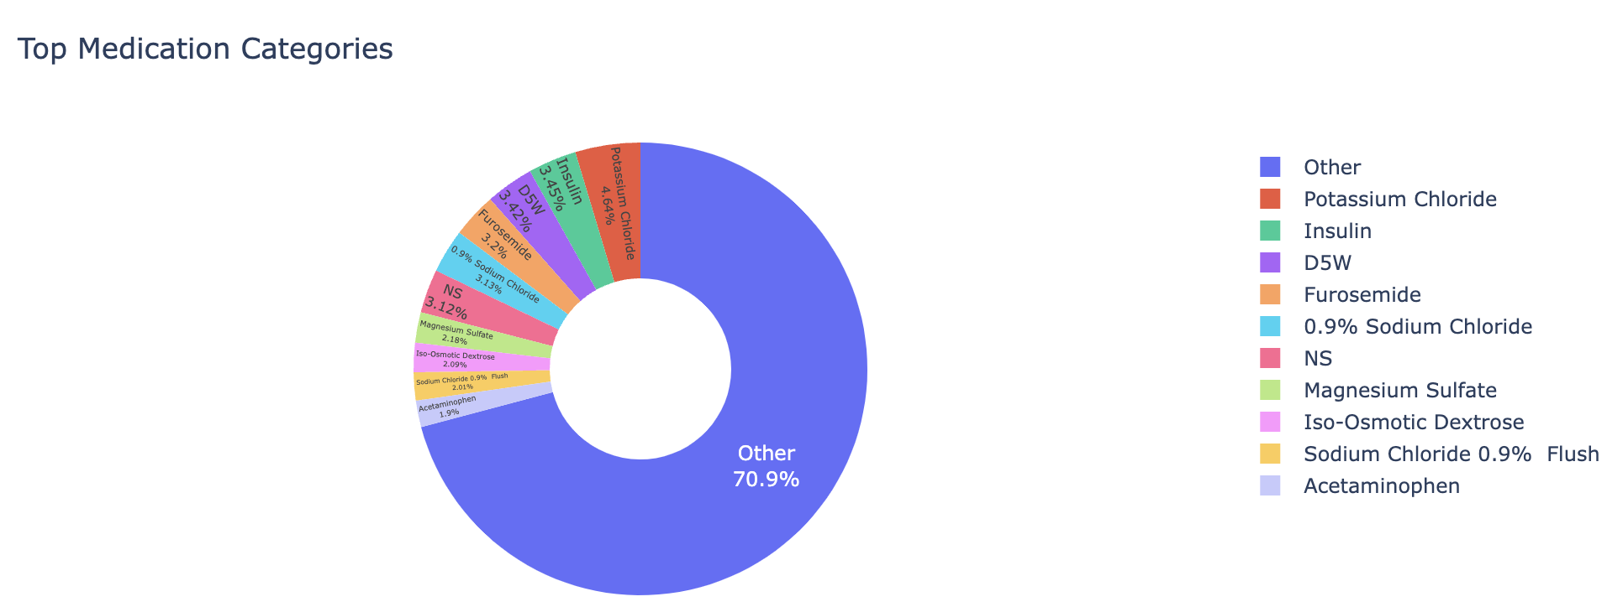
4. Top Medication Categories visualization using Plotly Donut Chart
Creates an interactive donut chart showing the proportion of top prescribed medications
Key features:
Focuses on top medication categories (with "Other" as catch-all)
40% center hole (hole=0.4) for modern data presentation
Clear percentage labels inside each segment
Focus:
Quickly identifies most common treatments
Highlights potential prescribing patterns or biases
Provides foundation for medication utilization research

Slide 10
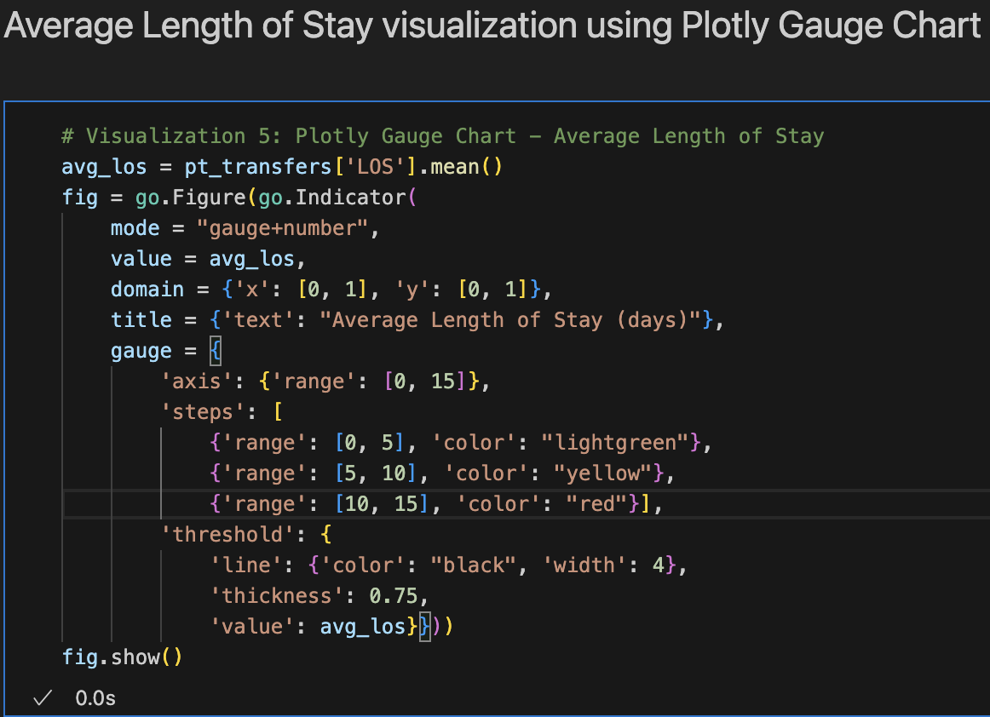
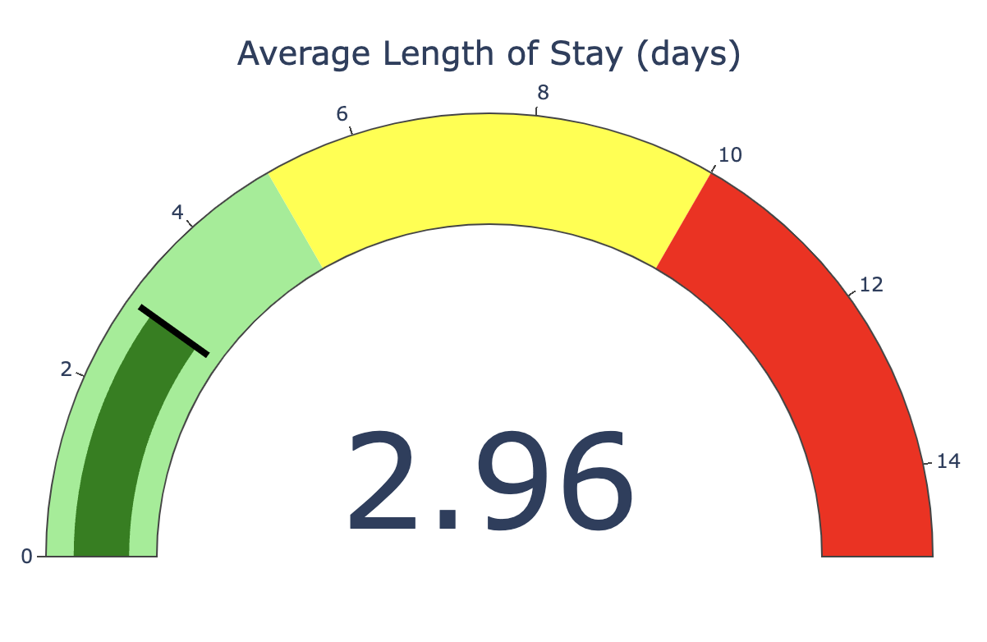
5. Average Length of Stay visualization using Plotly Gauge Chart
Creates an impactful gauge chart showing average hospital stay duration
Key features:
Color-coded ranges (green/yellow/red) for instant interpretation
Clear threshold marker at calculated mean value
Combines visual gauge with exact numeric display
Focus:
Provides at-a-glance performance metric
Enables quick benchmarking against targets
Visual color zones help identify potential operational issues

Slide 11
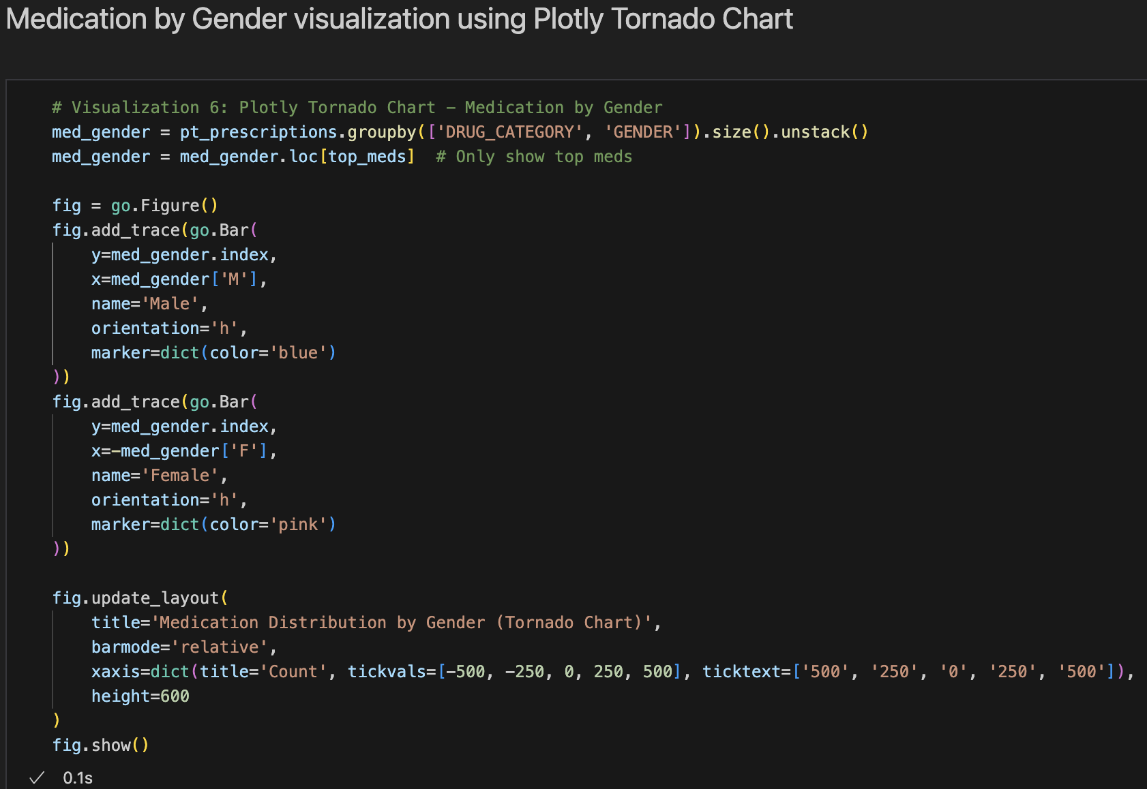
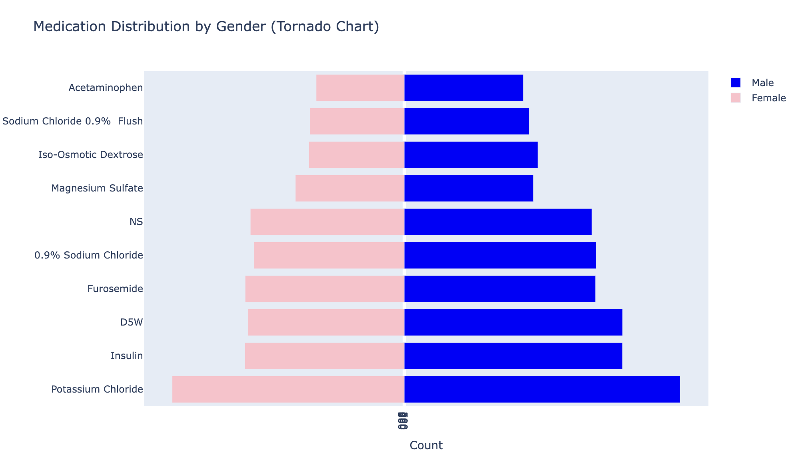
6. Average Length of Stay visualization using Plotly Gauge Chart
Creates a tornado chart comparing medication prevalence by gender
Key features:
Male/Female prescriptions mirrored for easy comparison
Focuses only on top medications for clarity
Custom x-axis labels for intuitive reading
Focus:
Reveals gender-based prescribing patterns
Helps identify potential treatment biases
Supports personalized medicine initiatives

Slide 12
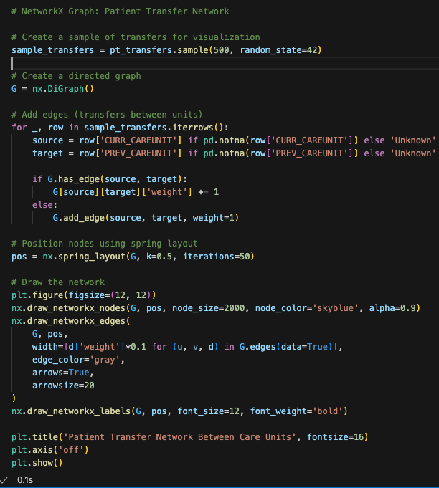
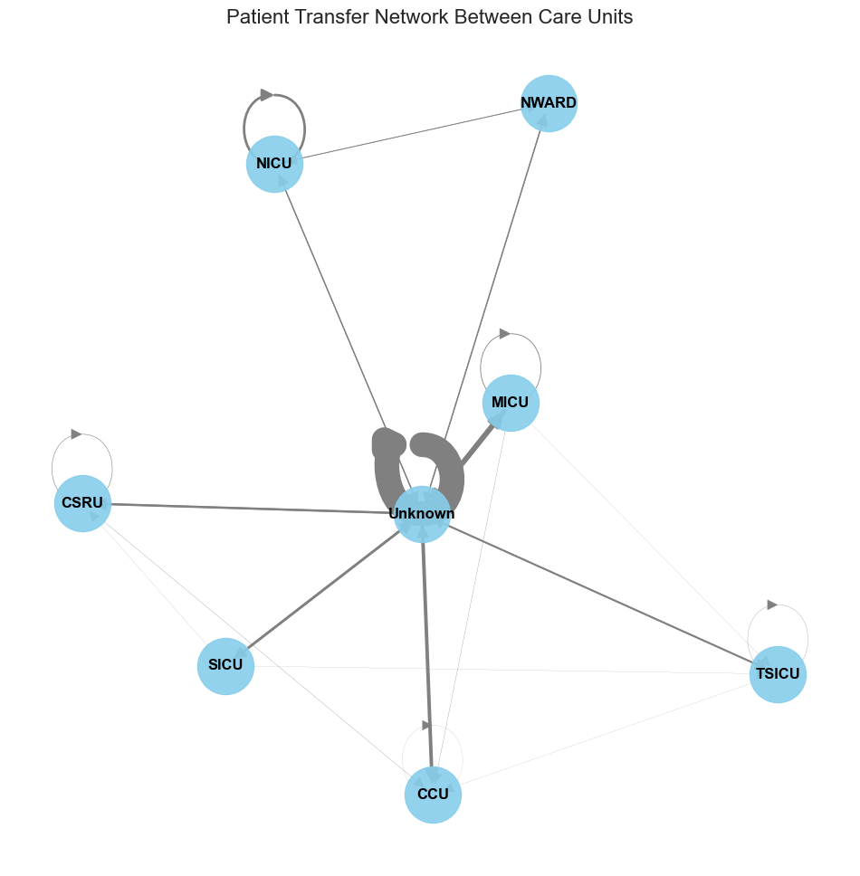
7. Patient Transfer Network visualization using NetworkX Graph
Creates a directed network graph of patient flows between hospital units
Key features:
Samples 500 transfers for manageable visualization
Edge weights represent transfer frequency
Spring layout optimizes node positioning
Custom styling for clarity
Focus:
Reveals care unit workflow patterns
Identifies high-traffic transfer pathways
Helps optimize patient flow management

