Slide 1
High Risk Project
Drug-to-Drug Interaction Prediction Using Neural Networks
Balaji Sethuraman – AI in Healthcare
Github location:
https://github.com/balajisethu03/ai-healthcare/tree/main/assignment-7

Slide 2
INTRODUCTION
In today's healthcare landscape, drug-to-drug interactions (DDIs) represent one of the most significant challenges to patient safety. This concern becomes particularly pronounced in the context of polypharmacy - a growing practice especially prevalent among aging populations - where multiple medications taken simultaneously can lead to harmful interactions. The traditional approach to identifying these interactions has relied heavily on static databases and manual reviews by healthcare professionals, methods that are increasingly recognized as both time-consuming and susceptible to human error.
The emergence of advanced machine learning techniques, particularly in the domains of natural language processing and neural networks, has created new opportunities for addressing this challenge. These computational approaches offer the potential to dynamically learn from vast pharmacological datasets, enabling more comprehensive and nuanced predictions of drug interactions than previously possible. By leveraging rich data sources such as DrugBank and Kaggle, these models can evaluate drug combinations based on their chemical properties, known interaction patterns, and embedded representations.
Our research introduces a novel deep learning framework designed to predict potential drug interactions with remarkable accuracy. This model aims to serve as a decision support tool for healthcare professionals, providing them with rapid and reliable assessments of interaction risks when prescribing multiple medications. The system is implemented through a user-friendly Streamlit application that allows for instant DDI predictions, demonstrating how AI-driven tools can be effectively integrated into clinical workflows to enhance patient care outcomes.
Dataset used: DDI dataset (https://www.kaggle.com/datasets/mghobashy/drug-drug-interactions/data)
Notes:
Drug-drug interactions pose a critical patient safety challenge, especially with increasing polypharmacy among aging populations. Traditional methods using static databases and manual reviews are time-consuming and error-prone.
Machine learning, particularly neural networks, offers revolutionary capabilities for DDI prediction by dynamically learning from extensive pharmacological data. Our model leverages datasets from DrugBank and Kaggle to analyze drug combinations based on chemical properties and known interaction patterns.
Our deep learning framework delivers highly accurate predictions through a user-friendly Streamlit application, providing healthcare professionals with instant DDI assessments. This integration of AI into clinical workflows represents a significant advancement in medication safety and patient care.
I used Kaggle DDI dataset, containing structured drug pair information with annotated interaction outcomes.

Slide 3
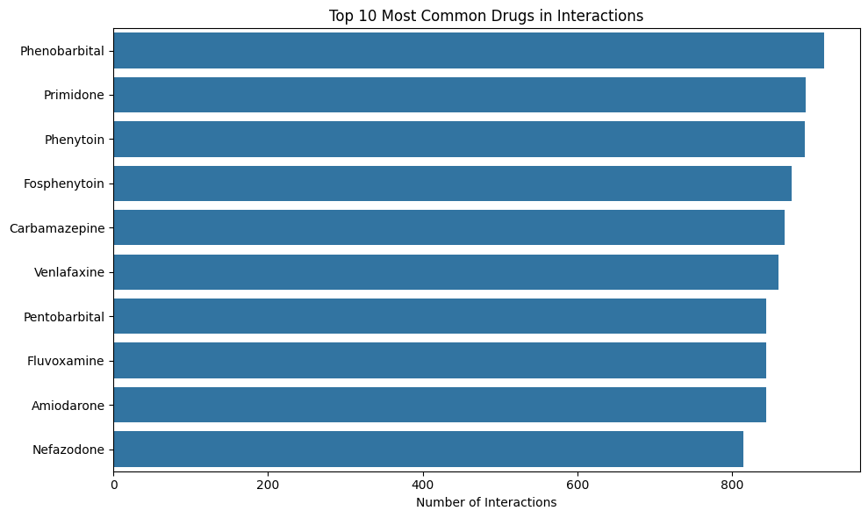
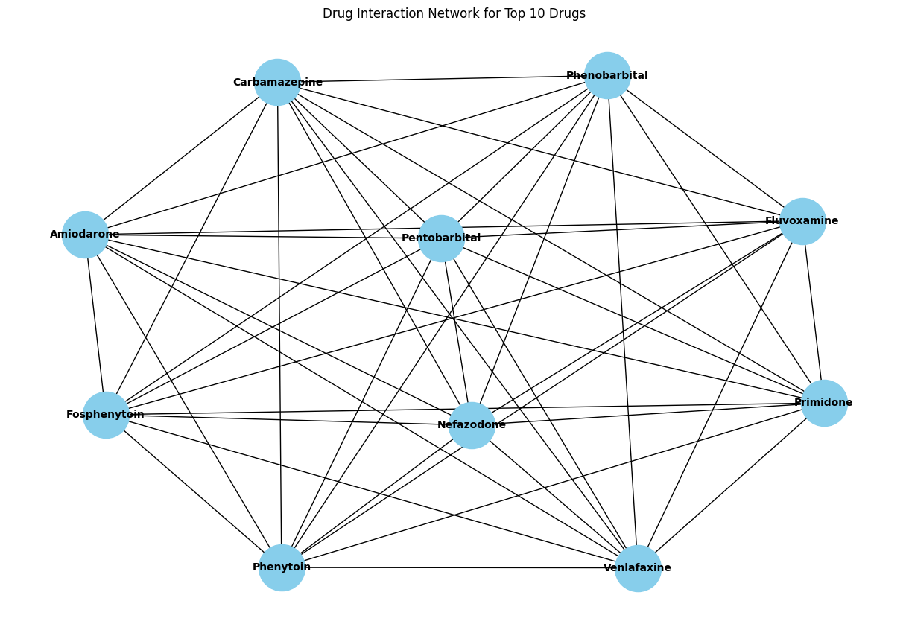
Methodology: Drug Interaction Prediction
Data Sources:
Primary dataset: Drug-Drug Interactions from Kaggle
Structured drug pair data with annotated interaction information
Enabled supervised training of classification models
Sources provided reliable foundation for model development and testing
Data Processing Pipeline:
Exploratory Data Analysis (EDA)
Analyzed data distribution patterns
Examined correlation between drug features
Identified potential biases in the dataset
Feature Engineering:
Feature selection based on:
Domain knowledge from pharmacological studies
Relevance to interaction mechanisms
Dimensionality reduction techniques applied to:
Enhance training efficiency
Prevent overfitting
Focus on most significant predictive features
Notes:
Our approach leverages the Kaggle Drug-Drug Interactions dataset as our primary data source. This structured collection of annotated drug pairs allowed us to build a supervised learning framework with a reliable foundation for development and validation.
In our exploratory data analysis, we visualized the top 10 most common drug interactions and created a network diagram showing relationships between frequently interacting medications. This revealed critical patterns in the data distribution and highlighted potential biases that needed to be addressed.
For feature engineering, we prioritized pharmacologically relevant attributes based on domain expertise rather than purely statistical correlations. We applied dimensionality reduction techniques to improve computational efficiency while preventing overfitting, ensuring our model focuses on the most significant predictive features for interaction detection. In next section, we will discuss about model architecture

Slide 4
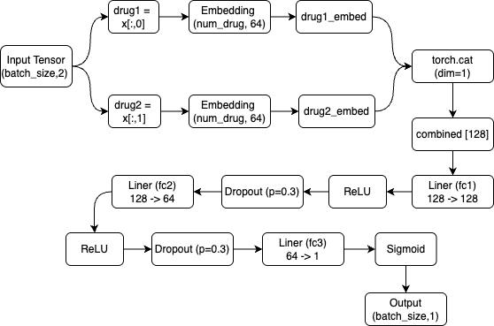
Methodology: Model Architecture
Neural Network Model Architecture
Model Components
Embedding Layer
Converts drug IDs into 64-dimensional feature vectors
Allows model to learn drug representations during training
Linear Layers
First layer (fc1): 128 → 128 features
Second layer (fc2): 128 → 64 features
Output layer (fc3): 64 → 1 feature (interaction probability)
Regularization
Dropout with 30% probability (p=0.3)
Applied after each hidden layer
Prevents overfitting during training
Activation Functions
ReLU: Applied after first and second linear layers
Sigmoid: Applied to final output for probability scaling (0-1)
Forward Pass Flow
Input Processing
Input: Tensor of drug pairs [batch_size, 2]
Separate drug1 and drug2 indices from each pair
Feature Extraction
Convert each drug index to embeddings using shared embedding layer
Concatenate embeddings to create combined representation (128 features)
Neural Network Pathway
First hidden layer: Linear transformation → ReLU activation → Dropout
Second hidden layer: Linear transformation → ReLU activation → Dropout
Output layer: Linear transformation → Sigmoid activation
Output
Final output: Probability score indicating likelihood of drug interaction
Range: 0 (no interaction) to 1 (high interaction probability)
Notes:
This slide presents our neural network designed to predict drug-drug interactions. It starts with an embedding layer that maps each drug ID into a 64-dimensional vector, capturing important pharmacological features. For each drug pair, embeddings are extracted and combined into a 128-dimensional vector that reflects their joint interaction context. This vector is passed through three fully connected layers, gradually narrowing down features and learning patterns indicative of interaction risk.
We apply ReLU activations for non-linearity and dropout at 30% to prevent overfitting. The final layer uses a sigmoid function to output a probability score between 0 and 1—signifying the likelihood of an adverse interaction. This architecture allows us to balance model complexity with accuracy and generalizability, supporting reliable predictions in real-world healthcare scenarios.

Slide 5
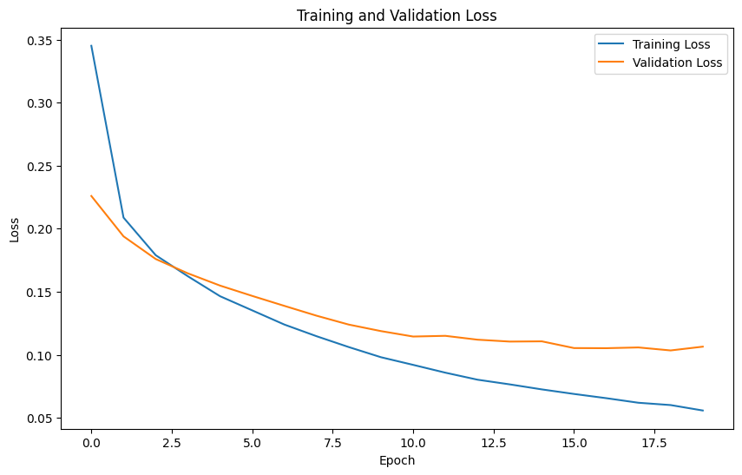
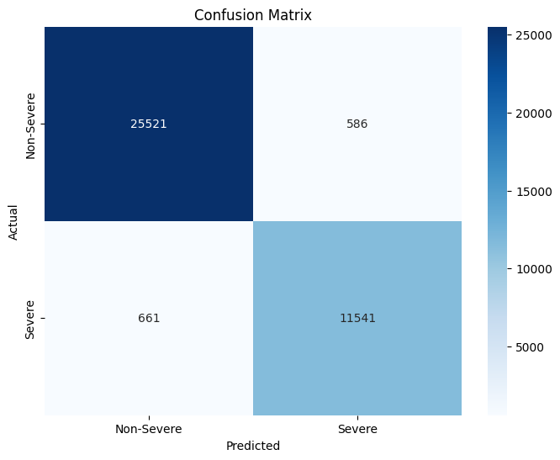
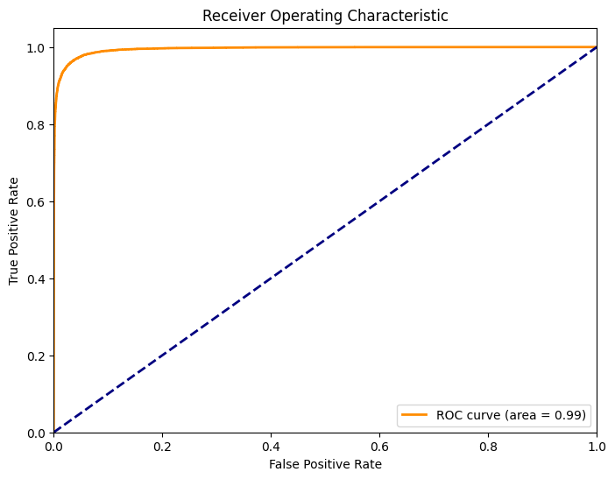
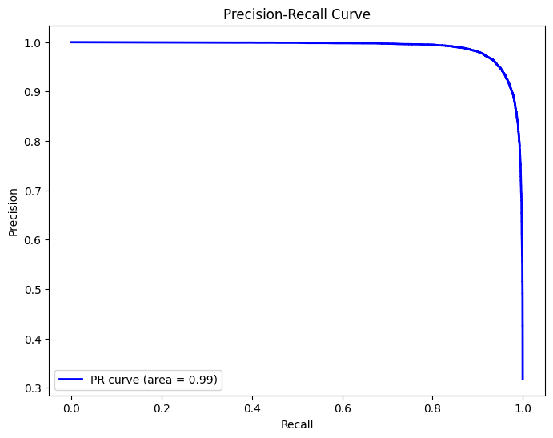
Results
Class | Precision | Recall | F1-Score | Support
0.0 | 0.97 | 0.98 | 0.98 | 26,107
1.0 | 0.95 | 0.95 | 0.95 | 12.202
Accuracy |  |  | 0.97 | 38,309
Macro Avg | 0.96 | 0.96 | 0.96 | 38,309
Weighted Avg | 0.97 | 0.97 | 0.97 | 38,309
Classification Results
For Interactions (Class 1.0)
Precision: 95%
Recall: 95%
F1-Score: 95%
Support: 12,202 samples
Balanced Performance
Macro Average: 96% across metrics
Weighted Average: 97% across metrics
Dataset Distribution
Total samples evaluated: 38,309
Class distribution:
68% non-interactions (26,107)
32% interactions (12,202)
Classification Results
Model correctly predicts 97% of all drug interactions
For Non-Interactions (Class 0.0)
Precision: 97%
Recall: 98%
F1-Score: 98%
Support: 26,107 samples
Notes:
This slide summarizes our model’s strong performance in predicting drug-drug interactions. With a 97% overall accuracy on over 38,000 test samples, the model consistently identifies both interacting and non-interacting drug pairs. For non-interacting pairs—about 68% of the data—it achieved 97% precision and 98% recall, meaning it correctly avoids false positives and captures nearly all true negatives.
Equally impressive is its performance on interacting pairs, with 95% precision and recall, showcasing its reliability in identifying potential risks. The high F1-scores for both classes confirm balanced predictions without bias toward the dominant class. Macro and weighted averages of 96% and 97% further highlight the model’s robustness and consistent accuracy across all interaction types.

Slide 6
Conclusion & Future Improvements
Conclusion:
Developed a deep learning model for drug-drug interaction prediction
Integrated public datasets for robust model training
Achieved strong performance in identifying potential interaction risks
Provided a practical Streamlit app for clinical use
Supports safer, data-driven medical decision-making
Future Considerations
Personalize predictions using patient-specific data
Integrate with real-time hospital data systems (EHR)
Explore more datasets for broader generalization
Enhance user interface and explainability for clinicians
Validate model with real-world clinical trials
Notes:
Our model effectively predicts drug interactions, showing strong potential in reducing adverse events. With rich datasets and a streamlined interface, we provide a useful clinical decision support tool.
Looking ahead, we plan to personalize predictions with patient data and integrate with clinical systems. We also aim to broaden dataset diversity and improve explainability for real-world use.
In next slide, we will show a sample Streamlit app demo using the saved DDI model

Slide 7
Demo
Drug-to-Drug Interaction Streamlit App demo
Notes:
We built a Streamlit app that lets users input two drugs and instantly see the interaction result. It's user-friendly and provides risk levels with clear interpretation, making ML models practical for real-world healthcare use.
Digoxin + Amphotericin B – High
Docetaxel + Paclitaxel – High
Digoxin + Poditaxel – Low
That it for my high risk project. Thank you

