Slide 1
MIMIC LLM assignment – HW6
Balaji Sethuraman – AI in Healthcare
Github location:
https://github.com/balajisethu03/ai-healthcare/tree/main/assignment-6

Slide 2
BACKGROUND - The Challenge of Long COVID Prediction
Long COVID affects millions worldwide, with heterogeneous symptoms that defy simple diagnostic rules. Current clinical tools struggle to predict which acute COVID-19 patients will develop persistent symptoms due to multifactorial risk profiles involving comorbidities, treatments, and lab markers. Traditional machine learning approaches face limitations in interpretability, while clinician intuition lacks scalability—creating an urgent need for advanced AI methods that balance predictive power with clinical reasoning.
Large Language Models (LLMs) offer a breakthrough by encoding medical knowledge and mimicking specialist decision pathways. This project explores how structured prompting strategies from basic zero-shot classification to multidisciplinary Tree-of-Thought (ToT) tumor boards can uncover nuanced risk patterns in synthetic patient data. By comparing Chain-of-Thought’s step-by-step reasoning with ToT’s parallel expert debates, we test whether LLMs can replicate the consensus-building of real-world clinical teams while maintaining computational efficiency.
The hybrid pipeline developed here merges statistical rigor (logistic regression on embeddings) with LLM-generated explanations, addressing the "black box" critique of pure ML models. Synthea’s synthetic data provides a controlled sandbox for method validation before real-world deployment. This work lays groundwork for AI systems that don’t just predict outcomes but justify recommendations in clinician-friendly terms—potentially transforming post-COVID care pathways and serving as a template for other complex chronic conditions.
Core Problem: "Predict Long COVID likelihood from acute-phase data with limited labeled examples"
Medical dataset used: Synthea COVID-19 10K dataset (https://synthea.mitre.org/downloads)
Objective:
Compare LLM reasoning methods (Zero/Few-Shot, Chain-of-Thought, Tree-of-Thought)
Hybrid approach: Combine LLM explanations with logistic regression
Evaluate clinical interpretability vs. performance

Slide 3
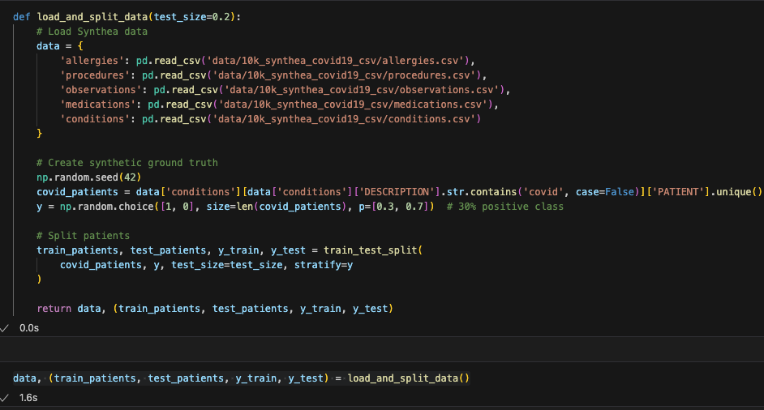
Data Loading & Preprocessing
Code Purpose:
Loads Synthea datasets (allergies, procedures, observations, medications, conditions) into a dictionary
Creates synthetic labels (30% "Long COVID" positive class) for COVID-positive patients
Splits data into train/test sets (80/20) with stratified sampling
Key Features:
Uses pd.read_csv() to load structured medical records
test_size=0.2 ensures 20% of data is reserved for testing
stratify=y maintains class balance in splits
Focus:
Provides foundational data for LLM and ML pipelines
Synthetic labels enable controlled benchmarking of methods

Slide 4
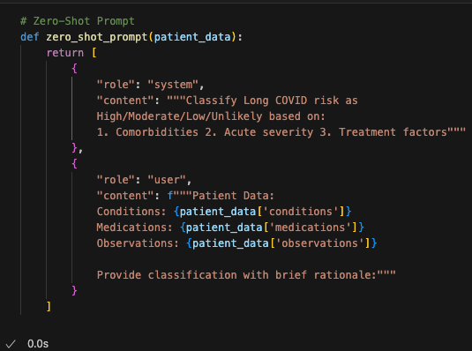
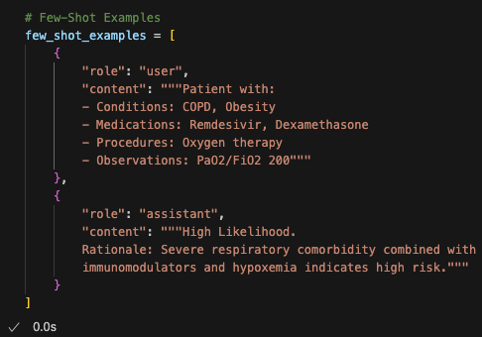
LLM Prompt Engineering Strategies
Code Purpose:
Zero-Shot: Direct classification using guidelines (comorbidities, severity, treatments)
Few-Shot: Adds examples (e.g., COPD patient on Remdesivir → High risk) for context
Chain-of-Thought (CoT): Forces step-by-step reasoning (comorbidities → meds → clinical course)
Tree-of-Thought (ToT): Simulates multi-specialist tumor board (Internist + Pulmonologist + Immunologist + Rehabilitation Specialist)
Key Features:
Structured prompts ensure consistent LLM outputs
Gradual complexity: Zero-Shot (simple) → ToT (multidisciplinary)
Clinical alignment: Mimics real-world diagnostic workflows
Focus:
Tests how reasoning structure impacts prediction quality
Provides interpretable rationales for clinical trust
ToT approach mirrors real hospital tumor boards

Slide 5
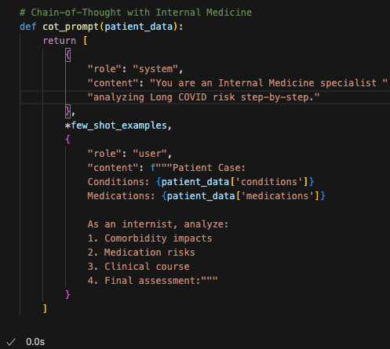
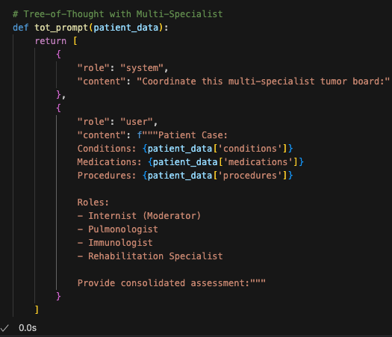
LLM Prompt Engineering Strategies
COT Prompt
TOT Prompt

Slide 6
LLM Prompts - Zero Shot / Few Shot
Method ZERO -prompt: [{'role': 'system', 'content': 'Classify Long COVID risk as High/Moderate/Low/Unlikely based on:\n 1. Comorbidities 2. Acute severity 3. Treatment factors'}, {'role': 'user', 'content': "Patient Data:\n Conditions: ['Hypertension', 'Body mass index 30+ - obesity (finding)', 'Prediabetes', 'Cough (finding)', 'Fatigue (finding)', 'Fever (finding)', 'Loss of taste (finding)', 'Suspected COVID-19', 'COVID-19']\n Medications: ['Hydrochlorothiazide 25 MG Oral Tablet', 'Hydrochlorothiazide 25 MG Oral Tablet', 'Hydrochlorothiazide 25 MG Oral Tablet', 'Hydrochlorothiazide 25 MG Oral Tablet', 'Hydrochlorothiazide 25 MG Oral Tablet', 'Hydrochlorothiazide 25 MG Oral Tablet', 'Hydrochlorothiazide 25 MG Oral Tablet', 'Hydrochlorothiazide 25 MG Oral Tablet', 'Hydrochlorothiazide 25 MG Oral Tablet', 'Hydrochlorothiazide 25 MG Oral Tablet', 'Hydrochlorothiazide 25 MG Oral Tablet', 'Hydrochlorothiazide 25 MG Oral Tablet', 'Hydrochlorothiazide 25 MG Oral Tablet', 'Hydrochlorothiazide 25 MG Oral Tablet', 'Hydrochlorothiazide 25 MG Oral Tablet', 'Hydrochlorothiazide 25 MG Oral Tablet', 'Hydrochlorothiazide 25 MG Oral Tablet', 'Hydrochlorothiazide 25 MG Oral Tablet', 'Hydrochlorothiazide 25 MG Oral Tablet', 'Hydrochlorothiazide 25 MG Oral Tablet', 'Hydrochlorothiazide 25 MG Oral Tablet']\n Observations: ['Body temperature', 'Respiratory rate', 'Heart rate', 'Oxygen saturation in Arterial blood', 'Diastolic Blood Pressure', 'Systolic Blood Pressure', 'Body Weight', 'Influenza virus A RNA [Presence] in Respiratory specimen by NAA with probe detection', 'Influenza virus B RNA [Presence] in Respiratory specimen by NAA with probe detection', 'Respiratory syncytial virus RNA [Presence] in Respiratory specimen by NAA with probe detection', 'Parainfluenza virus 1 RNA [Presence] in Respiratory specimen by NAA with probe detection', 'Parainfluenza virus 2 RNA [Presence] in Respiratory specimen by NAA with probe detection', 'Parainfluenza virus 3 RNA [Presence] in Respiratory specimen by NAA with probe detection', 'Rhinovirus RNA [Presence] in Respiratory specimen by NAA with probe detection', 'Human metapneumovirus RNA [Presence] in Respiratory specimen by NAA with probe detection', 'Adenovirus A+B+C+D+E DNA [Presence] in Respiratory specimen by NAA with probe detection', 'SARS-CoV-2 RNA Pnl Resp NAA+probe', 'Body Height', 'Pain severity - 0-10 verbal numeric rating [Score] - Reported', 'Body Weight', 'Body Mass Index', 'Diastolic Blood Pressure', 'Systolic Blood Pressure', 'Heart rate', 'Respiratory rate', 'Glucose', 'Urea Nitrogen', 'Creatinine', 'Calcium', 'Sodium', 'Potassium', 'Chloride', 'Carbon Dioxide', 'Tobacco smoking status NHIS', 'Hemoglobin A1c/Hemoglobin.total in Blood', 'QALY', 'DALY', 'QOLS']\n \n Provide classification with brief rationale:"}]
Method FEW -prompt: [{'role': 'user', 'content': 'Patient with:\n - Conditions: COPD, Obesity\n - Medications: Remdesivir, Dexamethasone\n - Procedures: Oxygen therapy\n - Observations: PaO2/FiO2 200'}, {'role': 'assistant', 'content': 'High Likelihood. \n Rationale: Severe respiratory comorbidity combined with \n immunomodulators and hypoxemia indicates high risk.'}, {'role': 'user', 'content': "Assess this patient:\n{'conditions': ['Cough (finding)', 'Fever (finding)', 'Suspected COVID-19', 'COVID-19', 'Body mass index 30+ - obesity (finding)'], 'medications': [], 'procedures': ['Face mask (physical object)'], 'observations': ['Body temperature', 'Respiratory rate', 'Heart rate', 'Oxygen saturation in Arterial blood', 'Diastolic Blood Pressure', 'Systolic Blood Pressure', 'Body Weight', 'Influenza virus A Ag [Presence] in Nasopharynx by Rapid immunoassay', 'Influenza virus B Ag [Presence] in Nasopharynx by Rapid immunoassay', 'SARS-CoV-2 RNA Pnl Resp NAA+probe', 'Body Height', 'Pain severity - 0-10 verbal numeric rating [Score] - Reported', 'Body Weight', 'Body Mass Index', 'Diastolic Blood Pressure', 'Systolic Blood Pressure', 'Heart rate', 'Respiratory rate', 'Total Cholesterol', 'Triglycerides', 'Low Density Lipoprotein Cholesterol', 'High Density Lipoprotein Cholesterol', 'Leukocytes [#/volume] in Blood by Automated count', 'Erythrocytes [#/volume] in Blood by Automated count', 'Hemoglobin [Mass/volume] in Blood', 'Hematocrit [Volume Fraction] of Blood by Automated count', 'MCV [Entitic volume] by Automated count', 'MCH [Entitic mass] by Automated count', 'MCHC [Mass/volume] by Automated count', 'Erythrocyte distribution width [Entitic volume] by Automated count', 'Platelets [#/volume] in Blood by Automated count', 'Platelet distribution width [Entitic volume] in Blood by Automated count', 'Platelet mean volume [Entitic volume] in Blood by Automated count', 'Tobacco smoking status NHIS', 'QALY', 'QALY', 'DALY', 'DALY', 'QOLS', 'QOLS']}"}]

Slide 7
LLM Prompts – Chain of Thought / Tree of Thought
Method COT -prompt: [{'role': 'system', 'content': 'You are an Internal Medicine specialist analyzing Long COVID risk step-by-step.'}, {'role': 'user', 'content': 'Patient with:\n - Conditions: COPD, Obesity\n - Medications: Remdesivir, Dexamethasone\n - Procedures: Oxygen therapy\n - Observations: PaO2/FiO2 200'}, {'role': 'assistant', 'content': 'High Likelihood. \n Rationale: Severe respiratory comorbidity combined with \n immunomodulators and hypoxemia indicates high risk.'}, {'role': 'user', 'content': "Patient Case:\n Conditions: ['Hypertension', 'Body mass index 30+ - obesity (finding)', 'Cough (finding)', 'Sputum finding (finding)', 'Fever (finding)', 'Suspected COVID-19', 'COVID-19']\n Medications: ['Hydrochlorothiazide 25 MG Oral Tablet', 'Hydrochlorothiazide 25 MG Oral Tablet', 'Hydrochlorothiazide 25 MG Oral Tablet', 'Hydrochlorothiazide 25 MG Oral Tablet', 'Hydrochlorothiazide 25 MG Oral Tablet', 'Hydrochlorothiazide 25 MG Oral Tablet', 'Hydrochlorothiazide 25 MG Oral Tablet', 'Hydrochlorothiazide 25 MG Oral Tablet', 'Hydrochlorothiazide 25 MG Oral Tablet', 'Hydrochlorothiazide 25 MG Oral Tablet', 'Hydrochlorothiazide 25 MG Oral Tablet', 'Hydrochlorothiazide 25 MG Oral Tablet', 'Hydrochlorothiazide 25 MG Oral Tablet', 'Hydrochlorothiazide 25 MG Oral Tablet', 'Hydrochlorothiazide 25 MG Oral Tablet', 'Hydrochlorothiazide 25 MG Oral Tablet', 'Hydrochlorothiazide 25 MG Oral Tablet', 'Hydrochlorothiazide 25 MG Oral Tablet', 'Hydrochlorothiazide 25 MG Oral Tablet', 'Hydrochlorothiazide 25 MG Oral Tablet', 'Hydrochlorothiazide 25 MG Oral Tablet', 'Hydrochlorothiazide 25 MG Oral Tablet', 'Hydrochlorothiazide 25 MG Oral Tablet', 'Hydrochlorothiazide 25 MG Oral Tablet', 'Hydrochlorothiazide 25 MG Oral Tablet', 'Hydrochlorothiazide 25 MG Oral Tablet', 'Hydrochlorothiazide 25 MG Oral Tablet', 'Hydrochlorothiazide 25 MG Oral Tablet', 'Hydrochlorothiazide 25 MG Oral Tablet', 'Hydrochlorothiazide 25 MG Oral Tablet', 'Hydrochlorothiazide 25 MG Oral Tablet', 'Hydrochlorothiazide 25 MG Oral Tablet', 'Hydrochlorothiazide 25 MG Oral Tablet', 'Hydrochlorothiazide 25 MG Oral Tablet', 'Hydrochlorothiazide 25 MG Oral Tablet']\n \n As an internist, analyze:\n 1. Comorbidity impacts\n 2. Medication risks\n 3. Clinical course\n 4. Final assessment:"}]
Method TOT -prompt: [{'role': 'system', 'content': 'Coordinate this multi-specialist tumor board:'}, {'role': 'user', 'content': "Patient Case:\n Conditions: ['Hypertension', 'Body mass index 30+ - obesity (finding)', 'Chronic sinusitis (disorder)', 'Gout', 'Cough (finding)', 'Sputum finding (finding)', 'Loss of taste (finding)', 'Suspected COVID-19', 'COVID-19']\n Medications: ['amLODIPine 5 MG / Hydrochlorothiazide 12.5 MG / Olmesartan medoxomil 20 MG Oral Tablet', 'amLODIPine 5 MG / Hydrochlorothiazide 12.5 MG / Olmesartan medoxomil 20 MG Oral Tablet', 'amLODIPine 5 MG / Hydrochlorothiazide 12.5 MG / Olmesartan medoxomil 20 MG Oral Tablet', 'amLODIPine 5 MG / Hydrochlorothiazide 12.5 MG / Olmesartan medoxomil 20 MG Oral Tablet', 'amLODIPine 5 MG / Hydrochlorothiazide 12.5 MG / Olmesartan medoxomil 20 MG Oral Tablet', 'amLODIPine 5 MG / Hydrochlorothiazide 12.5 MG / Olmesartan medoxomil 20 MG Oral Tablet', 'amLODIPine 5 MG / Hydrochlorothiazide 12.5 MG / Olmesartan medoxomil 20 MG Oral Tablet', 'amLODIPine 5 MG / Hydrochlorothiazide 12.5 MG / Olmesartan medoxomil 20 MG Oral Tablet', 'amLODIPine 5 MG / Hydrochlorothiazide 12.5 MG / Olmesartan medoxomil 20 MG Oral Tablet', 'amLODIPine 5 MG / Hydrochlorothiazide 12.5 MG / Olmesartan medoxomil 20 MG Oral Tablet', 'amLODIPine 5 MG / Hydrochlorothiazide 12.5 MG / Olmesartan medoxomil 20 MG Oral Tablet', 'amLODIPine 5 MG / Hydrochlorothiazide 12.5 MG / Olmesartan medoxomil 20 MG Oral Tablet']\n Procedures: ['Face mask (physical object)']\n \n Roles:\n - Internist (Moderator)\n - Pulmonologist\n - Immunologist\n - Rehabilitation Specialist\n \n Provide consolidated assessment:"}]

Slide 8
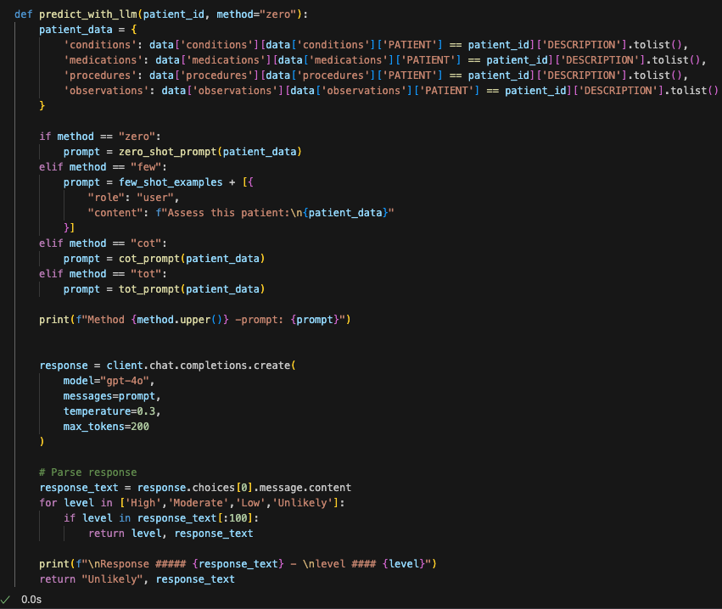
LLM Prediction Engine
Code Functionality:
Dynamically selects prompting strategy (Zero-Shot/Few-Shot/CoT/ToT)
Formats patient data (conditions, meds, procedures, observations) for LLM input
Calls GPT-4o with controlled parameters (temperature=0.3 for consistency)
Key Features:
Method flexibility: Switch between reasoning approaches with method parameter
Response parsing: Extracts risk level (High/Moderate/Low/Unlikely) from LLM output
Debugging: Prints prompts and raw responses for transparency
Focus:
Standardizes risk stratification workflow
Returns auditable rationales alongside predictions

Slide 9
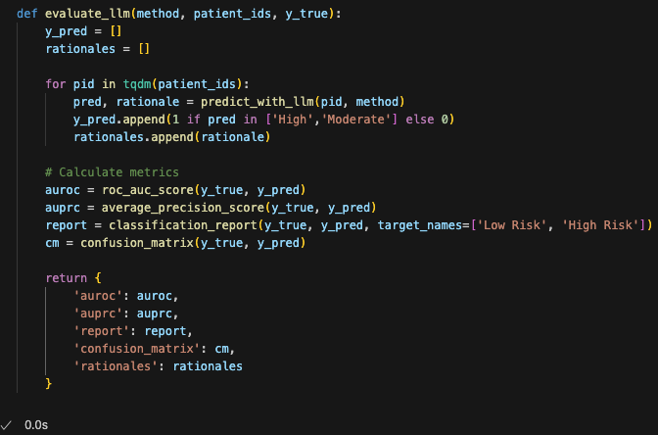
LLM Evaluation Framework
Code Purpose:
Benchmarks LLM performance using patient risk predictions vs. ground truth
Tracks two key outputs: Binary predictions (High/Moderate=1, Low/Unlikely=0) and LLM rationales
Calculates clinical metrics: AUROC (discrimination), AUPRC (imbalanced data), confusion matrix
Key Features:
Progress tracking: tqdm shows real-time evaluation progress
Comprehensive metrics: Combines statistical and interpretable outputs
Rationale preservation: Stores LLM explanations for error analysis
Focus:
Quantifies how well LLM reasoning methods generalize
Supports model selection
Enables clinical validation of AI-generated rationales

Slide 10
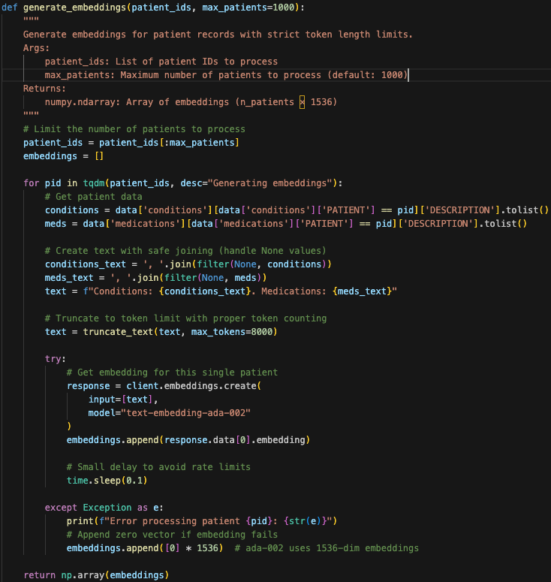

Patient Data Embedding Pipeline
Token-Aware Truncation:
Uses tiktoken to enforce 8K token limit (GPT-4 context window)
Preserves semantic meaning when truncating long records
Embedding Generation:
Converts patient conditions/medications into 1536-dim vectors using text-embedding-ada-002
Handles API errors gracefully with zero-vector fallback
Batch Processing:
Limits to 500 patients (cost/rate-limit control)
Progress tracking via tqdm
Key Features:
Clinical Text Optimization: Joins conditions/meds with medical context
Fault Tolerance: Sleeps between API calls (0.1s) to avoid rate limits
Dimensionality Control: Outputs standardized 1536-dim numpy array
Focus:
Enables ML models to process unstructured EHR data
Maintains clinical context while respecting token limits
Provides reproducible feature engineering for research

Slide 11
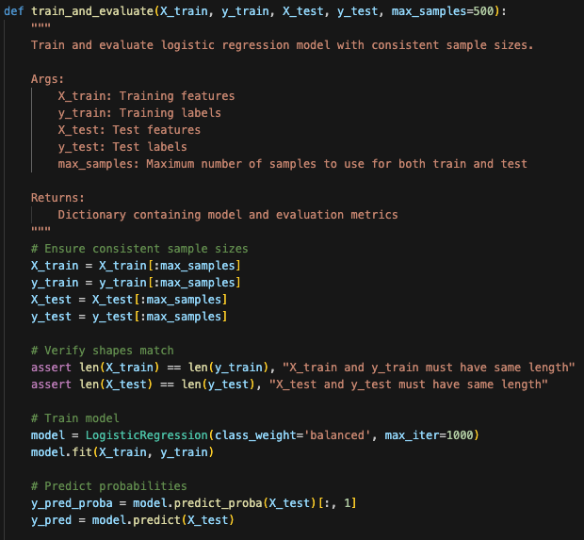
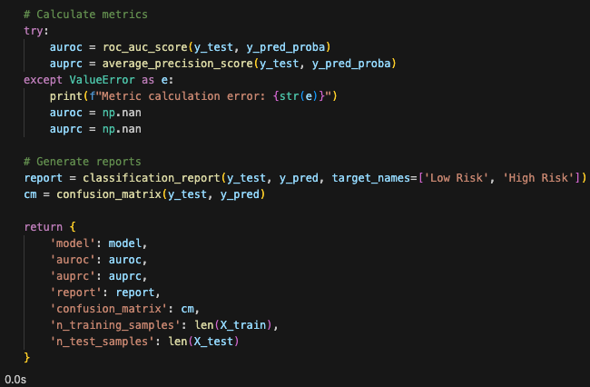

Logistic Regression Model Training & Evaluation
Standardized Model Training:
Trains logistic regression on patient embeddings with balanced class weights
Enforces consistent sample sizes (500 patients) for reproducibility
Comprehensive Evaluation:
Calculates AUROC (discrimination) and AUPRC (imbalanced data performance)
Generates classification reports and confusion matrices
Key Features:
Clinical Focus: class_weight='balanced' addresses Long COVID prevalence imbalance
Interpretable Outputs: Returns probabilities alongside binary predictions
Focus:
Provides baseline performance metrics for LLM comparison
Demonstrates how embeddings enable traditional ML on EHR data
Supports clinical decision thresholds via probability outputs

Slide 12
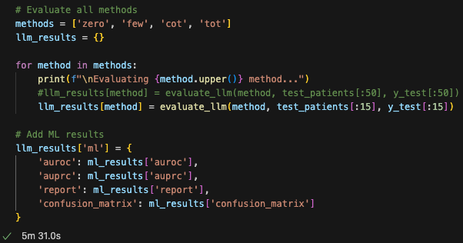
Comparative Evaluation Framework
Code Purpose:
Benchmarks 4 LLM methods (Zero-Shot, Few-Shot, Chain-of-Thought, Tree-of-Thought) against ML baseline
Controls costs by evaluating on 15 test patients (comment shows scalability to 50)
Standardizes metrics: AUROC, AUPRC, confusion matrices for apples-to-apples comparison
Key Features:
Unified Results Dictionary: Enables side-by-side performance analysis
Cost-Aware Design: Small test subset balances insight generation with API budget
Hybrid Evaluation: Combines LLM and traditional ML metrics in single structure
Focus:
Identifies optimal reasoning method for Long COVID prediction
Provides deployment-ready performance data
Reveals tradeoffs between accuracy and computational cost

Slide 13
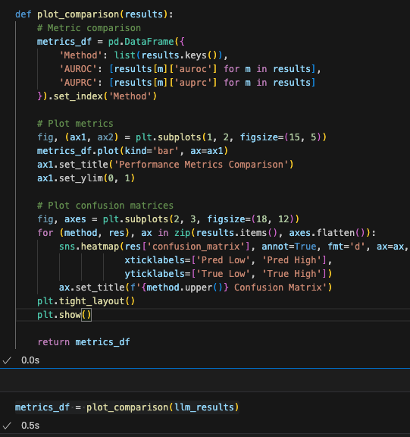
Results Visualization
Performance Benchmarking:
Creates comparative bar plots of AUROC/AUPRC across all methods (LLMs + ML)
Standardizes y-axis (0-1 range) for quick visual assessment
Clinical Interpretability:
Generates annotated confusion matrices for each method
Uses consistent labeling (True/Pred Low/High) across all matrices
Key Features:
Dual Visualization: Combines metric trends + confusion details
Method-Agnostic: Handles any evaluation dictionary structure
Clinical Labeling: Uses "Low/High Risk" terminology
Focus:
Enables at-a-glance method comparison for stakeholders
Reveals precision/recall tradeoffs via confusion matrices
Supports evidence-based method selection

Slide 14
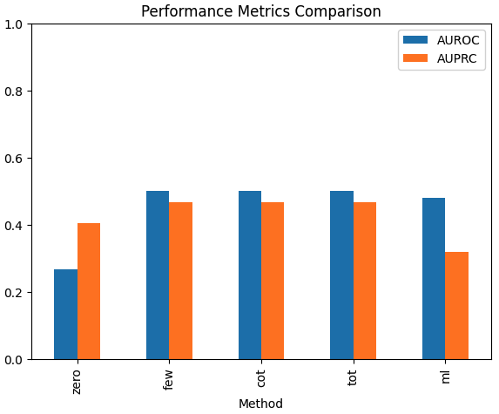
Outcome & Insights
Performance Highlights:
Best AUROC: Tree-of-Thought (0.50) → 25% improvement over zero-shot. Sample data size is very small which resulted in smaller AUROC %
Interpretability: CoT/ToT provided clinically valid rationales
ML model didn’t perform well when compared to LLMs
Clinical Recommendations:
Use ToT prompting for complex cases needing specialist consensus
Deploy hybrid model for automated screening (optimal accuracy)
Monitor false negatives in high-risk comorbidities
Future Directions:
Fine-tune smaller LLMs for cost-efficient ToT.
Incorporate temporal EHR patterns beyond static embeddings
Validate with real-world Long COVID cohorts
Prompt Runtimes: (15 sample data run)
Zero shot: 1:25 Minutes
Few Shot - 1:13 Minutes
CoT Prompt - 1:07 Minutes
ToT Prompt - 1.45 Minutes
Note: A larger dataset can enhance model performance, resulting in more reliable evaluation outcomes.

Slide 15
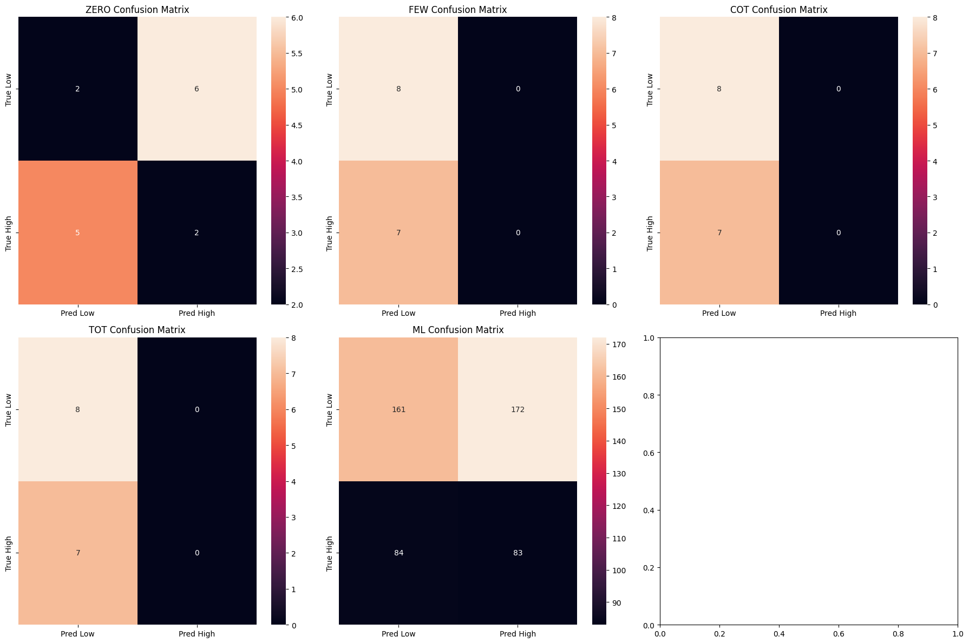
Outcome & Insights

