Slide 1
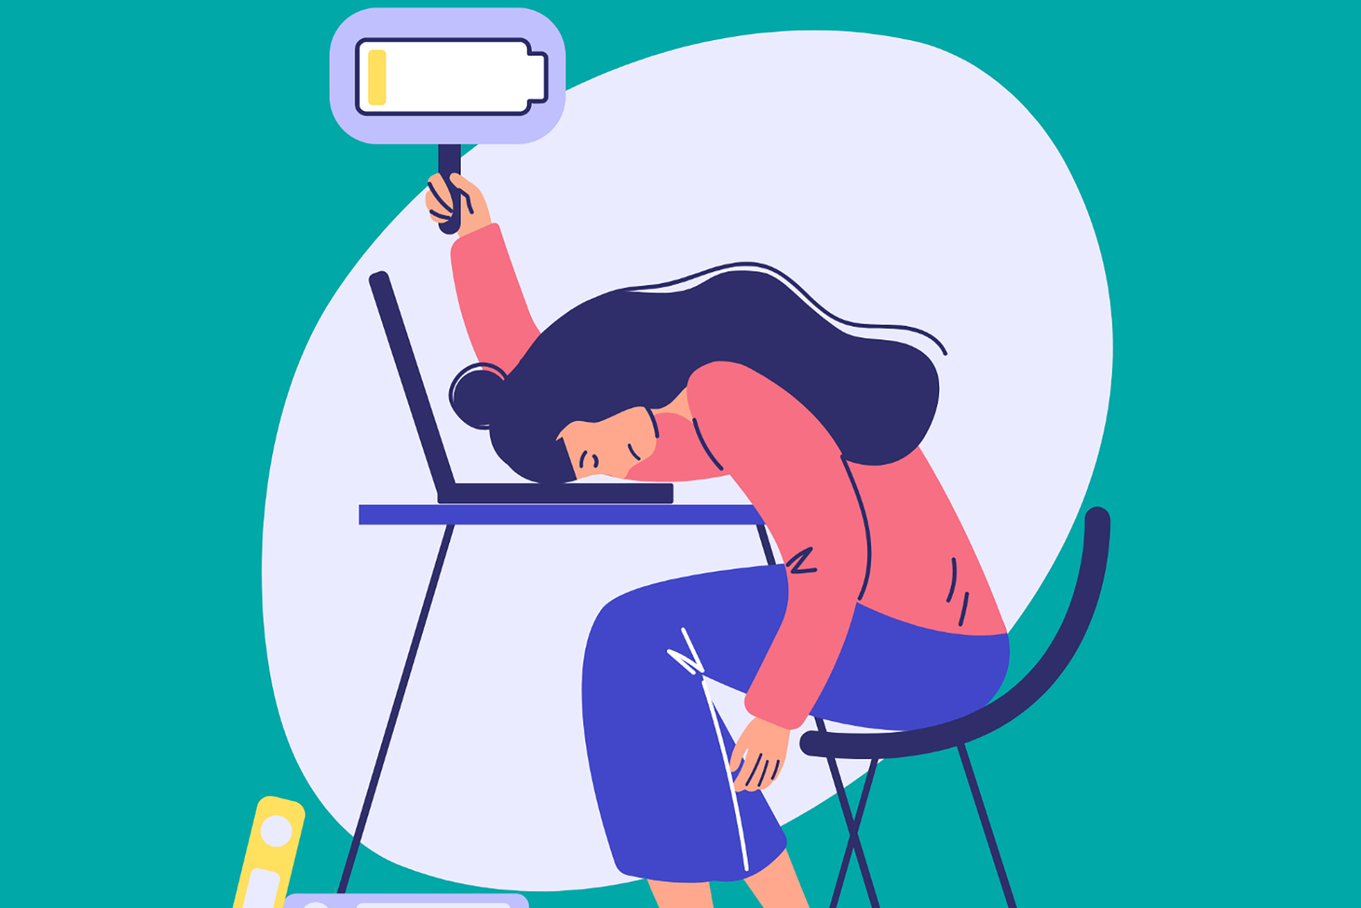
Breaking the Burnout Cycle
A Study on Work-Life Balance & Well-Being​
By:
Sunil Kumar Savana
Tharani Vadde
Balaji S. Pokuri
James Afful

Slide 2
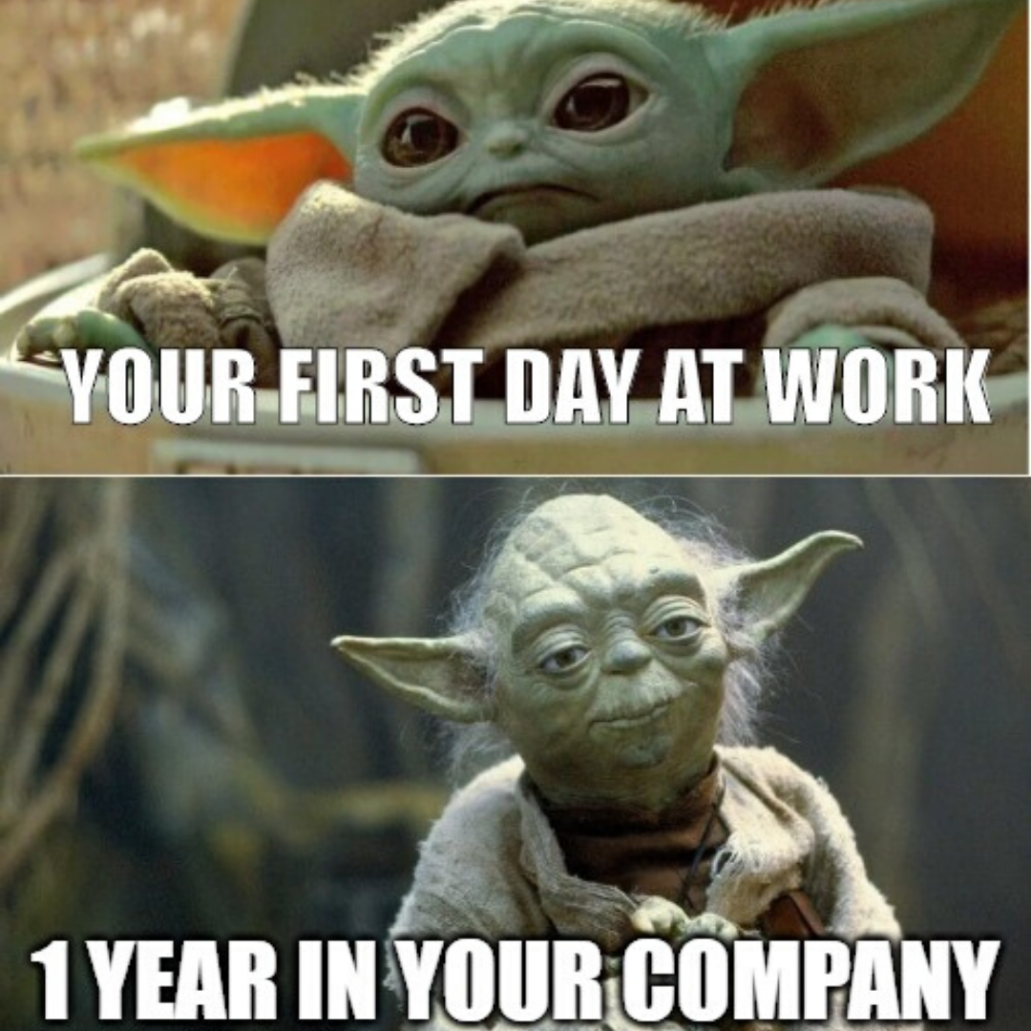
Why This Matters
In today's fast-paced world, stress, burnout, and work-life imbalance are at all-time highs.
Companies lose ~ $200 billion annually due to stress-related absenteeism & low productivity. (5-8% of National Spending on heathcare which is a trillion-dollar industry) ~ Harvard Business Review.
Individuals with high work-life balance are more productive and report higher job satisfaction
Our data-driven study answers: ​
What lifestyle factors most influence well-being & productivity?
How can individuals optimize their work-life balance?
What can businesses do to maximize workforce efficiency while reducing burnout?​
https://www.gallup.com/workplace/612518/driving-federal-government-burnout.aspx
https://www.library.hbs.edu/working-knowledge/national-health-costs-could-decrease-if-managers-reduce-work-stress

Slide 3
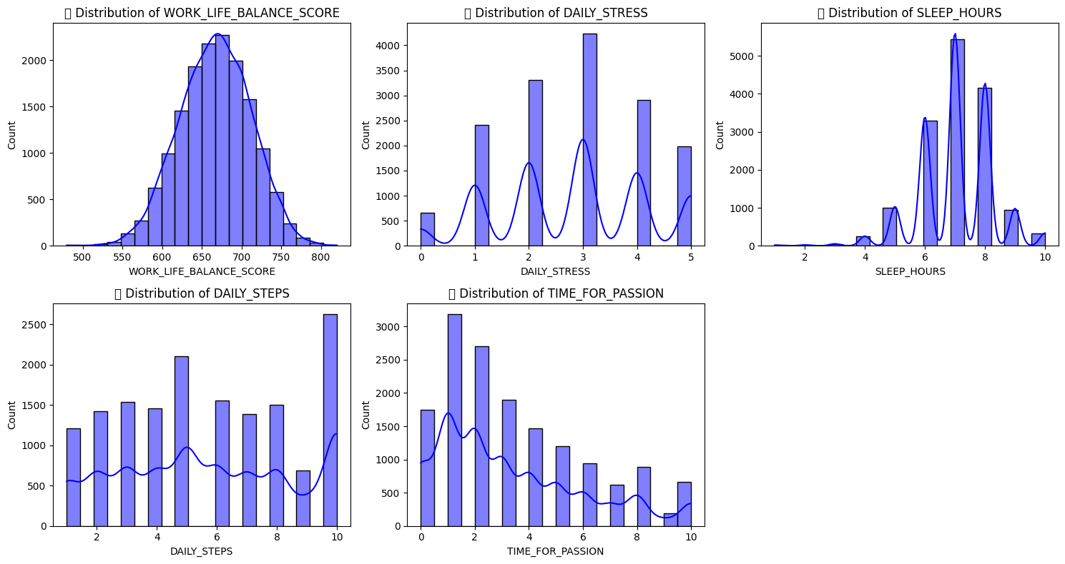
Description of Dataset
Total 24 data Columns
15972 entries
592 duplicates

Slide 4
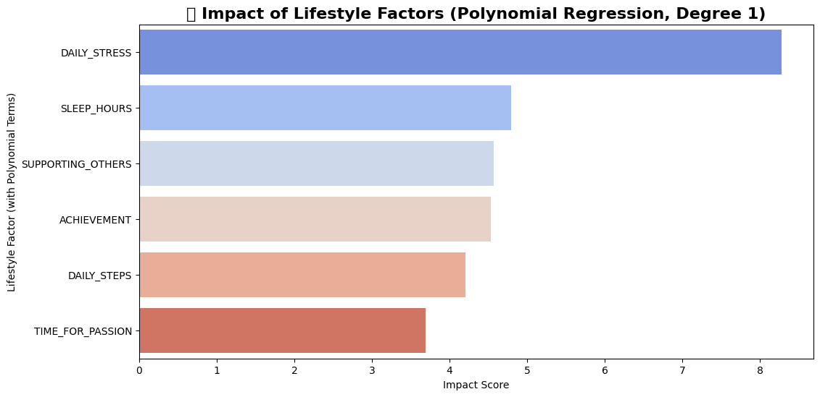
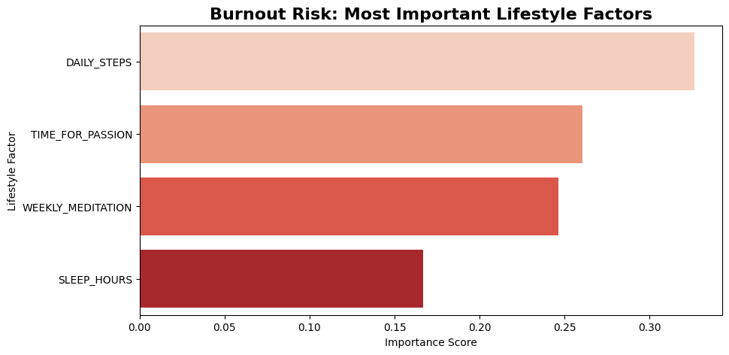
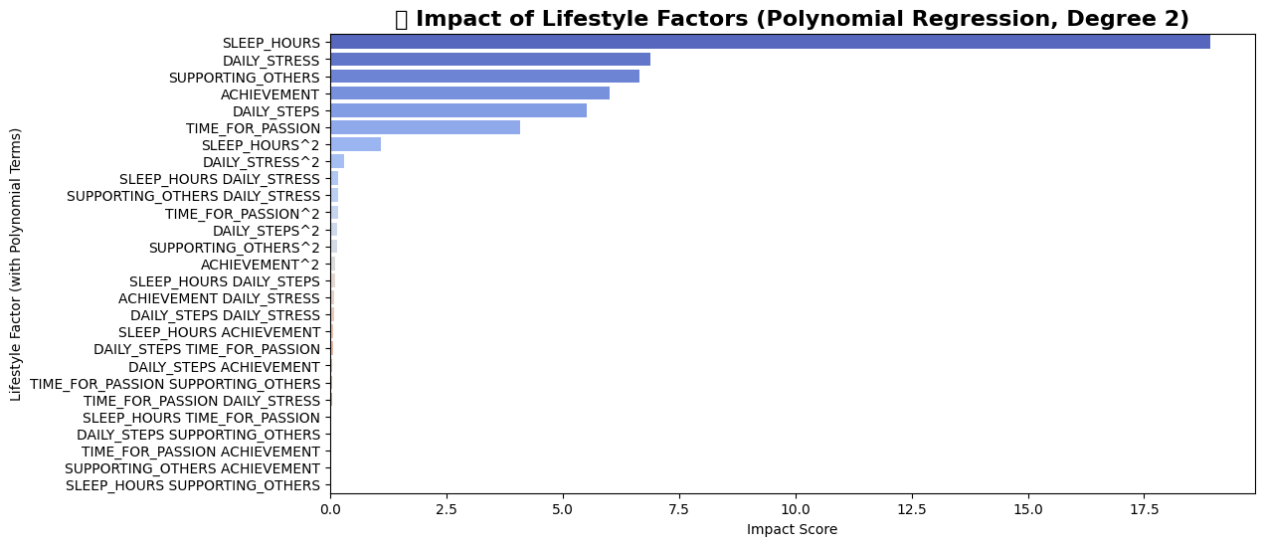
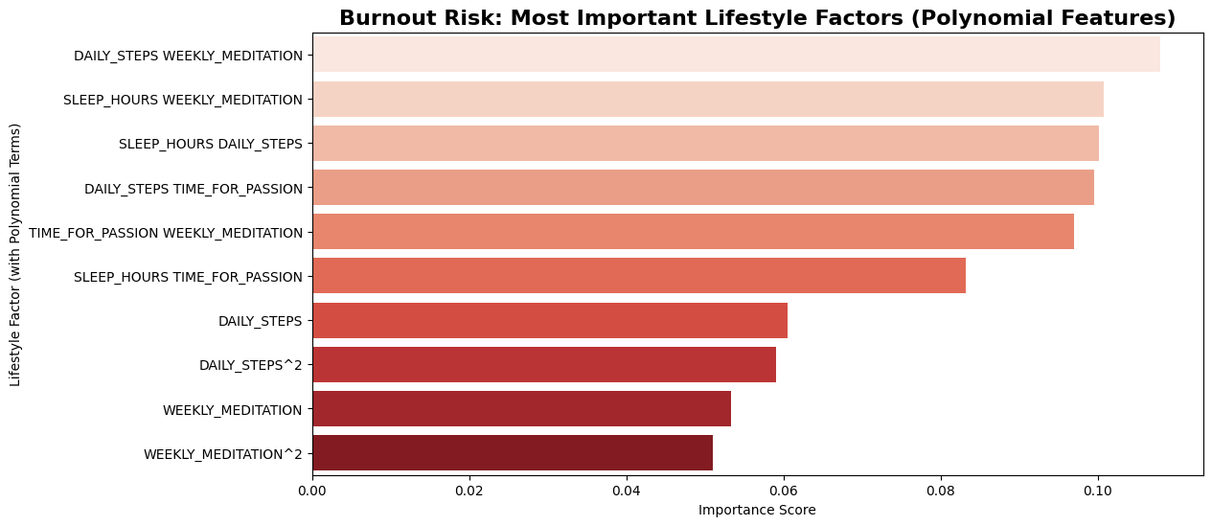
Description of Dataset and Analyses
Define burnout threshold (high stress level ≥ 4)

Slide 5
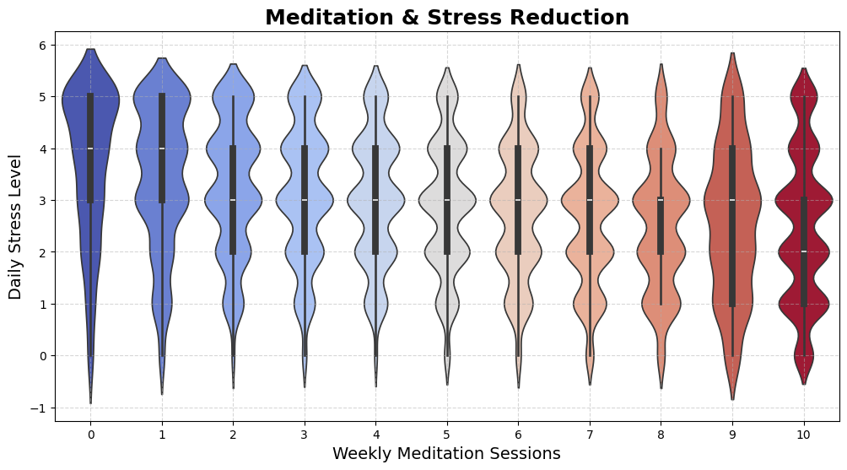
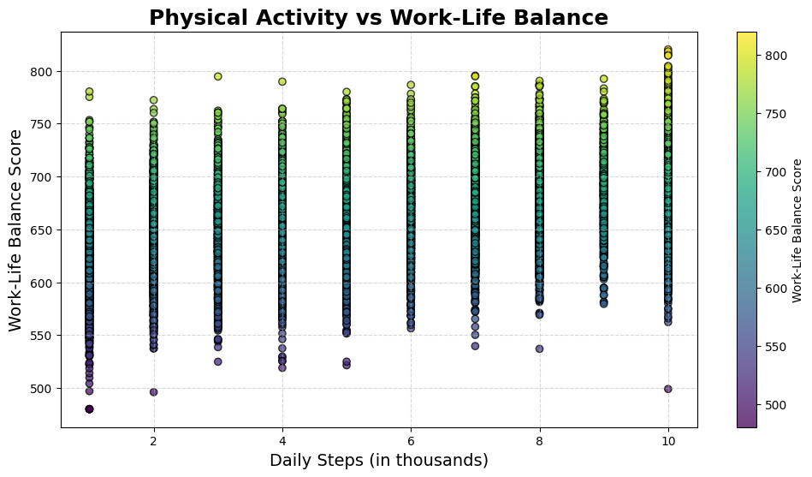
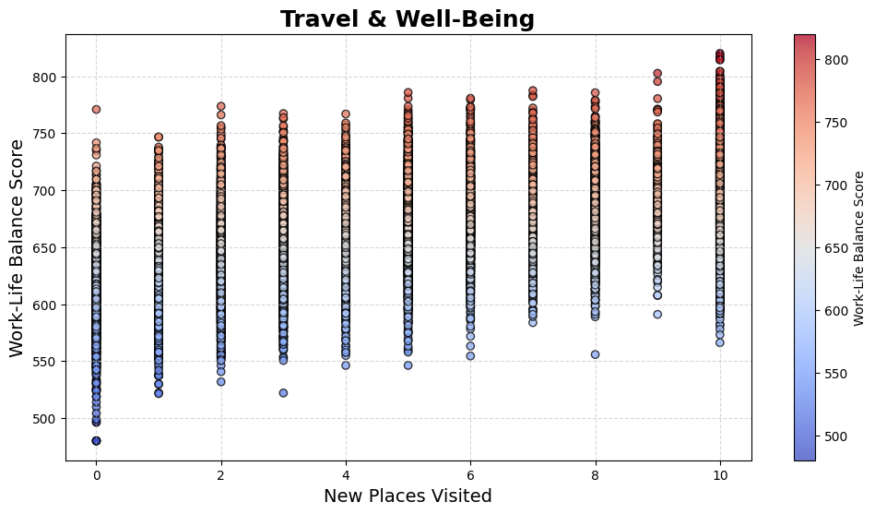
What Drives Well-Being?

Slide 6
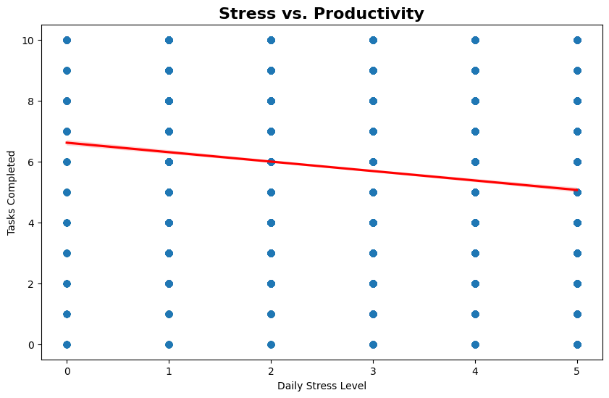
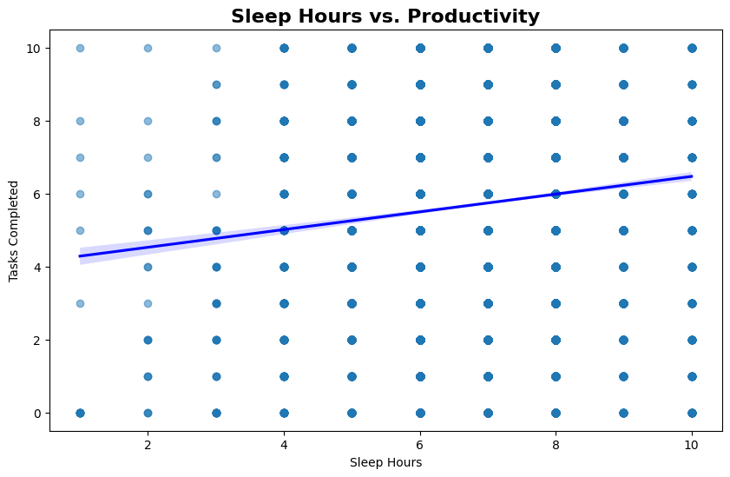
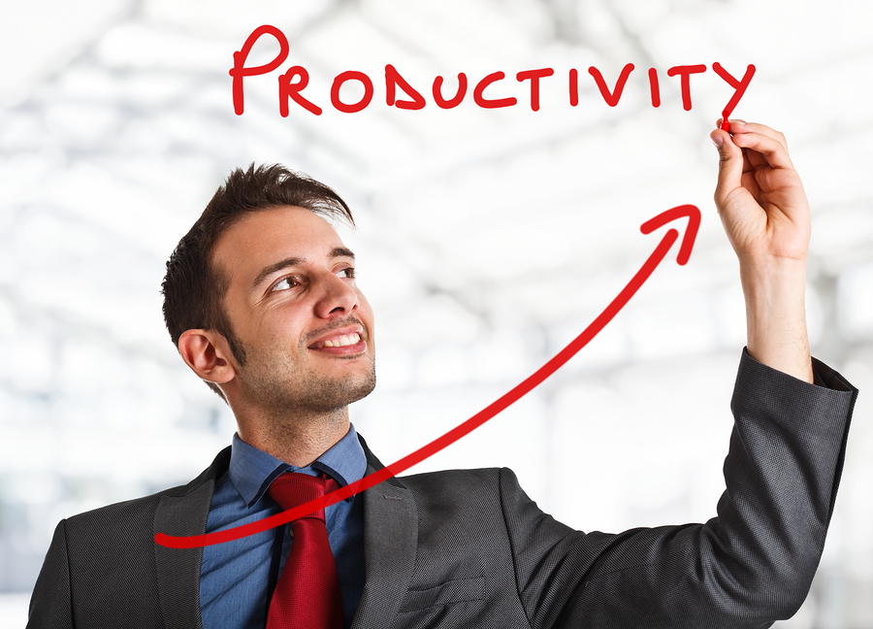

Sleep & Stress vs Productivity
=

Slide 7
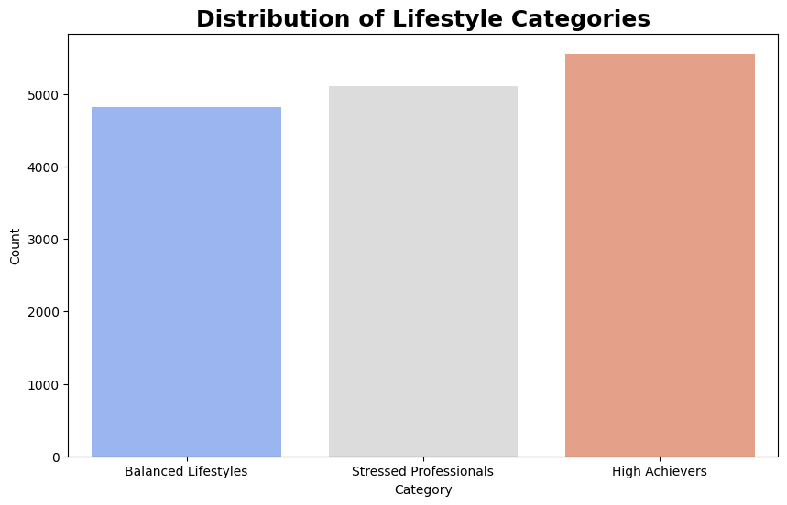
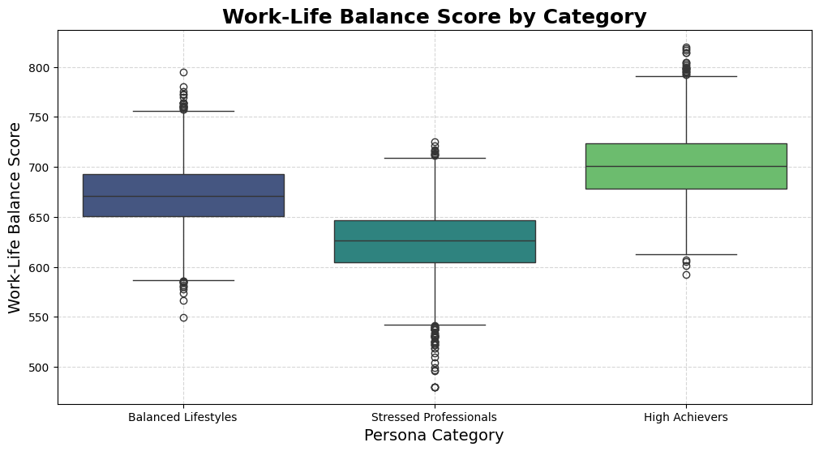
Categories of People & Conclusion
High Achievers:
- Work-Life Balance Score: 701.3
- High Productivity (7.18 tasks/week)
- But suffer from relatively high stress (2.51)
Stressed Professionals:
- Work-Life Balance Score: 625.15
- High stress levels (3.72)
- Lower productivity than other groups (3.56 tasks/week)
Balanced Lifestyles:
- Work-Life Balance Score (671.35)
- Moderate stress (2.14) but stable productivity (6.42 tasks/week)
Final Thought:
"The best teams and individuals are not just productive but balanced."

Slide 8
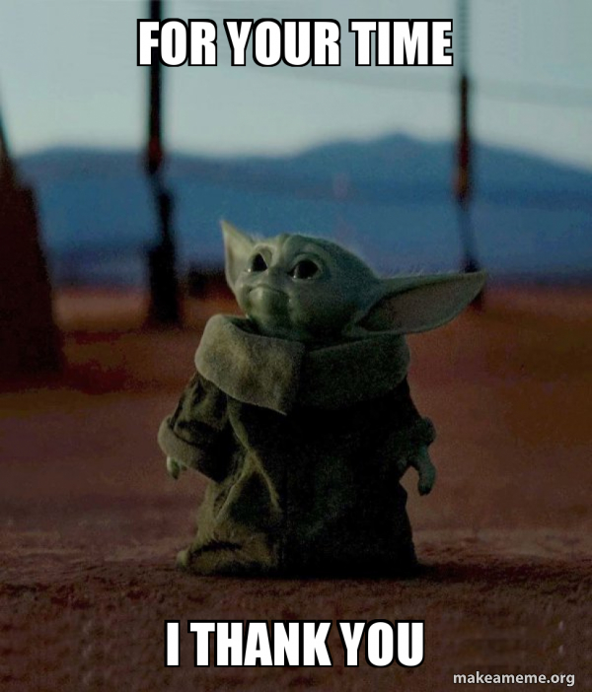
QUESTIONS?

