Slide 1
Multipattern Search Algorithm to determine the sentiment polarity of multiple documents.
Balaji Sukumaran
CSCI 6105 Algorithm Engineering
Date:

Slide 2
Introduction
Searching for patterns
Aims for efficient multiple pattern detection.
Algorithms include Aho-Corasick, Trie Search, and KMP.

Slide 3
Motivation
Real-world applications
Efficiency
Versatility

Slide 4
Hypothesis
Plan
Modeling : Model the Aho-Corasick Algorithm and Trie search.
Implementation : Develop sentiment polarity tool with different algorithms and optimizations at its core.
Experiments : Visualize and compare the performance and resources used.
Expectation
Multipattern Search should show performance improvement.

Slide 5
Previous Work and Context
Direct applications of multi-pattern search
T. Kida et al. showcased Aho-Corasick's efficiency in LZW-compressed texts, achieving a twofold speed increase compared to traditional decompression and search methods [1].
Yang et al.'s PASTA architecture, leveraging Aho-Corasick, exceeded next-gen security requirements in deep packet inspection [2].
Kennedy et al. developed an Aho-Corasick based algorithm for Snort ruleset, reducing memory usage by over 98% [4].
Benchmarking
When implemented it is usually compared with existing or alternate algorithms to showcase its performance. Eg. T. Tao et al. [4] claim that their multiple-pattern matching algorithm is practically the fastest among all approaches when the number of patterns is not very large.

Slide 6
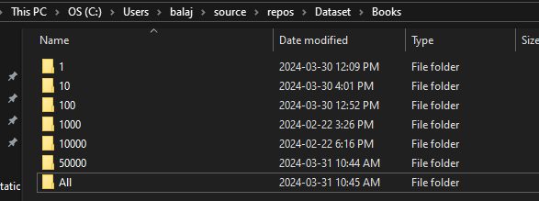
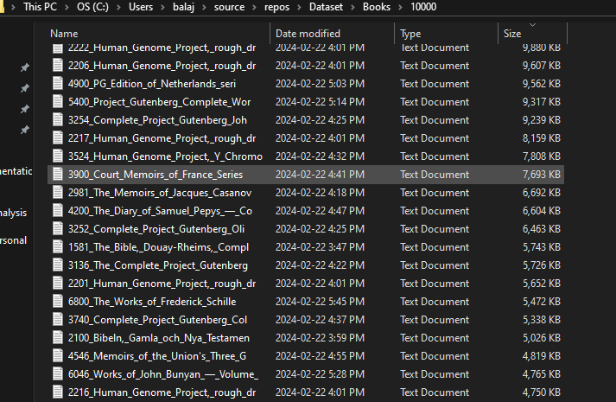
Input Data
English words (Positive, Negative, Stop words) [6]
E-Books from Project Gutenberg
Gutendex Api [5]
Scripts
Download
Clean and Setup

Slide 7
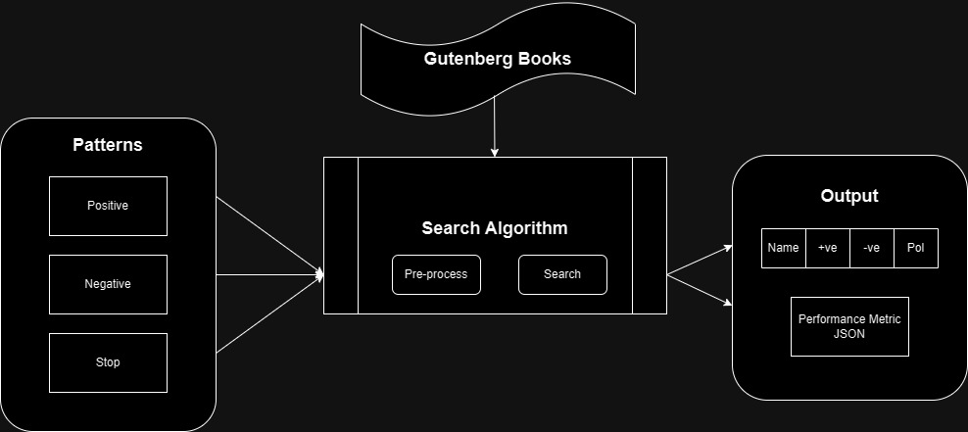
Methods

Slide 8
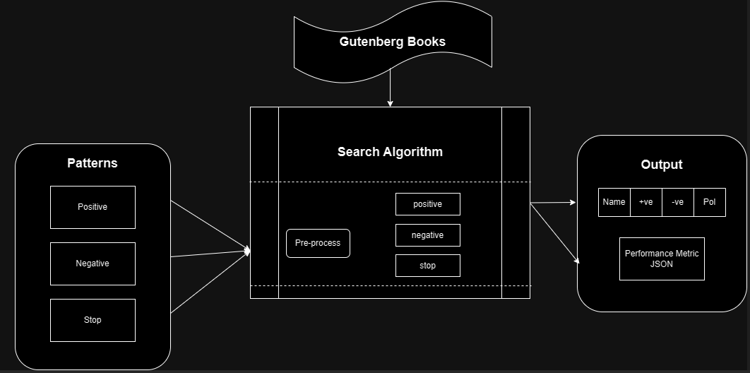
Methods

Slide 9
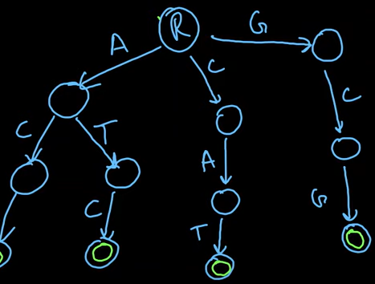
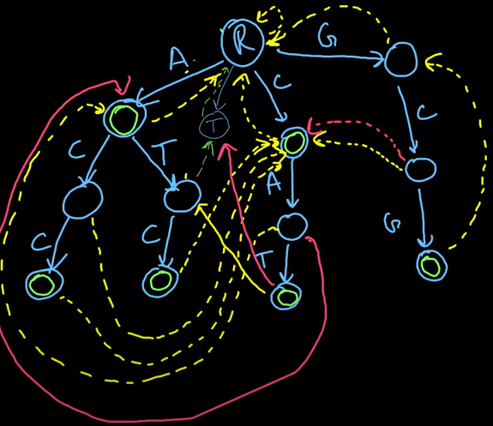
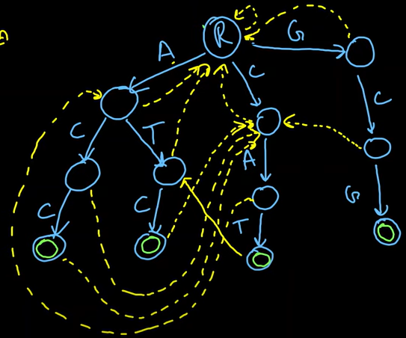
Aho-Corasick Algorithm - Working

Slide 10
Problems
Programming language
Hard to debug
Difficult to Implement
Setup

Slide 11
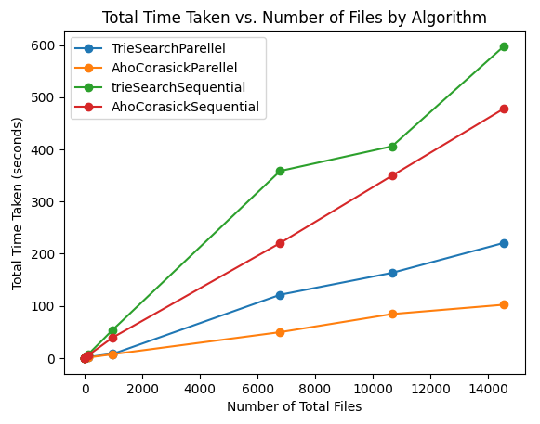
Results - Performance

Slide 12
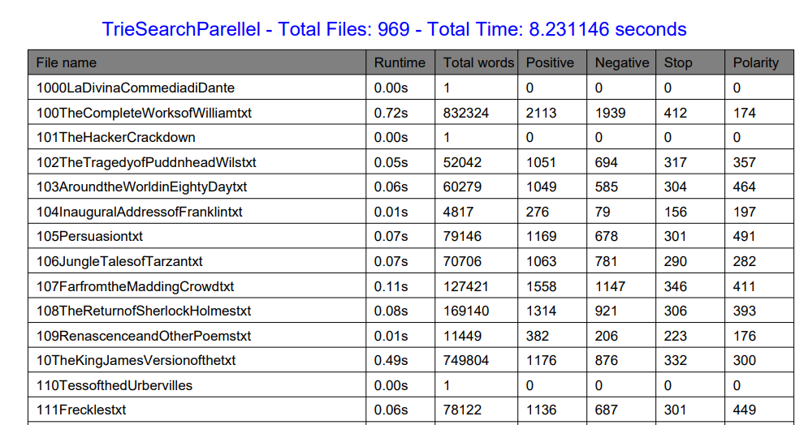
Results – Sentiment Analysis report

Slide 13
Conclusions
Future Word
Hypothesis validated
Performance ranked:
1. Parallel Aho-Corasick
2. Sequential Aho-Corasick
3. Parallel Trie
4. Sequential Trie
5. Parallel KMP
6. Sequential KMP
Extend the application
Search sentiment phrases instead of words for better accuracy.
Create a Product
Robust Library

Slide 14
References
[1] T. Kida, M. Takeda, A. Shinohara, M. Miyazaki and S. Arikawa, "Multiple pattern matching in LZW compressed text," Proceedings DCC '98 Data Compression Conference (Cat. No.98TB100225), Snowbird, UT, USA, 1998, pp. 103-112, doi: 10.1109/DCC.1998.672136.
[2] Y. H. E. Yang, H. Le and V. K. Prasanna, "High Performance Dictionary-Based String Matching for Deep Packet Inspection," 2010 Proceedings IEEE INFOCOM, San Diego, CA, USA, 2010, pp. 1-5, doi: 10.1109/INFCOM.2010.5462268.
[3] A. Kennedy, X. Wang, Z. Liu and B. Liu, "Ultra-high throughput string matching for Deep Packet Inspection," 2010 Design, Automation & Test in Europe Conference & Exhibition (DATE 2010), Dresden, Germany, 2010, pp. 399-404, doi: 10.1109/DATE.2010.5457172.
[4] T. Tao and A. Mukherjee, "Multiple-pattern matching for LZW compressed files,“ International Conference on Information Technology: Coding and Computing (ITCC'05) - Volume II, Las Vegas, NV, USA, 2005, pp. 91-96 Vol. 1, doi: 10.1109/ITCC.2005.206.
[5] “Project Gutenberg is a library of over 70,000 free eBooks”, Project Gutenberg, Available: https://www.gutenberg.org/, [Accessed: Jan 21, 2024].

