Slide 1
Multipattern Search Algorithm to determine the sentiment polarity of multiple documents.
Balaji Sukumaran
CSCI 6105 Algorithm Engineering
Date:

Slide 2
Introduction
Searching for patterns
Aims for efficient multiple pattern detection.
Algorithms include Aho-Corasick, Trie Search, and KMP.

Slide 3
Motivation
Real-world applications
Efficiency
Versatility

Slide 4
Hypothesis
Plan
Modeling : Model the Aho-Corasick Algorithm and Trie search.
Implementation : Develop sentiment polarity tool with different algorithms and optimizations at its core.
Experiments : Visualize and compare the performance and resources used.
Expectation
Multipattern Search should show performance improvement.

Slide 5
Previous Work and Context
Direct applications of multi-pattern search
T. Kida et al. showcased Aho-Corasick's efficiency in LZW-compressed texts, achieving a twofold speed increase compared to traditional decompression and search methods [1].
Yang et al.'s PASTA architecture, leveraging Aho-Corasick, exceeded next-gen security requirements in deep packet inspection [2].
Kennedy et al. developed an Aho-Corasick based algorithm for Snort ruleset, reducing memory usage by over 98% [4].
Benchmarking
When implemented it is usually compared with existing or alternate algorithms to showcase its performance. Eg. T. Tao et al. [4] claim that their multiple-pattern matching algorithm is practically the fastest among all approaches when the number of patterns is not very large.

Slide 6
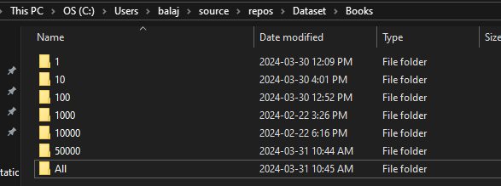
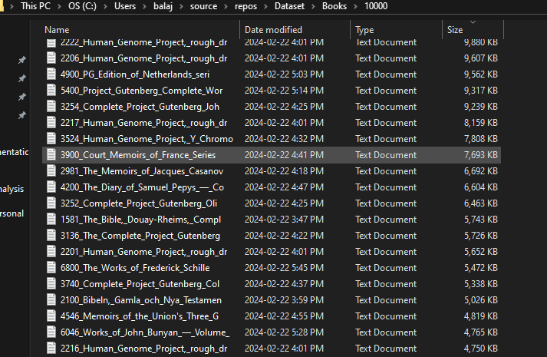
Input Data
E-Books from Project Gutenberg
Gutendex Api [5]
Scripts [6]
Download
Clean and Setup

Slide 7
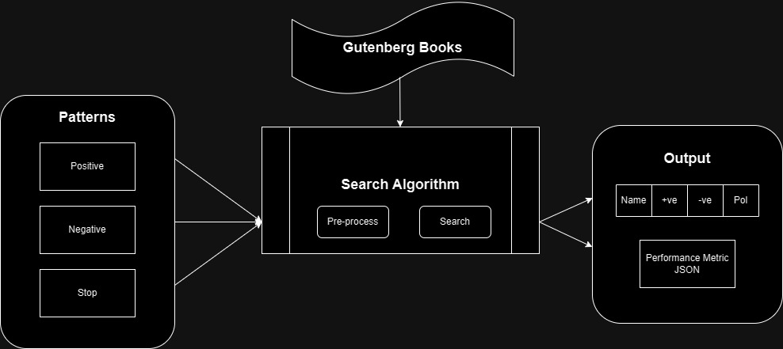
Methods

Slide 8
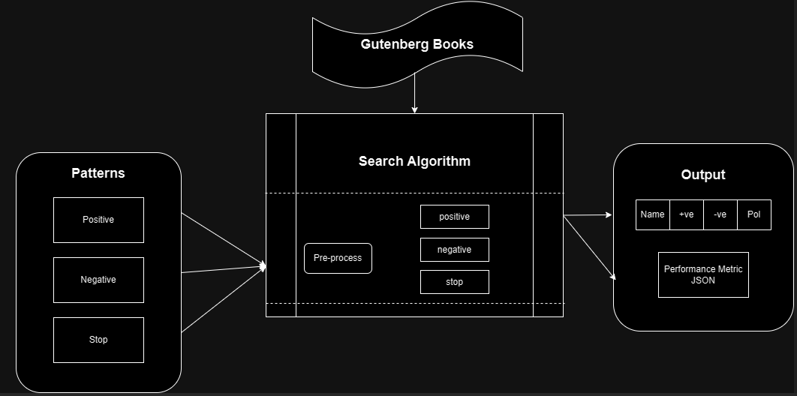
Methods

Slide 9
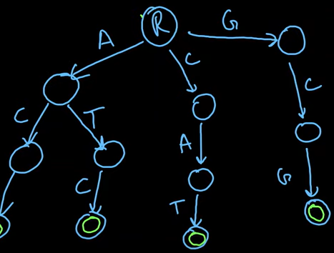
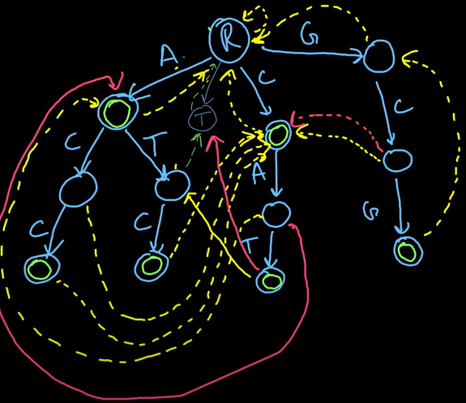
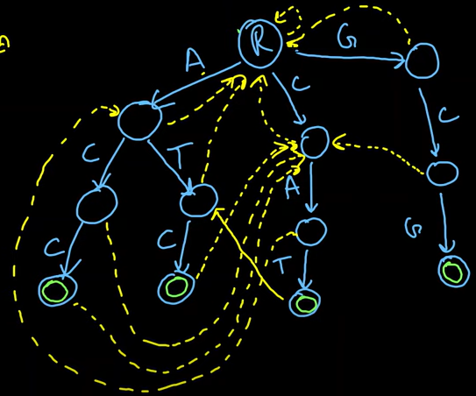
Aho-Corasick Algorithm - Working

Slide 10
Problems
Programming language
Hard to debug
Difficult to Implement
Setup

Slide 11
Results

Slide 12
Results

Slide 13
Results

Slide 14
Conclusions
Future Word
Hypothesis validated
Performance ranked:
1. Parallel Aho-Corasick
2. Sequential Aho-Corasick
3. Parallel Trie
4. Sequential Trie
5. Parallel KMP
6. Sequential KMP
Extend the application
Search sentiment phrases instead of words for better accuracy.
Create a Product
Robust Library

Slide 15
References
[1] T. Kida, M. Takeda, A. Shinohara, M. Miyazaki and S. Arikawa, "Multiple pattern matching in LZW compressed text," Proceedings DCC '98 Data Compression Conference (Cat. No.98TB100225), Snowbird, UT, USA, 1998, pp. 103-112, doi: 10.1109/DCC.1998.672136.
[2] Y. H. E. Yang, H. Le and V. K. Prasanna, "High Performance Dictionary-Based String Matching for Deep Packet Inspection," 2010 Proceedings IEEE INFOCOM, San Diego, CA, USA, 2010, pp. 1-5, doi: 10.1109/INFCOM.2010.5462268.
[3] A. Kennedy, X. Wang, Z. Liu and B. Liu, "Ultra-high throughput string matching for Deep Packet Inspection," 2010 Design, Automation & Test in Europe Conference & Exhibition (DATE 2010), Dresden, Germany, 2010, pp. 399-404, doi: 10.1109/DATE.2010.5457172.
[4] T. Tao and A. Mukherjee, "Multiple-pattern matching for LZW compressed files,“ International Conference on Information Technology: Coding and Computing (ITCC'05) - Volume II, Las Vegas, NV, USA, 2005, pp. 91-96 Vol. 1, doi: 10.1109/ITCC.2005.206.
[5] “Project Gutenberg is a library of over 70,000 free eBooks”, Project Gutenberg, Available: https://www.gutenberg.org/, [Accessed: Jan 21, 2024].

