Slide 1
Capstone Project: Analytical CRM Development for a Bank
Presented By : Balaji V

Slide 2
Introduction
We are Going to discuss Bank customer demographics, Transaction details,customer exit information and retain information and active customers.

Slide 3
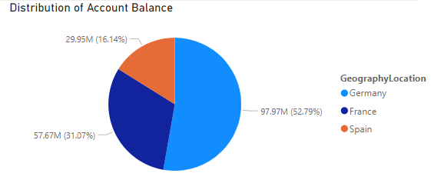
Distribution of account balance in different region

Slide 4
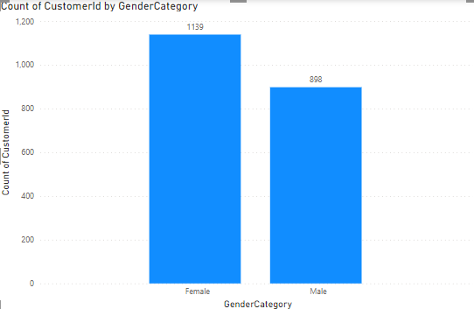
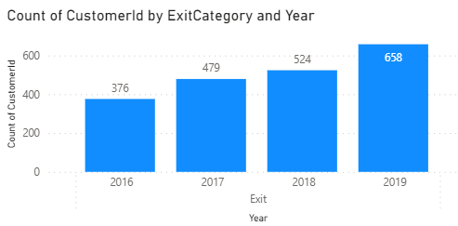
Gender Wise churn rate and year churn rate
Gender Exit Count
Year Exit Count

Slide 5
Based on Year Wise churn rate recent year churn is high compared to Previous year
In Gender wise churn rate female customers are Exited bank more compared to the male customers
Distribution of Account balance has 52.79% hold Germany country, 31.07% holds France and 16.14% holds Spain country

Slide 6
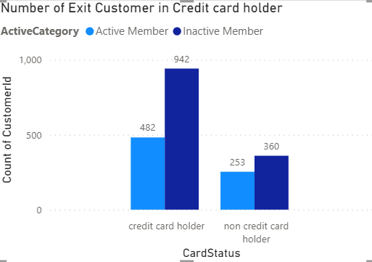
Credit Card holder Retain and churn Rate

Slide 7
Credit Card Exit and Non-credit card
Inactive customers are exited those who have credit card high and Number of customer exited is 942.
Active customer credit card holder has 482 Exit customers is less.
Non-credit holder has less number of exited rate compared to the Credit card holder.
If Bank give More offers for credit card holder and increase a due period to repay the payment then the exit rate will get reduced.
Attract more people those who haven’t credit card and increase chance to invest in the bank for future growth.

Slide 8
Thank You

