Slide 1
OAuth2 Using Spring Boot
By Balaji Vijayan

Slide 2
Introduction
OAuth2 is a authorization specification
It enables third-party applications to access a resource owner’s restricted resources.
It creates an authorization layer between the resource owner and the third-party application
OAuth2 replaces the now obsolete OAuth1.0 and OAuth1.0a

Slide 3
Entities in OAuth2
Resource Owner
An entity capable of granting access to a protected resource. When the resource owner is a person, it is referred to as an end-user.
Resource Server
The server hosting the protected resource.
Client
The entity accessing the protected resource.
Authorization Server
The server responsible for providing access tokens after successful authentication

Slide 4
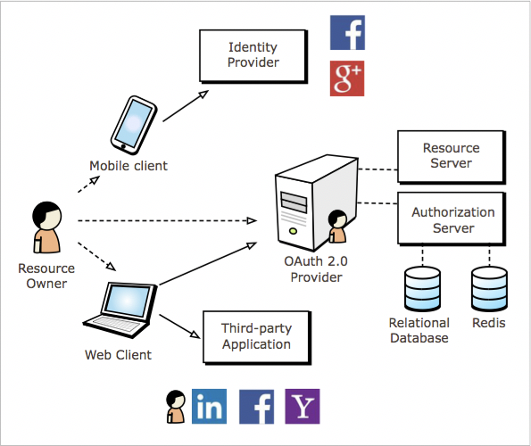
OAuth Provider
Resource Owner
Authorization Server
Resource Server
Web or Mobile Client

Slide 5
OAuth2 Grant Types
Authorization Code Grant
Implicit Grant
Client Credentials
Resource Owner Password Credentials Grant

Slide 6
Authorization Request,
client-id=album-maker
redirect_url=http://album-maker.com/callback
scope=photos
Client App
Resource Owner
Authorization Grant,
code = a384
Authorization Token Request,
code = a384, client-id=album-maker, password=secret
Authorization Server
Authorization Token Response,
auth_token = aae3341
Protected Resource Request,
auth_token = aae3341
Resource Server
Protected Resource Response,
{selfie.jpg, duckface.jpg…..}

