Slide 1

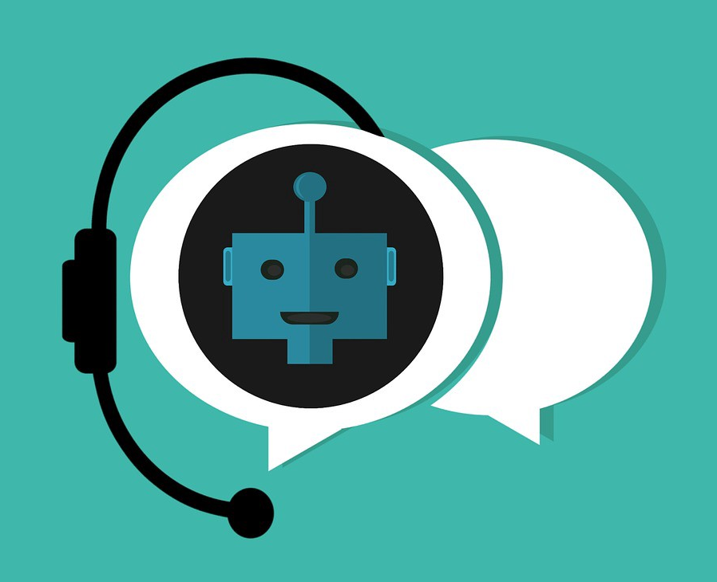
COLLEGE CHATBOT
NEIL GOGTE INSTITUTE OF TECHNOLOGY
By
Bala KIRAN Kumar (245318733127)
CH Prakash (245318733133)
MD Sadath hussain (245318733161)
Under the guidance of
Ms. M deepika
(Assistant Professor)

Slide 2
contents
Abstract
Introduction
Literature Survey
System Requirements
System Design
Modules
Results
Conclusion and Future Enhancements

Slide 3
Abstract
A Chatbot is the one that communicates with text or voice interface to provide the answers of student’s question.
The college chatbot system will help students to get information support online 24 x 7.
It is a web based application.
A simple user interface is made where user can type their questions and college buddy will give answers.
The functionality of the chatbot can be improved by integrating it into the college enterprise software, allowing more personal questions to be answered.
The user can ask college related questions like exam notifications, time tables, results and so on.

Slide 4
Introduction
A chatbot is a piece of technology that allows a computer program to communicate with people just like conversing through text messaging using a natural language.
Also known as Artificial Conversational Entity (ACE), Chat Robot, Talk Bot, Chatterbot or Chatterbox.
The first chatbot was made in the year 1966 at the MIT AI Laboratory, named Eliza whose purpose was to give an accurate simulation of a human conversation.

Slide 5
We can define the chatbots into two categories, following are the two categories of chatbots:
Rule-Based Approach – In this approach, a bot is trained according to rules. Based on this a bot can answer simple queries but sometimes fails to answer complex queries.
Self-Learning Approach – These bots follow the machine learning approach which is rather more efficient and is further divided into two more categories.
They are of follows -
Retrieval-Based Models – In this approach, the bot retrieves the best response from a list of responses according to the user input.
Generative Models – These models often come up with answers than searching from a set of answers which makes them intelligent bots as well.

Slide 6
LITERATURE SURVEY:-
Lets think if there is no chatbot for some reasons then the person who ask question and the person who tells the answer, both are busy.
We can save time of the person who answers the question using a chatbot
Its just like making an automated response using the chatbot.
The more we train and train the chatbot the more efficiency we get.
Chatbot makes every one life's easy.

Slide 7
System Requirements:-
Functional Requirements :
Users should give their input to start a chat with chatbot.
Non-Functional Requirements :
Scalability.
Recoverability.
Serviceability.
Maintainability

Slide 8
Software Requirements :
Operating System : Windows XP\7\8\10
Platform : PyCharm
Language : Python, HTML, CSS, SQLite.
Hardware Requirements
Processor : Intel corei5
Hard Disk : 40GB

Slide 9

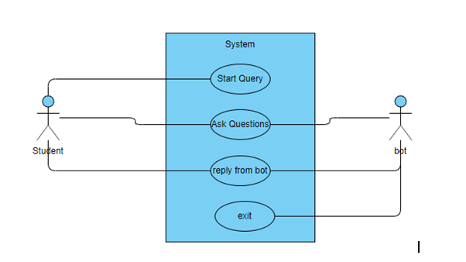
SYSTEM DESIGN:-
Use Case Diagram

Slide 10
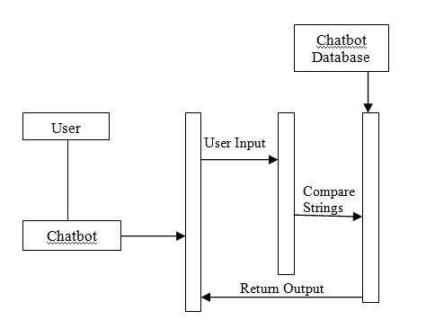
Sequence Diagram:-

Slide 11
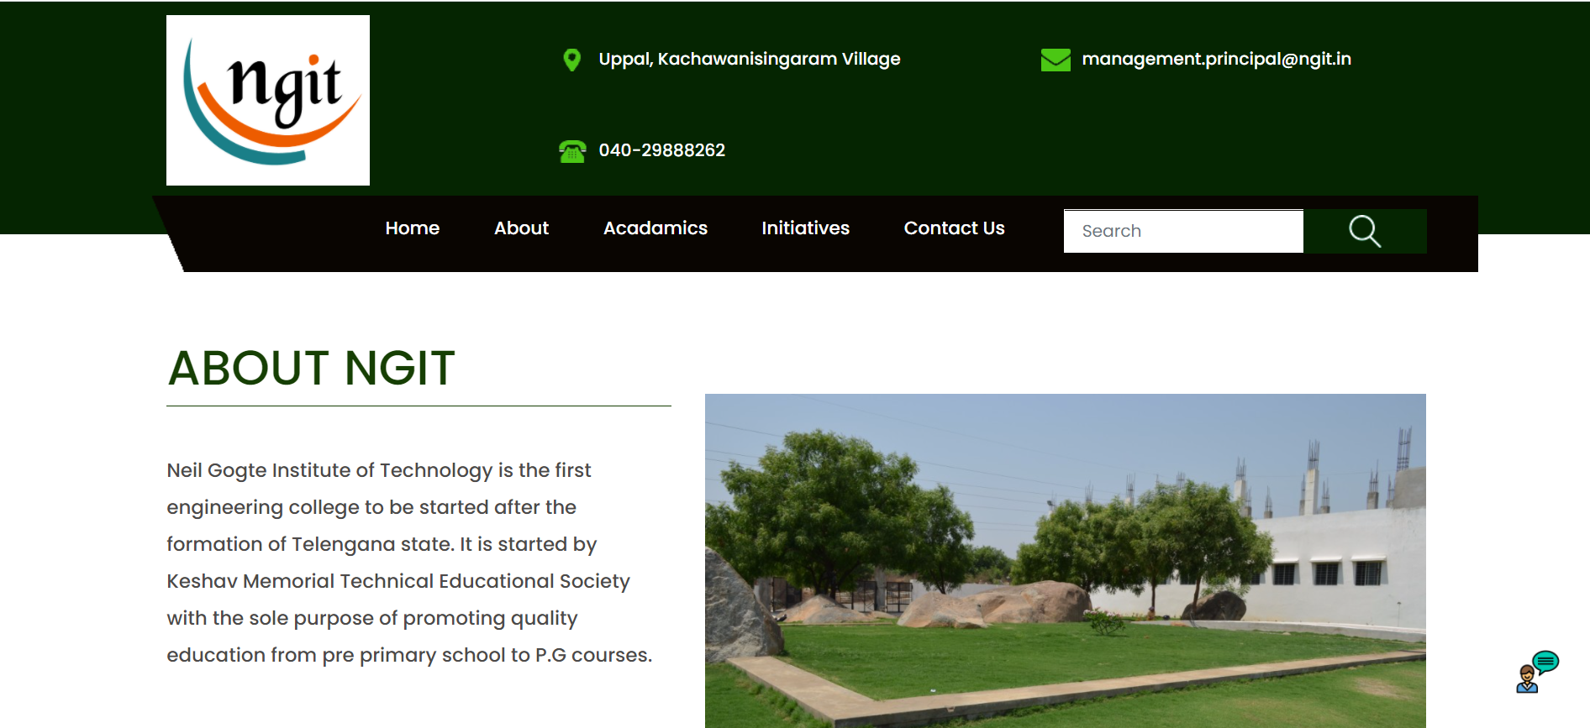
Result:-

Slide 12
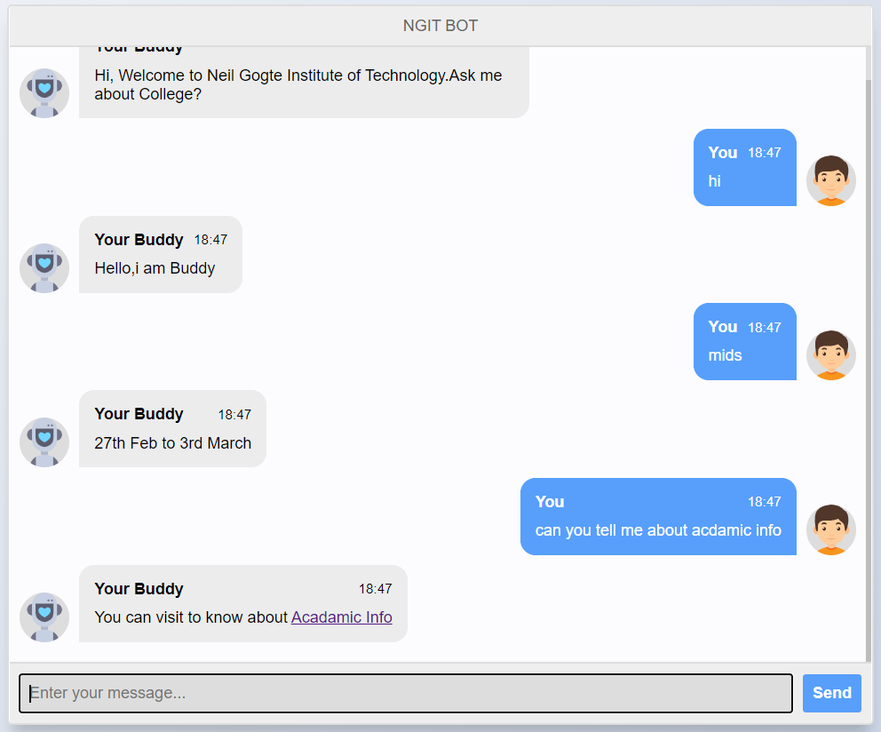
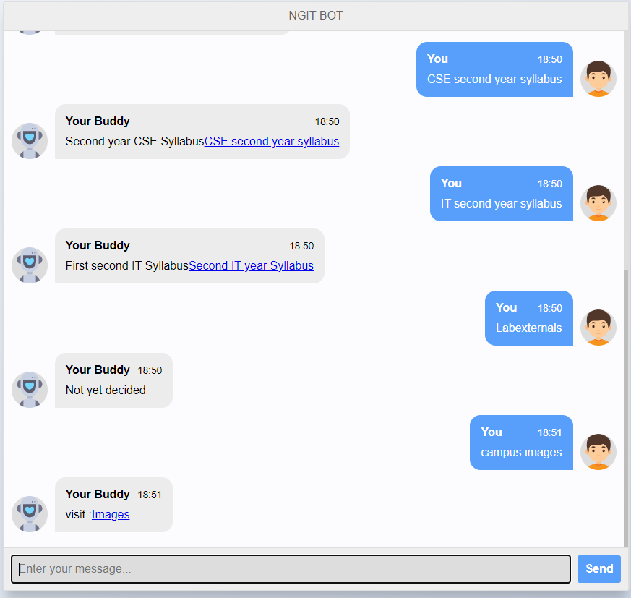
Implementation:-

Slide 13
Modules:-
Flask
Chatterbot
Chatterbot-Corpus
Spacy
Thinc

Slide 14
Conclusion and Future Enhancements :-
From my perspective, chatbots or smart assistants with artificial intelligence are dramatically changing businesses.
Chatbots can reach out to a large audience on messaging apps and be more effective than humans.
Student can get information without interacting to second person just by automated response’s.
We can try to make chatbot speak and take input from user in the form of audio.
This feature would be more useful for direct interacting as Alexa, Google assistant, Apple’s Siri, activates just by a word.

Slide 15
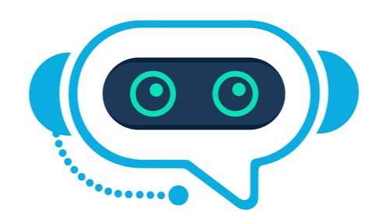
THANK YOU

