Slide 1


SRI RAMAKRISHNA INSTITUTE OF TECHNOLOGY
(An Autonomous Institution)
Pachapalayam, Perur Chettipalayam, Coimbatore- 641 010
IOT BASED SYSTEM FOR WOMEN SAFETY
DEPARTMENT OF COMPUTER SCIENCE AND ENGINEERING
Eight Semester / 2023-2024
FYP Phase II
BATCH NO :10
Presented by:
BALASUBRAMANIAM K R - 71382002016 HARIHARAN K - 71382002042
AKIL K - 71382002301
Guided by:
Ms.P.Parameswari
Assistant Professor
Department of CSE
BATCH ID: 10 IOT BASED SYSTEM FOR WOMEN SAFETY

Slide 2
Recap of Objectives
SRI RAMAKRISHNA INSTITUTE OF TECHNOLOGY
(An Autonomous Institution)
Develop an IoT system for women's safety with real-time vital sign monitoring and automated alerts for swift emergency responses.
Integrate GPS technology for accurate location tracking, automatically relaying coordinates to contacts and authorities for timely responses.
Design an intuitive interface compatible with mobile devices, setting the stage for continuous improvement based on emerging technologies and user feedback.
BATCH ID: 10 IOT BASED SYSTEM FOR WOMEN SAFETY

Slide 3
Project Overview
SRI RAMAKRISHNA INSTITUTE OF TECHNOLOGY
(An Autonomous Institution)
Scope :
        The main advantage of this system is that it is compact and portable.
        Real-time GPS tracking is used here for finding the location during emergency conditions.
Tools:
        NodeMCU(ESP8266)
        GSM Modem
        GPS module
        Battery 12V
        pressure sensor
        temperature sensor
        pulse rate sensor
        Accelerometer - NEW
Technologies:
        Arduino IDE
BATCH ID: 10 IOT BASED SYSTEM FOR WOMEN SAFETY

Slide 4
Methodology-Manual
SRI RAMAKRISHNA INSTITUTE OF TECHNOLOGY
(An Autonomous Institution)
When the device is powered on, it connects to Wi-Fi, and the GPS module starts receiving location data.
The NodeMCU decodes this data and displays it on the serial monitor.
If the SOS button is pressed and held, an LED lights up, and the NodeMCU connects to an online service called IFTTT.
NodeMCU sends a request to IFTTT with the GPS coordinates.
IFTTT activates the Android messaging app and sends a message to a specified phone number.
This message also triggers an emergency notification on the phone, including the GPS coordinates.
BATCH ID: 10 IOT BASED SYSTEM FOR WOMEN SAFETY

Slide 5
Methodology-Automated
SRI RAMAKRISHNA INSTITUTE OF TECHNOLOGY
(An Autonomous Institution)
  In critical case, sensors like Accelerometer sensor, temperature sensor, and pulse rate sensor pass a signal which is used as an alarm to alert the controller.
  Microcontroller gets the values from the GPS receiver as inputs and transfers it to the preprogrammed list
  NodeMCU will start connecting to IFTTT server and make a Webhook request, along with the GPS Coordinates.
  It will also trigger an Emergency Notification alert on the Phone and message sent consists of the GPS Coordinates that was received from the GPS module.
BATCH ID: 10 IOT BASED SYSTEM FOR WOMEN SAFETY

Slide 6
Methodology- Manual Mechanism
SRI RAMAKRISHNA INSTITUTE OF TECHNOLOGY
(An Autonomous Institution)
A manual switch called the emergency switch is attached with our system. During an emergency situation women can press this switch to activate.
The If This Then That (IFTTT) server intimates to the list of emergency contacts via call and SMS.
Microcontroller gets the values of the latitude and longitude from the GPS receiver as inputs and transfers it to the preprogrammed list of emergency number via SMS through IFTTT Webhook.
BATCH ID: 10 IOT BASED SYSTEM FOR WOMEN SAFETY

Slide 7
Methodology- Automated Mechanism
SRI RAMAKRISHNA INSTITUTE OF TECHNOLOGY
(An Autonomous Institution)
In most of the situations, the woman may not be able to react and use the manual mechanism.
In critical case, sensors like accelerometer sensor, temperature sensor, and accelerometer sensor pass a signal which is used as an alarm to alert the controller.
Microcontroller gets the values from the GPS receiver as inputs and transfers it to the preprogrammed list
The global system for mobile communication (GSM) modem make emergency via SMS.
BATCH ID: 10 IOT BASED SYSTEM FOR WOMEN SAFETY

Slide 8

System Architecture
SRI RAMAKRISHNA INSTITUTE OF TECHNOLOGY
(An Autonomous Institution)
LED
Temperature sensor
Get GPS Data
(coordinates)
Pulse rate Sensor
NODE MCU
GPRS
Module
Accelerometer
sensor
Send Data the controller
Push Button
IFTTT
Server
Mobile
phone
Activation
Trigger Webhook request
Send SMS of
Coordinates to Mobile phones
Battery
BATCH ID: 10 IOT BASED SYSTEM FOR WOMEN SAFETY

Slide 9
Implementation
SRI RAMAKRISHNA INSTITUTE OF TECHNOLOGY
(An Autonomous Institution)
In this device GPS tracking is used to find the victims location.
GSM module is used to send SOS messages to the police, relatives and dear ones.
Node-MCU: The Node-MCU ESP8266 is a microcontroller having General-purpose input/output (GPIO) pins for controlling devices and sensors and Wi-Fi for wireless communication.
Pulse rate sensor : It is very compact with low cost which is used to detect abnormalities in the pulse rate of the woman
Temperature sensor : It is small sized, low cost sensor. The temperature sensor is used to detect any deviation in the body temperature.
Accelerometer's Role: Detects sudden movements, enhancing the emergency alert with crucial data.
BATCH ID: 10 IOT BASED SYSTEM FOR WOMEN SAFETY

Slide 10
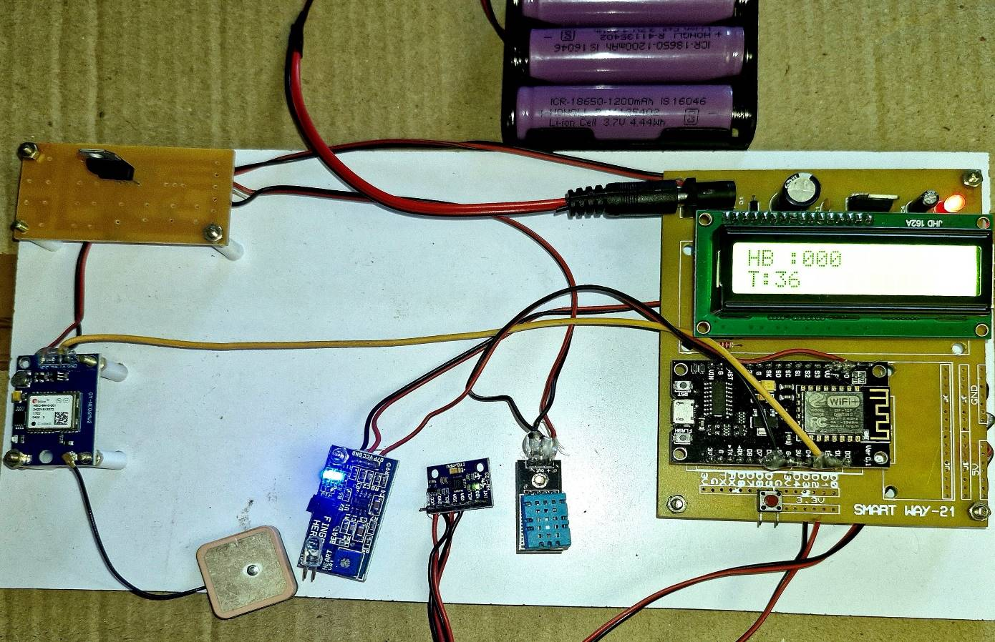
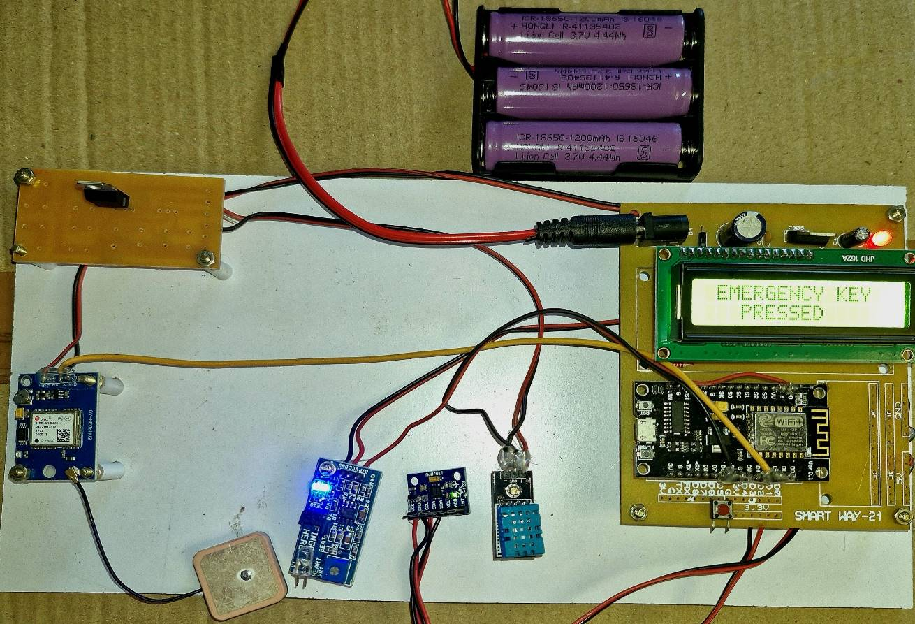
Result & Analysis
SRI RAMAKRISHNA INSTITUTE OF TECHNOLOGY
(An Autonomous Institution)
Developed device with heart rate and temperature displayed
Activation of alert mechanism
and Alert message triggered by IFTTT
BATCH ID: 10 IOT BASED SYSTEM FOR WOMEN SAFETY

Slide 11
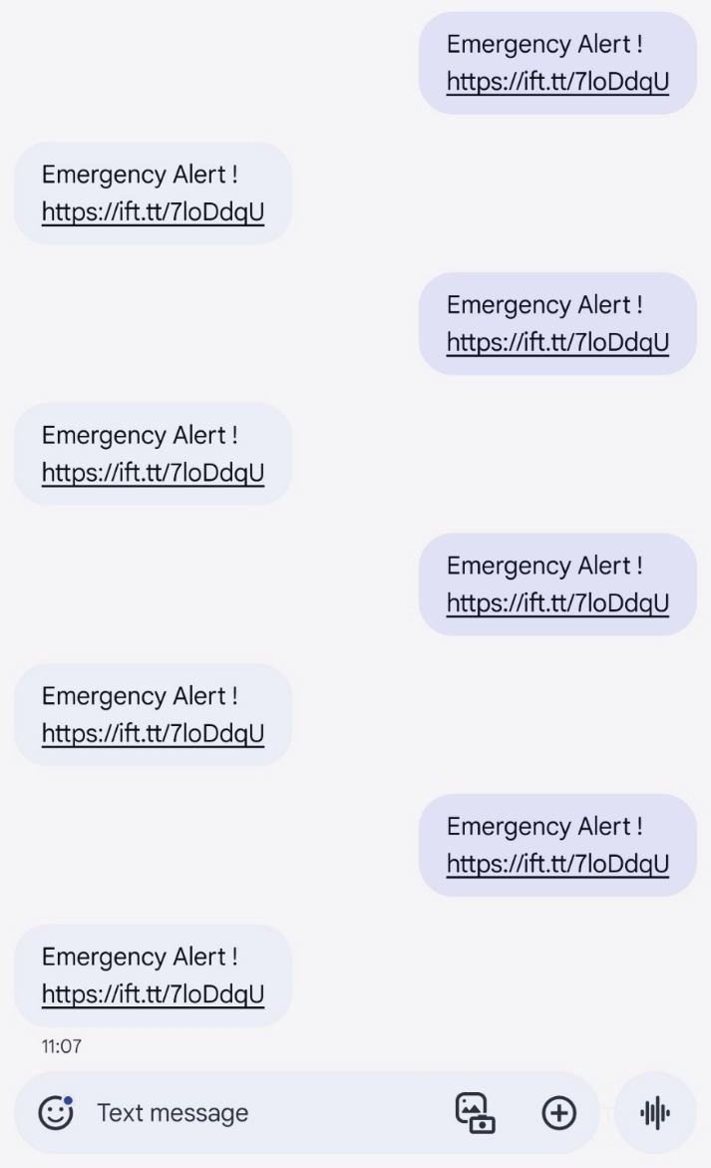
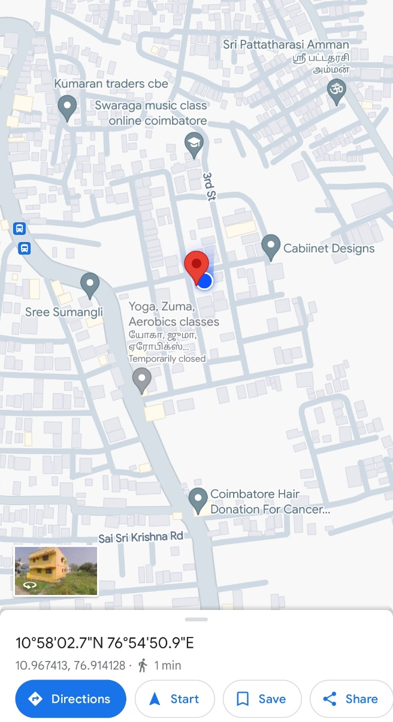
Result & Analysis
SRI RAMAKRISHNA INSTITUTE OF TECHNOLOGY
(An Autonomous Institution)
SMS received form IFTTT
latitude and longitude are Located in map
BATCH ID: 10 IOT BASED SYSTEM FOR WOMEN SAFETY

Slide 12
Future work & Extensions
SRI RAMAKRISHNA INSTITUTE OF TECHNOLOGY
(An Autonomous Institution)
    Introduce new gadget versions to keep up with the latest technologies while maintaining efficiency and allowing for easy improvements.
    Enhance the gadget with voice detection modules to capture important data during emergencies by recording and interpreting spoken phrases.
    Enable the device to record both audio and video when the alarm is activated, providing crucial evidence for legal purposes.
    Keep improving the gadget to meet the evolving needs of women's safety, ensuring it stays valuable in supporting efforts to enhance security and protection.
BATCH ID: 10 IOT BASED SYSTEM FOR WOMEN SAFETY

Slide 13
Conclusion
SRI RAMAKRISHNA INSTITUTE OF TECHNOLOGY
(An Autonomous Institution)
    Main purpose of this system is Swiftly detects potential threats and triggers immediate responses, ensuring women's security.
    The system's architecture allows for easy scalability and adaptation to various environments, ensuring its effectiveness in both urban and rural settings, thereby extending its impact.
    Collaborative deployment of this system contributes to a world where women can live free from fear, empowered by comprehensive safety measures.
    The merit of this work is not only provides safety and is also provide security by means of Self defense mechanism
BATCH ID: 10 IOT BASED SYSTEM FOR WOMEN SAFETY

Slide 14
References
SRI RAMAKRISHNA INSTITUTE OF TECHNOLOGY
(An Autonomous Institution)
Abhijit Paradkar, Deepak Sharma. 2015. All in one Intelligent Safety System for Women Security” International Journal of Computer Applications (0975-8887), 130(11).
D. Chitkara, N. Sachdeva and Y. Dev Vashisht, "Design of a women safety device," IEEE Region 10 Humanitarian Technology Conference (R10-HTC), Agra, 2016, pp. 1-3
Ashlesha Wankhede, Ashwini velankar, Priyanka Shinde “PORTABLE DEVICE FOR WOMEN SECURITY”. IJRET, eISSN:2319-1163|p ISSN:2321- 7308.
Dhruv Chand, Sunil Nayak, Karthik S. Bhat, Shivani Parikh, Yuvraj Singh, Amita AjithKamath. 2015. A Mobile Application for Women's Safety: WoSApp. DOI: 978-1-4799-8641-5, IEEE.
S. Vahini, N. Vijaykumar, “Efficient tracking for women safety and security using IoT”, Inter- national Journal of Advanced Research in Computer Science, Volume 8, No,.9, November- December 2017
BATCH ID: 10 IOT BASED SYSTEM FOR WOMEN SAFETY

Slide 15
References
SRI RAMAKRISHNA INSTITUTE OF TECHNOLOGY
(An Autonomous Institution)
6. Geetha Pratyusha Miriyala, P.V.V.N.D.P.Sunil, RamyaSreeY allapalli, Vasantha Rama Lakshmi Pasam, TejaswiKondapalli ,Anusha Miriyala,”Smart Intelligent Security System for Women”, International Journal of Electronics and Communication Engineering & Technology(IJECET),Vol: 7, Issue 2, March-April 2016, pp. 41–46,Andhra Pradesh, India.
7. A.Helen, M.FathimaFathila, R.Rijwana,Kalaiselvi V.K.G,”A Smart Watch for Women Security based on IoT Concept”,2nd International Conference on Computing and Communications Technologies (ICCCT),23-24 Feb 2017, Chennai, India.
8. Nishant Bhardwaj, Nitish Aggarwal, “Design and Development of “Suraksha”-A Women Safety Device,International Journal of Information & Computation Technology, Volume: 4,pp. 787-792.
9. Akash Moodbidri, HamidShahnasser,” Child Safety Wearable Device”,International Conference on Information Networking(ICOIN),11-13 Jan,2017,Da Nang,Vietnam.
10.HearMe: A Smart Mobile Application for Mitigating Women Harassment”, International WIE Conference on Electrical and Computer Engineering (WIECON-ECE), 19-21Dec,2016, Pune, India
BATCH ID: 10 IOT BASED SYSTEM FOR WOMEN SAFETY

Slide 16
        Thank You
BATCH ID: 10 IOT BASED SYSTEM FOR WOMEN SAFETY

