Slide 1
hack CX
Return to The New Normal

Slide 2
Reboot to The New Normal – hack CX
Technology infused process to empower business to normal return with in-person service cautiously and confidently.

Slide 3
What’s your hack project story?
We have fallen into an unexpected time of crisis globally due to the pandemic, COVID-19, which is impacting our lives in many ways. The entire world was not prepared for such a breakout. It is evident that this situation must come to an end, where we will be back to normal at some point. While coming to normal living, our lives will change in many ways. I questioned at a professional level to assess new form of strength, weaknesses, opportunities and threats to each business towards new normal. Answer to my questions may categorized in two concepts.
Shift in work towards independent of location i.e. Virtual, Distant, Contracting
Change in existing process while opening business with careful planning and conscious safeguarding
We will focus on series of solutions to help business welcome their customer base with new normal towards steady state through variety of tools
Scheduling & Confirm Appointments – to avoid unplanned clutter of people
Safeguarding & Proximity alerting - for alerting people missing on safe practice with social distancing
Study exposure and service pattern – for tracing back on exposure of individual and risk analysis
Notes:
Note: Don’t spend too much time on the “set-up” or problem statement. Viewers usually pick that up quickly, and they want to get to hearing about your project/solution.

Slide 4
Primary customer
MTC – Events
Important meetings
Customer Workshops
Internal Workshops

Slide 5
How does it work?
Scheduling
Safeguarding
Study - Analyze
Booking – Link
Scheduling Event facilitators
Open portal to events
Registration of Events based on facility and facilitators availability
Registration questioner -
Approval and Confirmation
Disclaimer and Terms agreement
Post event survey 1
Post event survey 2 (14 days)
Event and Facility Monitoring
Alerting system – Proximity
Monitoring event – Image / Stream alerting
Risk profiling
Reporting
Attendee report
Risk profile report
ML-AI report of anomalies
Return to the new normal impact

Slide 6
Impact for the Customer
Why is this solution different and compelling for the customer?

Slide 7
Impact for Microsoft
What business value does your project provide to Microsoft? e.g., attract new users, make current users happier, increase revenue, do some good in the world, increase usage, retain customers, etc.

Slide 8
Tips
Be concise.
Make your presentation as simple as possible, but no simpler.

Slide 9
Project Overview

Slide 10
Why?
Employee + Safety + Healthy = Productivity
Increase Confidence = Increase Revenue

Slide 11
Technology
Office 365 E5 license as booking.Microsoft.com – Team Event
Position of Sitting or standing/Social Distancing notification - AI
Intelligent Edge

Slide 12
Flow
Book schedule ahead in advance
Stage slots based on facility and occupancy count
Once the schedule time customer walks to facility
Facility might have other customers and employees
Monitor Social Distancing and Alert User

Slide 13
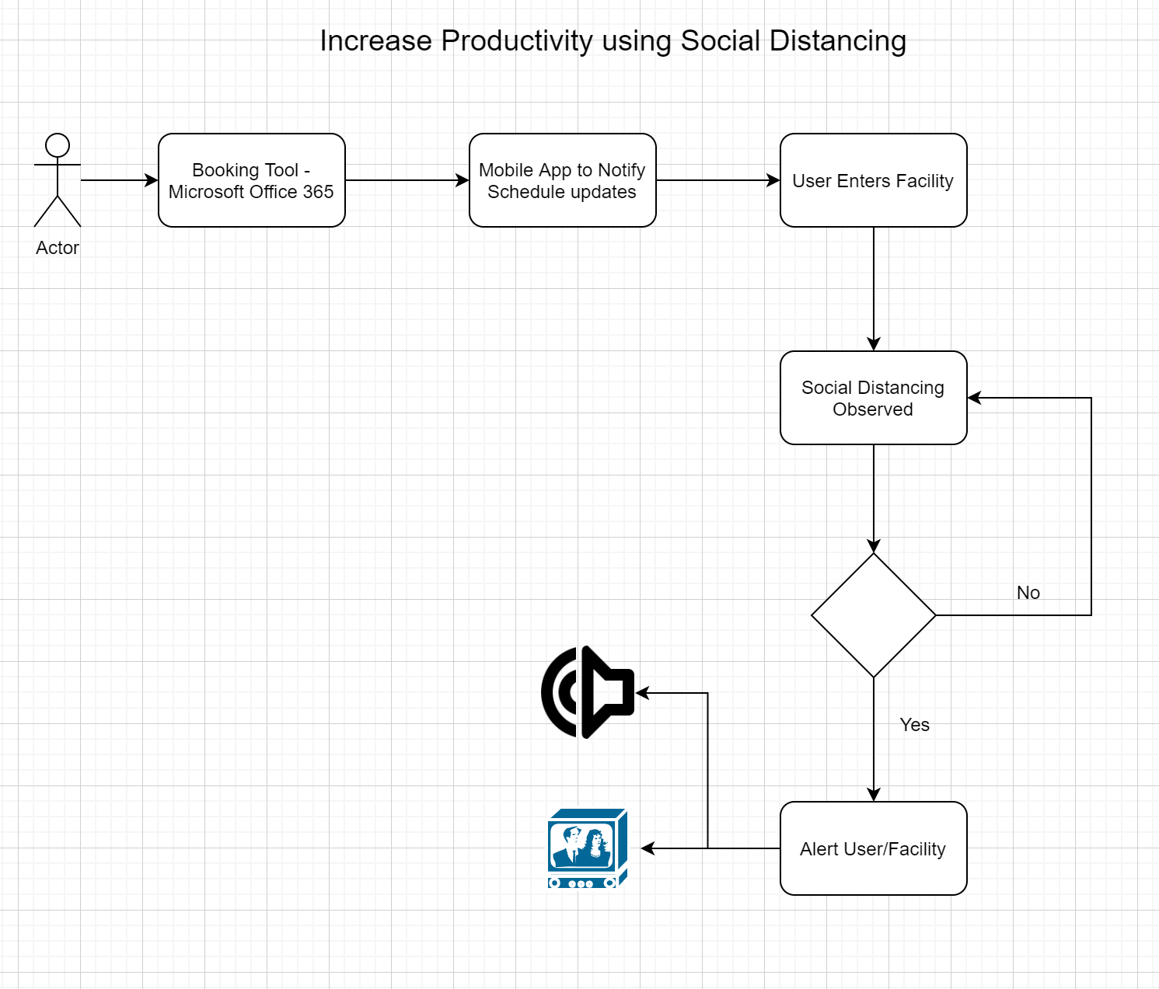
Process Flow

Slide 14
To do
Brainstorm Ideas
Wireframes or brainstorm diagrams
Whiteboard and Architecture
Form Teams
Assign Responsibilities
Project Plan – what can be done for 3 days
Recurring meeting to discuss progress
Measurements

Slide 15
Outcomes
Reference Architecture
PoC
Design document for PoC

Slide 16
Program Management

Slide 17
Team structure
Scheduling
Safeguarding
Study - Analyze
Booking – Link
Lead :
Contributor :
Event and Facility Monitoring
Lead 1:
Contributor :
Lead 2:
Contributor :
Reporting
Lead 1:
Contributor :
Lead 2:
Contributor :

Slide 18
Collaboration Channel
https://microsoft.sharepoint.com/teams/wwccx83/SitePages/HackCX2020.aspx
hack CX – Hackathon (Team)
General (Channel)
Scheduling (Channel) ?
Safeguarding (Channel) ?
Study (Channel) ?
Files Section
How To Guide
Github Solution Links
Meeting Schedule (July 27 – 30)
Group Sync
Breakout for Scheduling
Breakout for Safeguarding
Breakout for Study
Video Script
Introduction 20 sec
Booking 20 sec
Safeguarding 1 – 30 sec
Safeguarding 2 – 30 sec
Reporting 1 – 30 sec
Reporting 2 – 30 Sec
Closing – 20 sec

