Slide 1
TEAM STORY
Motivation
Mission: To empower everyone’s project viewing experience.
Meet the team members and appreciate the team diversity.
Understand the origin of the project and team.
Be energized by the passion and commitment.

Slide 2
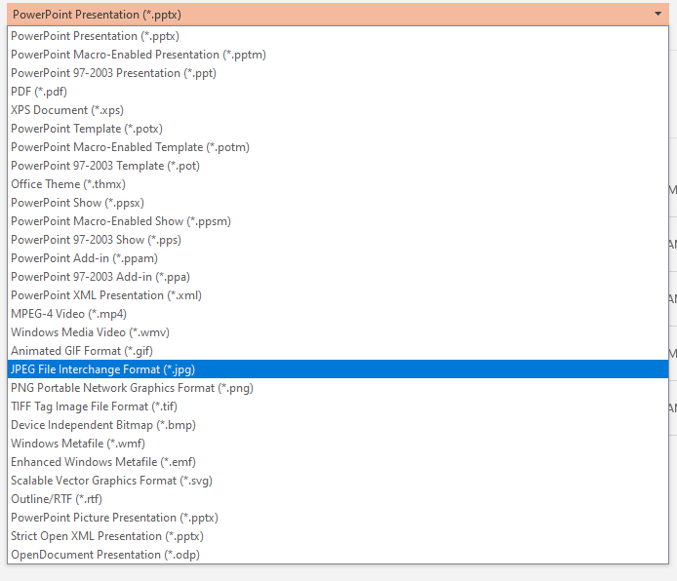
Instructions for creating a Team Story
Use slides 3, 4, and 5 as a guide
Add your team story to each of the slides
Save each slide as an image file
File > Save As > JPEG File Interchange Format (*.jpg)
Each slide will be saved as an individual picture (Save to desktop to access quickly and it might save all pictures in one folder)
Go to your project page, edit your project
In the Team Story tab, upload your 3 pictures
Save project!

Slide 3

Introduce Your Dream Team
Balamurugan Balakreshnan
CSA/CSU/WI
Mickey Patel
CSA/CSU/Illinois
Prateek Gandhi
CSA/CSU/MN
Dee Kumar
CSA/CSU/Illinois
Samson Leung
CSA/CSU/illinois
Steve Thompson
CSA/CSU/illinois
First Last
Title/Org/Location
First Last
Title/Org/Location
First Last
Title/Org/Location

Slide 4
Describe How The Team Formed
Where did the idea originate from?
What shared experiences brought you together?
What’s your team mojo?

Slide 5
Let’s Talk Passion
What drove you to care about this idea/area?
What motivates your team?
Why is Microsoft Hackathon meaningful to your team?
What’s one thing that you want everyone to leave remembering about your team?

