Slide 1
TEAM STORY
Motivation
Mission: To empower everyone’s project viewing experience.
Meet the team members and appreciate the team diversity.
Understand the origin of the project and team.
Be energized by the passion and commitment.

Slide 2
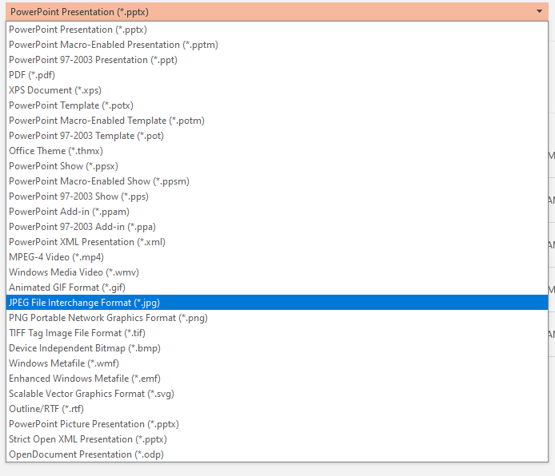
Instructions for creating a Team Story
Use slides 3, 4, and 5 as a guide
Add your team story to each of the slides
Save each slide as an image file
File > Save As > JPEG File Interchange Format (*.jpg)
Each slide will be saved as an individual picture (Save to desktop to access quickly and it might save all pictures in one folder)
Go to your project page, edit your project
In the Team Story tab, upload your 3 pictures
Save project!

Slide 3

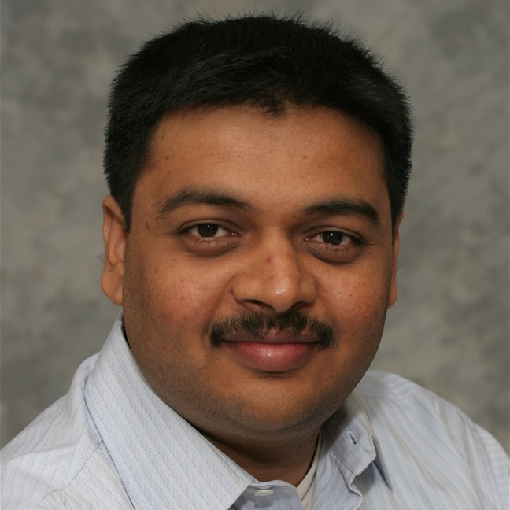
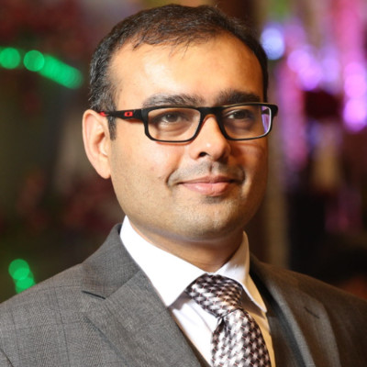

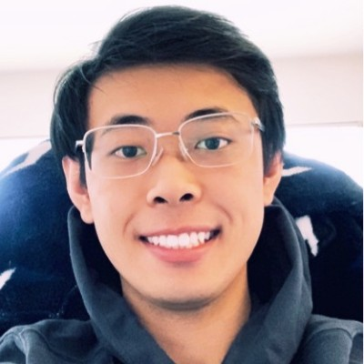
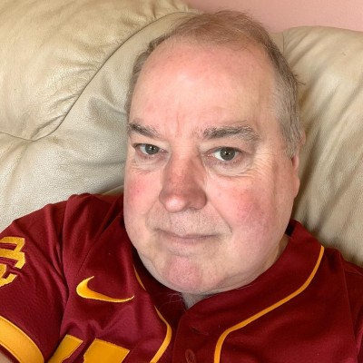
Introduce Your Dream Team
Balamurugan Balakreshnan
CSA/CSU/WI
Mickey Patel
CSA/CSU/Illinois
Prateek Gandhi
CSA/CSU/MN
Dee Kumar
CSA/CSU/Illinois
Samson Leung
CSA/CSU/illinois
Steve Thompson
CSA/CSU/Illinois

Slide 4
Describe How The Team Formed
Idea to detect masks and social distancing came from the helmets demo for creativity
Collaboration, Teamwork and Growth Mindset
Returning to a new normal - intelligently

Slide 5
Let’s Talk Passion
Following in the footsteps of the heroes of COVID-19, our first responders, my team was motivated to help create a safe work environment for our colleagues and other businesses to return to - even if we are all working from home.
Our team is motivated by the efforts Microsoft and other companies are taking worldwide to safely reopen so we may meet and work together again in a new normal.
Our team misses seeing each other and working together at the office. Furthermore, we may live with those that are immuno-compromised, our children, and the elderly. To finally meet again, while keeping family and loved ones safe, has been our drive to come together and create a solution that brings us closer to that goal.
Even though we are not together physically, we are together mentally, emotionally, and intellectually in these extraordinary times - so that we may once again, meet again.

