Slide 1



AWS Concepts and Lab Intro
Saptarshi Debroy, Minh Nguyen
Contact: Prasad Calyam
Slides adapted from Hwang, Fox, Dongarra
&
Programming Amazon EC2, Vliet, Paganelli

Slide 2
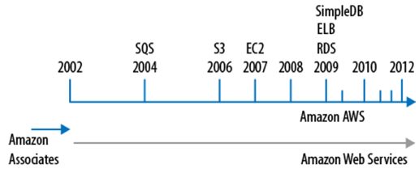
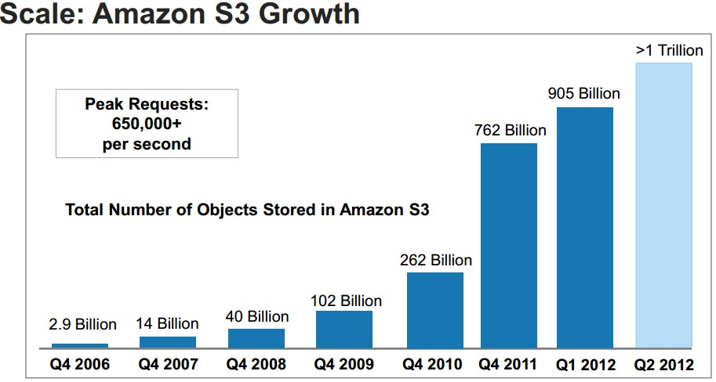
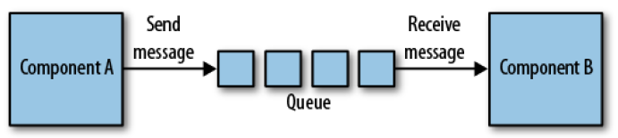
Growth of AWS
1.3 Trillion in 2013
DynanoDB
Amazon S3 Growth
2006
2012
AWS “Simple Queue Service” fosters ‘decoupled’ service oriented architecture message passing
“Developers can move data between distributed components of their applications that perform different tasks, without loosing messages or requiring each component to be always available”
S3 Storage, EC2 Compute, ELB Load Balancing, RDS Relational Database, SimpleDB

Slide 3
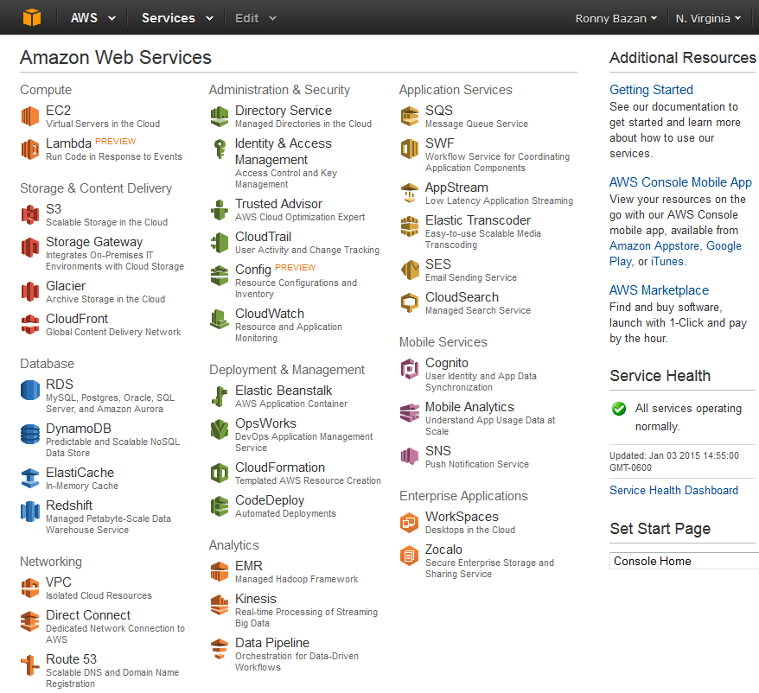
AWS Free-Tier

Slide 4
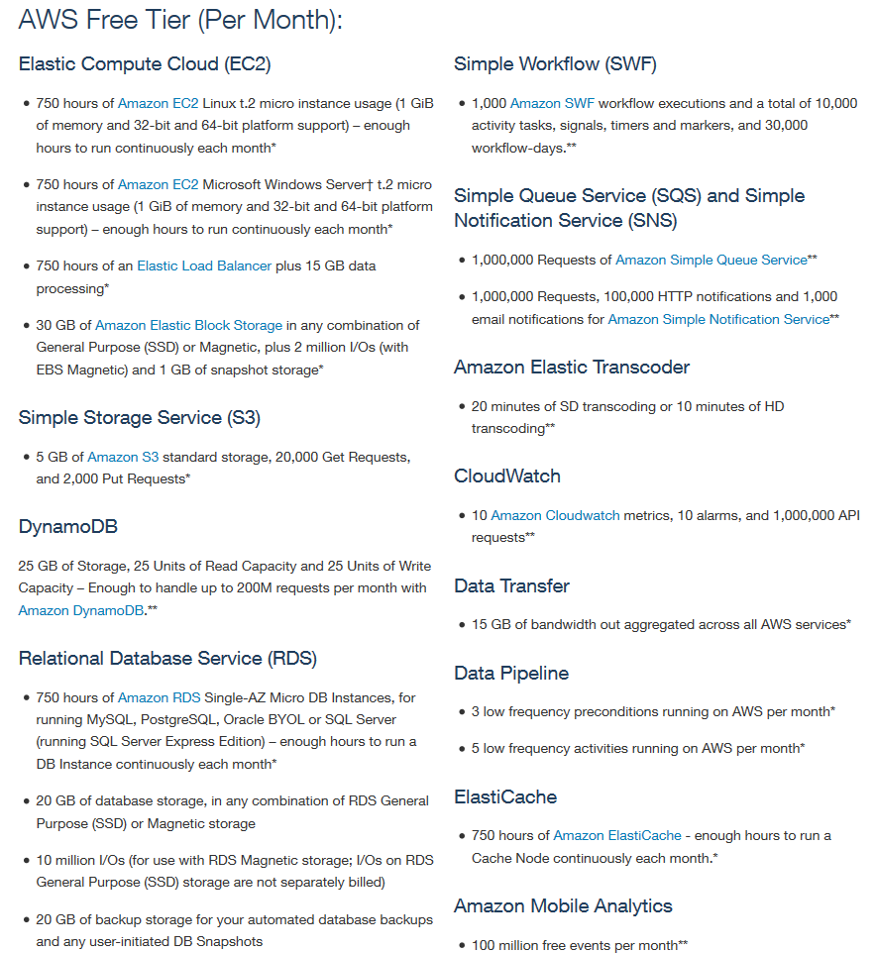
Free Usage Restrictions

Slide 5
$100 Promotional Code/Student Tier
You can access -
AmazonRedshift
AWSDirectConnect
AmazonCloudcast
AWSQueueService
AmazonVPC
AmazonElastiCache
AmazonSES
AmazonSIS
AmazonCloudSearch
AmazonSNS
AmazonRoute53
AWSStorageGateway
AmazonEC2
AmazonDynamoDB
ElasticMapReduce
Amazon ETS
AmazonSimpleDB
AmazonRDS
AWSDataTransfer
AWSSupportBasic
AmazonS3
AmazonCloudFront
AWSElasticBeanstalk
AmazonGlacier
AWS Lambda
AWS Key Management Service
CloudWatch
AWS cognito
Amazon ELB
Students will receive a $100 AWS usage credit code from me/TA via e-mail
Although each assigned lab session will only use free-tier resources, the credit is helpful if there are accidental charges or if a student would like to experiment with any advanced AWS capabilities
If a student exceeds the $100 usage credit, he/she will be responsible for payment of any overage charges

Slide 6
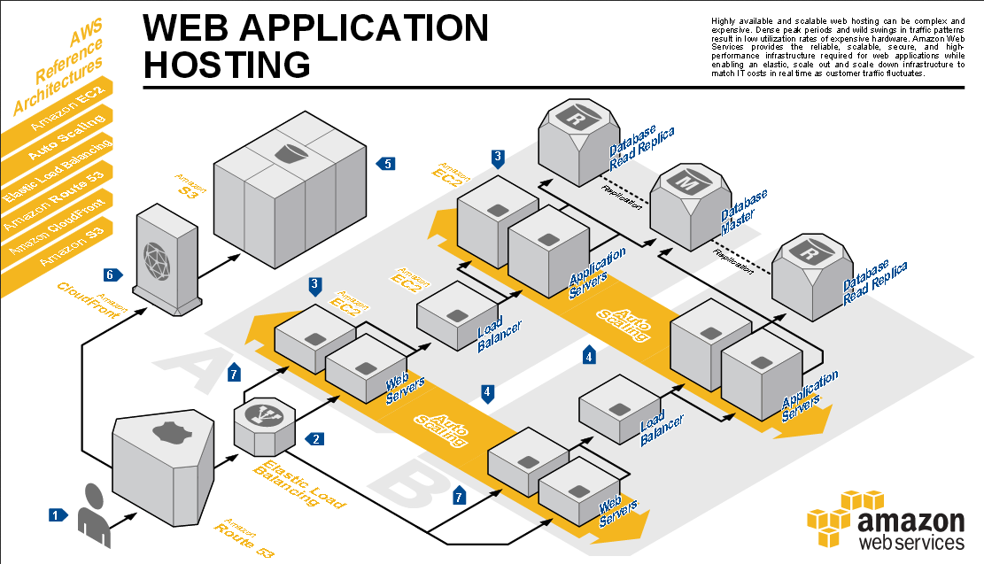
Example Application Hosting in AWS

Slide 7
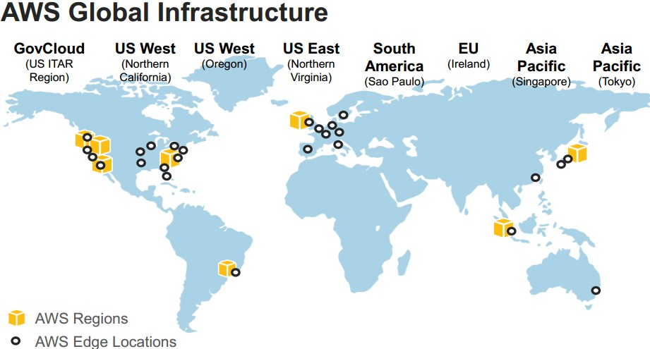
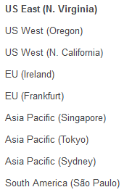
AWS Regions 11 regions, 28 availability zones (1 to 6 data centers)… ~1.4 million servers worldwide!!
More Introduction Information about AWS at – (especially see different networking setups allowed by AWS including ‘Direct Connect’)
http://www.slideshare.net/AmazonWebServices/03-introduction-to-aws

Slide 8
Interesting must-read article…
T. Morgan, “A Rare Peek Into The Massive Scale of AWS”, Nov. 2014
http://www.enterprisetech.com/2014/11/14/rare-peek-massive-scale-aws/

Slide 9
Lab Steps
Amazon Web Services
AWS Architecture
Add AWS Education Credit for $100
AWS Account Creation
SSH to instance
Launch instance
Lab – AWS Account Setup, Services Overview, Resource Discovery, and Instance Setup
Purpose of the Lab
Understand definitions of various Amazon Web Services (AWS) and their use in cloud computing based web applications that are accessible over the Internet through an AWS account
Use the AWS account for the discovery, reservation and access of virtual compute/storage infrastructure instances

Slide 10
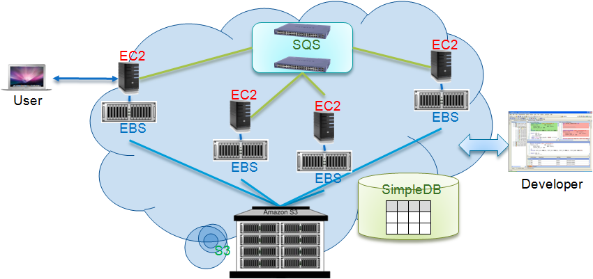
AWS Platform Example Deployment

Slide 11
AWS Execution Environment
Private AMI: Images created by you, which are private by default; you can grant access to other users to launch your private images
Private AMI: Images created by users and released to the community, so anyone can launch instances based on them and use them any way they like
Paid AMI: You can create images providing specific functions that can be launched by anyone willing to pay you per each hour of usage on top of AWS charges

Slide 12
AWS Access Credentials
Credential type you use depends on the type of AWS API
Access Keys
To make secure REST or Query protocol requests to any AWS service API
Parts and Usage
Access Key ID—Your Access Key ID identifies you as the party responsible for service requests; you include it in each request, so it's not a secret
Secret Access Key—Each Access Key ID has a Secret Access Key associated with it; This key is used to calculate the digital signature that you include in the request; Your Secret Access Key is a secret, and only you and AWS should have it
X.509 Certificates
To make secure SOAP protocol requests to AWS service APIs
Parts and Usage
X.509 Certificate – holds the public key and related metadata; You include it in each service request, so it's not a secret
Private Key—Each certificate has a private key associated with it; Use the private key to calculate the digital signature to include in the request; Your private key is a secret, and only you should have it and AWS doesn't keep a copy
Key Pairs
To launch and then securely access your Amazon EC2 instances
You can make as many as you like by giving friendly names (can’t replace any particular key pair)
Private key that you keep with you; Public key that AWS keeps to allow access

Slide 13
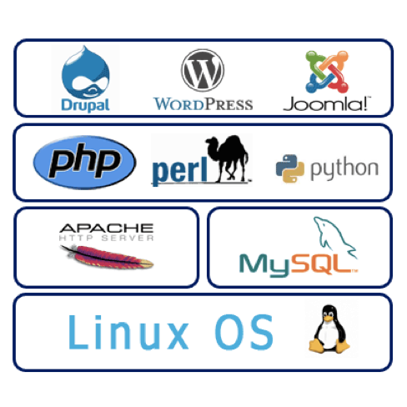
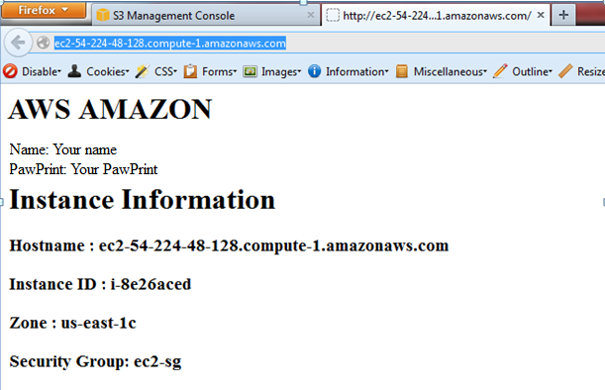
Install your first AWS-hosted Web App!
Install HTTP, PHP and MySQL – LAMP package in your instance
Read Hostname, Instance ID, Zone and Security Group from Instances Data from metadata set and show it on the web page
Clean-up resources – remove snapshot, detach/remove volume

Slide 14
Recap: Example Application Hosting in AWS

Slide 15
Cost Saving Considerations in AWS
On-Demand Instances
Pay for compute capacity by the hour with no long-term commitments
Reserved Instances
Make a low, one-time payment for each instance you want to reserve and in turn receive a significant discount on the hourly charge for that instance
Spot Instances
Bid on unused EC2 capacity and run those instances for as long as their bid exceeds the current Spot Price

Slide 16
Other Best Practices…
AWS Lab Reading
http://media.amazonwebservices.com/AWS_Cloud_Best_Practices.pdf
Design for failure and nothing will fail
Decouple your components
Implement elasticity
Think parallel
Keep dynamic data closer to compute and static data closer to user
Know security and performance tradeoffs
Another great link for high scalability, architecture case studies
http://highscalability.com - ‘Building bigger, faster, more reliable websites’
YouTube Architecture
http://highscalability.com/youtube-architecture
Good Dashboard Example:
http://stackexchange.com/performance

