Slide 1
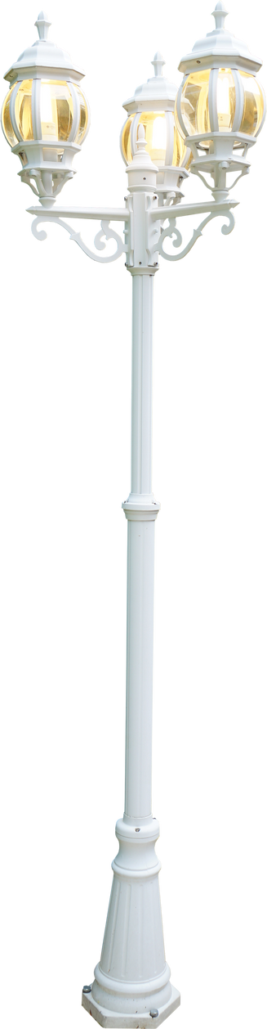
Digital portfolio
Digital portfolio
student name: Balakrishnan.S
register no and nmid: 212402331 and A3B7D5137096F098C7E447931E07094D
deportment: BCA
college: A.M.Jain College

Slide 2
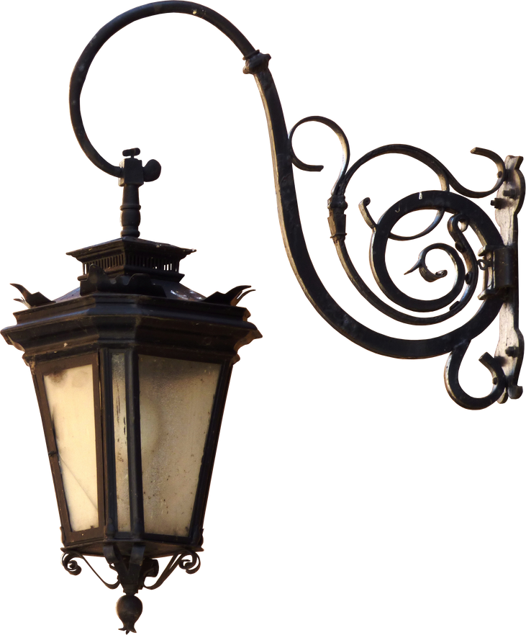

PROJECT TITLE
PROJECT TITLE
Responsive Portfolio Website

Slide 3
AGE
AGENDA
AGENDA
1.PROBLEM STATEMENT
2.Project Overview
3.END USERS
4.TOOLS AND TECHNOLOGIES
5.PORTFOLIO DESIGN AND LAYOUT
6.FEATURES AND FUNCTIONALITY
7.RESULTS AND SCREENSHOTS
8.CONCLUSION
9.GITHUB LINK

Slide 4
PROBLEM STATEMENT
PROBLEM STATEMENT
I am a potential employer or client trying to quickly understand a developer’s skills and work, but I struggle because many portfolios are not responsive or visually clear, which makes me feel frustrated and uncertain about the candidate’s abilities

Slide 5

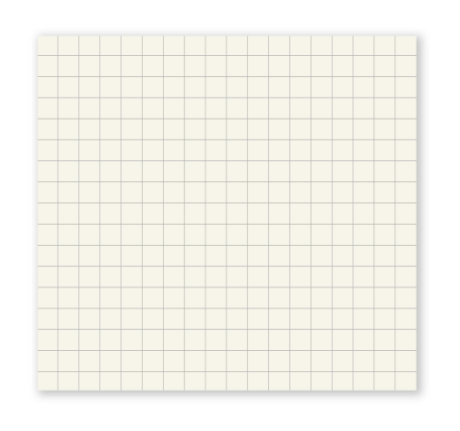
PROJECT OVERVIEW
PROJECT OVERVIEW
This project aims to deliver a [brief project purpose, e.g., "responsive portfolio website"] that effectively showcases skills and projects with a modern and accessible design. Using technologies such as [list major tools], the project focuses on clean UI, responsive layout, and user-friendly features like dark mode and smooth navigation. The end result is a professional portfolio that works seamlessly across devices and enhances the user's online presence.

Slide 6

WHO ARE THE END USERS?
WHO ARE THE END USERS?
THE PEOPLE WHO WILL VISIT AND USE YOUR PORTFOLIO WEBSITE ARE MAINLY:
EMPLOYERS AND RECRUITERS LOOKING TO EVALUATE YOUR SKILLS AND SUITABILITY FOR JOBS.
CLIENTS SEEKING PROFESSIONALS FOR PROJECTS OR SERVICES.
COLLEAGUES AND PEERS WANTING TO CONNECT OR COLLABORATE.
OTHER PROFESSIONALS OR LEARNERS INTERESTED IN YOUR WORK AND EXPERIENCE.

Slide 7

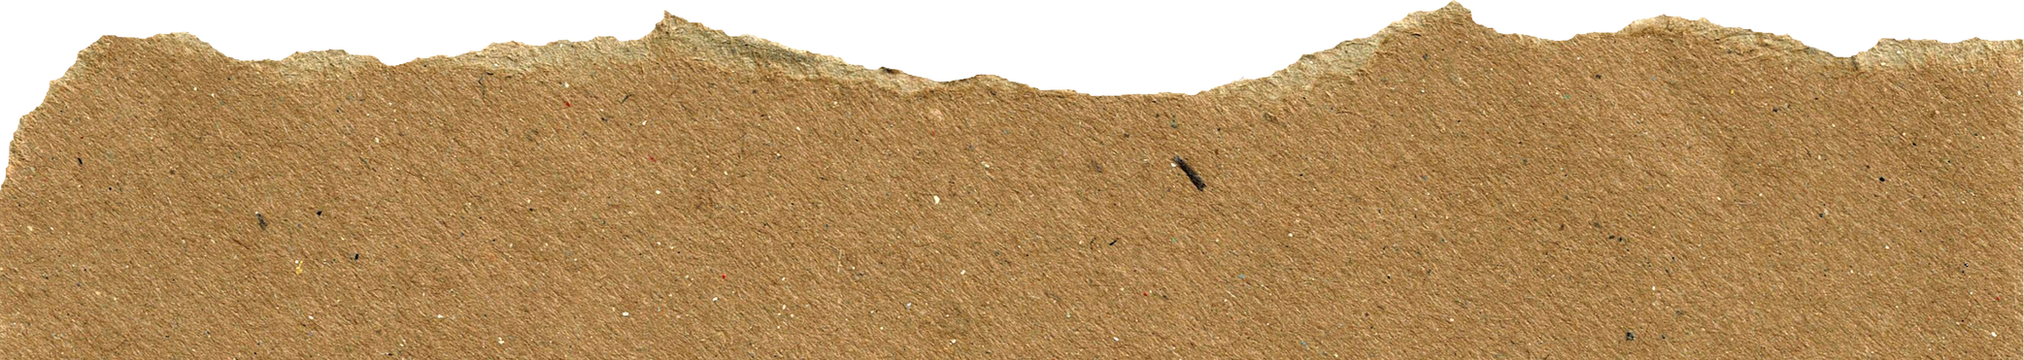
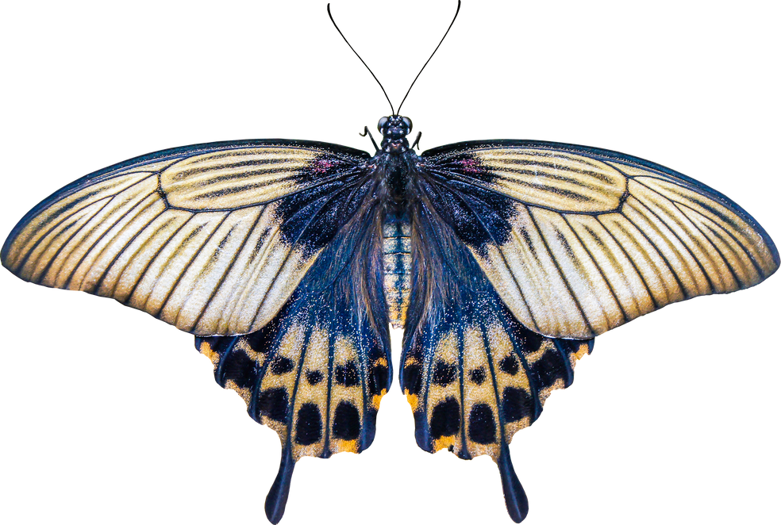
TOOLS AND TECHNIQUES
TOOLS AND TECHNIQUES
The projects were built using HTML, CSS, and JavaScript for front-end development, ensuring a responsive and interactive user interface. Additional tools include CSS animations for smooth visual effects and local storage for dark mode preference. Backend technologies (if applicable) may include Node.js, Express, and MongoDB for server-side logic and data management. Version control was managed using Git and GitHub. Design tools such as Google Fonts and SVG icons were also utilized for clean aesthetics.

Slide 8
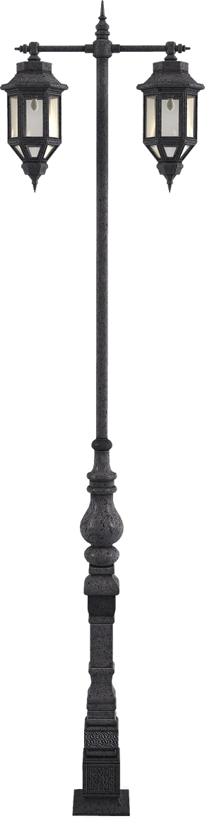
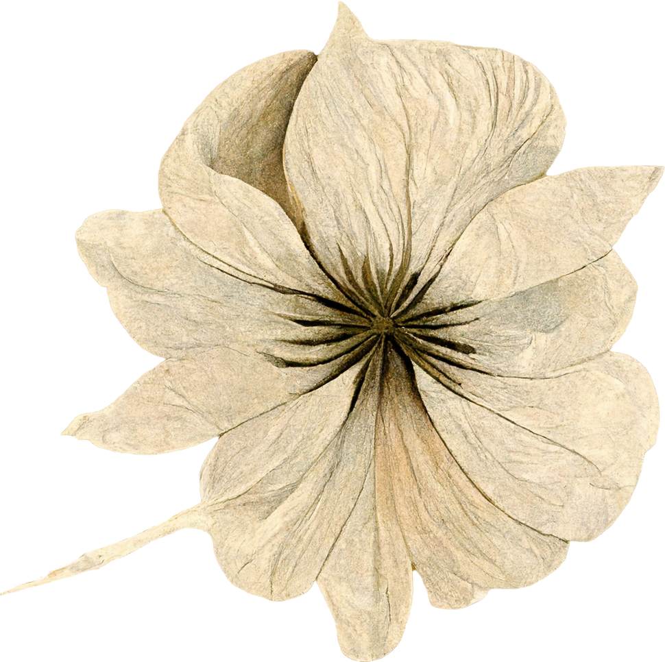
POTFOLIO DESIGN AND LAYOUT
The portfolio uses a clean, modern dark theme with glassmorphism-style cards for distinct content sections. The navigation bar is fixed at the top with the profile and links clearly separated for easy access. Sections (About, Projects, Contact) are spaced with rounded panels that highlight content without clutter. Responsive grid layouts display projects attractively on all screen sizes. Interactive elements like buttons and hover states improve usability and engagement. The design balances simplicity and elegance to professionally showcase skills and work.

Slide 9
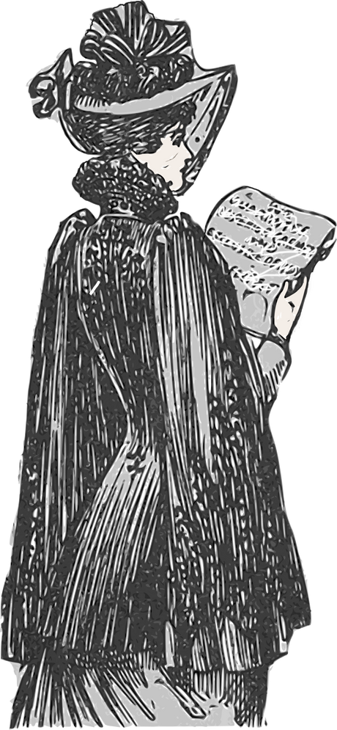
FEATURES AND FUNCTIONALITY
The portfolio includes responsive design for all screen sizes, dark/light mode toggle with saved preferences, smooth scrolling navigation with active link highlighting, and animated section reveal effects for enhanced user experience. Projects are displayed in a clean grid with hover effects. The contact form offers live validation and confirmation alerts. The top navigation bar shows profile image, name, menu links, and Instagram with accessible keyboard support.
The portfolio includes responsive design for all screen sizes, dark/light mode toggle with saved preferences, smooth scrolling navigation with active link highlighting, and animated section reveal effects for enhanced user experience. Projects are displayed in a clean grid with hover effects. The contact form offers live validation and confirmation alerts. The top navigation bar shows profile image, name, menu links, and Instagram with accessible keyboard support.

Slide 10
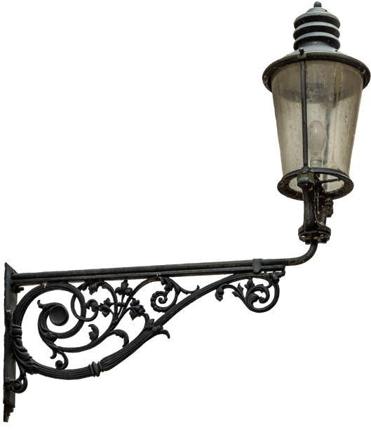
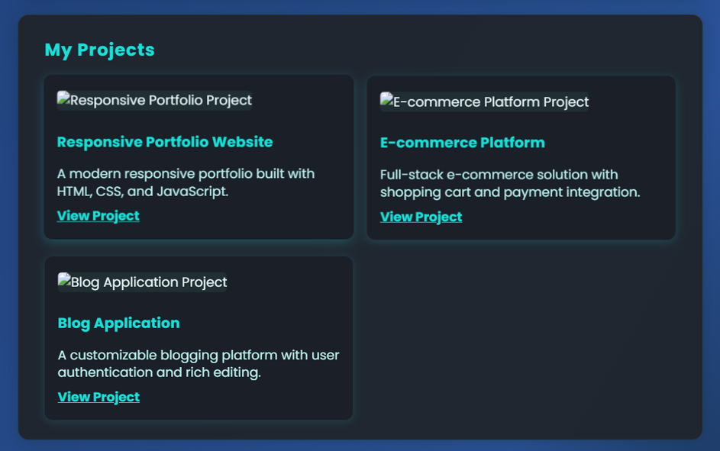
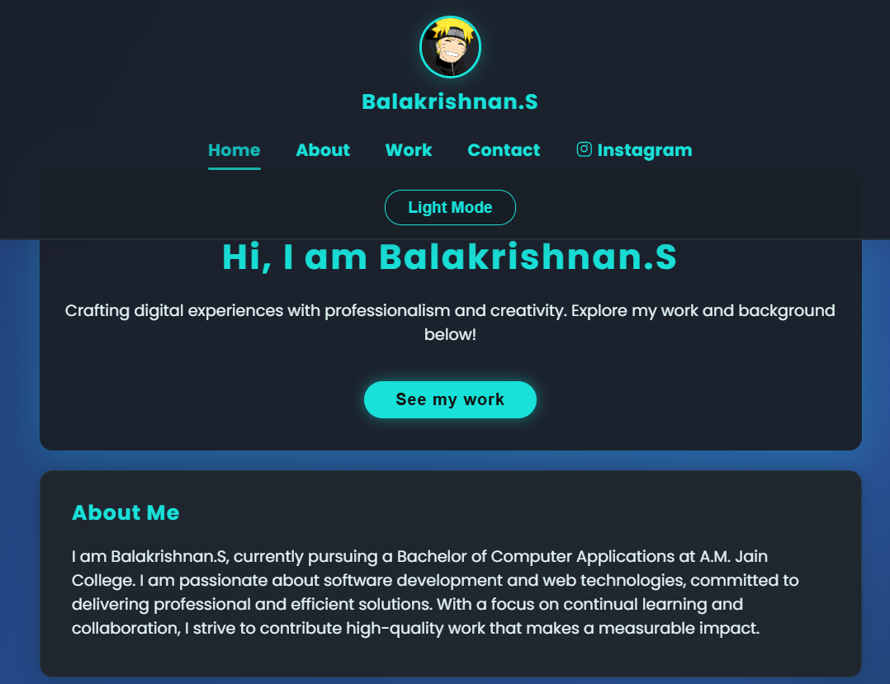
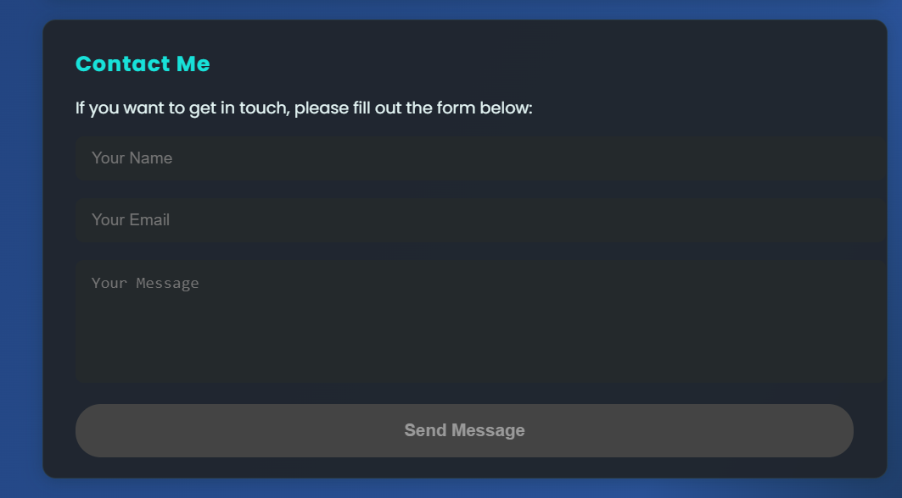

RESULTS AND SCREENSHOTS

Slide 11
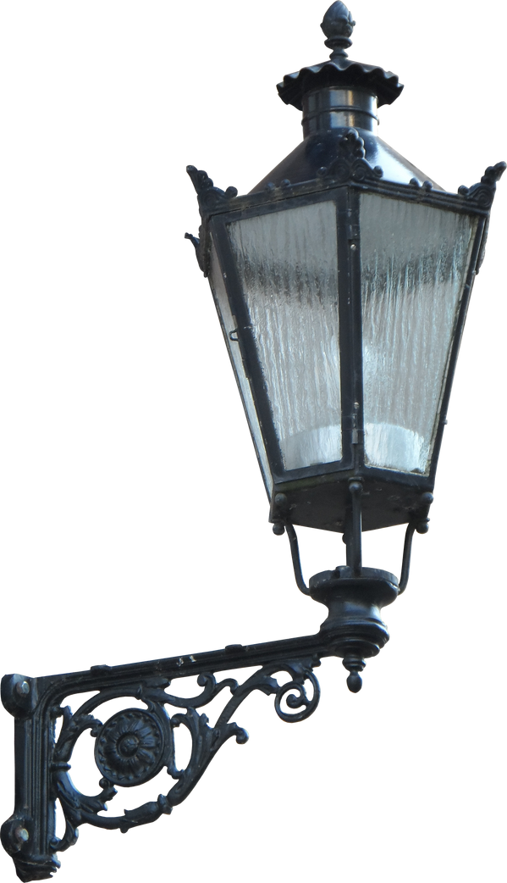
CONCLUSION
CONCLUSION
THIS PORTFOLIO SUCCESSFULLY PRESENTS SKILLS, EXPERIENCE, AND PROJECTS IN A CLEAN, PROFESSIONAL, AND ENGAGING WAY. WITH RESPONSIVE DESIGN, DARK MODE, AND INTUITIVE NAVIGATION, IT OFFERS VISITORS A SEAMLESS EXPERIENCE ACROSS DEVICES. THE DESIGN BALANCES AESTHETICS AND USABILITY, EFFECTIVELY SUPPORTING PERSONAL BRANDING AND PROFESSIONAL GROWTH.

Slide 12

Github Link
server link
https://github.com/balakrishnan-200517/TNSDC-FWD-DigitalPortfolio.git
deployment link
https://balakrishnan-200517.github.io/TNSDC-FWD-DigitalPortfolio/
THANK YOU

