Slide 1
    Docker is the world's leading software container platform.
    Docker is the leading Containers as a Service (CaaS) platform
    Package software into standardized units for development, shipment and deployment - Standardized unit is called Container
    Operators use Docker to run and manage apps side-by-side in isolated containers to get better compute density
    Docker containers running on a single machine share that machine's operating system kernel; they start instantly and use less compute and RAM

Slide 2
    Docker container is an open source software development platform. Its main benefit is to package applications in “containers,” allowing them to be portable among any system running the Linux operating system (OS).

Slide 3
    What is a Container?
  Containers are a way to package software in a format that can run isolated on a shared operating system.
Unlike VMs, containers do not bundle a full operating system - only libraries and settings required to make the software work are needed.
This makes for efficient, lightweight, self-contained systems and guarantees that software will always run the same, regardless of where it’s deployed.

Slide 4
    Advantages:
    Operators use Docker to run and manage apps side-by-side in isolated containers to get better compute density
    Containers isolate software from its surroundings, for example differences between development and staging environments and help reduce conflicts between teams running different software on the same infrastructure.
    Enterprises use Docker to build agile software delivery pipelines to ship new features faster, more securely and with confidence for both Linux, Windows Server, and Linux-on-mainframe apps
    Docker automates the repetitive tasks of setting up and configuring development environments so that developers can focus on what matters: building great software

Slide 5
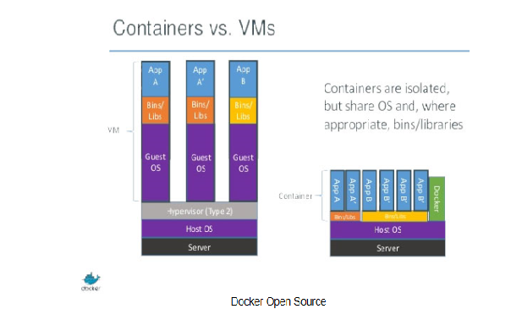
https://www.sdxcentral.com/cloud/containers/definitions/what-is-docker-container-open-source-project/

