Slide 1

Smart Meters

Slide 2
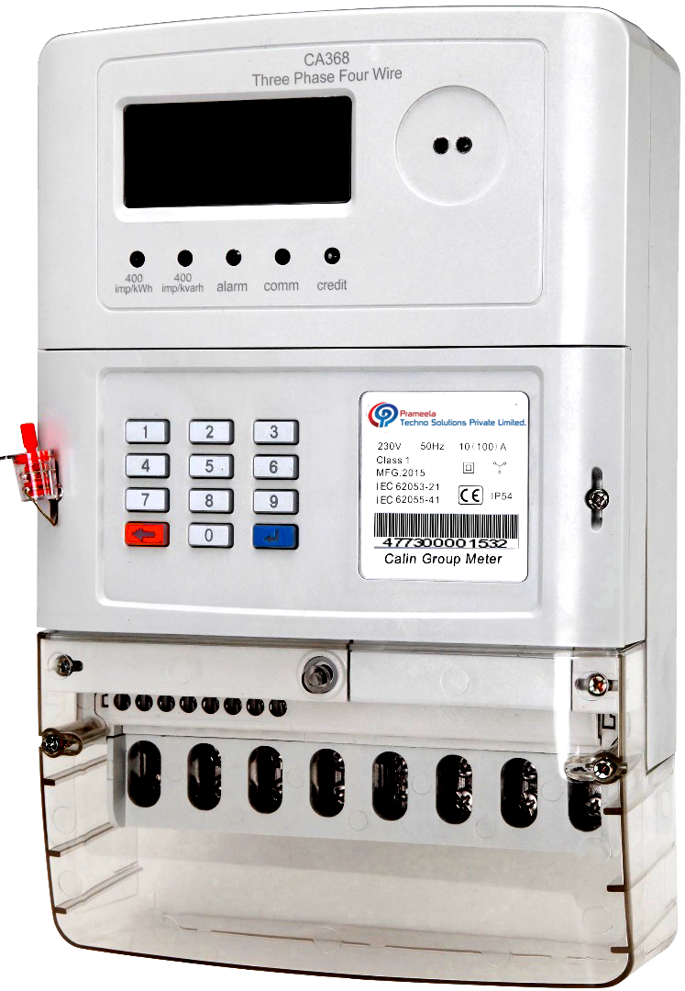
Dual Source Energy Meter
It Can Read Both EB and DG
It is a Global Standard Product.
Certified with NABL/CE.
Meter Can store the Data For 12 Months.
Features Like Anti Tamper
Low Credit Alarm.
20 Digit Token for Recharge .
End user can check the usage with short keys for Balance Amount and Usage.
It shows Total usage, Usage of Power , Usage of Generator.
It supports Various types of Communication system for remote reading like Lora/NBIOT

Slide 3
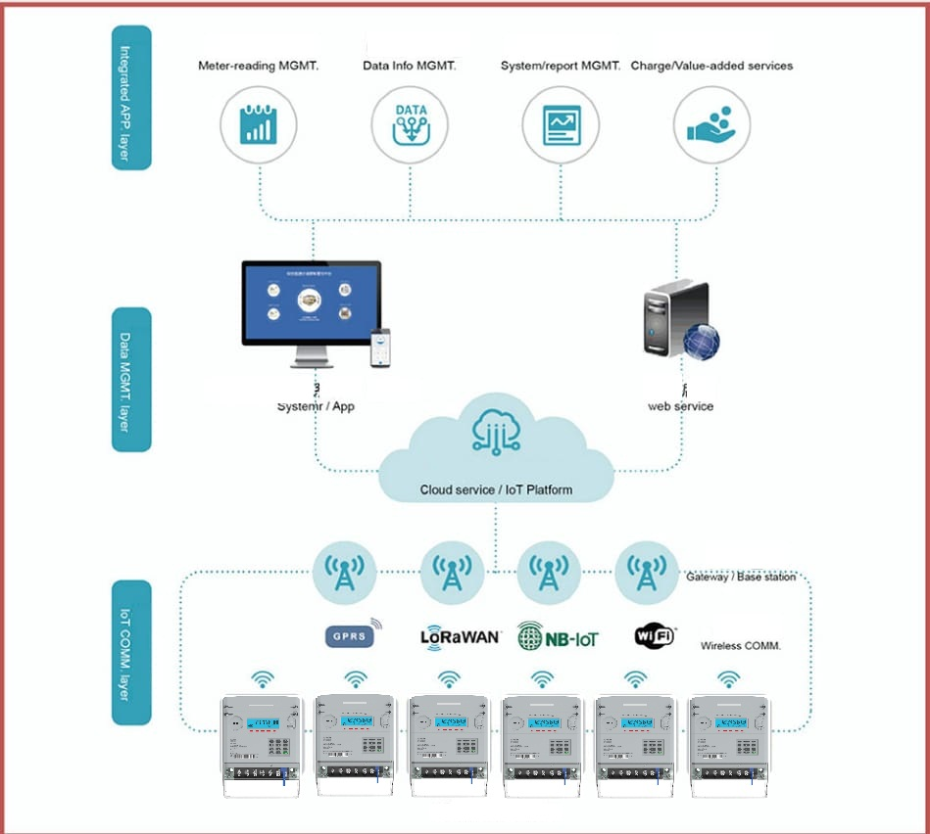
Architecture

Slide 4
software
Our software is developed in such a way that, with high Security and it can be deployed on cloud server as well as client/on-site server as per the client requirement.
It is multi user platform with high scalability and with mobile App functionality.
Our software is plug and play type where we can add New features and integrate multiple instruments.
Admin can manage all the activities like monitoring the meters, can Control the meters, Billing.
User can monitor his/her usage, register a query, Download the Bills and Pay the bills.
SMS Alerts will be sent to customers during Low credit Balance and on Bill Payments.
Customizable to add more features based on client requirements.

Slide 5
AMC
We provide Comprehensive AMC to our customer, we cover malfunctioned or defective product.
With comprehensive Annual maintenance contract we replace the item with New item.
AMC starts from Day 1 after the installation of the meter.
On Time service will be provided to our customer

Slide 6
Pricing
Pricing of the product: we give Cost-effective with loaded features and support when compared to other companies.

Slide 7
Meter Types(Plug and Play Type Model)
Meter Without Communication Module.
We Provide Username and Password for Login Portal.
Admin can generate 20 digit Token Number to recharge the meters.

Slide 8
Meter with Wired Communication
For Wired Communication A Data Collector is Required.
Every Meter has a RS485 Communication port.
Each meter is Connected with Cable with Towards the Data Collector.
Each Data Collector(DCU)Can connect upto 130 meters.
DATA Collector Can communicate the server Either with Ethernet Port or 4g Communication(SIM).

Slide 9
Wireless Communication
Energy meter supports Various types of Communication system for remote reading.
LORAWAN
LORA
NBIOT
WIFI
GPRS

Slide 10
WHY WE?
PRAMEELA TECHNO SOLUTIONS
GLOBAL STANDARD PRODUCT STS KEYPAD MODEL
BUILD QUALITY
VOLTAGE 3 * 230
Frequency 50Hz
HIGH SECURITY FEATURES
Automatically disconnects on high voltage , cover open, reverse connection and magnetic impulse
But need to give tamper token to activate the power.
Recharge can be done online and offline
Recharging can be done even there is no network
Storage of data for 12 months
End user can manage ussage by short cut keys like recharges , coveropen, monthly usage
IP54
Low Credit Alaram
Normal Cable For RS485 cost Effective
ELMEASURE & OTHERS
IN INDIA ONLY
Normal MODEL
VOLTAGE 3 * 240
Frequency 50 HZ
HIGH SECURITY FEATURES
Similar features but after fixing cover power activates
Only online recharge.
Recharging can be done even there is no network
Storage N/A
Just scroll to check the current usage
IP 51
N/A
CAT cable

