Slide 1
Analysis of Top 5 Institutes in NIRF Ranking
By:
Balakumaran K
Mail: balakumaranknd@gmail.com
Phone: 9940800973
Linkedin: www.linkedin.com/in/balakumaranknd

Slide 2
About Myself
My Skills:
Post Graduate Programme in Data Science and Engineering
B.E. Mechanical Engineering
Two years of experience as Data Associate at
Alexa Data Services, Amazon India Development Centre.
Linkedin: https://www.linkedin.com/in/balakumaranknd
GitHub: https://github.com/balakumaranknd
Programming & Database Management | : Python, SQL
EDA Libraries | : Numpy, Pandas, Plotly, Seaborn
Visualization Tools | : Tableau, Excel
Statistical Methods | : Hypothesis Testing, Chi-square Test, ANOVA
ML Algorithms | : Regression, Classification, Unsupervised Learning.

Slide 3
About National Institute of Ranking Framework
The National Institutional Ranking Framework (NIRF) is a methodology adopted by the Ministry of Education, Government of India, to rank institutions of higher education in India.
The Framework was approved by the MHRD and launched by Minister of Human Resource Development on 29 September 2015.
Depending on their areas of operation, institutions have been ranked under 11 different categories – overall, university, colleges, engineering, management, pharmacy, law, medical, architecture, dental and research.
The Framework uses several parameters for ranking purposes like resources, research, and stakeholder perception. These parameters have been grouped into five clusters and these clusters were assigned certain weightages.

Slide 4
Top 5 Institutes
IIT – Madras
IIT – Delhi
IIT – Bomaby
IIT – Kanpur
IIT - Kharagpur

Slide 5
1. Intake / Graduating Students

Slide 6
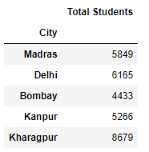
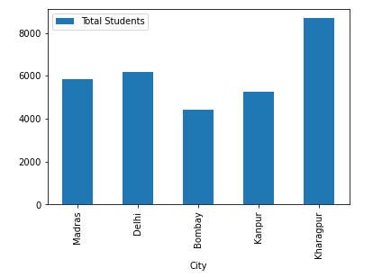
Total Students

Slide 7
Male / Female Composition

Slide 8
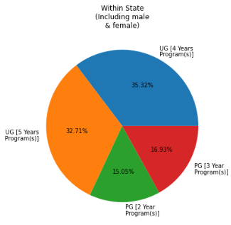
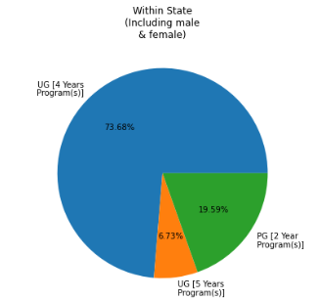
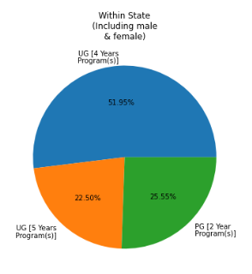
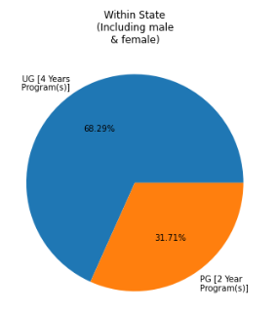
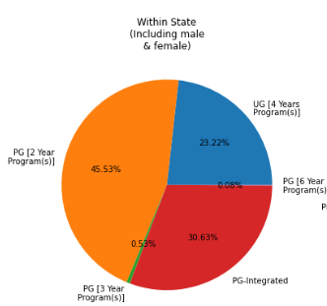
Native Region
1. IIT - Madras
2. IIT - Delhi
3. IIT - Bombay
4. IIT - Kanpur
5. IIT - Kharagpur

Slide 9
2. Placements /
Higher Studies

Slide 10
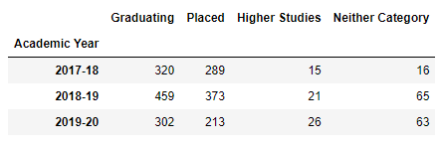
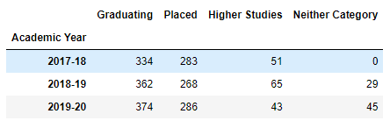
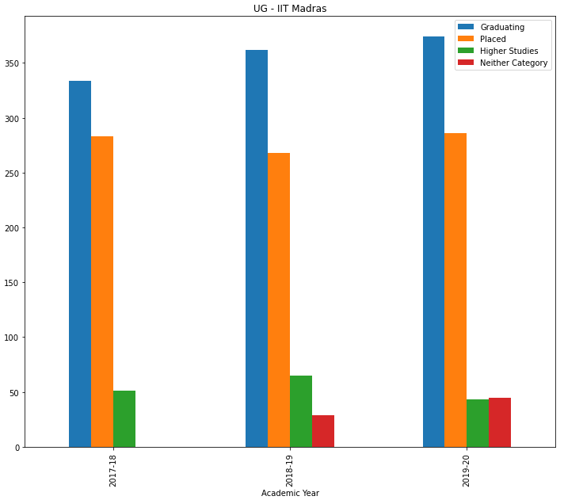
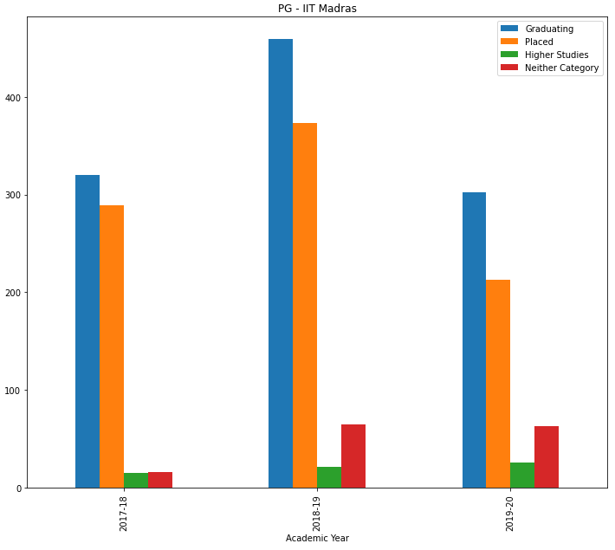
IIT Madras

Slide 11
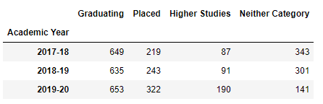
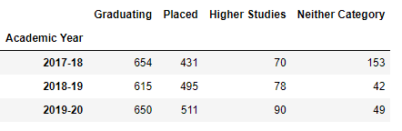
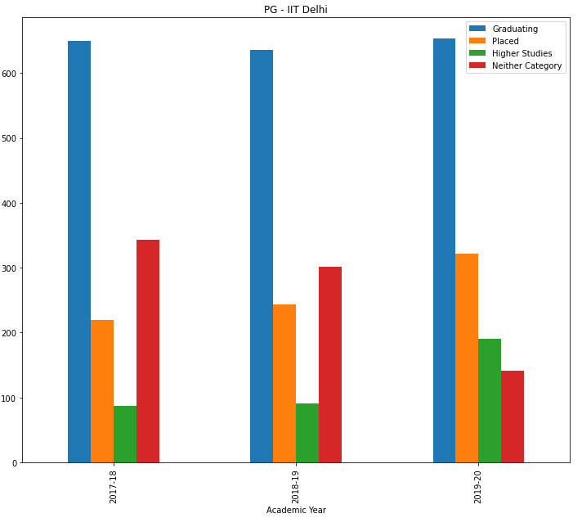
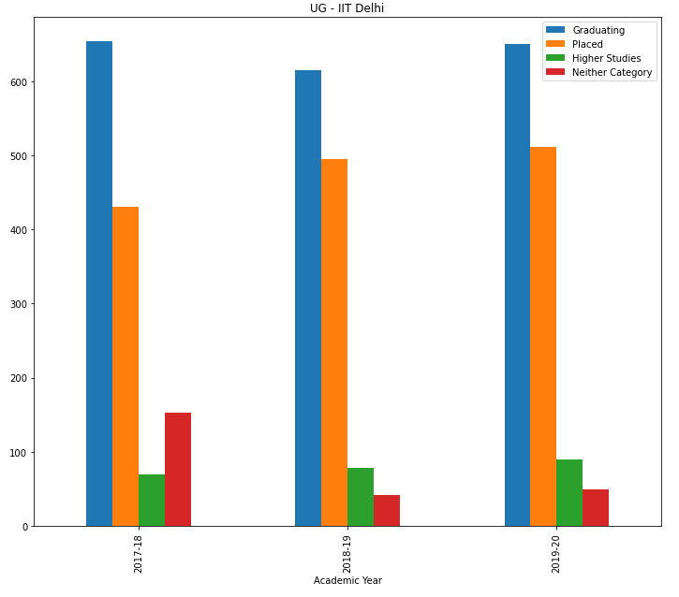
IIT Delhi

Slide 12
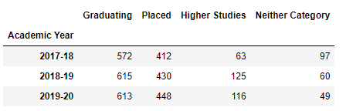
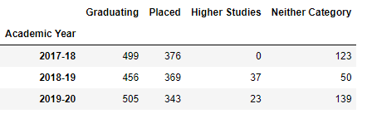
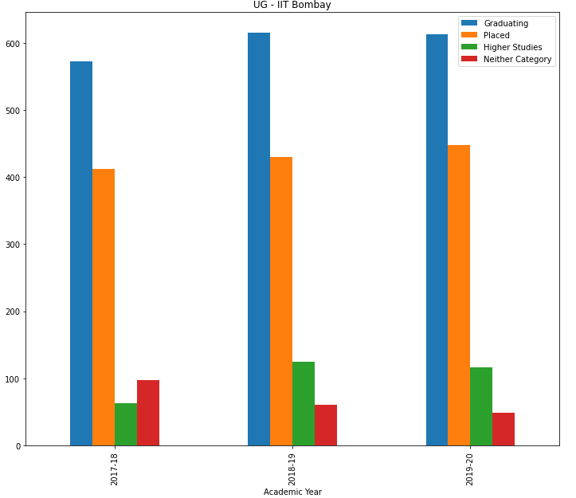
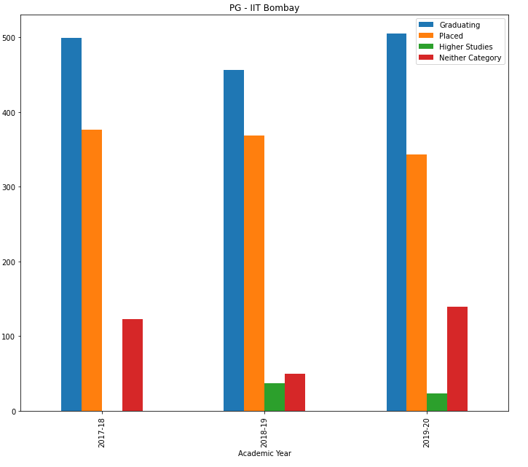
IIT Bombay

Slide 13
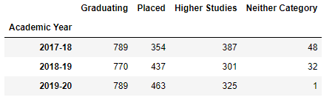
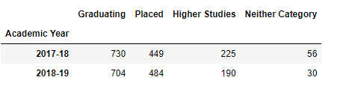
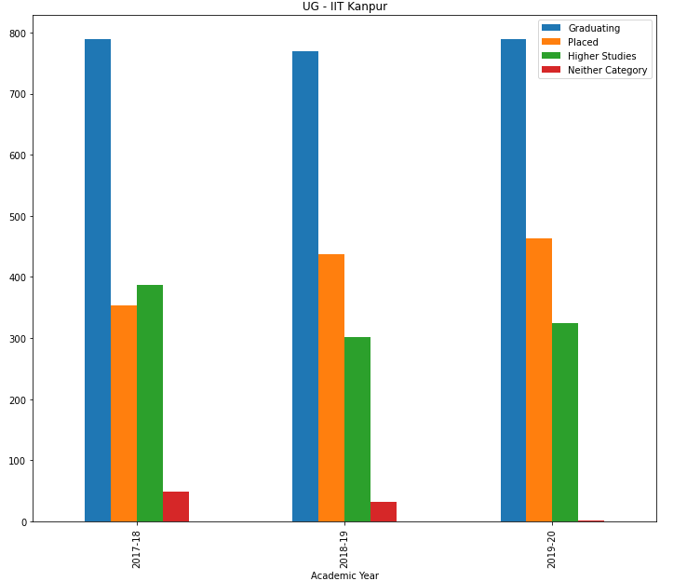
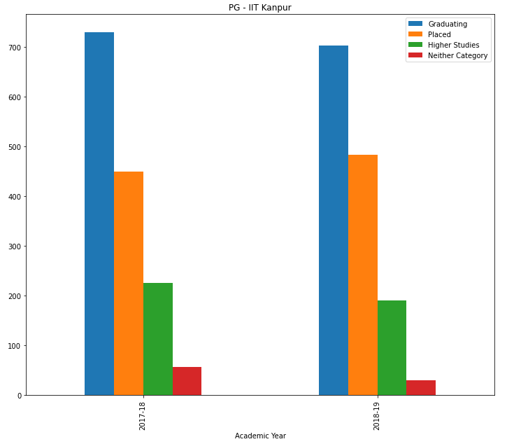
IIT Kanpur

Slide 14
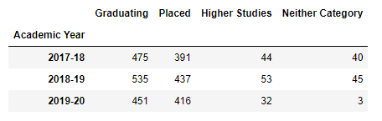
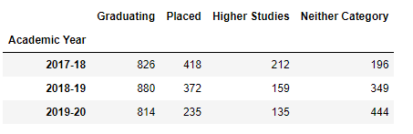
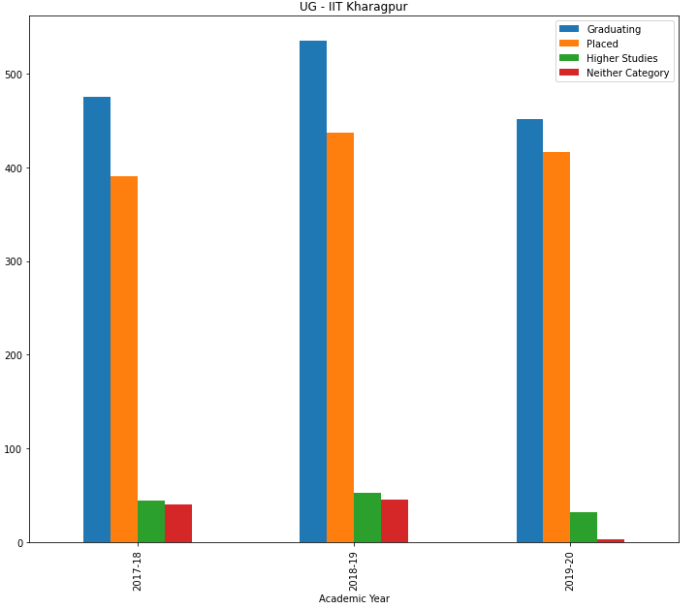
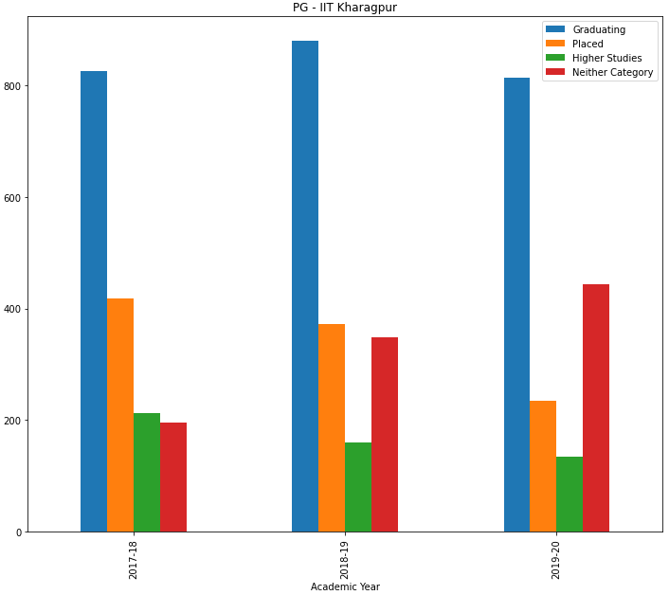
IIT Kharagpur

Slide 15
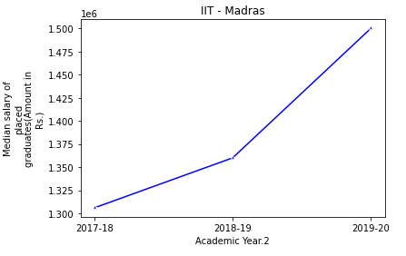
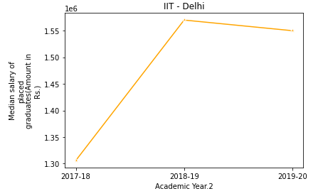
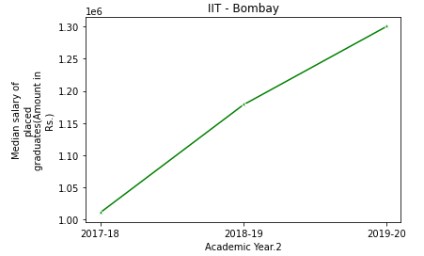
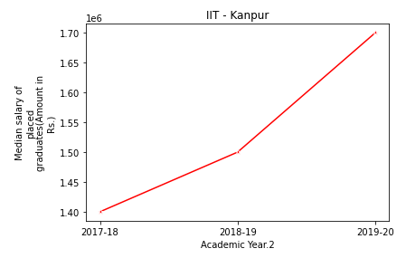
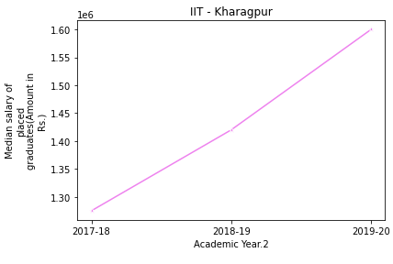
UG Placement Salary
1. IIT - Madras
2. IIT - Delhi
3. IIT - Bombay
4. IIT - Kanpur
5. IIT - Kharagpur

Slide 16
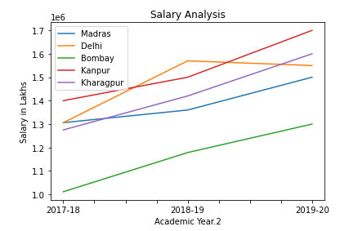
UG Placement Salary

Slide 17
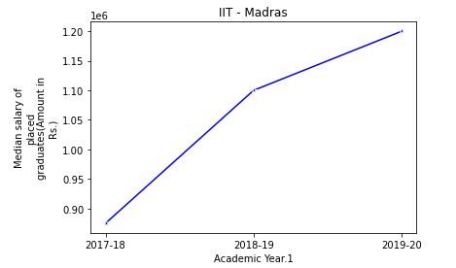
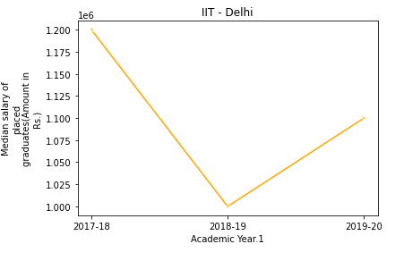
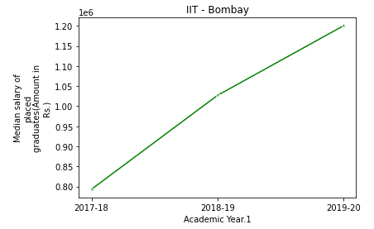
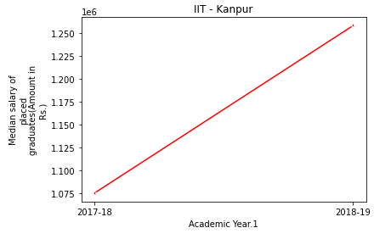
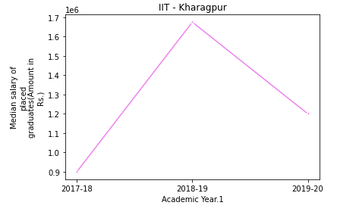
PG Placement Salary
1. IIT - Madras
2. IIT - Delhi
3. IIT - Bombay
4. IIT - Kanpur
5. IIT - Kharagpur

Slide 18
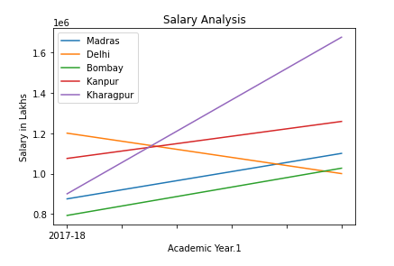
PG Placement Salary

Slide 19
3.Funding Received

Slide 20
Sponsored Research Funding
 | 2019-20 | 2018-19 | 2017-18
Madras | ₹ 1,71,52,92,173.00 | ₹ 1,36,84,92,534.00 | ₹ 1,05,77,16,173.00
Delhi | ₹ 30,96,08,826.00 | ₹ 45,07,96,210.00 | ₹ 27,05,77,543.00
Bombay | ₹ 59,67,00,000.00 | ₹ 75,66,00,000.00 | ₹ 46,36,00,000.00
Kanpur | ₹ 31,03,20,868.00 | ₹ 27,04,96,071.00 | ₹ 30,88,24,752.00
Kharagpur | ₹ 19,49,69,571.00 | ₹ 27,71,02,370.00 | ₹ 29,26,50,000.00

Slide 21
Consultancy Project Funding
 | 2019-20 | 2018-19 | 2017-18
Madras | ₹ 5,61,87,52,384.00 | ₹ 6,59,18,88,522.00 | ₹ 4,23,48,00,169.00
Delhi | ₹ 2,58,46,34,826.00 | ₹ 2,49,97,62,162.00 | ₹ 5,68,19,95,011.00
Bombay | ₹ 2,89,44,48,211.00 | ₹ 3,05,47,87,443.00 | ₹ 2,49,86,39,984.00
Kanpur | ₹ 2,70,00,66,718.00 | ₹ 2,24,54,09,467.00 | ₹ 2,05,58,38,339.00
Kharagpur | ₹ 25,98,01,587.00 | ₹ 1,62,62,49,488.00 | ₹ 2,34,39,00,000.00

Slide 22
Total Funding
 | 2019-20 | 2018-19 | 2017-18
Madras | ₹ 5,61,87,52,384.00 | ₹ 6,59,18,88,522.00 | ₹ 4,23,48,00,169.00
Delhi | ₹ 2,58,46,34,826.00 | ₹ 2,49,97,62,162.00 | ₹ 5,68,19,95,011.00
Bombay | ₹ 2,89,44,48,211.00 | ₹ 3,05,47,87,443.00 | ₹ 2,49,86,39,984.00
Kanpur | ₹ 2,70,00,66,718.00 | ₹ 2,24,54,09,467.00 | ₹ 2,05,58,38,339.00
Kharagpur | ₹ 25,98,01,587.00 | ₹ 1,62,62,49,488.00 | ₹ 2,34,39,00,000.00

Slide 23
4. Expenditure

Slide 24
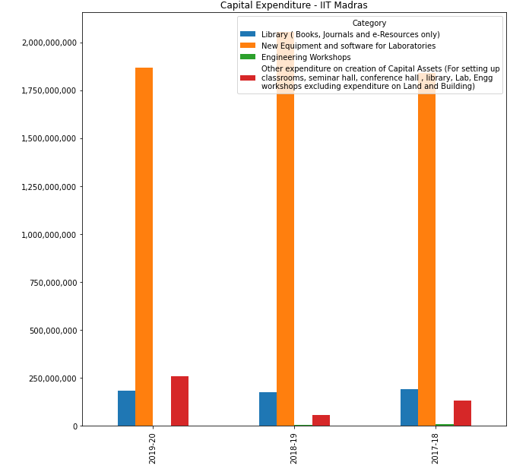
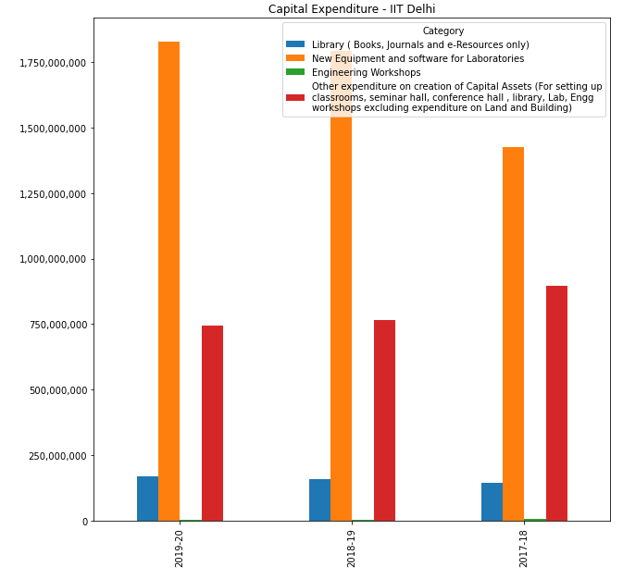
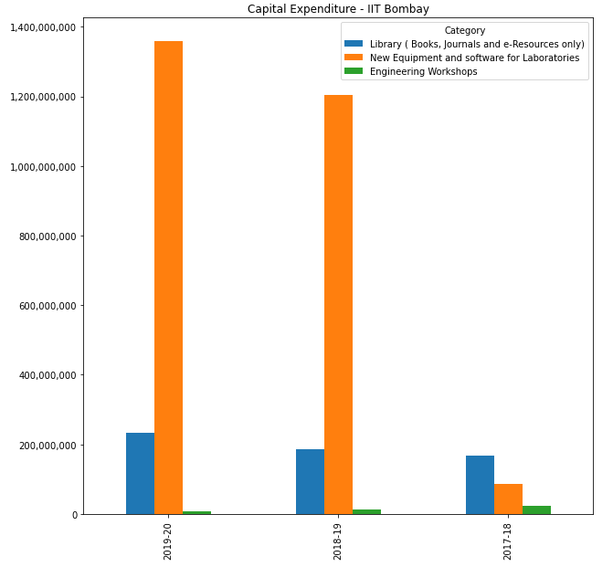
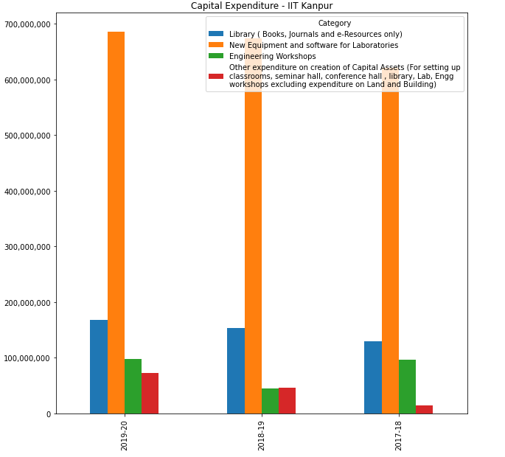
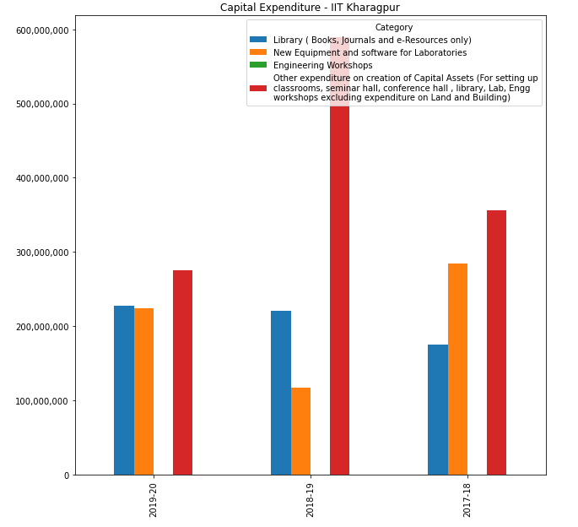
Capital Expenditure
1. IIT - Madras
2. IIT - Delhi
3. IIT - Bombay
4. IIT - Kanpur
5. IIT - Kharagpur

Slide 25
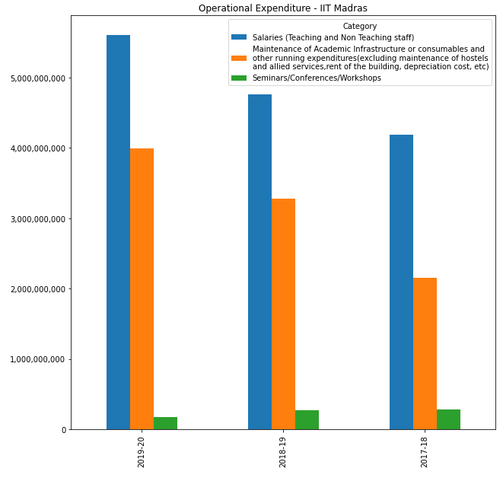
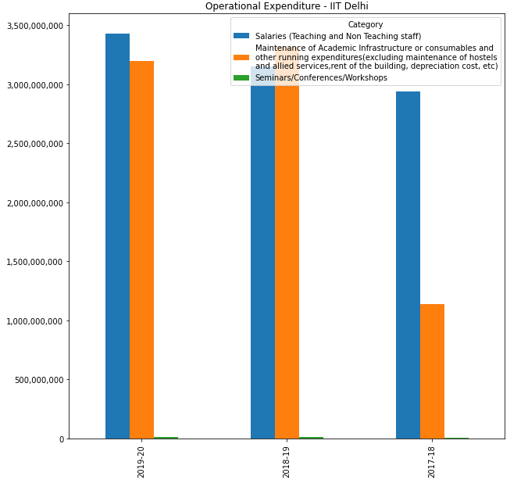
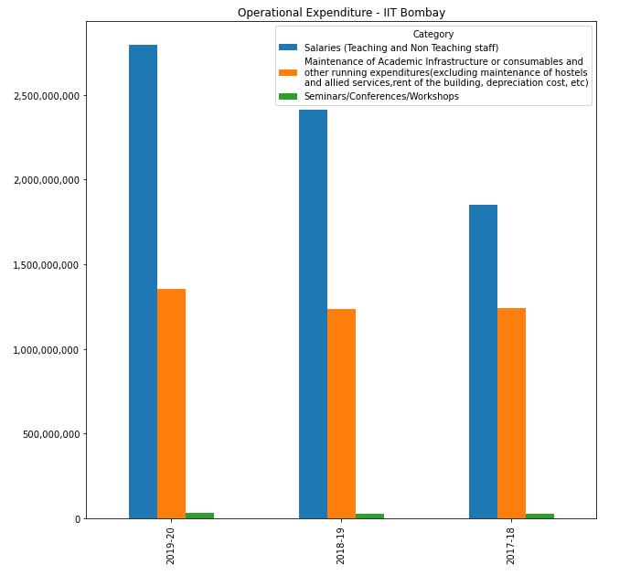
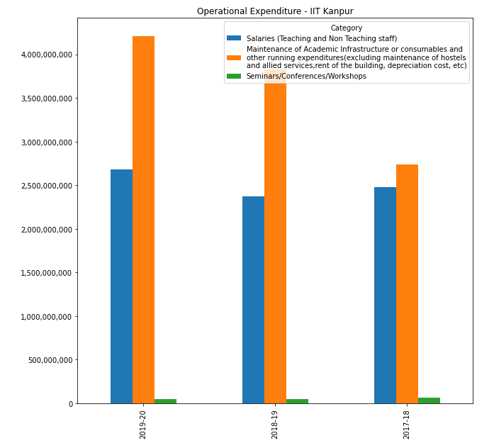
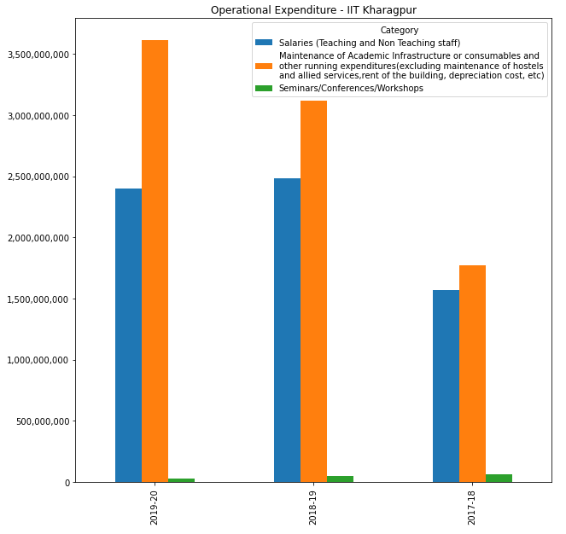
Operational Expenditure
1. IIT - Madras
2. IIT - Delhi
3. IIT - Bombay
4. IIT - Kanpur
5. IIT - Kharagpur

Slide 26
Expenditure Analysis (2019-20)
 | Operational Expenditure | Capital Expenditure
Madras | ₹ 9,76,59,80,361.00 | ₹ 2,30,36,31,730.00
Delhi | ₹ 6,64,23,96,544.00 | ₹ 2,74,24,95,496.00
Bombay | ₹ 4,17,93,26,243.00 | ₹ 1,59,93,18,692.00
Kanpur | ₹ 6,93,98,02,693.00 | ₹ 92,71,69,251.00
Kharagpur | ₹ 3,40,40,52,531.00 | ₹ 81,63,20,809.00

Slide 27
Total Expenditure (2019-20)
 | Total
Madras | ₹ 12,06,96,12,091.00
Delhi | ₹ 9,38,48,92,040.00
Bombay | ₹ 5,77,86,44,935.00
Kanpur | ₹ 7,86,69,71,944.00
Kharagpur | ₹ 4,22,03,73,340.00

Slide 28
Observations & Suggestions
Intake of girls into all of the IITs poor. Encouraging girls towards STEM, scholarships, government initiatives like Vigyan Jyoti Scheme are need of the hour.
Except for IIT-Madras the placement record for PG courses is poor. Steps must be taken to match industry and academia for better opportunity to students.
Salary performance of IIT-Delhi has gone down.
Bombay, Kanpur & Kharagpur have been performing consistently poor in attracting Sponsored Research. Adoption of Standard Practices and mentorship from successful IITs (Madras) would help.
Delhi, Kanpur & Kharagpur are attracting very low consultancy projects.
Capital Expenditure of Kharagpur is not going for New Equipment Purchase which is critical for lab infrastructure.
Kanpur & Kharagpur spending on Maintenance (Opex) compared to other Opex is good which other IITs could emulate.
In all the IITs Capital Expenditure is not even half of Operational Expenditure.
These are the top performing institutions across the nation, data analysis can help point out why these institutes are successful and may turn as a benchmark indicator for other institutions to learn and compete with one another.

Slide 29
Thank You. . . …

