Slide 1
ctrl+click
to follow the link
Zaxxon’s method for
creating BTB base projects
Most recent video tutorial in english:
http://www.divshare.com/download/11447916-783
DOWNLOAD
French site by parlesportes
http://plpcreation.cfun.fr/zaxxondes.html
DOWNLOAD
Example project (multi-track)
http://www.mediafire.com/file/ymjzwft4qz5/example_multitrack.7z
DOWNLOAD

Slide 2
Download the scripts
Downloading the scripts
1) Install Subversion
http://www.sliksvn.com/pub/Slik-Subversion-1.6.12-win32.msi
2) Run download_scripts.bat
http://www.mediafire.com/file/y45mwxjmumz/download_scripts.7z
DOWNLOAD
DOWNLOAD
Now you should have a folder c:\project with all the files you need
Updating the scripts
1) Run c:\project\update_scripts.bat

Slide 3
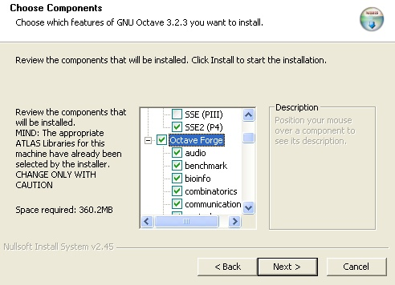
Install Octave 3.2.3
DOWNLOAD
In the Installation step select Octave Forge libraries
Alter installing Octave 3.2.3 run:
> pkg rebuild -auto communications

Slide 4
Install Gmsh and MeshLab
GMSH
http://geuz.org/gmsh/#Download
DOWNLOAD
MeshLab
http://meshlab.sourceforge.net/
DOWNLOAD
SASPlanet
http://sasgis.ru/programs/sasplanet/SASPlanet_100707.zip
DOWNLOAD

Slide 5
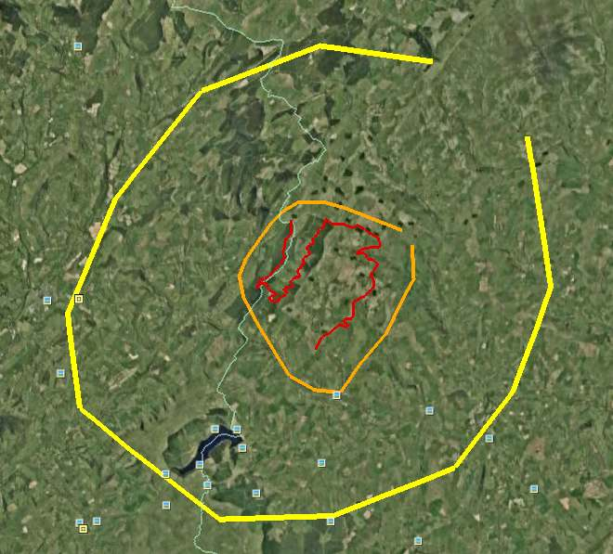
Let’s start
Get or create a kml file for your track
  Use enough nodes to have your track defined without ambiguity
  Save it inside s0_import folder as road.kml
OPTIONAL
If you want you can use kml paths to define the terrain zone for which you want elevation data. Otherwise you can define those zones numerically
limits.kml delimiting the terrain for the main route plus all the detours. Save it inside s2_elevation
limits_b.kml delimiting the terrain for all the project. Save it inside s2_elevation_b

Slide 6
Importing the kml
Run Octave
  > addpath(‘c:\project\scripts’)
If you created limits.kml and limits_b.kml
(you will use Google Earth as the source for elevation data)
If you didn’t create limits.kml and limits_b.kml
(you will use Google Earth as the source for elevation data but you want to do the steps manually or you are getting elevation data from a different source)
CLICK HERE
CLICK HERE

Slide 7
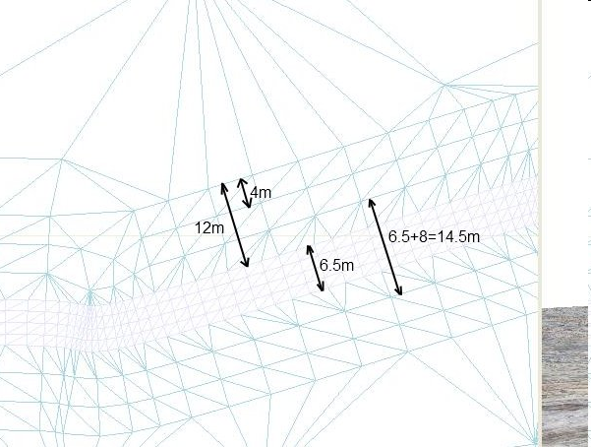
Using start
start script processes road.kml with importakml script and limits.kml and limits_b.kml with make_grid script
> cd c:\project
> start(25,75,5000)
> cd ..\Venue
> btb06(6.5,1)
Approximated width of your road (m)
gridXXX.kml have been created inside s2_elevation\salida and s2_elevation_b\salida folders. They have to be raised
NEXT

Slide 8
Manual import
> cd c:\project
> cd s0_import
> importakml(‘road.kml’)
> cd ..\Venue
> btb06(6.5,1)
Approximated width of your road (m)
NEXT

Slide 9
Getting elevation data
A file called lamalla.mat is created with the elevation data inside
Several elevation data sources are possible:
.hgt file
gridfloat
> cd ..\s2_elevation
> lee_hgt(“N41W009.hgt”,[41 42],[-9 -8])
> cd ..\s2_elevation
> leer_gridfloat(“file.hdr”,”file.flt”)
NEXT
NEXT
> cd ..\s2_elevation
> make_grid(-1000,1000,-1000,1000,25,5000)
or
> make_grid(‘limits.kml’,25,5000)
Google Earth
A set of files named gridXXX.kml have ben created inside salida directory
They need to be raised. Once that is done, read_grid script will read elevation data and create lamalla.mat
NEXT

Slide 10
Raise gridXXX.kml files
Options:
1) BTBLofty
Only works with WindowsXP, not with Vista nor Windows7
a) Open Google Earth
b) Process gridXXX.kml with BTBLofty. Save as gridXXX_relleno.kml
c) Close Google Earth
d) If not finished go to step a)
2) 3DRouteBuilder (not freeware. 15 euros)
3) raise_kml script (read doc raise_with_python before trying it)
(inside s2_elevation)
> raise_kml
(repeat for s2_elevation_b)
DOWNLOAD
DOWNLOAD
Once all the gridXXX_relleno.kml have been created:(
(Inside s2_elevation)
> read_grid

Slide 11
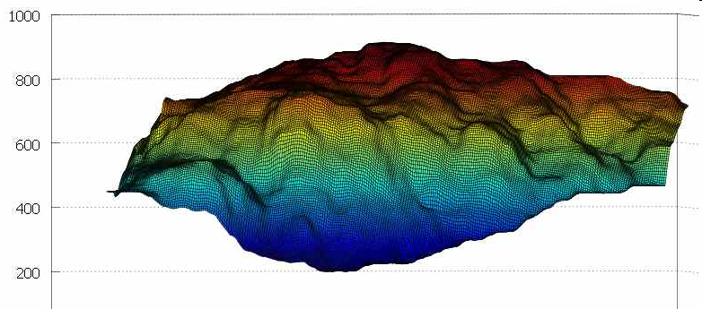
View lamalla.mat
(optional)
(inside s2_elevation)
> plot_lamalla

Slide 12
Raise the road
Once we have the road and elevation data, we give the road a elevation profile
Road
position
creartrack1
dar_altura
Elevation
profile
Terrain
elevation
data
End
corregir changes the terrain elevation data so it fits the desired road elevation profile
corregir
Good elevation data
Good road
elevation
profile
We go to the next step
We will have a bad road that fits a bad mountain
Bad
elevation
data
We accept the profile
Bad road
elevation
profile
We change the profile
We will have a good road that doesn’t fit a bad mountain

Slide 13
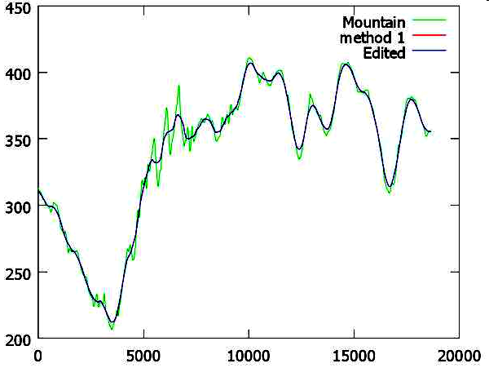
Raise the road
> cd ..\s3_road
> coge_datos
> creartrack1
> dar_altura(19,0.2,-0.2,25)
We want to
adapt the terrain
to the profile
We accept
the profile
> corregir
> cd ..\Venue
> btb06(6.5)
NEXT

Slide 14
Creating the mesh for the terrain
> cd ..\s1_mesh
> mallado_regular(12,3)
salida\anchors_carretera.geo has been created
Use gmsh to create
the mesh
save mesh as salida\anchors_carretera.msh
> trocea_malla

Slide 15
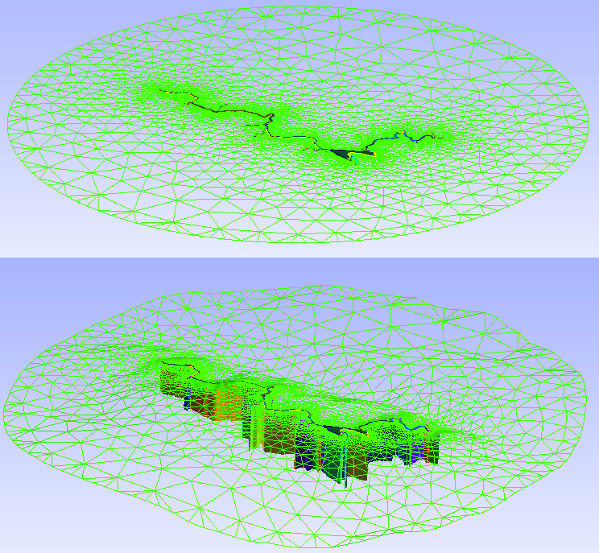
Raising the mesh
> cd ..\s4_terrain
> coge_datos
> procesar_nodostxt
We want to use MeshLab to change the mesh
We accept
anchors_carretera.msh
> simplificar
Use MeshLab
> accept_mesh
> juntar_mallas
NEXT

Slide 16
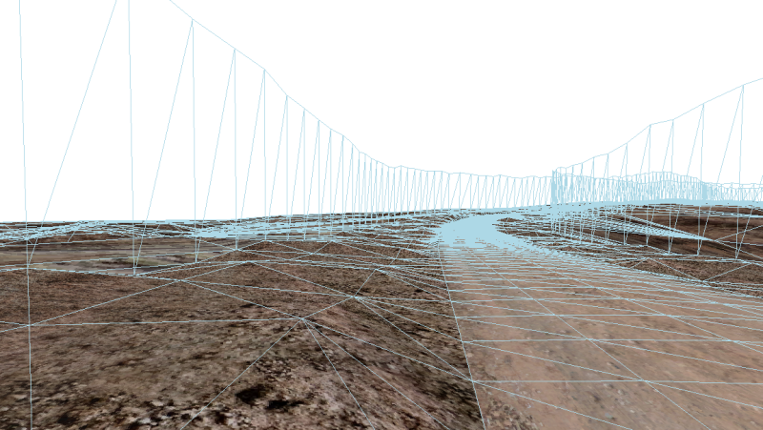
Add protection walls
> cd ..\s7_walls
> coge_datos
> poner_muro
NEXT

Slide 17
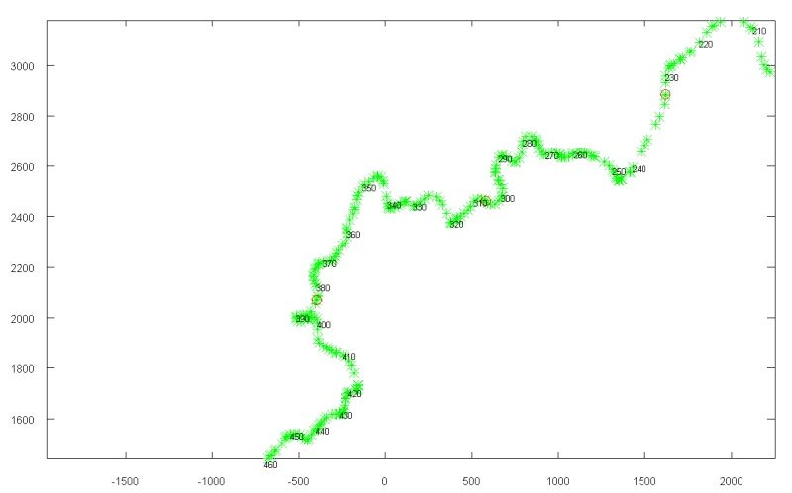
Split the track and terrain
You can split your track to be formed by several independent tracks. This makes BTB edition quicker
> cd ..\s10_split
> coge_datos
> split_track(6)
Check the points where the track will be splitted. If you want to change them, edit pos_nodes.txt
Split terrain using a 10x10 grid
> partir_track
> procesar_elementstxt_mt(10,10,1)
1 means blending with background images

Slide 18
Add background images
> cd ..\s1_mesh
> create_hlg
1) Open s1_mesh\grid.hlg with SASPlanet:
Operations -> Select -> Load from file -> Load -> Start
2) Save the images in a folder (c:\example_folder) with the desired splitting (5x3 in this example):
Operations -> Select -> Previous Selection -> Stick -> Start (YOU MUST select .dat file bindings)
The satellite images have been splitted and the info about the splitting coordinates is in the created .dat files.
> add_dat_to_geo (select option “create grid.geo”)
File list_bi.txt has been created. We will need it later

Slide 19
Add pacenotes
> cd ..\pacenotes
> coge
> pacenotes_a
> pacenotes2_a(0.1,10)
NOTE: afaik pacenotes are well positioned by the scripts, but BTB moves them for reasons I don’t understand. Usually the user has to reposition them by hand

Slide 20
Join the parts
> cd ..\s9_join
> join_all
salida\Venue.xml is the final result of the process
NOTE: background Images should be named sat_X-Y.dds and should be located inside
My Project\XPacks\Common\Textures
NOTE: if you have background images, open Venue.xml with a text editor and substitute
<BackgroundImages count="0">
with the contents of s1_mesh\list_bi.txt

