Slide 1
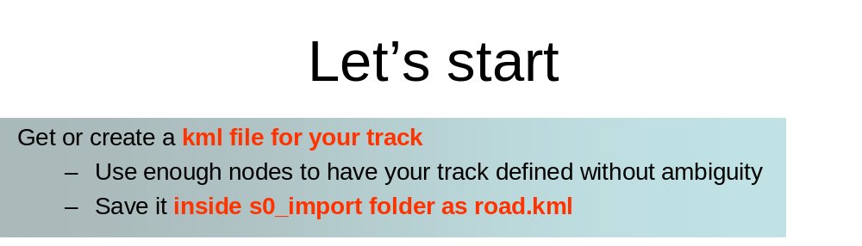
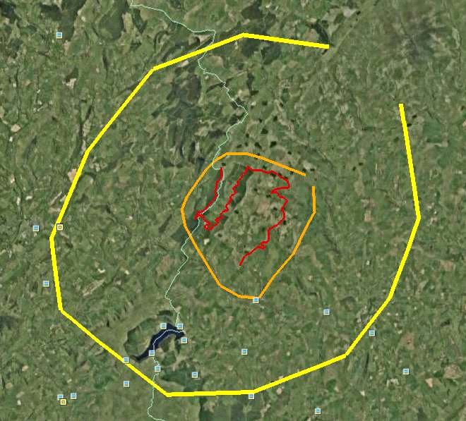
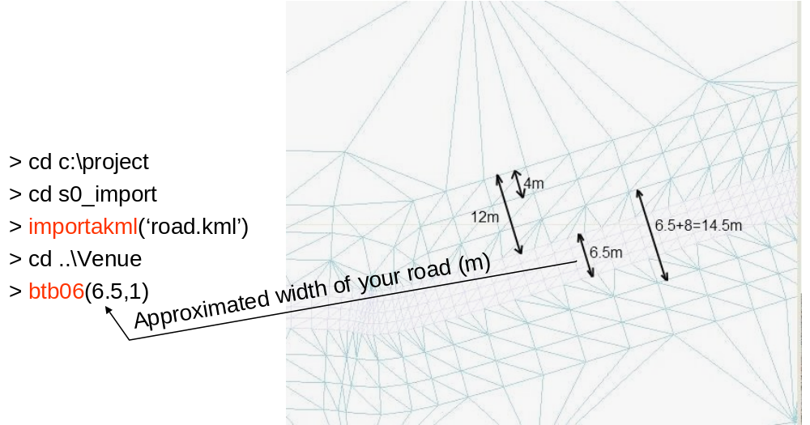
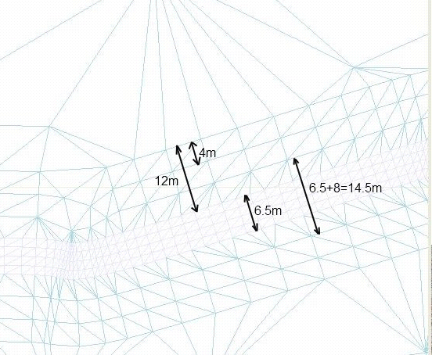
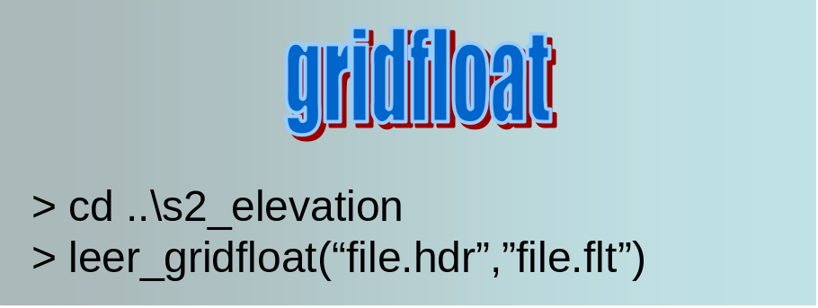
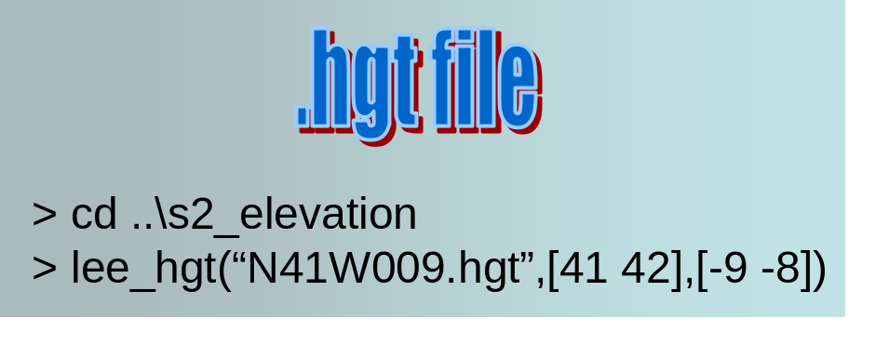
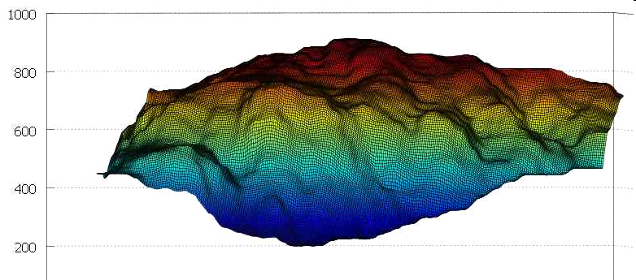
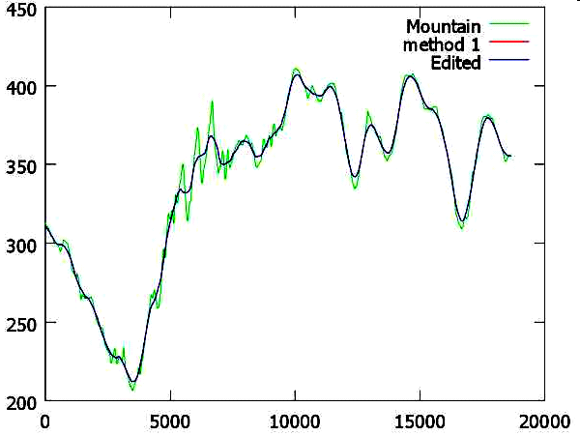
If
you
want
you
can use
kml
paths
to
define
the
terrain
zone
for
which
you
want
elevation
data.
limits.kml
delimiting the terrain for the
main route plus all the detours. Save it
inside
s2_elevation
limits_b.kml
delimiting the terrain for all
the project. Save it inside
s2_elevation_b
start
script
processes
road.kml
with
importakml
script
and
limits.kml
and
limits_b
.kml
with
make_grid
script
>
cd
c:
\
project
>
start
(25,75,5000)
(m)
>
cd
..
\
Venue
width
of
your
road
>
btb06
(6.5,1)
Approximated
>
cd
..
\
s2
_
elevation
>
make_grid
(
-
1000,1000,
-
1000,1000,25,5000)
or
gridXXX.kml
have
been
created
inside
A set
of
files
>
make_grid(
‘
limits.kml
’
,25,5000)
s2_
elevation
\
salida
and
s2_
elevation_b
\
salida
They
need
to
named
gridXXX.kml
have
ben
created
inside
salida
directory
folders
.
They
have
to
be
raised
data
and
be
raised
. Once
that
is
done,
read_grid
script
will
read
elevation
create
lamalla.mat
raise_kml script
3DRouteBuilder
BTBLofty
(read doc raise_with_python before trying it)
Not
freeware
Only works with WindowsXP, not with Vista nor Windows7
a) Open Google Earth
b) Process gridXXX.kml with BTBLofty. Save as gridXXX_relleno.kml
c) Close Google Earth
d) If not finished go to step a)
> raise_kml
(inside s2_elevation)
Give elevation
To the gridXXX.kml files. Save
As gridXXX_relleno.kml
.AGR files
Copy files inside
agr folder
> read_grid
(Inside s2_elevation and s2_elevation_b)
lamalla.mat
has been created
Once all the gridXXX_relleno.kml have been created:
lamalla.mat
and lamalla2.mat
have been created
lamalla.mat
has been created
(
inside
s2_
elevation
)
(optional)
>
plot_lamalla
>
cd
..
\
s3
_
road
>
s3_coge_datos
> creartrack1
>
dar_altura
(19,0.2,
-
0.2,25)
We
want
to
adapt
the
terrain
We
accept
to
the
profile
the
profile
> corregir
>
cd
..
\
Venue
> btb06(6.5)
>
cd
..
\
s1
_
mesh
>
mallado_regular
(12,3)
salida
\
anchors_carretera.geo
has
been
created
Use
gmsh
to
create
Read
gmsh_threshold.pdf
the
mesh
save
mesh
as
salida
\
anchors_carretera.msh
>
trocea_malla

Slide 2
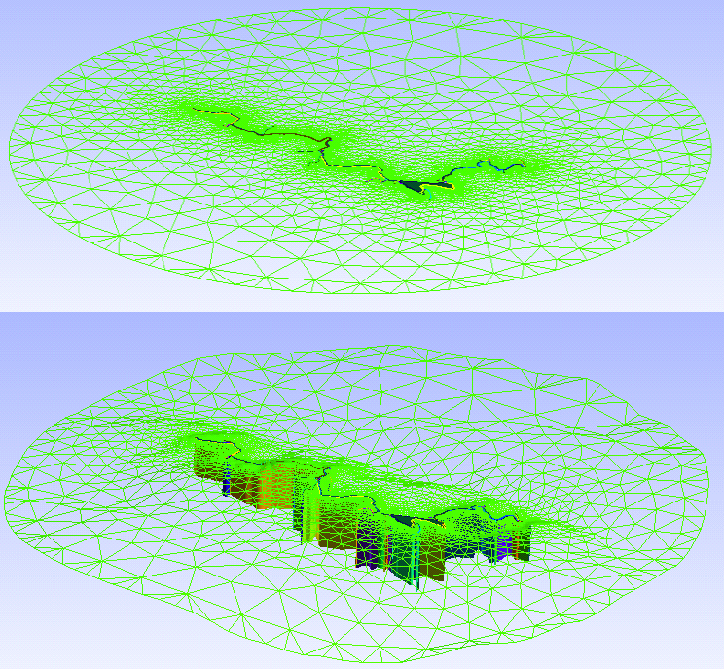
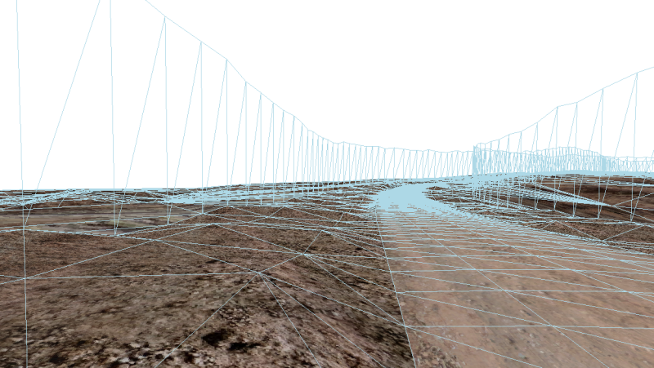
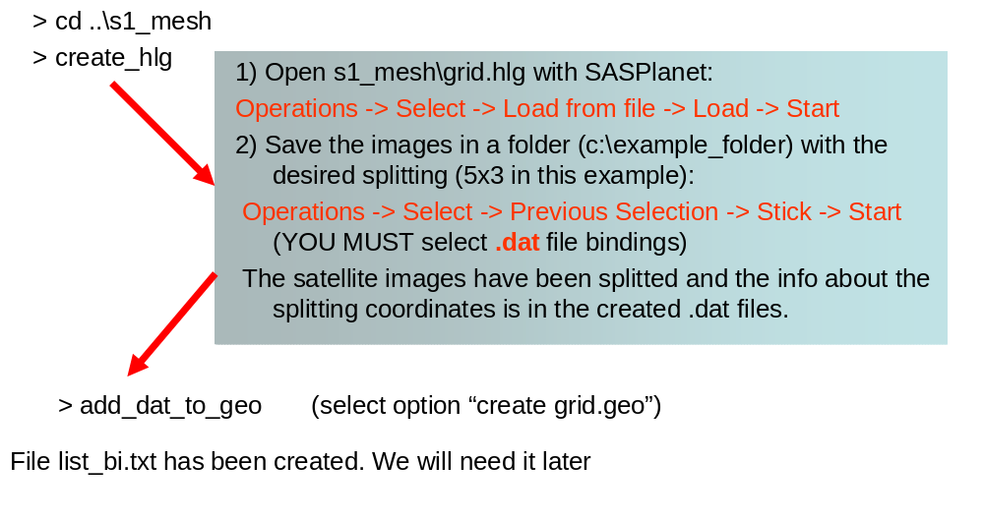
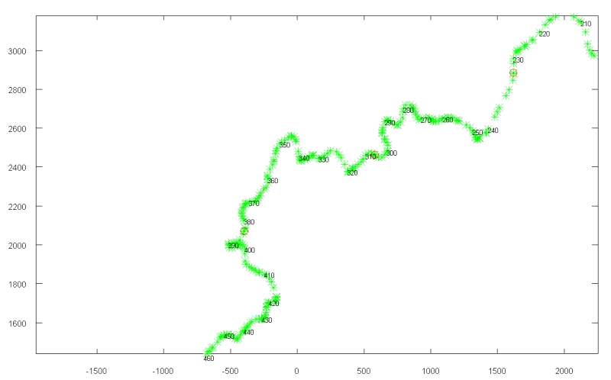
>
cd
..
\
s4
_
terrain
>
s4_coge_datos
procesar_nodostxt
We
want
to
use
We
accept
MeshLab
to
anchors_carretera.msh
change
the
mesh
> simplificar
Optional
>
accept_mesh
Use
MeshLab
>
juntar_mallas
> cd ..\s7_walls
> s7_coge_datos
> poner_muro
You can split your track to be formed by several independent tracks. This makes BTB edition quicker
>
cd
..
\
s10
_
split
NOTE: background Images should be named sat_X-Y.dds and should be located inside
My Project\XPacks\Common\Textures
>
s10_coge_datos
>
split_track
(6)
Check
the
points
where
the
track
will
be
splitted
.
If
you
want
to
change
them
,
edit
pos_nodes.txt
Split
terrain
using
>
partir_track
a 10x10
grid
>
procesar_elementstxt_mt
(10,10,1)
1
means
blending
with
background
images
> cd ..\pacenotes
> pn_coge_datos
> pacenotes_a
> pacenotes2_a(0.1,10)
> cd ..\s9_join
> join_all
s9_join\salida\Venue.xml is the final result of the process

