Slide 1
www.java9s.com

Slide 2
Spring Basic Bean wiring
www.java9s.com

Slide 3
Container and Wiring
www.java9s.com

Slide 4
Two important containers
org.springframework.beans.factory.BeanFactory
org.springframework.context.ApplicationContext
www.java9s.com

Slide 5
BeanFactory
Factory design pattern.
BeanFactory factory =new XmlBeanFactory(new FileSystemResource(“e:/spring/beans.xml"));
www.java9s.com

Slide 6
ApplicationContext
An application context gives more:
Support for I18N(Internationalization) for messages.
Provides generic way to load resources.
Publish events to beans registered as events.
www.java9s.com

Slide 7
ApplicationContext
ClassPathXmlApplicationContext - XML file located in the classpath
FileSystemXmlApplicationContext - XML file in the file system
XmlWebApplicationContext - XML file
contained within a web application
www.java9s.com

Slide 8
ApplicationContext
ApplicationContext context = new FileSystemXmlApplicationContext("c:/foo.xml");
ApplicationContext context = new ClassPathXmlApplicationContext("foo.xml");
www.java9s.com

Slide 9
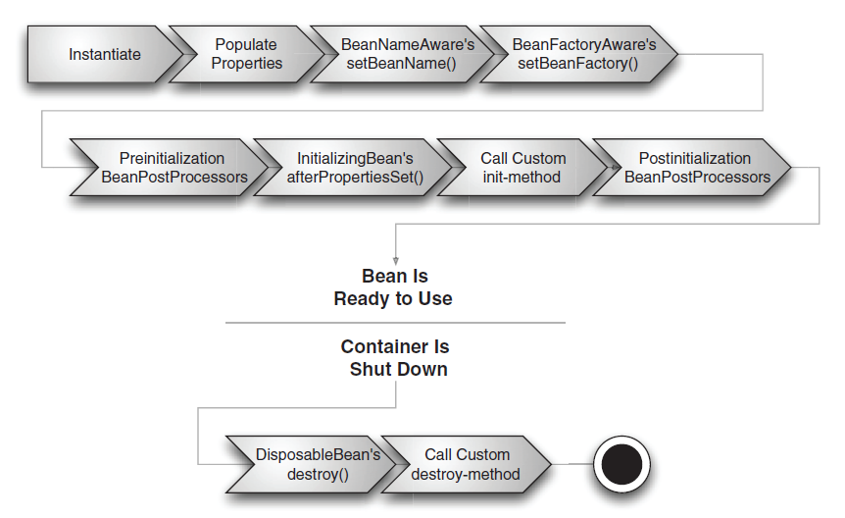
Beans Life cycle
www.java9s.com
Above Figure is from Spring in action book, Manning publications

Slide 10
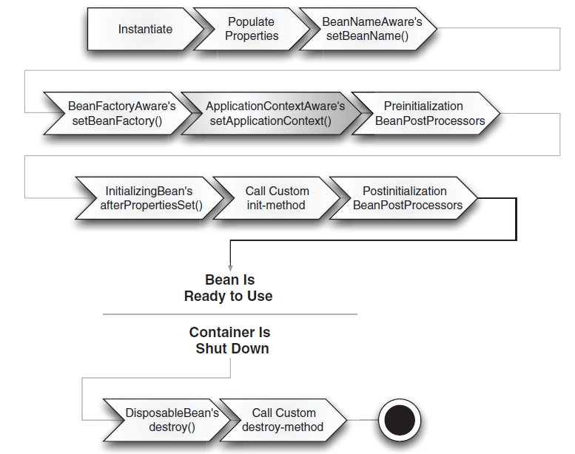
ApplicationContext – Bean Life Cycle
Above Figure is from Spring in action book, Manning publications
www.java9s.com

