Slide 1
Spring Bean Factory

Slide 2
BeanFactory
BeanFactory is an implementation of Factory design pattern.
It is a general purpose factory ,creating and dispensing many types of beans.
There are several implementations of BeanFactory in Spring framework.
Most commonly used is org.springframework.beans.factory.xml.XmlBeanFactory.

Slide 3
BeanFactory
BeanFactory bfact = new XmlBeanFactory(new InputStreamResource(new FileInputStream("hello.xml")));
GreetingService ser = (GreetingService)bfact.getBean("greetingService");

Slide 4
Basic Wiring
<?xml version="1.0" encoding="UTF-8"?>
<!DOCTYPE beans PUBLIC "-//SPRING//DTD BEAN//EN" "http://www.springframework.org/dtd/spring-beans.dtd">
<beans>
<bean id ="greetingService" class="GreetingServiceImpl" singleton="false">
<property name="greeting">
<value> india </value>
</property>
</bean>
</beans>

Slide 5
ApplicationContext
Same as BeanFactory , provides much more functionality than BeanFactory.
It can resolve text messages,internationalization etc.
Provides generic way to load file resources.
Can publish events to beans that are registered as listeners.

Slide 6
Types of ApplicationContext
ClassPathXmlApplicationContext
  Loads the context definitions from an XML file located in the classpath.
FileSystemXmlApplicationContext
  Loads the context definitions from an XML file located in the File System.
XmlWebApplicationContext
  Loads the context definitions from an XML file contained within a web application.

Slide 7
Bean Lifecycle
org.springframework.beans.factory.InitializingBean.afterPropertiesSet()
  Allows a bean to perform initialization work after all necessary properties on the bean are set by the BeanFactory
Alternate way
  <bean id="exampleInitBean" class="examples.ExampleBean" init-method="init"/>

Slide 8
Bean Lifecycle Cont …
org.springframework.beans.factory.DisposableBean. destroy()
  interface allows a bean to get a callback when the BeanFactory containing it is destroyed.
Alternate way
  <bean id="exampleInitBean" class="examples.ExampleBean" destroy-method="cleanup"/>

Slide 9
Spring interfaces
org.springframework.beans.factory.BeanFactoryAware. setBeanFactory(BeanFactory beanFactory)
  provides with a reference to the BeanFactory that created it, when it is created by that BeanFactory.
org.springframework.beans.factory.BeanNameAware.setBeanName(String name)
  The callback will be Invoked after population of normal bean properties but before an init callback like InitializingBean's afterPropertiesSet or a custom init-method.

Slide 10
Lifecycle of BeanFactory
Bean is instantiated and populates all the properties using IOC.
If BeanNameAware is implemented , setBeanName() is called.
If BeanFactoryAware is implemented , setBeanFactory() is called.
If BeanPostProcessors is implemented , PostProcessBeforeInitialization() is called.
If an Init-Method is specified for the bean , then it will be called.
If BeanPostProcessors is implemented , PostProcessAfterInitialization() is called.
If DisposableBean is implemented, destroy() is called.
If a custom destroy-method is specified, it will be called.
For ApplicationContext ApplicationContextAware’s setApplicationContext() will be called before PostProcessBeforeInitialization().

Slide 11
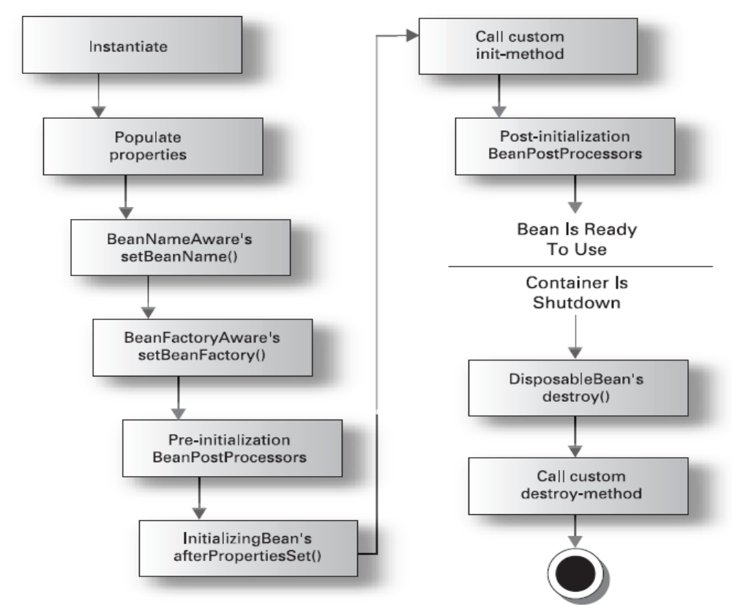
Bean Lifecycle with Spring Bean Factory

Slide 12
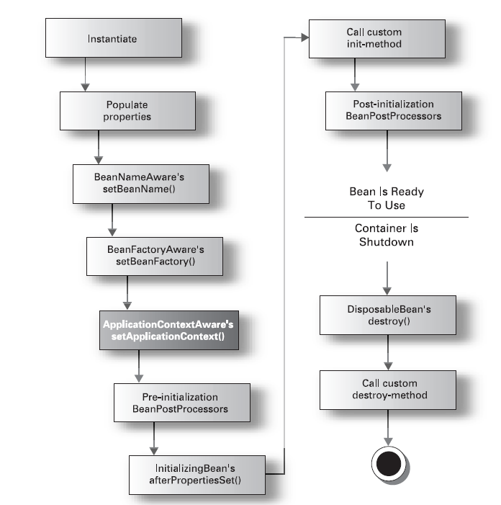
Bean LifeCycle with Spring ApplicationContext

Slide 13
Multiple xml files
<beans>
<import resource="services.xml"/>
<import resource="resources/messageSource.xml"/>
<import resource="/resources/themeSource.xml"/>

Slide 14
Injecting dependency via setter method
<bean id="exampleBean“ class="examples.ExampleBean">
<property name="beanOne"><ref bean="anotherExampleBean"/></property>
<property name="beanTwo"><ref bean="yetAnotherBean"/></property>
<property name="integerProperty"><value>1</value></property>
</bean>
<bean id="anotherExampleBean" class="examples.AnotherBean"/>
<bean id="yetAnotherBean" class="examples.YetAnotherBean"/>

Slide 15
Bean Class
public class ExampleBean {
private AnotherBean beanOne;
private YetAnotherBean beanTwo;
private int i;
public void setBeanOne(AnotherBean beanOne) {
this.beanOne = beanOne;
}
public void setBeanTwo(YetAnotherBean beanTwo) {
this.beanTwo = beanTwo;
}
public void setIntegerProperty(int i) {
this.i = i;
}
}

Slide 16
Constructor based injection
<bean id="exampleBean" class="examples.ExampleBean">
<constructor-arg><ref bean="anotherExampleBean"/></constructor-arg>
<constructor-arg><ref bean="yetAnotherBean"/></constructor-arg>
<constructor-arg type="int"><value>1</value></constructor-arg>
</bean>
<bean id="anotherExampleBean" class="examples.AnotherBean"/>
<bean id="yetAnotherBean" class="examples.YetAnotherBean"/>

Slide 17
Bean Class
public class ExampleBean {
private AnotherBean beanOne;
private YetAnotherBean beanTwo;
private int i;
public ExampleBean(AnotherBean anotherBean, YetAnotherBean yetAnotherBean, int i) {
this.beanOne = anotherBean;
this.beanTwo = yetAnotherBean;
this.i = i;
}
}

Slide 18
Factory
<bean id="exampleBean" class="examples.ExampleBean" factory-method="createInstance">
<constructor-arg><ref bean="anotherExampleBean"/></constructor-arg>
<constructor-arg><ref bean="yetAnotherBean"/></constructor-arg>
<constructor-arg><value>1</value></constructor-arg>
</bean>
<bean id="anotherExampleBean" class="examples.AnotherBean"/>
<bean id="yetAnotherBean" class="examples.YetAnotherBean"/>

Slide 19
Bean Class
public class ExampleBean {
private ExampleBean(...) {
}
public static ExampleBean createInstance(AnotherBean anotherBean,
YetAnotherBean yetAnotherBean, int i) {
ExampleBean eb = new ExampleBean(...);
return eb;
}
}

Slide 20
Constructor argument resolution
public class ExampleBean {
private int years;
private String ultimateAnswer;
public ExampleBean(int years, String ultimateAnswer) {
this.years = years;
this.ultimateAnswer = ultimateAnswer;
}
}

Slide 21
xml
<bean id="exampleBean" class="examples.ExampleBean">
<constructor-arg type="int"><value>7500000</value></constructor-arg>
<constructor-arg type="java.lang.String"><value>42</value></constructor-arg>
</bean>

Slide 22
Constructor argument index
<bean id="exampleBean" class="examples.ExampleBean">
<constructor-arg index="0"><value>7500000</value></constructor-arg>
<constructor-arg index="1"><value>42</value></constructor-arg>
</bean>

Slide 23
Setting null
<bean class="ExampleBean">
<property name="email"><null/></property>
</bean>

Slide 24
List,Set,Map,Properties
<beans>
<bean id="moreComplexObject" class="example.ComplexObject">
<property name="people">
<props>
<prop key="HarryPotter">The magic property</prop>
<prop key="JerrySeinfeld">The funny property</prop>
</props>
</property>
<property name="someList">
<list>
<value>a list element followed by a reference</value>
<ref bean="myDataSource"/>
</list>
</property>
<property name="someMap">
<map>
<entry key="yup an entry">
<value>just some string</value>
</entry>
<entry key="yup a ref">
<ref bean="myDataSource"/>
</entry>
</map>
</property>
<property name="someSet">
<set>
<value>just some string</value>
<ref bean="myDataSource"/>
</set>
</property>
</bean>
</beans>

Slide 25
Application Context
AbstractApplicationContext ctx = new ClassPathXmlApplicationContext(new String []{“beans.xml”,”test.xml”});

