Slide 1
Singleton

Slide 2
*Some applicaBons need only one instance of a class. * The instance needs to be easily accessible for clients. * Context:'Ensuring that there is only one instance created.

Slide 3
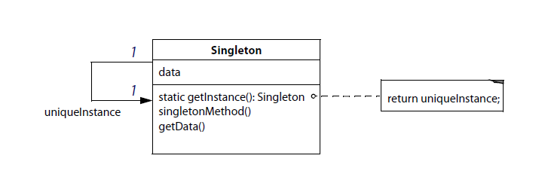
Singleton:'Generalized'Solution‘
* Clients access the unique Instance only through the
getInstance"method of the"Singleton"class.

Slide 4
Subclasses'of'Singleton‘ *Major issue: installing the unique instance. *A factory that creates an appropriate subclass. *A registry: *Subclasses register their instances in a dicBonary. *Pair<ClassName, Singleton instance>

Slide 5
Uses'of'the'Singleton' *Smalltalk uses Singleton for metaclasses. *GUI systems use Singleton to define their look and feel.

Slide 6
Subclasses'of'Singleton‘ * Major issue: installing the unique instance * A factory that creates an appropriate subclass *A registry: * Subclasses register their instances in a dicBonary * Pair<ClassName, Singleton instance>

Slide 7
Uses'of'the'Singleton‘ * Smalltalk uses Singleton for metaclasses *GUI systems use Singleton to define their look and feel

Slide 8
Benefits'of'Singleton' * Controlled access to the single instance * Cleaner name space * Can be modified to provide for an arbitrary number of unique instances * Greater flexibility than with class methods • In C , they cannot be redefined

Slide 9
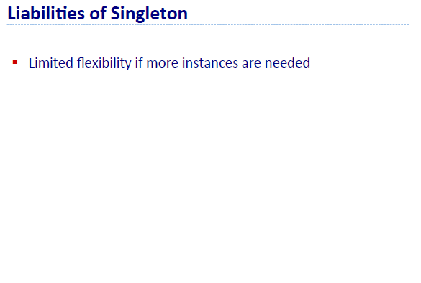

Slide 10
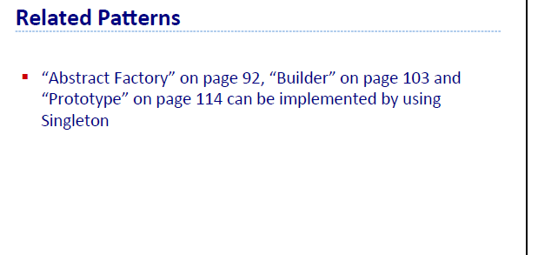

Slide 11
End

