Slide 1
Owl-M-A-Material-Design-Study-App
Submitted By
AARTHI DEVI A V
BALAMBIGAI M
DEEPAK R
GOKUL G

Slide 2
DESCRIPTION
A project that demonstrates the use of Android Jetpack Compose to build a UI for a Owl-M: a material design study app.
Owl-M app is a sample project built using the Android Compose UI toolkit. A Compose implementation of the Owl Material study.

Slide 3
To complete the project you need to finish up the tasks listed below:
Tasks:
1.Required initial steps
2.Creating a new project.
3.Adding required dependencies.
4.Creating the database classes.
5.Building application UI & connecting to database.
6.Using AndroidManifest.xml
7.Running the application.

Slide 4
Main Activity.JAVA
name: Android CI on: [push] jobs: build: runs-on: ubuntu-latest steps: - uses: actions/checkout@v1 - name: set up JDK 1.8 uses: actions/setup-java@v1 with: java-version: 1.8 - name: Build with Gradle run: ./gradlew build

Slide 5
<?xml version="1.0" encoding="UTF-8"?>
<project version="4">
<component name="GradleSettings">
<option name="linkedExternalProjectsSettings">
<GradleProjectSettings>
<option name="distributionType" value="DEFAULT_WRAPPED" />
<option name="externalProjectPath" value="$PROJECT_DIR$" />

Slide 6
<option name="modules"> <set>
<option value="$PROJECT_DIR$" /> <option value="$PROJECT_DIR$/app" /> <option value="$PROJECT_DIR$/design_system" /> <option value="$PROJECT_DIR$/rally_line_chart" /> <option value="$PROJECT_DIR$/rally_line_indicator" /> <option value="$PROJECT_DIR$/rally_pie" /> <option value="$PROJECT_DIR$/rally_scrollable_tab" /> <option value="$PROJECT_DIR$/themebuilder" />
</set> </option>

Slide 7
<option name="resolveModulePerSourceSet" value="false" />
</GradleProjectSettings> </option> </component> </project>

Slide 8
encodings.xml
<?xml version="1.0" encoding="UTF-8"?>
<project version="4">
<component name="Encoding"
addBOMForNewFiles="with NO BOM" />
</project>

Slide 9
idea/gradle.xml
<?xml version="1.0" encoding="UTF-8"?> <project version="4"> <component name="GradleSettings"> <option name="linkedExternalProjectsSettings"> <GradleProjectSettings>
<option name="distributionType" value="DEFAULT_WRAPPED" /> <option name="externalProjectPath" value="$PROJECT_DIR$" />

Slide 10
.<option name="modules"> <set> <option value="$PROJECT_DIR$" /> <option value="$PROJECT_DIR$/app" /> <option value="$PROJECT_DIR$/design_system" /> <option value="$PROJECT_DIR$/rally_line_chart" /> <option value="$PROJECT_DIR$/rally_line_indicator" /> <option value="$PROJECT_DIR$/rally_pie" /> <option value="$PROJECT_DIR$/rally_scrollable_tab" /> <option value="$PROJECT_DIR$/themebuilder" /> </set> </option>

Slide 11
<option name="resolveModulePerSourceSet" value="false" />
</GradleProjectSettings> </option> </component> </project>

Slide 12
app/build.gradle
apply plugin: 'com.android.application' apply plugin: 'kotlin-android' apply plugin: 'kotlin-android-extensions' android { def globalConfiguration = rootProject.extensions.getByName("ext") compileSdkVersion 29 buildToolsVersion "29.0.3"

Slide 13
defaultConfig { applicationId "io.playground.material.rally" minSdkVersion 23 targetSdkVersion 29 versionCode
globalConfiguration["androidVersionCode"] versionName globalConfiguration["androidVersionName"] testInstrumentationRunner
"androidx.test.runner.AndroidJUnitRunner"

Slide 14
buildTypes { release { minifyEnabled false proguardFiles getDefaultProguardFile('proguard-android-optimize.txt'), 'proguard-rules.pro' } }

Slide 15
android { compileOptions { sourceCompatibility 1.8 targetCompatibility 1.8 } kotlinOptions { jvmTarget = "1.8" } } }

Slide 16
dependencies { implementation fileTree(dir: 'libs', include: ['*.jar']) implementation project(':design_system') implementation project(':rally_pie') implementation project(':rally_scrollable_tab') implementation project(':rally_line_chart') implementation project(':rally_line_indicator')

Slide 17
implementation "org.jetbrains.kotlin:kotlin-stdlib-jdk7:$kotlin_version" implementation 'androidx.appcompat:appcompat:1.1.0' implementation 'androidx.constraintlayout:constraintlayout:2.0.0-beta4' testImplementation 'junit:junit:4.12' implementation 'androidx.legacy:legacy-support-v4:1.0.0' androidTestImplementation 'androidx.test:runner:1.2.0'

Slide 18
androidTestImplementation 'androidx.test.espresso:espresso-core:3.2.0' implementation 'com.google.android.material:material:1.1.0' implementation 'androidx.core:core-ktx:1.2.0' } }

Slide 19

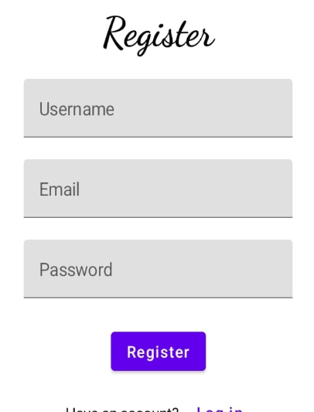

Slide 20

