Slide 1
Learn and Share
———————————————————-
1. Springboot
2. Microservice
3. Restful
4. Eureka (Discovery Server)
5. Zuul (API Gateway)
6. Hibernate/JPA
7. Circuit Breaker and Fall-back concepts
8. Spring cloud sleuth (Logging)
9. Java 8 features
10. Junit (Mockito/Powermockito)
11. Test API Automation using Cucumber framework
12. UI - Angular or ReacJS (Optional)
13. UI Automation using Selinium (Optional)
14. Docker (Optional)
15. AWS (Optional)
16. RabbitMQ / Kafka
17. Cloud foundry(optional)
And more
Internal
Screening
Tracker

Slide 2
User Service
Product Service
Cart Service
Checkout Service
Payment Service
Wallet Service
Order Service
Shipment Service
Delivery Service

Slide 3
User Service
Login ( Authorize User )
Signup (Add User)
View User (Only When Admin ask)
Cart Service
Add Product to Cart
View Cart
Remove Product/Item From Cart(external call)
Checkout (external call)
Wallet Service
Check Payment Balance
Credit / Add Money
Debit / Deduct Money
Products Service
Add Product
View Product
Add Product to cart (call external)
Checkout Service
Checkout which performs below actions
Validate the order
Apply Discount Coupon for Order
Payment (external call)
Create order(external call)
Payment Service
Do Payment
Check Wallet Balance
Authorize payment
Refund payment
Shipment Service
Create Shipment
Cancel Shipment( External Call)
Update Shipment
Order Service
Create Order
Update Order
Process Order (call package )
Cancel Order (call refund)
Delivery Service
Track Shipment
Cancel Shipment
Return Package
Deliver Package

Slide 4
User Service
Login ( Authorize User )
Signup (Add User)
View User (Only When Admin ask)
Goal:
Learn the Springboot and Restful
Understand the JPA/Hibernate
Understand the HTTP POST, GET Method
Must implement the Security feature for Role based authentication.
All Users Can Login
Anyone Can Sign Up/Register (For Admin Users, Other Admin should change the User type/role to Admin)
Admin User can view all the user details (Except password)
Back

Slide 5
Products Service
Add Product
View Product
Add Product to cart (call external)
Update Product quantity
Goal:
Learn the Springboot and Restful
Understand the JPA/Hibernate
Understand the HTTP POST, GET, DELETE, PUT Method
Must know how to call external service using Rest Template and Spring Feign Client. (Refer https://dzone.com/articles/microservices-communication-service-to-service)
View All Products
Add Products
Adding Products to Cart (Send all items to be added to cart and send to Cart Service)
Update the product quantity when we add to care or remove from cart.
Back

Slide 6
Cart Service
Add Product to Cart
View Cart
Remove Product/Item From Cart(external call)
Checkout (external call)
Goal:
Learn the Springboot and Restful
Understand the JPA/Hibernate
Understand the HTTP POST, GET Method
Must know how to call external service using Rest Template and Spring Feign Client. (Refer https://dzone.com/articles/microservices-communication-service-to-service)
Save the items received from Products Service and create order id and put status as “NEW”
View Cart based on the User Id and New Status, Order Id and New Status,
Remove items from Cart by user id, new status, and product id (Also need to update the Quantity of Product to the number of quantity is being removed) – Should call the product service to remove and update the quantity back.
Back

Slide 7
Goal:
Learn the Springboot and Restful
Understand the JPA/Hibernate
Understand the Validation API for Verifying data.
Understand the HTTP POST, GET Method
Must know how to call external service using Rest Template and Spring Feign Client. (Refer https://dzone.com/articles/microservices-communication-service-to-service)
Checkout Service
Checkout which performs below actions
Validate the order
Apply Discount Coupon for Order
Payment (external call)
Create order(external call)
When Check is Called
Validate the Order (Check for the Quantity, Price)
Change the Order Status to “PAYMENT_PENDING”
Apply Offer to the Checkout Order
Just have some Coupon code to give discount and Update the Final Order payment amount, Note: User Need to pay only the post discount amount)
Payment
Call the Payment service with the after discount Amount.
Create Actual Order (Just Update the Status to PAYMENT_SUCCESS when the Payment is Success)
When calling the OrderService , Send the PAYMENT_PROGRESS status along with the order id.
Back

Slide 8
Goal:
Learn the Springboot and Restful
Understand the JPA/Hibernate
Understand the Custome Exception handling.
Understand the HTTP POST, GET Method
Must know how to call external service using Rest Template and Spring Feign Client. (Refer https://dzone.com/articles/microservices-communication-service-to-service)
Payment Service
Do Payment
Accept Payment
Authorize payment
Refund payment
When Do Payment is Called
Get the Transaction Mode as Wallet (So pass the Mobile number as wallet acount detail)
Just Verify the wallet has enough balance to pay
If Yes, Then proceed with deduction
change the Order status to “PAYMENT_SUCCESS”
If No, Throw error that InsufficientBalanceException
change the Order status to “PAYMENT_FAILED”
Need to remove the order, update the product with respective quantity.
Refund the Payment
If the Order is cancelled, then we refund the amount to the customer wallet.
Back

Slide 9
Wallet Service
Check Payment Balance
Credit / Add Money
Debit / Deduct Money
Goal:
Learn the Springboot and Restful
Understand the JPA/Hibernate
Understand the Security concept, Use Role based authentication.
Understand the HTTP POST, GET Method
Must know how to call external service using Rest Template and Spring Feign Client. (Refer https://dzone.com/articles/microservices-communication-service-to-service)
Check Payment Balance
Show the balance amount for the user logged in.
Credit / Add Money
Allow logged user to add fund to their wallet.
Debit / Deduct Money
Reduce the balance.
Back

Slide 10
Order Service
Create Order
Update Order
Process Order (call package )
Cancel Order (call refund)
Goal:
Learn the Springboot and Restful
Understand the JPA/Hibernate
Understand the HTTP POST, GET Method
Must know how to call external service using Rest Template and Spring Feign Client. (Refer https://dzone.com/articles/microservices-communication-service-to-service)
Create Order
Create new order and give the order id and status of the order as NEW.
Update Order
Change the Order Status based on the Status passed in request
Status can be any ont of the Following
NEW – Order is New
PAYMENT_PENDING – Payment is not done, waiting for the payment
PAYMENT_SUCCESS – Payment is done, and waiting for order to be shipped
PAYMENT_FAILED – When payment is failed
SHIP_CREATED – When Package is created
SHIP_READY – When shipment is reay to leave the warehouse
SHIP_TRANSMIT – When Package is in Transmit
SHIP_OUT_FOR_DELIVERY – When Package is out for Delivery
SHIP_RETURN – When Package is returning
SHIP_DELIVERED – When Shipment is Delivered to the Customer.
ORDER_CANCELLED – When User cancels the Order.
REFUND_INPROGRESS – When user has cancelled and waiting for the Refund.
REFUND_DONE – When refund is done
COMPLETED – This is the Final Status (When everything is completed)
Back

Slide 11
Goal:
Learn the Springboot and Restful
Understand the JPA/Hibernate
Understand the HTTP POST, GET Method
Must know RabbitMQ (Message Queue) https://www.rabbitmq.com/tutorials/tutorial-one-spring-amqp.html
Must know how to call external service using Rest Template and Spring Feign Client. (Refer https://dzone.com/articles/microservices-communication-service-to-service)
Package Service
Create Shipment
Cancel Shipment( External Call)
Update Shipment
Create Shipment
Get the order and estimate the delivery date.
Create new Shipment details and Update the Order with SHIP_CREATED status
Cancel Shipment
If the Order is cancelled, Cancel the Shipment (Cancel cannot be done when the status are in SHIP_DELIVERED)
Update Shipment
Its a MessageQueue, which gets messages from the delivery service to update the status of the shipment.
Back

Slide 12
Delivery/Track Service
Track Shipment
Cancel Shipment
Return Package
Deliver Package
Goal:
Learn the Springboot and Restful
Understand the JPA/Hibernate
Understand the HTTP POST, GET Method
Must know RabbitMQ (Message Queue) https://www.rabbitmq.com/tutorials/tutorial-one-spring-amqp.html
Must know Scheduler (Batch/Cron Job)
Must know how to call external service using Rest Template and Spring Feign Client. (Refer https://dzone.com/articles/microservices-communication-service-to-service)
Track Shipment
Use Batch Scheduler to fake the transit staus.
Which should update the status code in order.
Cancel Shipment
If the Order is cancelled, Cancel the Shipment (Cancel cannot be done when the status are in SHIP_DELIVERED)
Return Package
When user is not available or Order is cancelled, return the package (Should be mocked/facked)
Deliver Package
Randomely Change the Status of Package to Delivered based on the transmit info and delivery date. Use Batch to Update the transmit location status.
Use MQ for updating the shipment service
Back

Slide 13
Things to Follow
Follow the code standards (Next Slide)
Use the same db configuration (Refer to the existing module properties file)
Write/Update Readme.md file when needed
Use branch name appropriately (Proper naming for the branch name) - we can discuss on the naming convension.
Add the URL/Website which you are refering to work, add into the ReadMe.md file in each modules. Or Prepare a Presentation with the short walk through for teaching others instead of go througing the code. (Good to have presentation)
Do not spend time for nozama in Office/Working Hours, but you can learn if it helps in your work.

Slide 14
Code Standards
Proper casing
Proper Naming
Junit Should be covered with at most 80-90% code coverage (Use Mockito or Powermockito)
Exception handling with Custom Exception
Use LOGGERs instead of System.out.print
Add Java Doc or comments for the required place.
Use Java 8 features.

Slide 15
User Service
Login
Signup
Create 3rd Party User
User id
Fullname
Email
Mobile
Password (encrypt)
Address
street
City
State
pincode
user_type (THIRD_PARTY)
Create Bots
User id
Fullname
Email (null)
Mobile (null)
Password (encrypt)
Address(null)
user_type (BOT)
Create Consumer User
User id
Fullname
Email
Mobile
Password (encrypt)
Address
street
City
State
pincode
user_type (BASIC|PRIME)
Create Admin User
User id
Fullname
Email
Mobile
Password (encrypt)
Address
street
City
State
pincode
user_type (ADMIN)

Slide 16
Products Service
View Product
Add Product to cart (call external)
View Products
Product Code
Product Name
Category
Quantity
Product_image_url
Products
Product Code
Product Name
Category
Quantity
Price_per_item
Warehouse_details
Warehouse_id
warehouse_city
warehouse_pincode
warehouse_contact(reference to 3rd party user)
Product_image_url
Add Product to Cart
Product Code
Quantity
Price_per_item
Warehouse_details
Warehouse_id
warehouse_city
warehouse_pincode
warehouse_contact(reference to 3rd party user)

Slide 17
Cart Service
Add items in Cart
View Cart
Remove Item From Cart
Checkout (external call)
View Cart
Added Products
Name
Code
Quantity
Price_per_item
Add Product to Cart
Product Code
Quantity
Warehouse_details
Warehouse_id
warehouse_city
warehouse_pincode
warehouse_contact(reference to 3rd party user)

Slide 18
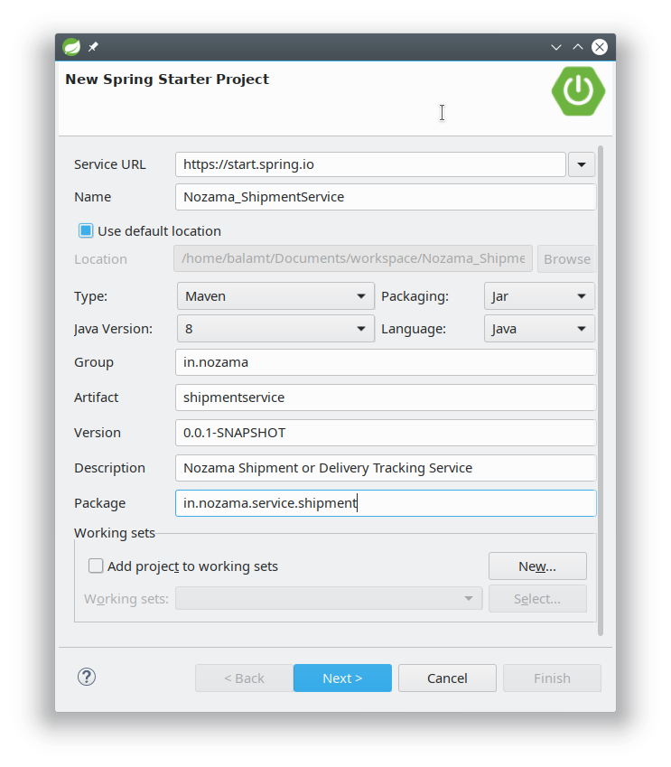
How to Name and Config each Modules ?
Name : Starts with Nozama_<<ServiceOrModuleName>>
Group: in.nozama (always)
Artifact: <<yourModuleName>>
Description: Explaination about the module in short
Package: Starts with in.nozama.service.<<modulename>>

Slide 19
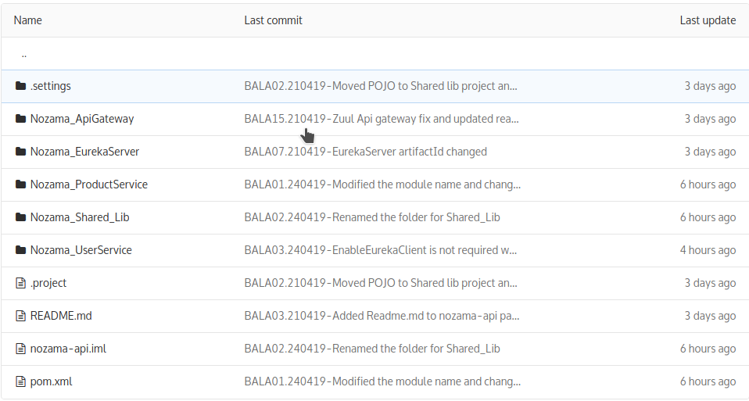
How Code Commit Message should be ?
Commit should have prefixed with your name first 4/5 letters followed by increment number and a dot and followed by the date in DDMMYY and hyphen and then your commit message.
Example : "BALA01.020419-Commit Message"
BALA - First 4 letters
01 - Version Number
. - Dot
020419 - Date in DDMMYY Format
- Hyphen to split the message from the above identifier
Commit Message - Your commit message

