Slide 1
SMART INDIA HACKATHON 2026
Landslide Sentinel
EARLY WARNING LOOP
Observe
AI-powered early warning for the North-Eastern Region
01
rainfall | soil | slope
From changing ground conditions to clear, local action.
Score
02
XGBoost risk inference
AI RISK SCORING
OFFLINE-FIRST
MESH RELAY
Alert
03
web | SMS | push
Act
9
4-tier
3
04
report | route | evacuate
monitored regions
risk classification
connected interfaces
Team RIT Chennai | Problem Statement: AI-Powered Landslide Early Warning System for NER
01 / 06

Slide 2
THE OPPORTUNITY
Make a warning useful before the slope moves.
Landslide risk is not only a prediction problem. It is a last-mile coordination problem.
FRAGILE SIGNALS
FRAGMENTED ACTION
LOW CONNECTIVITY
Rainfall, soil saturation, slope angle and vibration can change faster than manual reporting.
Citizens, administrators and responders need the same local picture, in the same moment.
An internet outage should not erase the last alert or block a new hazard report.
ONE SHARED OPERATING PICTURE
01
Sense
02
Infer
03
Decide
04
Reach
Live observations
Explainable risk tier
Admin + citizen context
Online or mesh
Outcome: a risk signal becomes a visible, actionable safety decision.
RIT Chennai | Smart India Hackathon 2026
RIT Chennai | Smart India Hackathon 2026
02 / 06
02 / 06

Slide 3
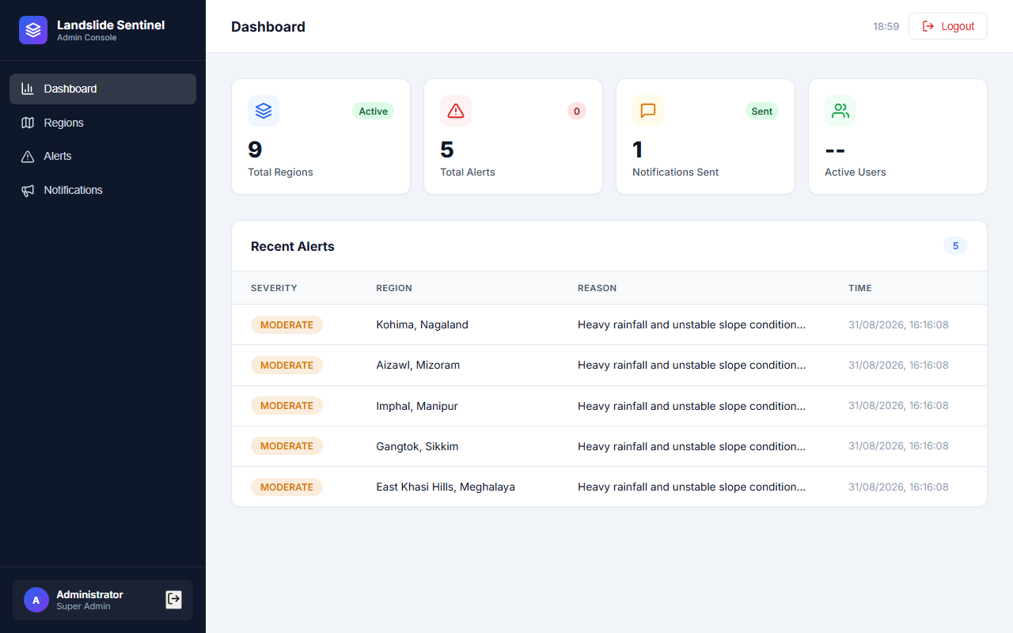
TECHNICAL APPROACH
A resilient path from signal to safety action.
Modular services keep live monitoring, decision logic and last-mile delivery independently testable.
Proof in the product
DATA
sensor feeds | citizen reports
INTELLIGENCE
XGBoost inference | 4-tier decision
OPERATIONS
FastAPI | SQLite | alert dispatch
LAST MILE
web | mobile | mesh relay
ADMIN COMMAND VIEW
ROLE-BASED
GIS-AWARE
AUDITABLE
RIT Chennai | Smart India Hackathon 2026
RIT Chennai | Smart India Hackathon 2026
03 / 06
03 / 06

Slide 4
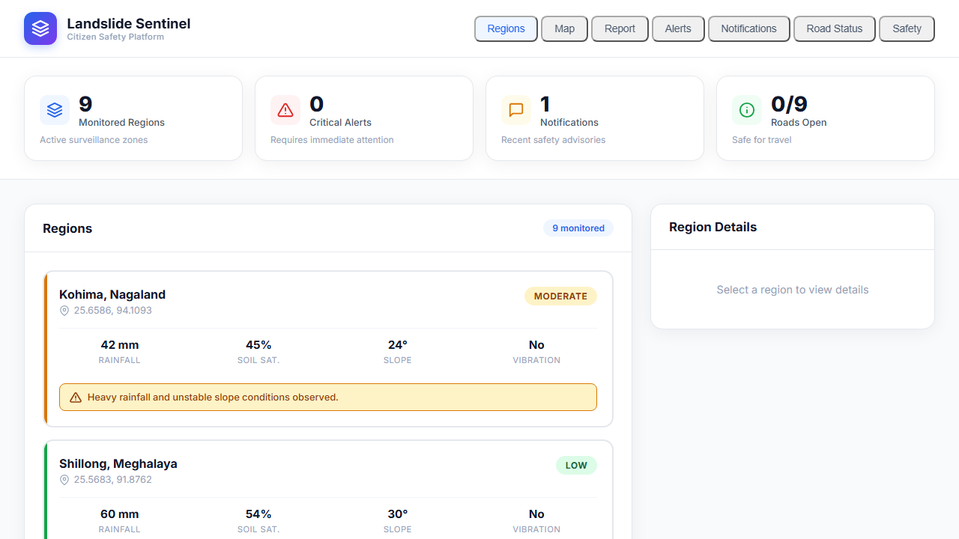
FEASIBILITY AND VIABILITY
Designed for the conditions it must survive.
The architecture is practical today and extensible tomorrow: familiar web services, local persistence and a tested offline path.
Offline-first behavior
CACHE
Keep the last known region, alert and road status locally.
QUEUE
Store hazard reports while the network is unavailable.
SYNC
Replay queued reports automatically when connectivity returns.
CITIZEN GIS VIEW
RELAY
Pass unseen alerts phone-to-phone with TTL-based deduplication.
6 suites
SQLite
API-first
Pilotable
backend + frontend + offline workflows
local persistence for low-connectivity use
ready for sensors, SMS and satellite feeds
deploy backend, web and APK independently
RIT Chennai | Smart India Hackathon 2026
RIT Chennai | Smart India Hackathon 2026
04 / 06
04 / 06

Slide 5
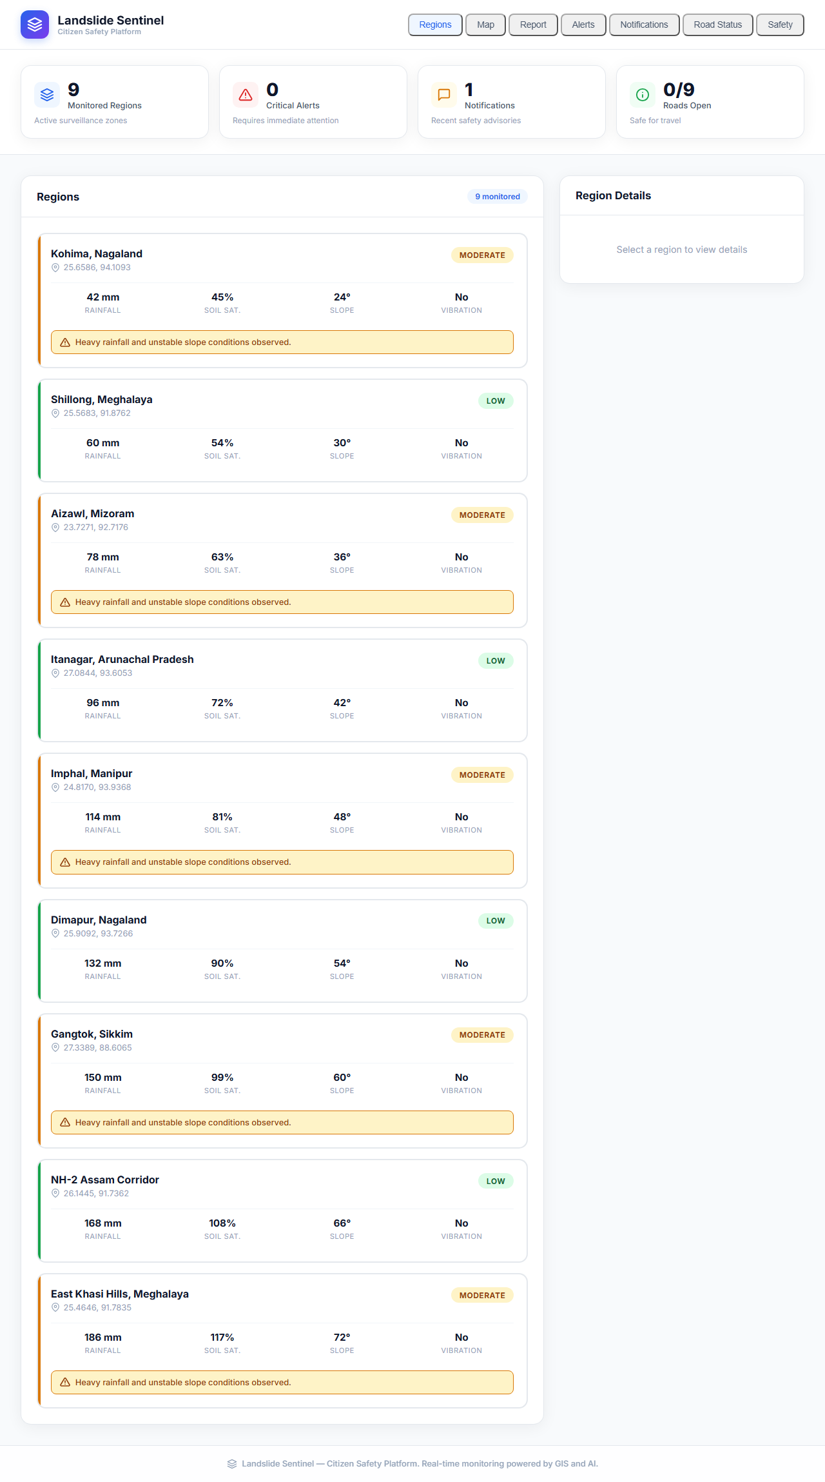
IMPACT AND BENEFITS
Give every role the next useful action.
The system turns uncertainty into a shared response: observe clearly, communicate early, move deliberately.
CITIZENS
See local risk, alerts, safe routes and reporting tools in one place.
AUTHORITIES
Prioritize regions, issue targeted alerts and track road conditions.
RESPONDERS
Carry the last known alert beyond the edge of connectivity.
CITIZEN MONITORING VIEW
Success looks like
a warning that still reaches people when the network does not.
RIT Chennai | Smart India Hackathon 2026
RIT Chennai | Smart India Hackathon 2026
05 / 06
05 / 06

Slide 6
VALIDATION AND NEXT STEP
Built to be tested in the field, then extended.
Current implementation is validated across the decision path; the next milestone is real-world sensor and community pilot data.
VALIDATED NOW
NEXT PILOT
✓
Risk decision and threshold mapping
✓
Sensor ingestion and validation
Connect live observation to local action.
✓
Citizen report submission
✓
Offline queue and reconnect sync
IoT sensors → district pilot → multilingual delivery → community feedback
✓
Push / notification behavior
✓
Admin alert dispatch workflow
SCALABLE
MEASURABLE
COMMUNITY-READY
References
FastAPI, SQLAlchemy, XGBoost, React/Vite, React Native, Expo, SQLite, Google Nearby Connections
Thank you
RIT Chennai | NER Landslide Early Warning System
RIT Chennai | Smart India Hackathon 2026
RIT Chennai | Smart India Hackathon 2026
06 / 06
06 / 06

