Slide 1

SMART INDIA HACKATHON 2026
TITLE PAGE
Citizen and Admin web portals | FastAPI backend | AI risk scoring | Offline-ready mobile app
Problem Statement ID – AI-Powered Landslide Early Warning System for NER
Problem Statement Title- AI-Powered Landslide Early Warning System for NER
Theme- Disaster Management
PS Category- Software
Team ID- To be added
Team Name- RIT Chennai

Slide 2
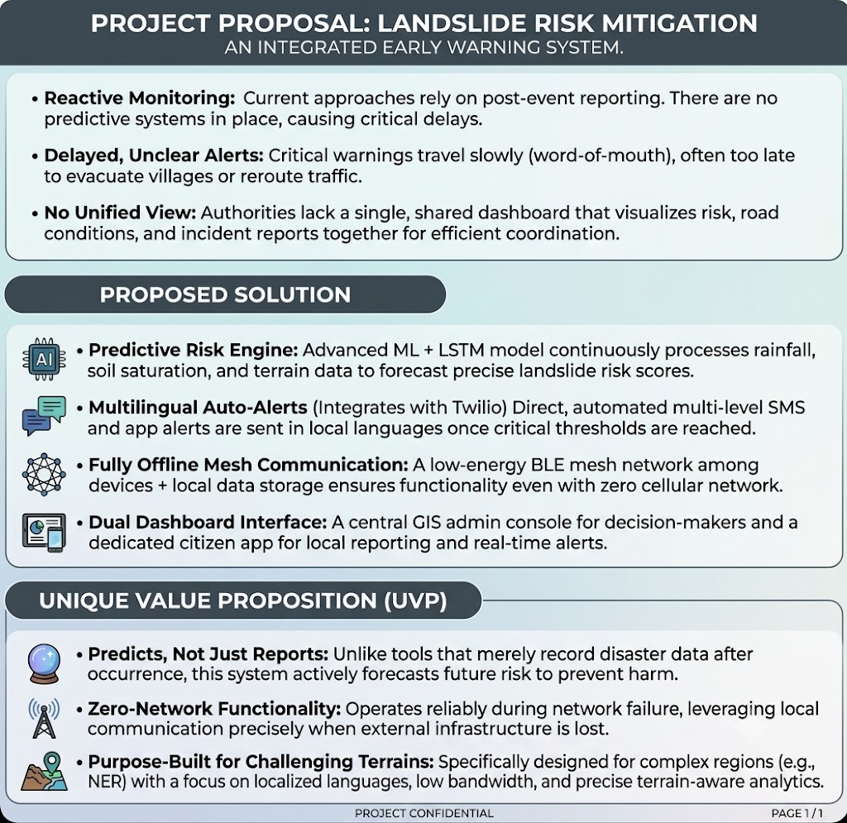
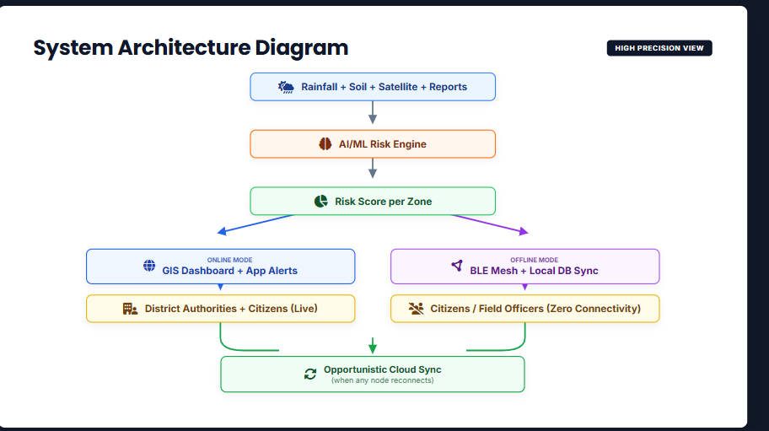
AI-Powered Landslide Early Warning System for NER
RIT Chennai
End-to-end workflow: observe hazards, score risk, issue alerts, and support evacuation decisions.

Slide 3
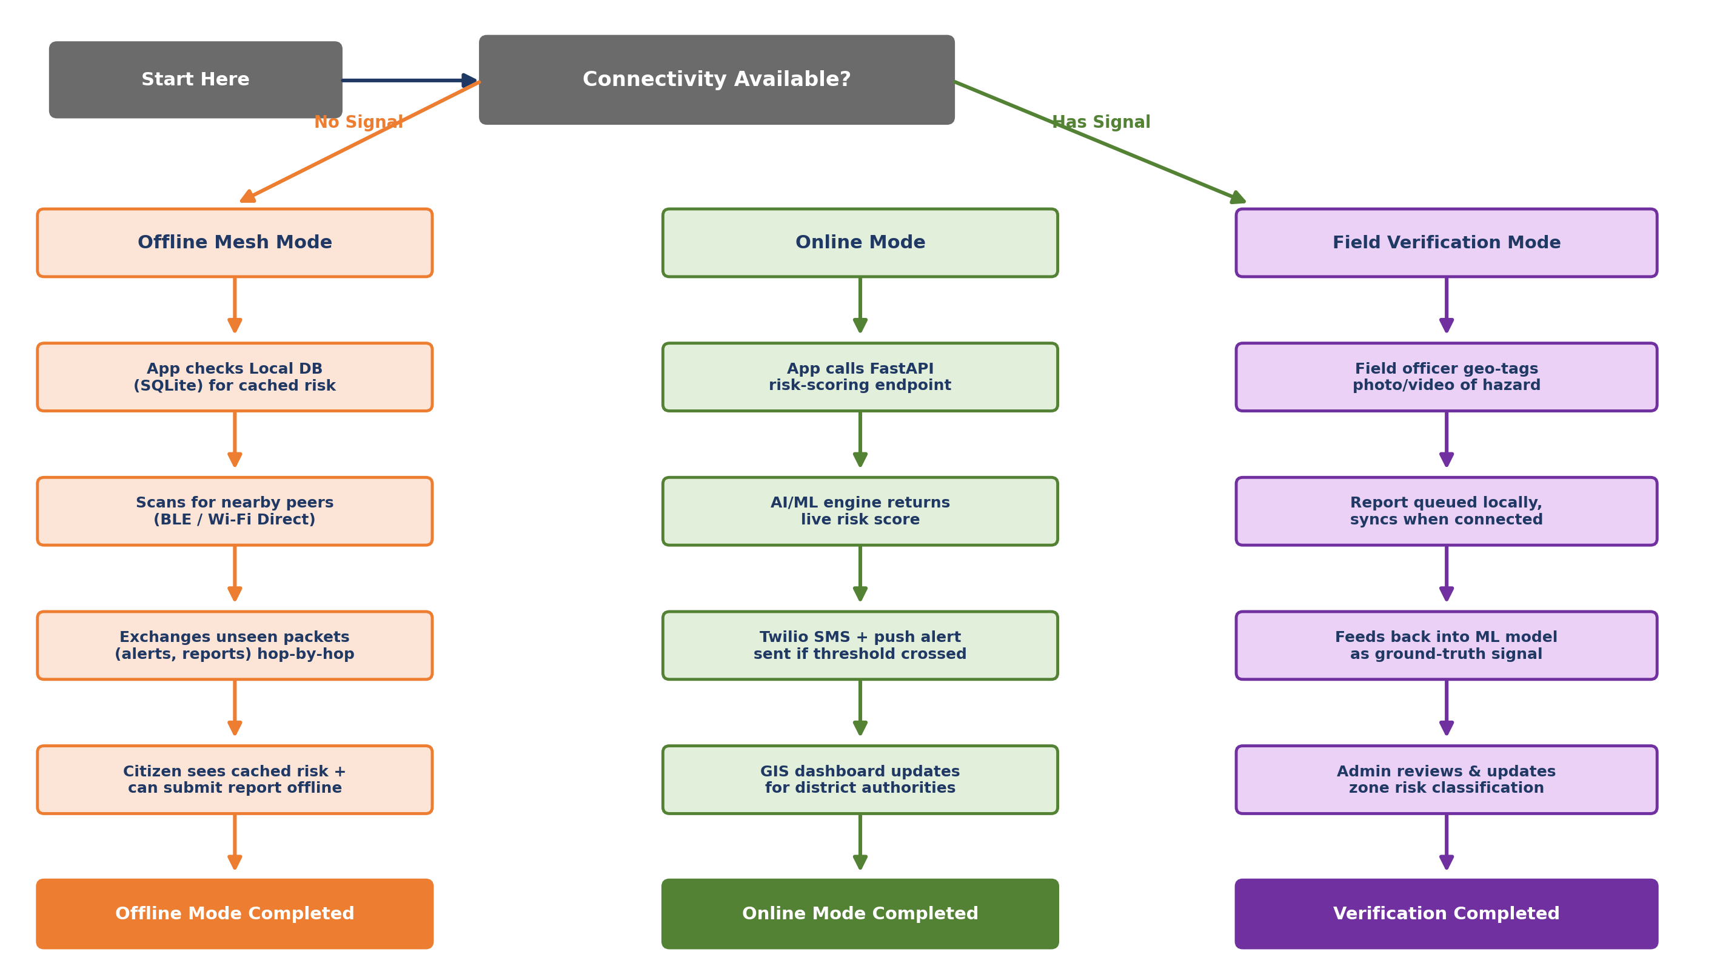
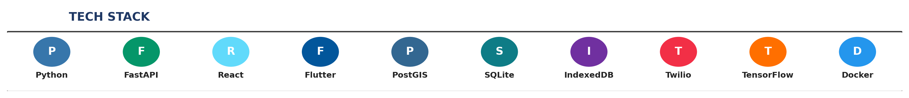
TECHNICAL APPROACH
RIT Chennai
Live region monitoring, earthquake-style vibration status, emergency contacts, and role-based Admin controls.

Slide 4
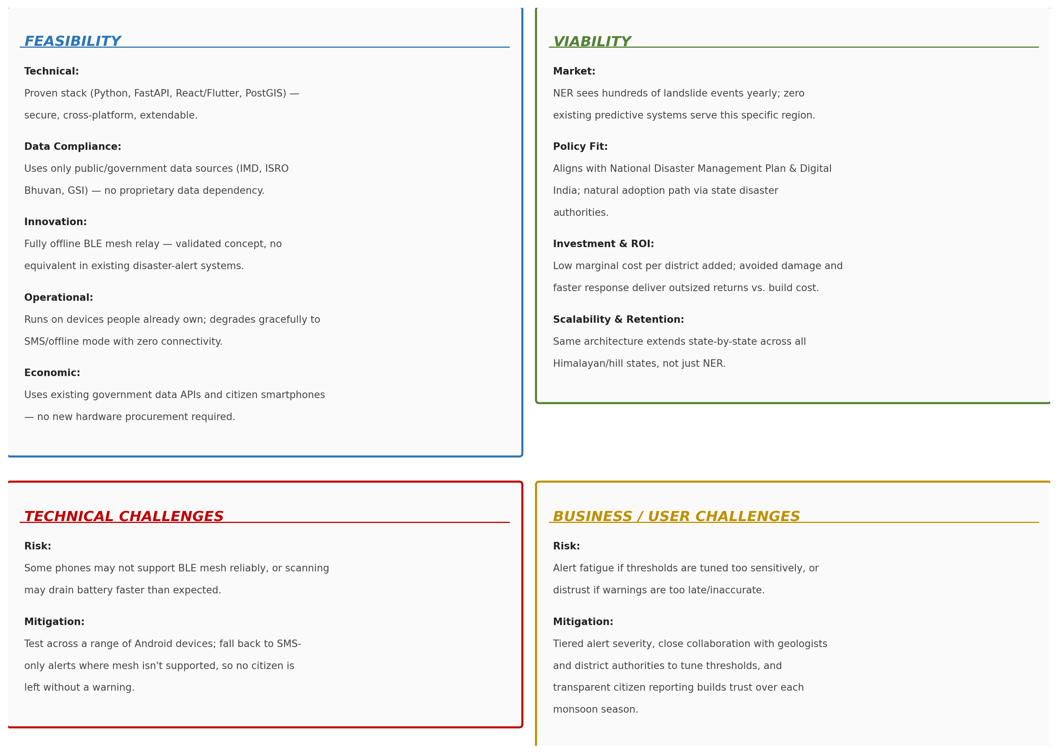
FEASIBILITY AND VIABILITY
RIT Chennai
Uses existing observations, XGBoost risk inference, SQLite persistence, IndexedDB cache, and offline queue sync.

Slide 5
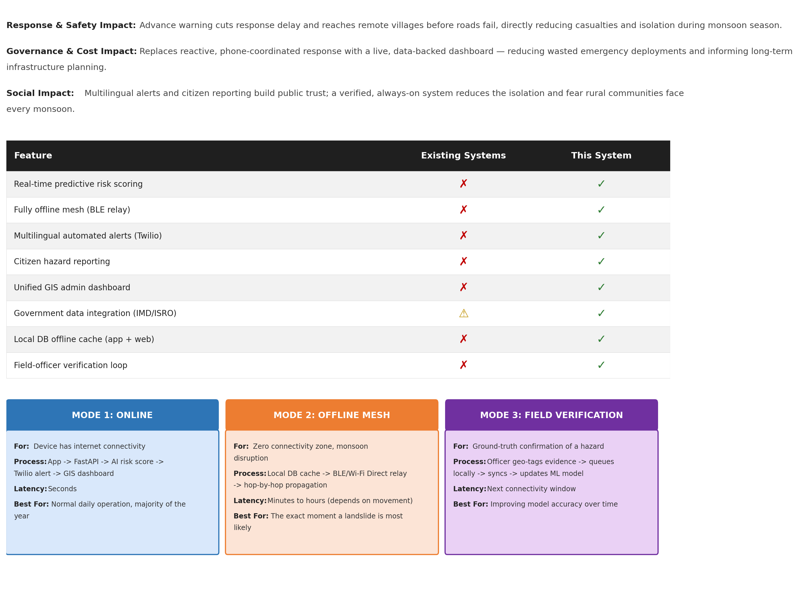
IMPACT AND BENEFITS
RIT Chennai
Faster warnings for communities, clearer decisions for authorities, and actionable safety information for citizens.

Slide 6
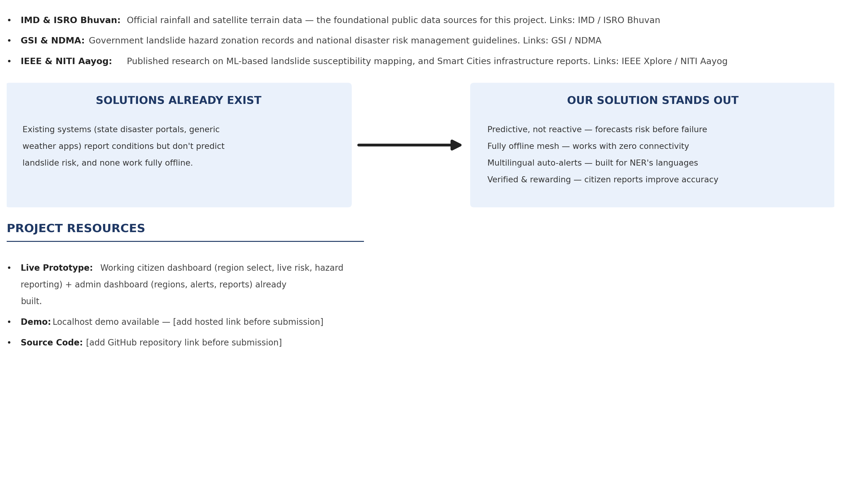
RESEARCH AND REFERENCES
RIT Chennai
Validated through backend, frontend, offline queue, notification, ingestion, and decision workflow tests.

