Slide 1

IVY League Program Societe Generale
Azure Architect

Slide 2
About me
Name - Balamurugan Sandanaraj(2658)
Assignment – Virtual Networking (week #3)

Slide 3
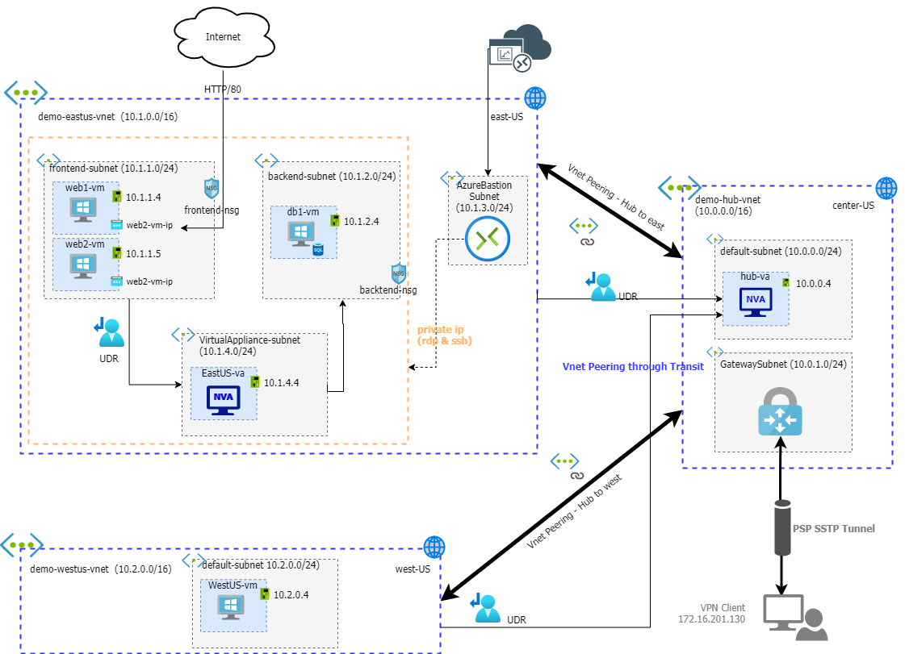
Architecture

Slide 4
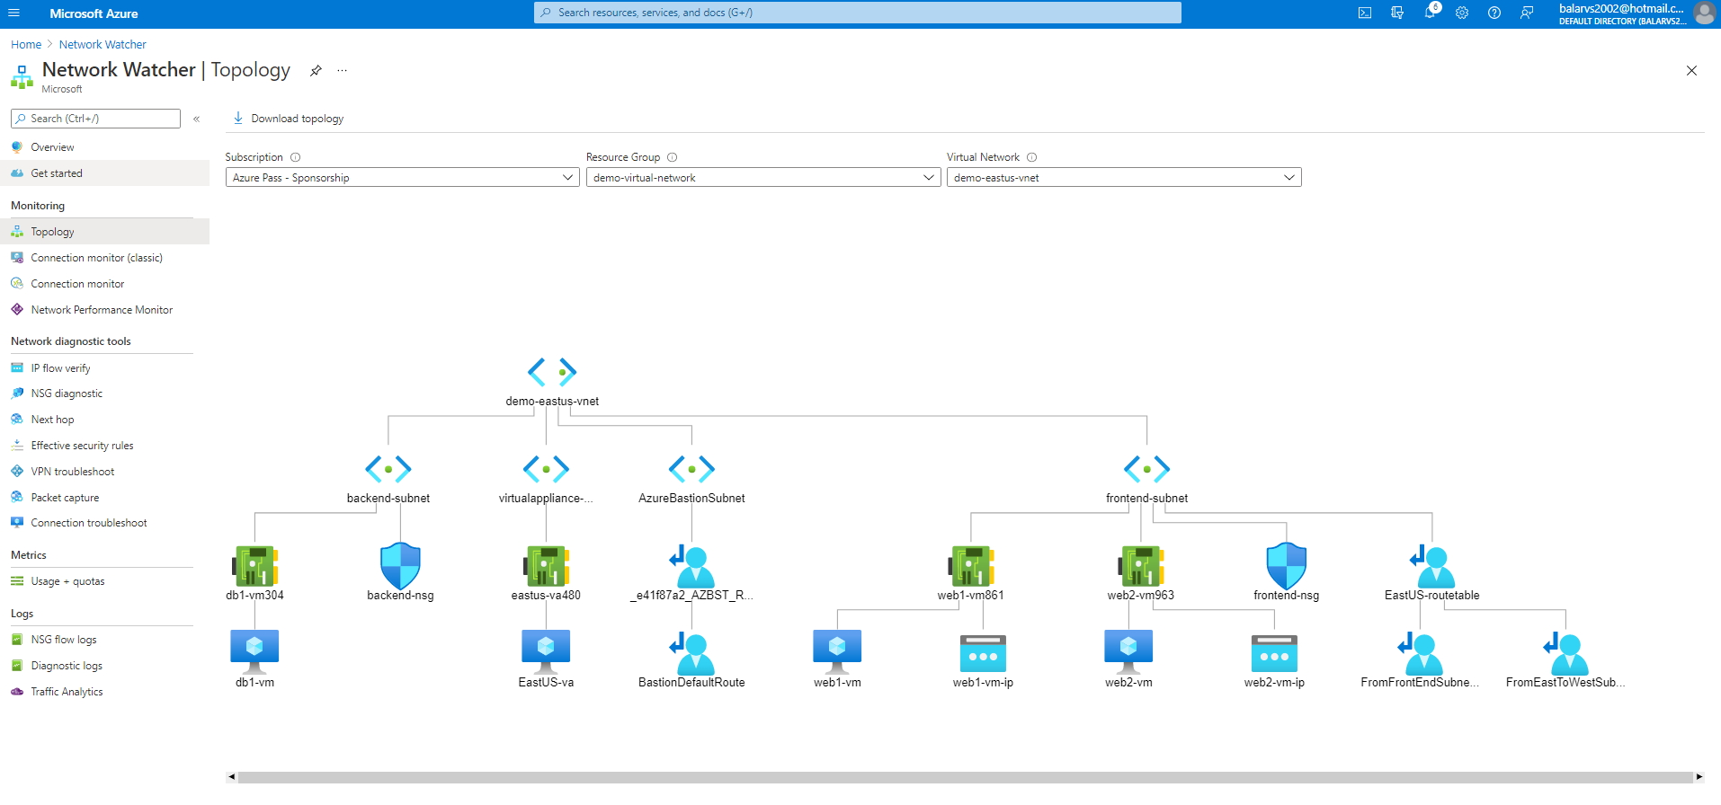
Demo-eastus-vnet : Topology

Slide 5
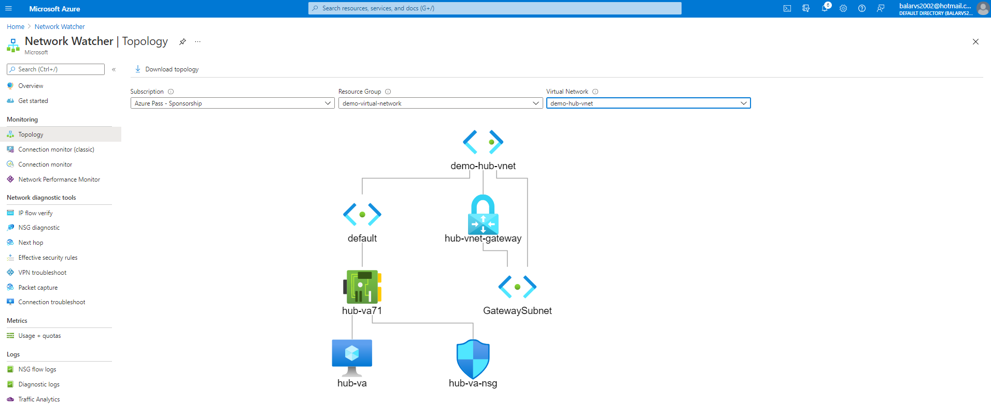
Demo-hub-vnet : Topology

Slide 6
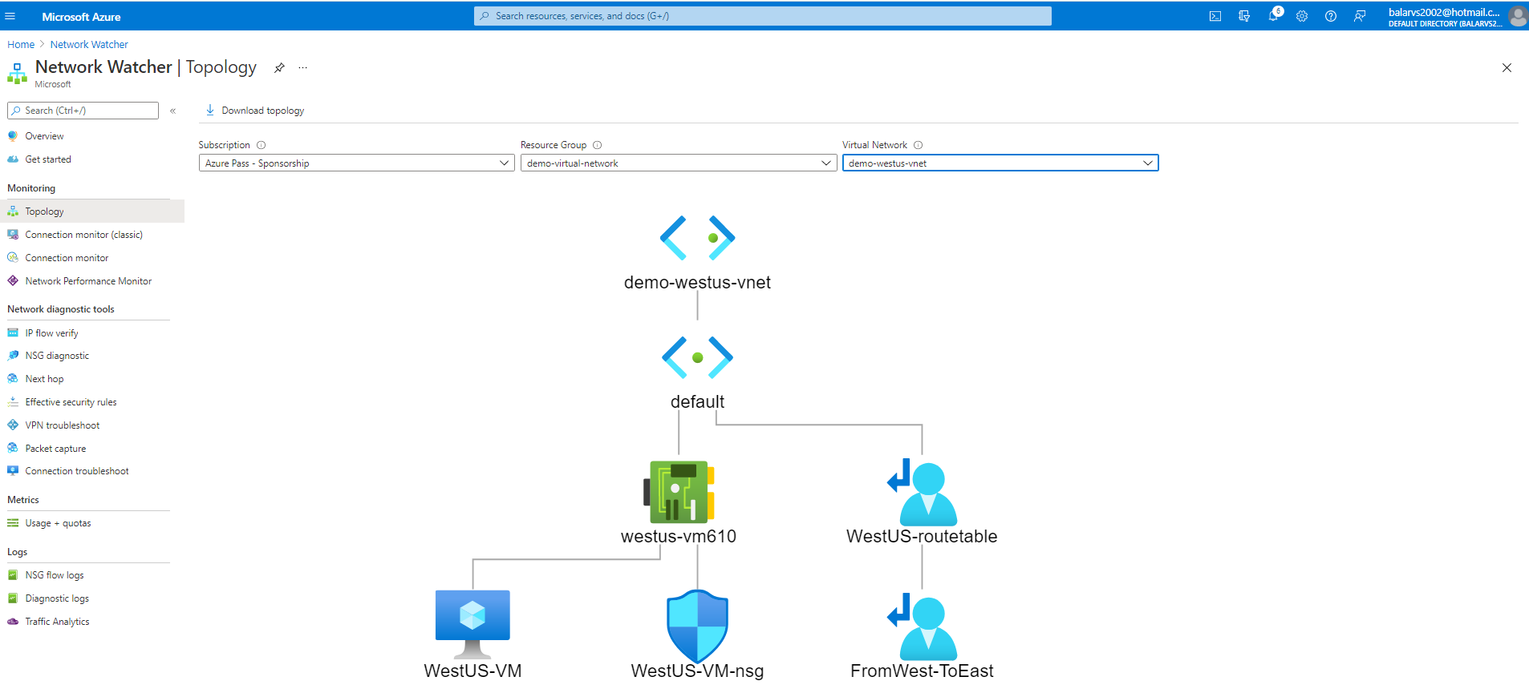
Demo-westUS-vnet : Topology

Slide 7
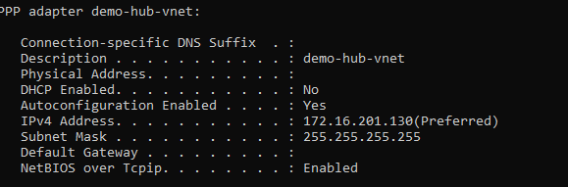
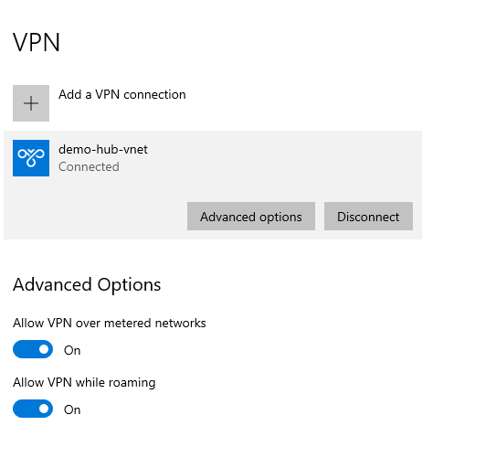
VPN Client - Setup

Slide 8
Thank You

