Slide 1
Field work
a companion for all teams

Slide 2
What is Field Work?
A business companion for managers and individuals that ensures the best control, supervision and handling of human resources needed in certain fields of work.
A tool for correctly and efficiently assigning multiple tasks to different teams based on their skill sets and on the availability of certain resources.
An instrument that provides meaningful data and correlation to help speed up any project.

Slide 3
Business Model

Slide 4
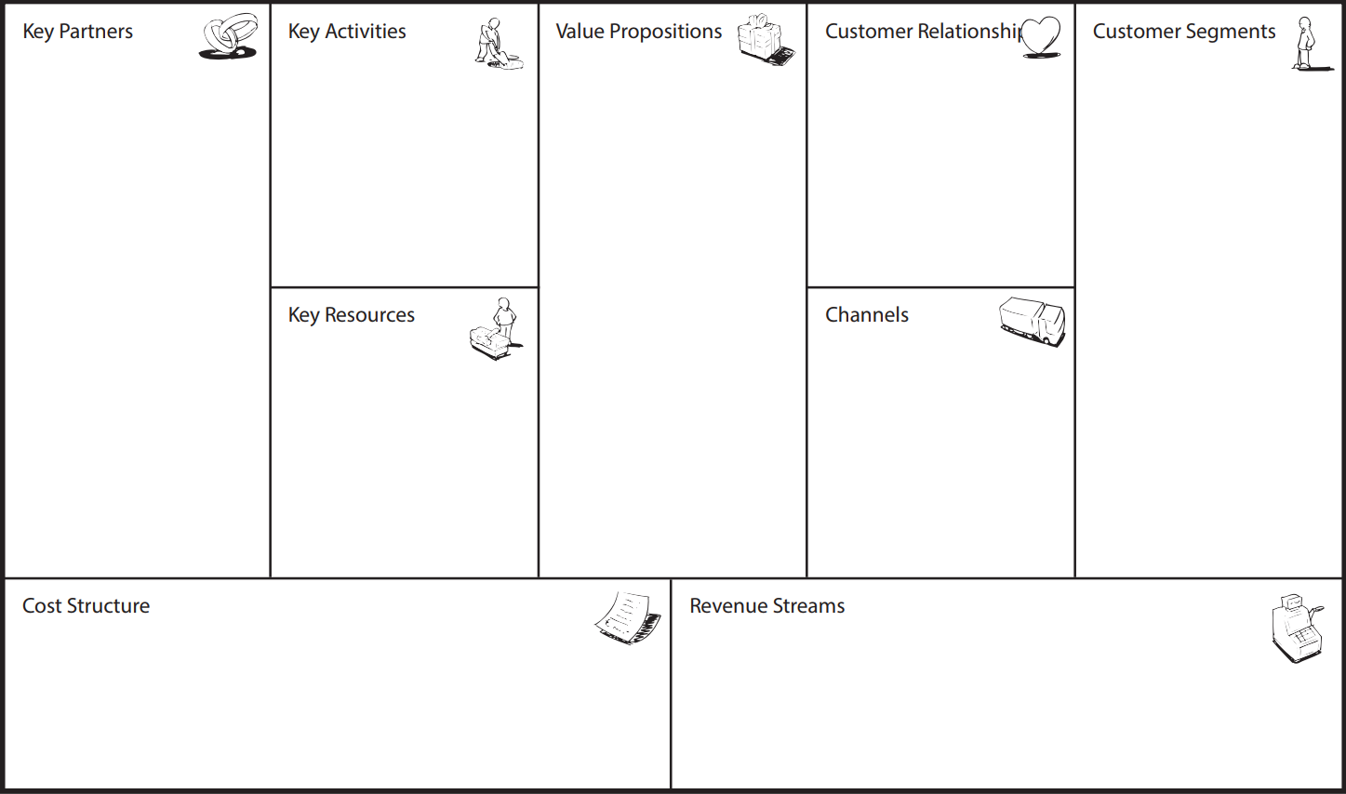
ongoing learning about users
Efficient management of human resources
email based interaction
Construction companies
Amazon Web-Services
development of new techniques to tackle specific problems
24/7 support line call
Centralized data collection
Google Services
cloud resources
Shipping companies
Business versatility
Online platform
talent assets
API Service cost
Salary based costs
monthly subscriptions
medium and long term contracts
personalized services

Slide 5
Customer segments (Segment dimensions)
Construction and engineering companies working on high profile projects such as Bechtel or Grupo ACS, currently deploying large scale dams.
Multinationals that operate in the commercial, residential and infrastructure sectors such as Skansa.
Courier companies that provide services on a global scale such as DHL Express or FedEx Corporation for which the logistic aspects are crucial.
National or local delivery companies that rely on speed and the best customer service such as FAN Curier or Urgent Cargus.

Slide 6
Customer segments (Segment composition)
Construction segment Personas:
Administrative Officers, Architects, Designers, Construction Managers
Communications Engineers, Electrical Supervisors
Technicians, Electricians
Masons, Painters, Carpenters, Plumbers, Welders
Delivery segment Personas:
Logistics Managers
Customs/Purchasing/Warehouse/Trading Supervisors
Delivery Recruits

Slide 7
Customer segments (Problems and Needs)
Problems:
Stagnant productivity levels.
Labor shortages in certain areas.
Resource efficiency.
Needs:
Centralized data collection entity.
Proper administration of physical resources.
Better management of human resources

Slide 8
Value Propositions
Some problems in our customer segments are effectively targeted by the Field Work application. We propose a centralized utility that provides data collection from your teams out in the field in order to better understand their productivity levels and if there is a need to invest in certain areas.
The application understands the need to efficiently tackle human resource needs and provides an array of options to deploy materials and tasks wherever and whenever needed.

Slide 9
Customer Relationships & Channels
The relationship between our company and our current and potential customers is crucial to us. We believe in a more personal approach and thus provide a support line that is available 24/7 for any issues that may arise.
Email interaction is also available if preferred by certain customers and it is also publicly available for any questions regarding Field Work in general.
Simplicity is one of the goals of this product and so the main channel for interacting with it and achieving this simplicity is purely web based.

Slide 10
Key Activities & Key Resources
One of the main activities that is crucial to further development is the non-intrusive collection of specific user data to help our application scale up or down depending on the needs that must be satisfied.
We are aware of our growth possibilities and in consequence we are actively searching for new talent to enlarge our team, which is by essence also our greatest resource.
To keep up with our ideology of letting things be simple and elegant, but also secure and reliable, we interact with key cloud resources to achieve every technological aspect.

Slide 11
Key Partners
Cooperation is the key to serve mutual interests and greatly increases the likelihood of us achieving our goals and amplifying our reach.
Partnerships between tech companies have a long history and following the example of Netflix and other industry giants we have invested in a contract with Amazon designed to facilitate the usage of cloud specific resources provided by their Web Services platform.
Any application is built with specific definitions, protocols and tools. API services provided by Google come in helpful when tackling the issues that we aim to resolve.

Slide 12
Costs & Revenue
Nothing comes cheap and it shouldn’t. Our partnerships are governed by contract and the usage of external services are a cost for which we take full responsibility. In consequence, all the cloud services that we use are covered by us.
We are fully accountable for the well being of our employees and thus part of our costs are due to honest and fair payments.
Revenue is obviously an important part that we must consider. For this matter the solutions we devised are monthly and medium/long term subscriptions. We also generate an important part of our revenue from providing specific technical services to customers that demand them.

Slide 13
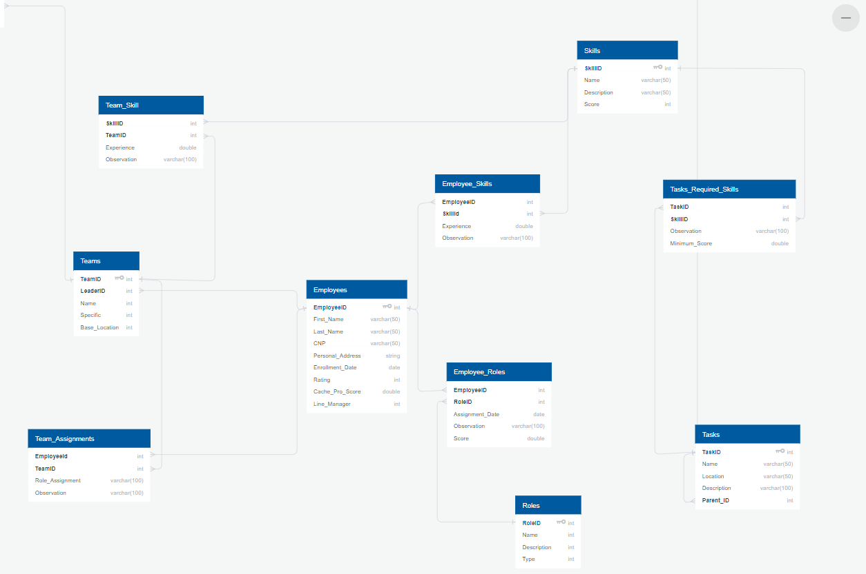
Costs & Revenue
Nothing comes cheap and it shouldn’t. Our partnerships are governed by contract and the usage of external services are a cost for which we take full responsibility. In consequence, all the cloud services that we use are covered by us.
We are fully accountable for the well being of our employees and thus part of our costs are due to honest and fair payments.
Revenue is obviously an important part that we must consider. For this matter the solutions we devised are monthly and medium/long term subscriptions. We also generate an important part of our revenue from providing specific technical services to customers that demand them.

