Slide 1


FOOTBAL
T5 Bootcamp project
Bashayer Alanzi

Slide 2

Introduction
The purpose of this project is to use statistical modeling to predict the outcome of a football match using historical data.

Slide 3

Objective
football prediction model with 3 possible outcomes: home win, draw or away win using poisson distribution model

Slide 4
Data process
obtained the data
cleaned data.
data analysis
using various methods.

Slide 5
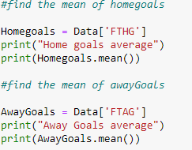
Exploratory Data analysis
Determine the average number of goals scored by home teams and the average goals scored by the away teams

Slide 6

Exploratory Data analysis
The results were as follows
This shows that the home team always scores a higher number of goals compared to the away team.
The assumption is always that the home fans always give the home team a favorable environment and motivation to play better and therefore score more.

Slide 7
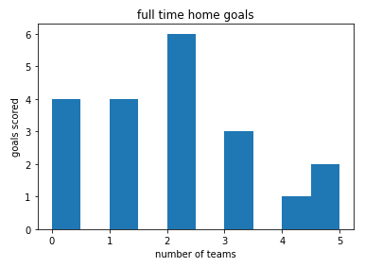
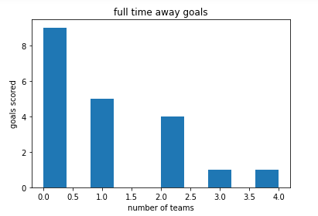
Modeling
histograms

Slide 8
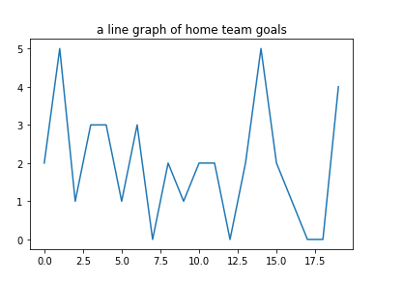
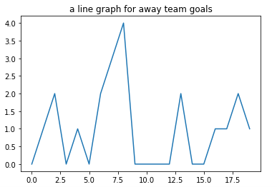
Modeling
Line graphs

Slide 9

Conclusion
The Poisson distribution algorithm only uses the number of goals scored to compare it to the top flight teams.

Slide 10

THANK YOU

