Slide 1

Advanced GIT Operation
Faculty Name : Mrs. Sujata Oak
Ms. Kshipra Tatkare
Assistant Professor, RAIT
Dept. Of Information Technology

Slide 2
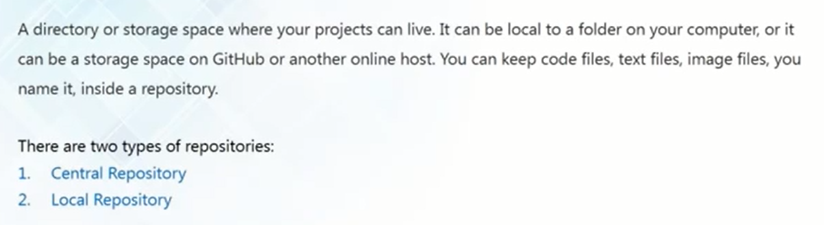
What is a Repository

Slide 3
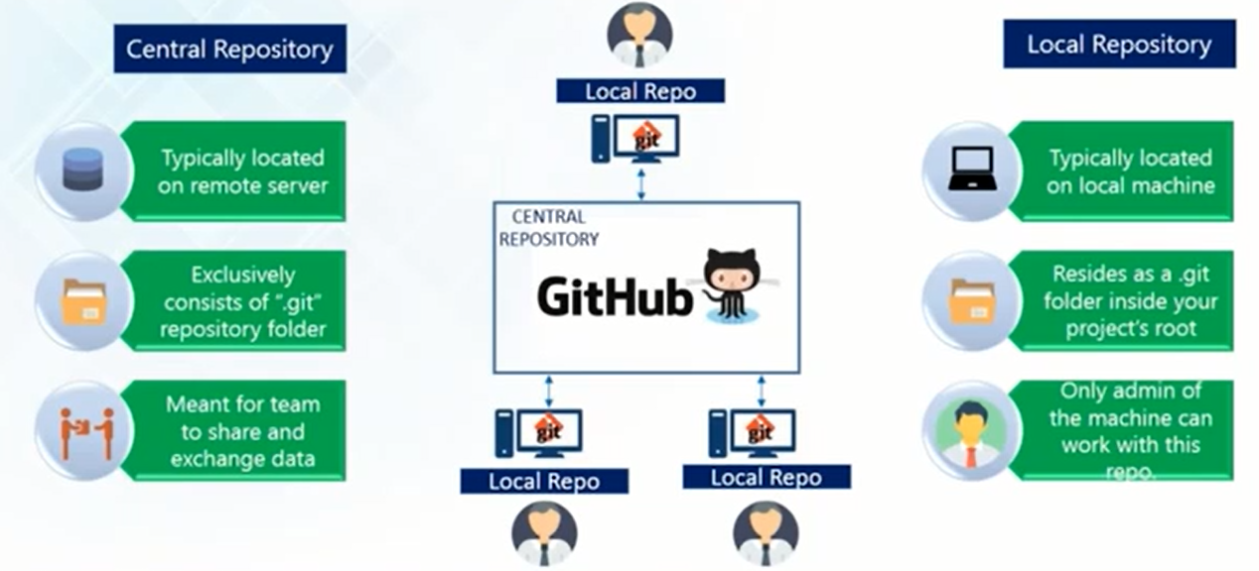
Types of Repository

Slide 4
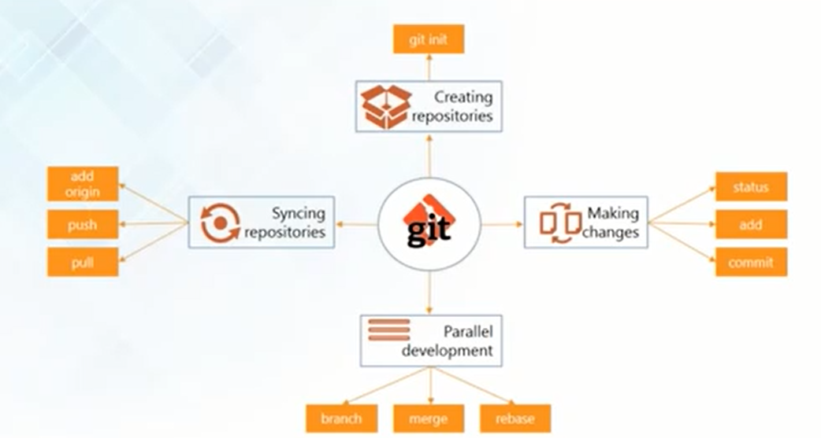
Git Operations and Commands

Slide 5
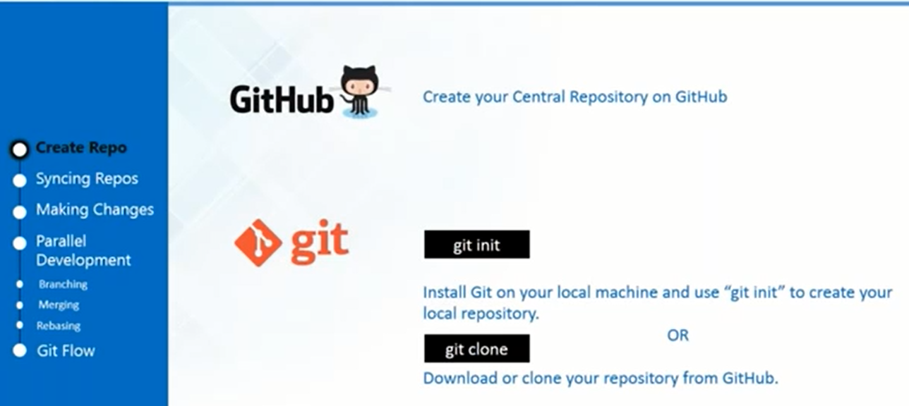
Creating Repositories

Slide 6
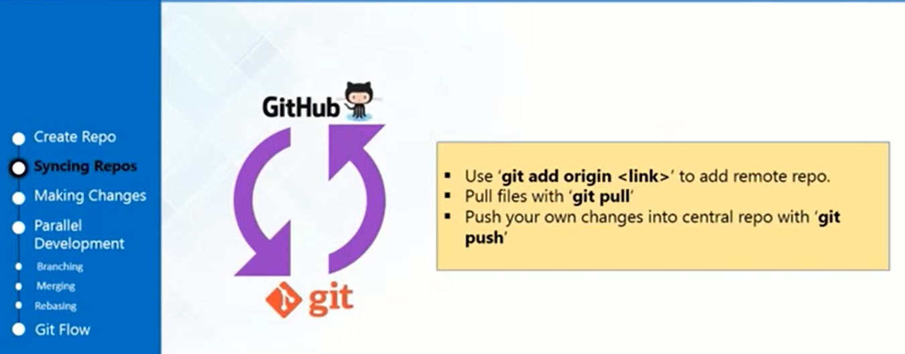
Synching Repositories

Slide 7
Synching Repositories
To Add Remote Repositories:
git remote add origin “ Path copied from clone or download”
To fetch all the files from the central repository into my local repository:
git pull origin master

Slide 8
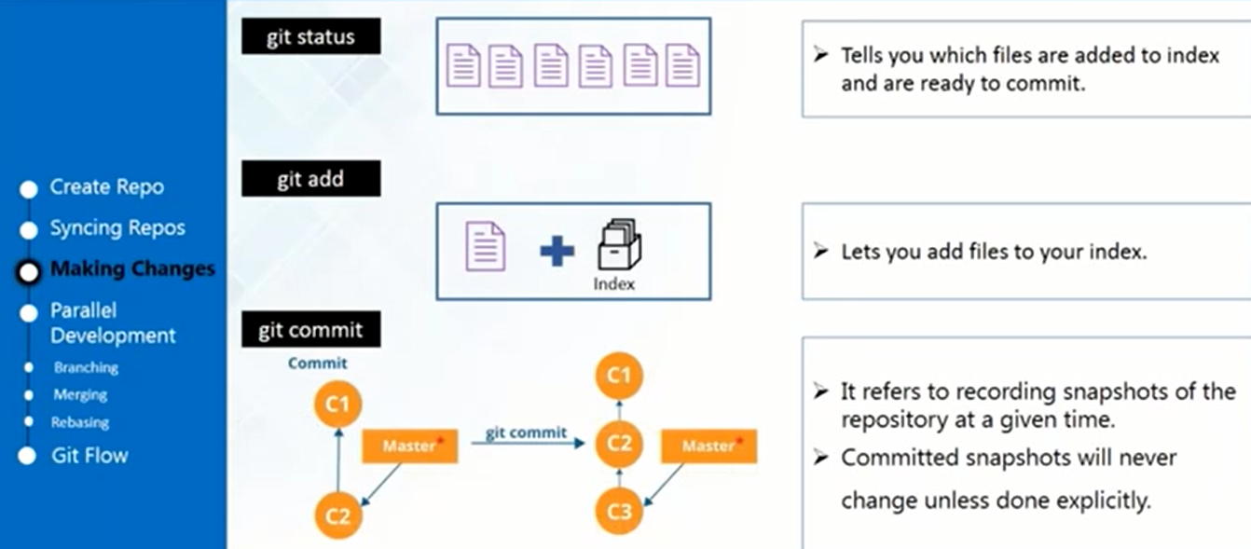
Making Changes

Slide 9
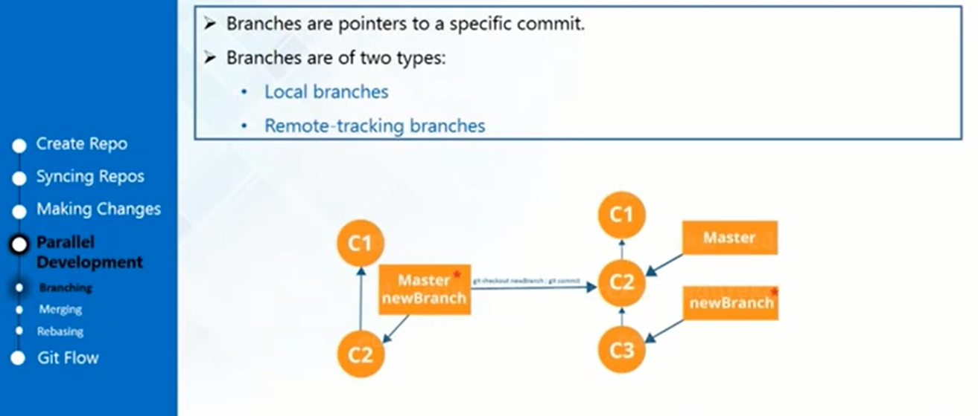
Parallel Development - Branching

Slide 10
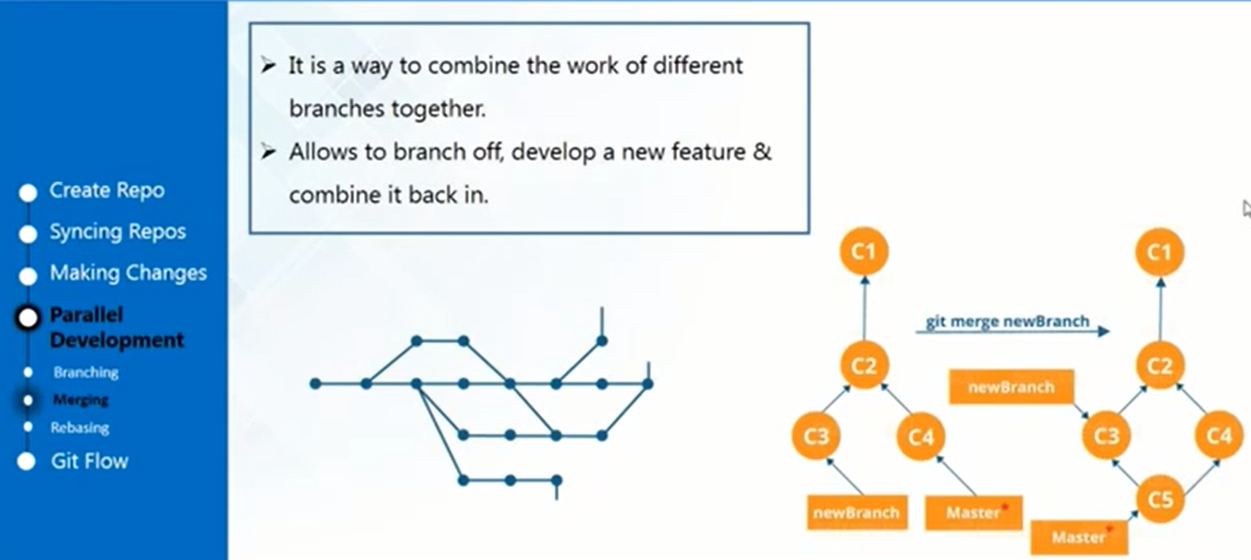
Parallel Development- Merging

Slide 11
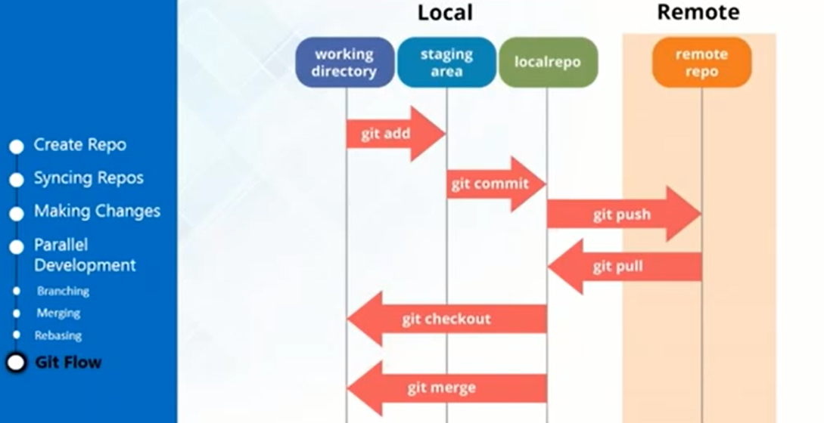
Summarize- Git Flow

Slide 12
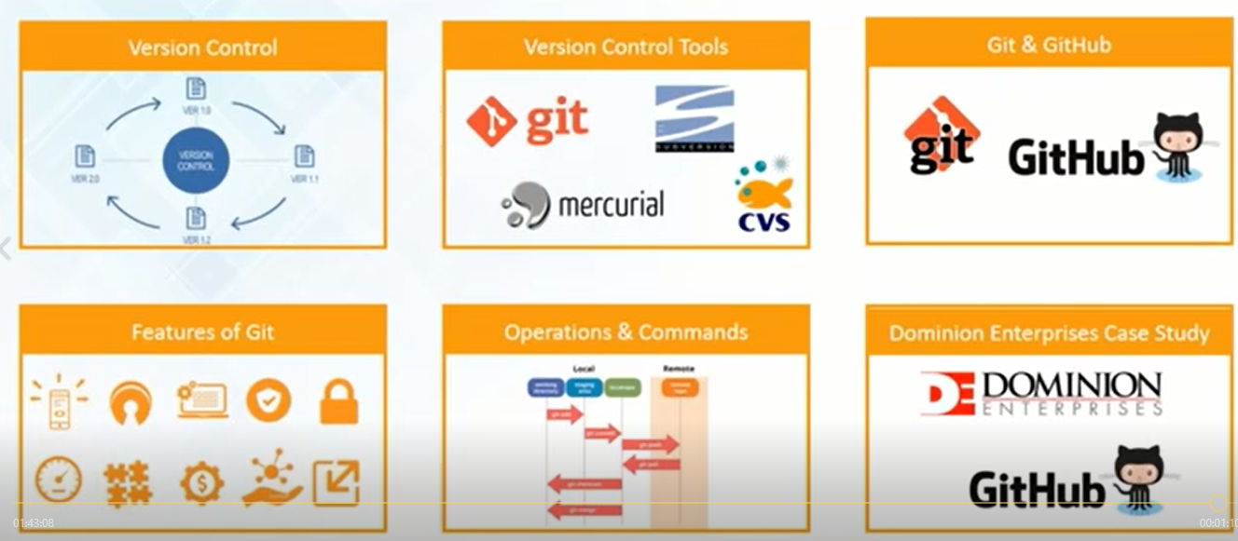
Summary

Slide 13

Thank You

