Slide 1
CLINICAL DECISION MAKING & PATTERN RECOGNITION
Agentic Generative AI for
Treatment, Payment & Operations
AISHWARYA BALARAJU
Intern Candidate Submission · Cotiviti
PAYMENT INTEGRITY SIGNAL

Slide 2
From static recommendations to agentic systems
Classification & Prediction
Clustering & Inference
Time-Series Anomaly Detection
Assigning records to categories (fraud / not fraud) and estimating future outcomes like readmission risk.
Grouping similar cases without predefined labels, and drawing conclusions from incomplete clinical or claims data.
Flagging deviations from an expected pattern over time — the statistical trigger for our Agentic POC.
Agentic generative AI
Earlier clinical decision support offered a single static recommendation. Agentic systems — one or more LLM-driven agents that plan, call tools, and query databases — can gather supporting evidence, reconcile conflicting sources, and adjust their plan as new information arrives. This shifts AI from a consultative tool toward an active participant in clinical and administrative (TPO) workflows.
02

Slide 3
Three forces reshaping payment-integrity AI
80%+
Real-time
Jan 2026
of health care executives expect agentic & generative AI to deliver moderate-to-significant value across clinical and back-office functions in 2026.
FWA platforms now score full claims populations — not samples — combining classification, anomaly detection, and reinforcement learning.
FDA guidance gives CDS tools more room for single recommendations, but leaves “clinically appropriate” undefined — oversight stays risk-calibrated.
03

Slide 4
Where the upside and the risk both concentrate
OPPORTUNITIES
THREATS
●
Higher-precision FWA detection by combining anomaly detection with predictive scoring to surface novel fraud patterns
●
Regulatory ambiguity: undefined terms like “clinically appropriate” create compliance risk
●
Agentic claims triage that pre-packages evidence for human reviewers, cutting time-to-decision
●
Adversarial gaming: bad actors use generative tools of their own to evade detection models
●
Explainable scoring as a market differentiator as clients expect auditable reason codes
●
Over-trust in automated outputs: reviewers may anchor on AI recommendations with weak evidentiary basis
04

Slide 5
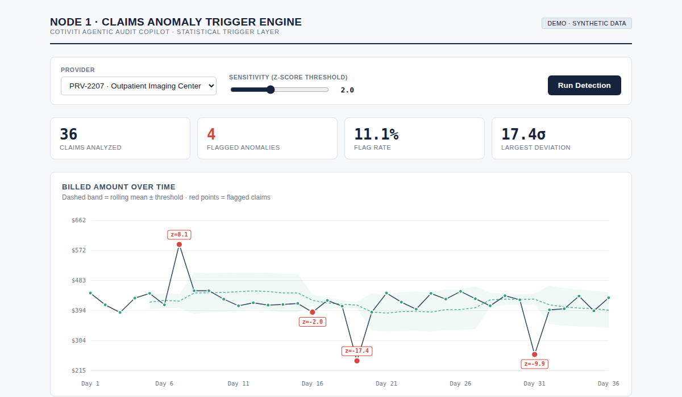
HACKATHON PROOF OF CONCEPT
Claims Anomaly Detector
A browser-based demonstrator of time-series anomaly detection, routing flagged claims to downstream Agentic investigation.
01
02
03
04
05
Generate claim series
Compute rolling baseline
Score & flag deviations
Surface a reason code
Live in the browser
Synthetic billed-amount sequences per provider.
Trailing mean & std. dev. establish the expected range.
Claims beyond the z-score threshold are flagged.
Each flag reports a plain-language, auditable reason.
Provider & sensitivity adjustable; recomputes instantly.
ARCHITECTURE BRIDGE
NODE 1
Trigger Engine
statistical z-score detector
z > ±2.0
NODE 2
Generative AI Clinical Reasoner
extracts EHR proof; drafts narrative
05

Slide 6
Three moves worth piloting
1
Agentic claims-investigation assistant
Autonomously assembles evidence — claim history, provider patterns, policy language — behind every anomaly flag, with a human approving the final call.
2
Explainability built into the roadmap
Tiered, audit-ready reason codes for every flagged claim, ahead of likely future FDA and payer documentation requirements.
3
Pilot continuous model retraining
Validate moving from static thresholds to online retraining on the claim types most exposed to adversarial gaming.
06

Slide 7
Thank you
Report, POC source code, this ppt, and the recorded walkthrough are included in my submission repository on GitHub:
github.com/balarajuaishwarya
AISHWARYA BALARAJU · COTIVITI INTERN ASSESSMENT

