Slide 1
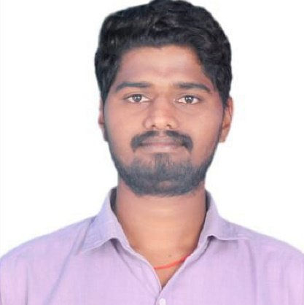

BALARAMAIAH MACHAVARAM
Analyst/Software Engineer
Bachelor of Technology
Computer science : 2015 -2019
Skills
BANGALORE
bala-ramaiah.machavaram@capgemini.com
C# | Basics,OOPS,Exception Handling,Collections& Generics,Delegates,Events , File IO and Serialization
.NET Framework | ADO.NET with Entity Framework And LINQ,ASP.NET with MVC5, ASP.NET CORE WEB API.
ADO.NET | Basics, Connected and Disconnected Architecture
RDBMS | Basic And Advanced Using SQL Server, Oracle and Maria DB.
UI Technology | HTML 5, CSS And JavaScript
Tools | Git ,GitHub, IDE
Add On Skills | Communication , Team management
+91 9705117047
A4
Full Stack Developer
• Hands on experience on C#,ADO.NET,LINQ,Entity framework,Sql Server,ASP.NET MVC5 with WEB API,ASP.NET CORE WEB API.
•Practical understanding of SQL concepts using SQL Server
•Successfully completed iTransform Training: SQL,C#, DOTNET,Angular.
• Currently completed Microsoft AZ-900 and AZ-104 certification.
ONDEMANDCARWASH SYSTEM
Case study of OnDemandCarWashSystem along with API Gateway, Swagger,responsive UI with HTML5, CSS, Bootstrap and Angular used as User Interface.
Three layered architecture which includes a Data Access Layer, Business Logic Layer using C#, ASP.NET CORE WEB API. , SQL Server . Exception.
Classes in all layers were designed using C# and ASP.NET CORE WEB API. Database was designed in SQL Server.
Connecting the application with database was done using ASP.NET CORE WEB API.
Check out my work on GitHub

