Slide 1
Friend Affinity Finder
Team 128 Gigs

Slide 2



128 Gigs - The Team of 4
Balaraman M
Team Lead | Backend Integration & API Handling
Ganesh Ramkumar R
Backend Developer | Data Analysis & Server Architecture
Gowtham C
Backend Developer | Data Extraction & Database Design
Rahul Raj K
Front End Developer | UI Design & Client Architecture

Slide 3
Technologies Used
APIs Used
Frontend - Android Application
Backend - Python Flask
Database - MongoDB
Facebook API
Twitter API
IBM Personality Insights API

Slide 4
Architecture Diagram
Flask (Server)
MongoDB (database)
Android application
(Client)
Facebook API
Twitter API
Personality Insights API

Slide 5
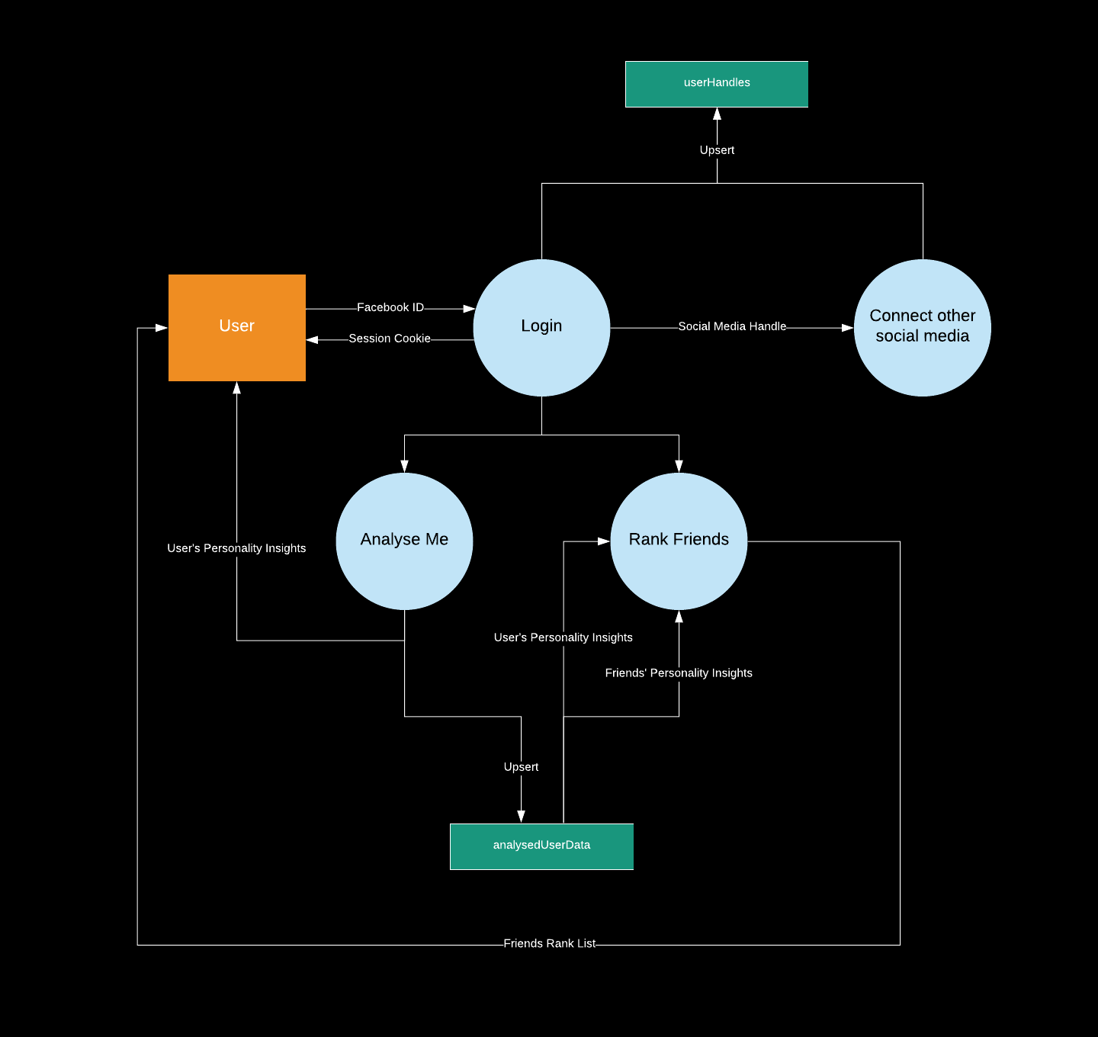
Data Flow Diagram

Slide 6
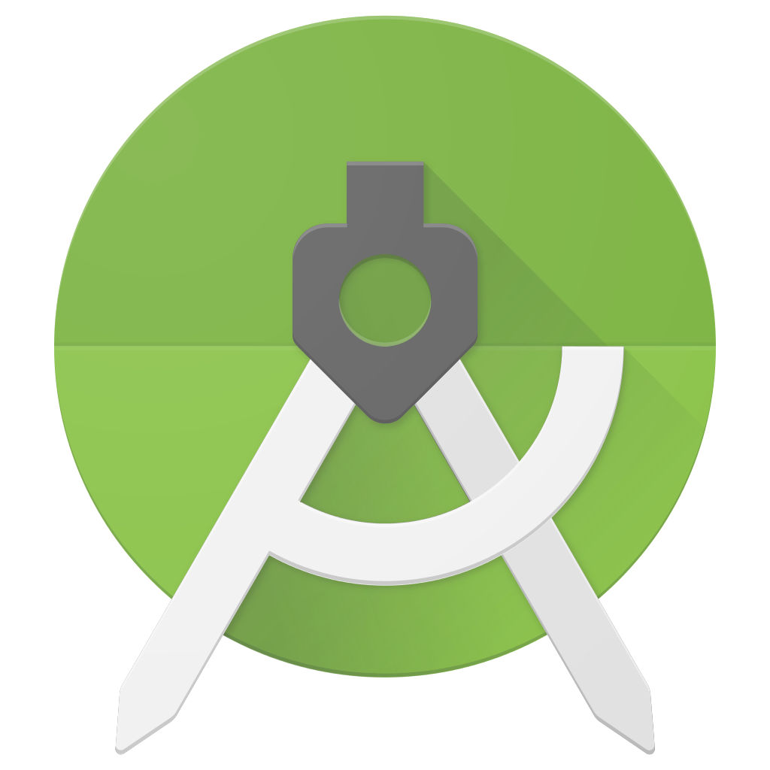
The UI / UX Design
Android SDK Tools
SDK tools are platform-independent and provides you resources, platforms and other useful components needed to build apps
Platform tools
Platform tools are customized and used to support new features of Android´s latest version, but also compatible with prior versions. Some of these tools include: Android Debug Bridge, Fastboot or Systrace.
Android Studio
It is an Integrated Development Environment (IDE) to properly run this set of tools.
It improves your app performance with instant visualization, smart code editor, a fast emulator and a unified environment

