Slide 1
Global CO₂ Emission Analysis
A Data-Driven Study using Global Panel Data (1990–2022)
PRESENTATION BY:
GROUP 9
Bala Ramya Gudivaka
Sai Sony Malapati
Thai Toan Tran
Aviral Chanchal
Meet Naresh Brahmbhatt

Slide 2
Agenda
Introduction & Motivation
Dataset Overview
Data Cleaning & Preprocessing
Exploratory Data Analysis (EDA)
Research Question 1 — Regression Analysis
Research Question 2 — Clustering Analysis
Research Question 3 — Forecasting Analysis
Research Question 4 — Energy & Development Analysis
Summary

Slide 3
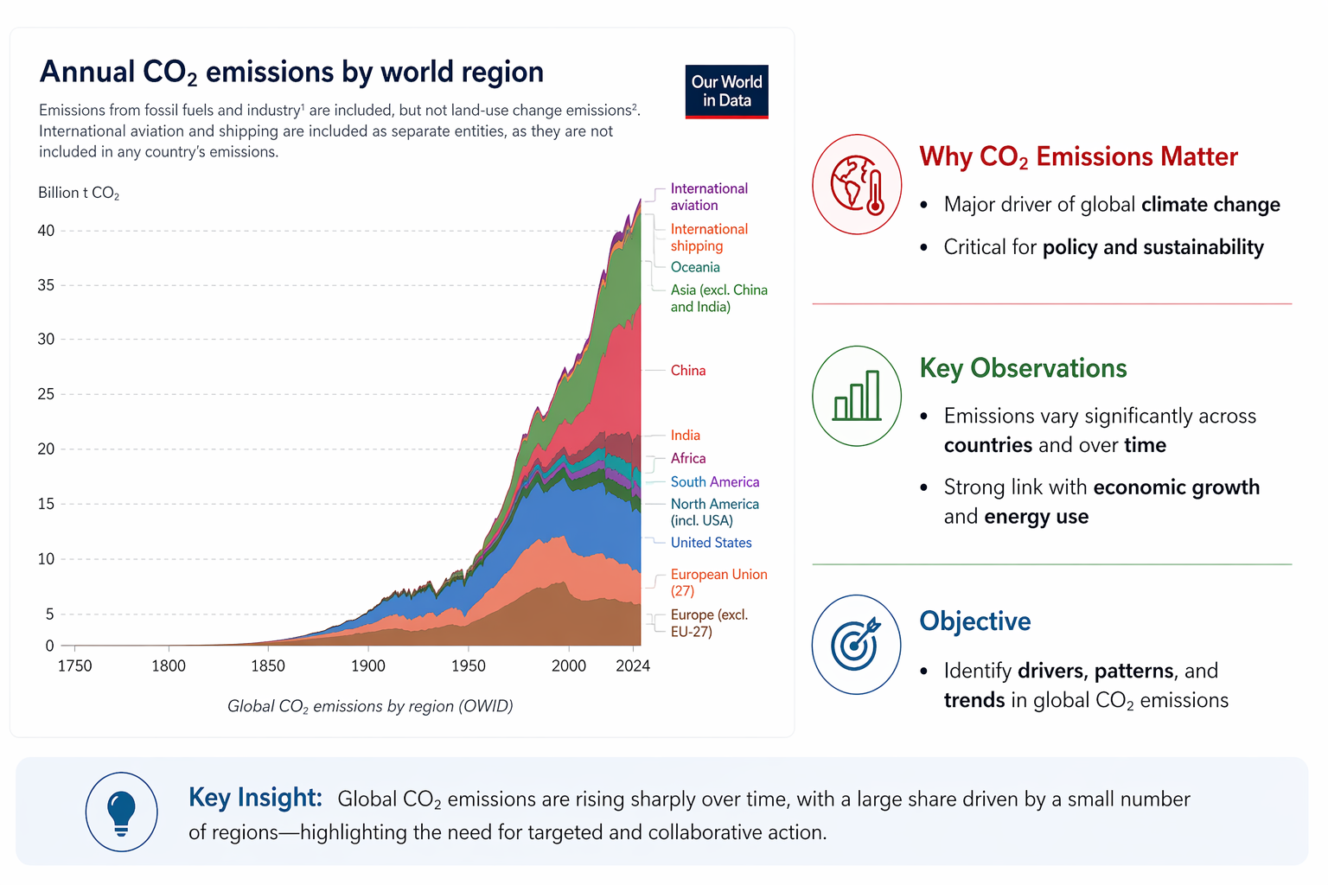
Introduction & Motivation

Slide 4
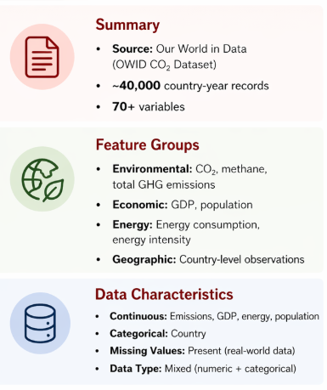
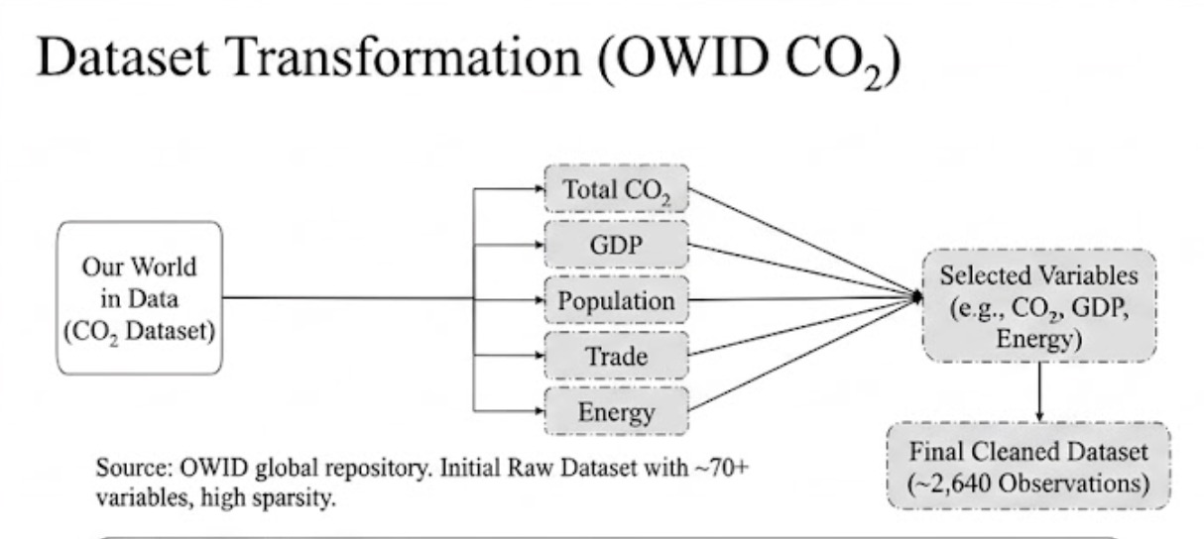
Dataset Overview

Slide 5
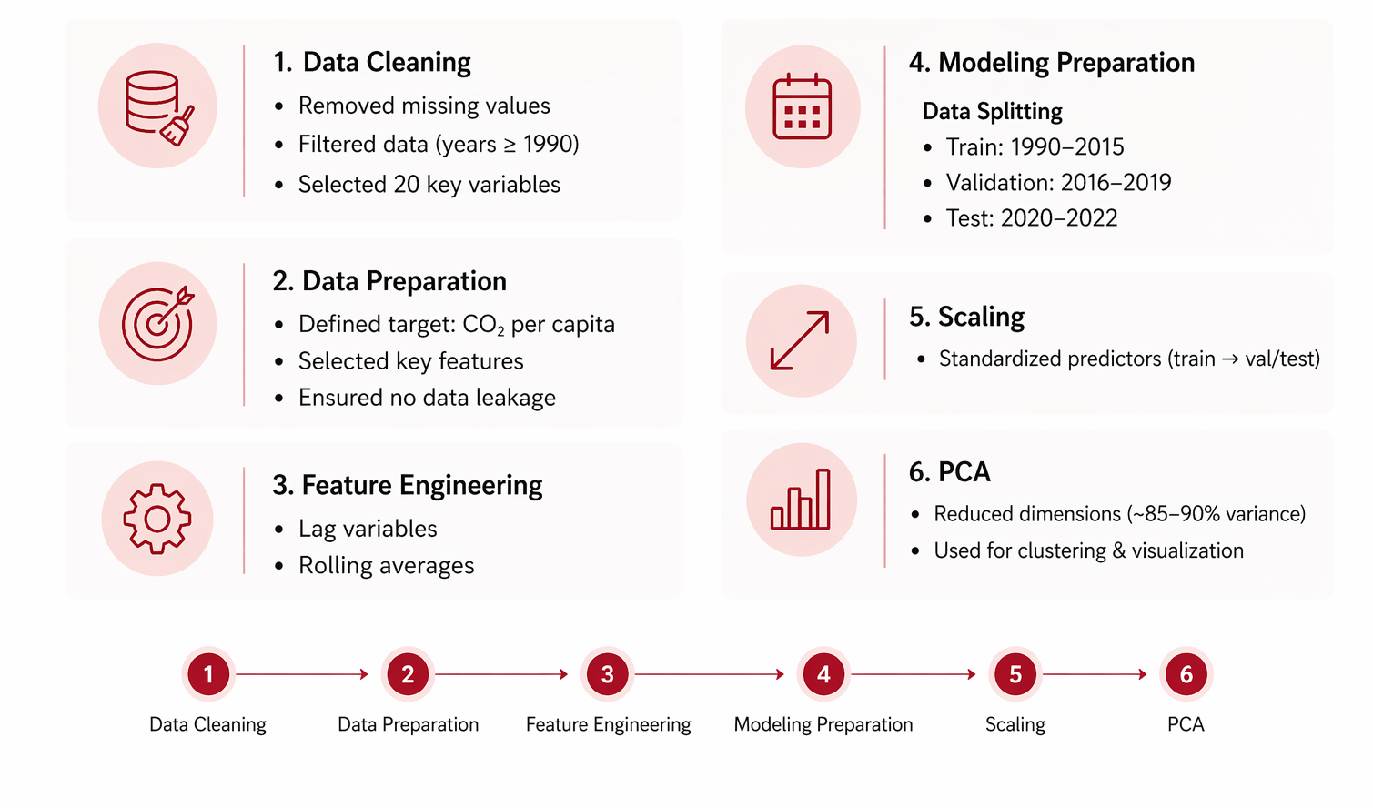
Data Cleaning & Preprocessing

Slide 6
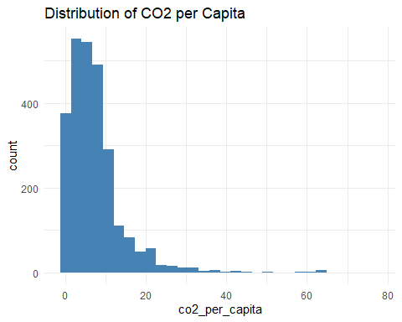
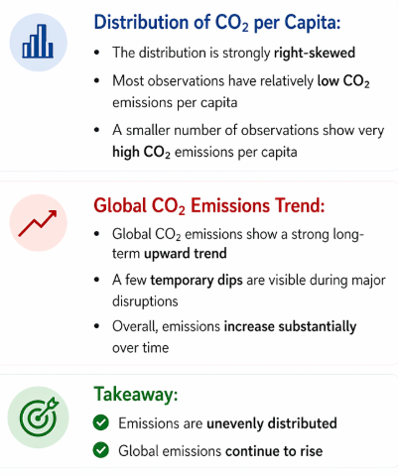
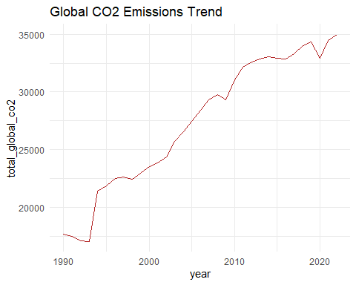
EDA — Overall CO₂ Emission Patterns

Slide 7
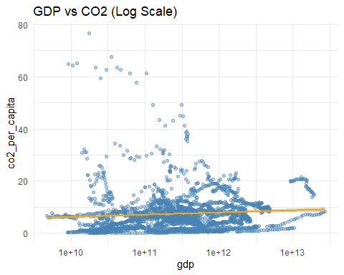
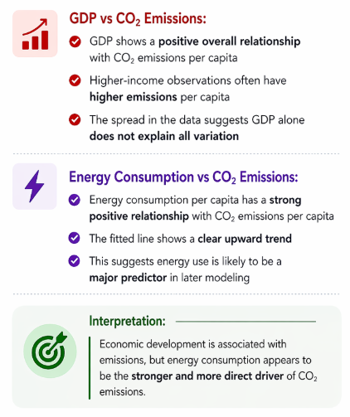
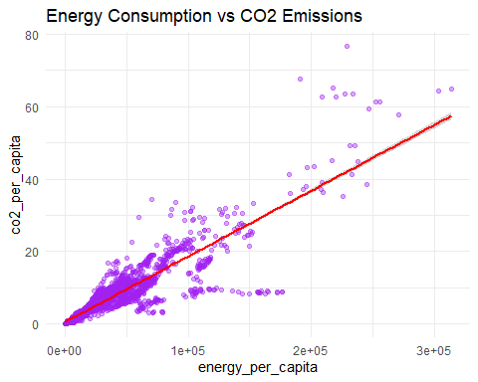
EDA — Economic and Energy Relationships

Slide 8
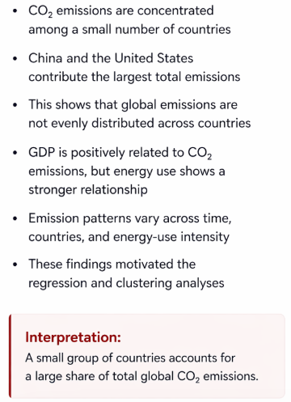
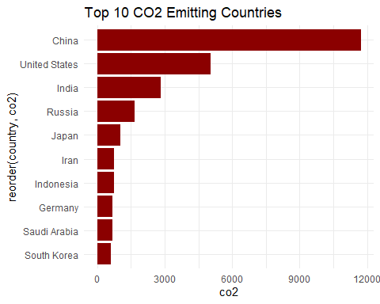
EDA — Country-Level Emission Structure

Slide 9
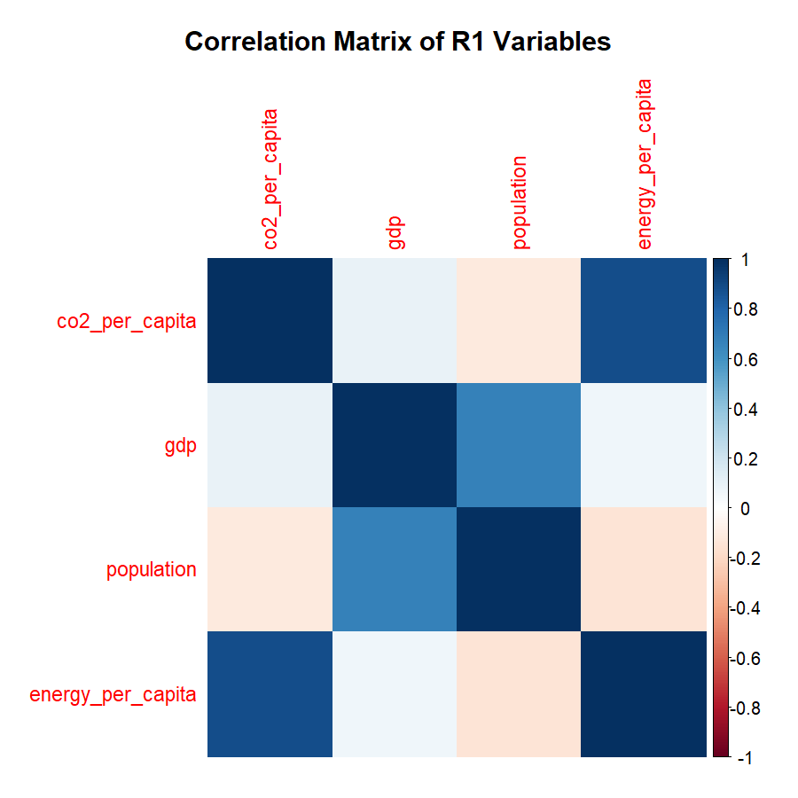
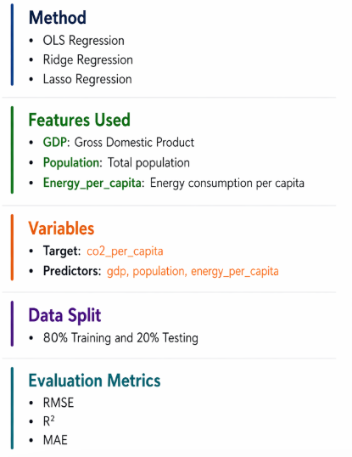
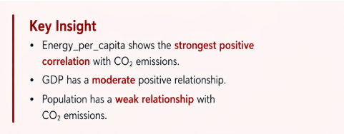
R1 — Regression Analysis
RQ 1:Which economic and energy-related variables are most strongly associated with CO₂ emissions per capita?

Slide 10
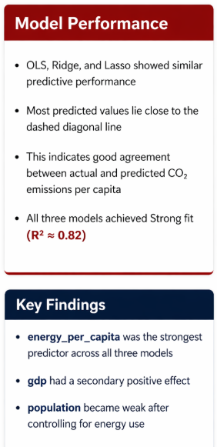
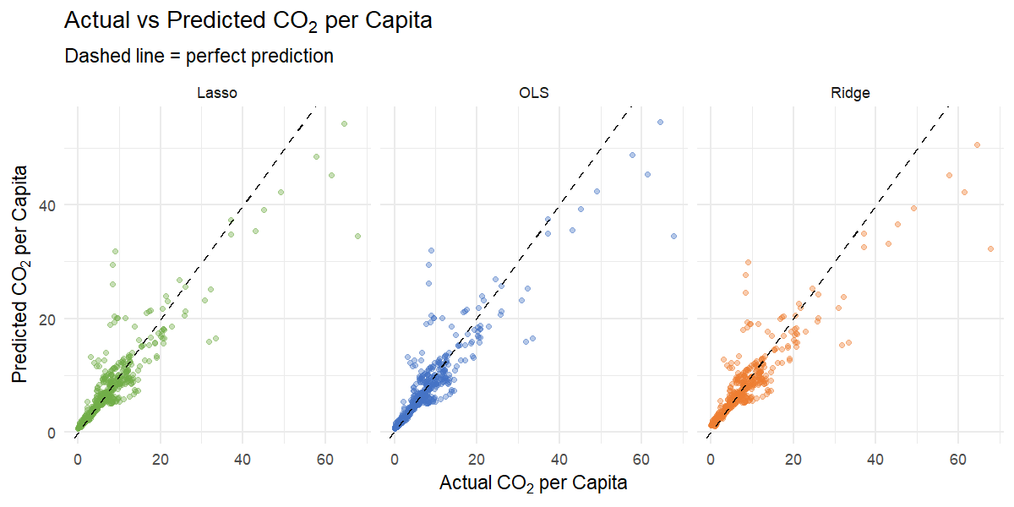
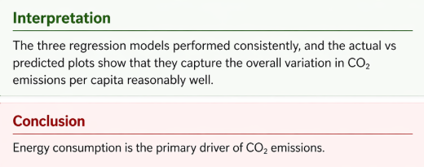

Slide 11
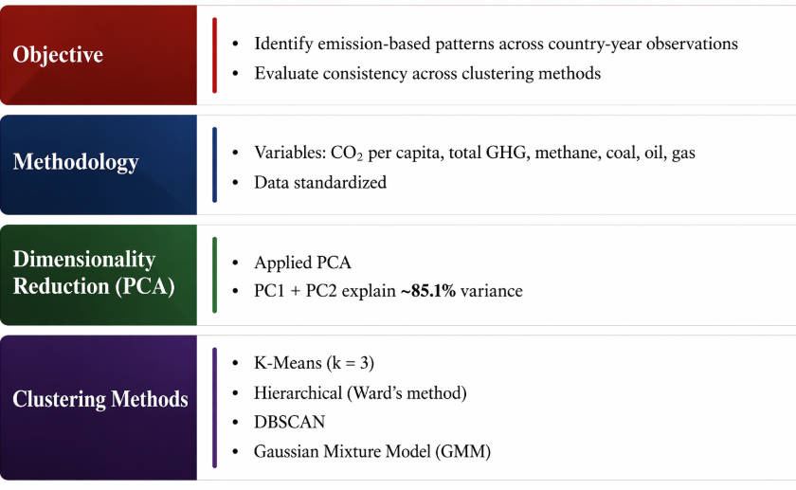
R2 — Clustering Analysis
RQ 2: Can country-year observations be grouped into meaningful clusters based on emission-related characteristics, and do different unsupervised learning methods yield consistent groupings?

Slide 12
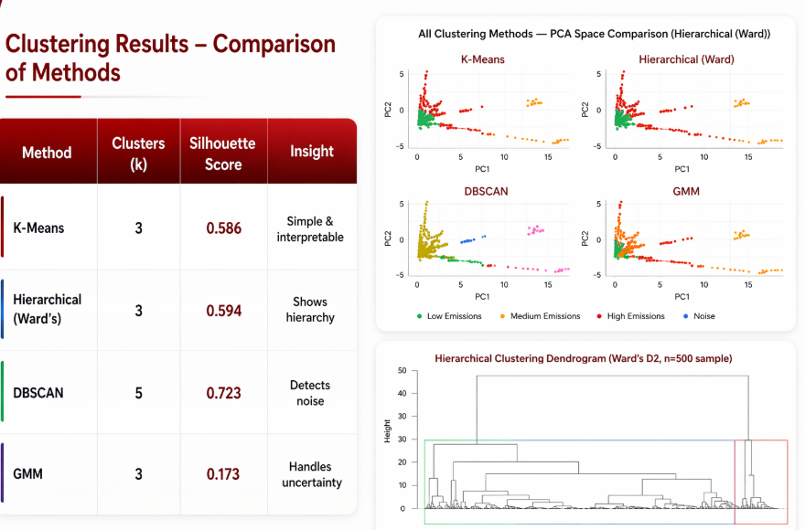

Slide 13
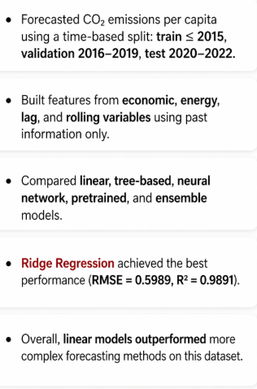
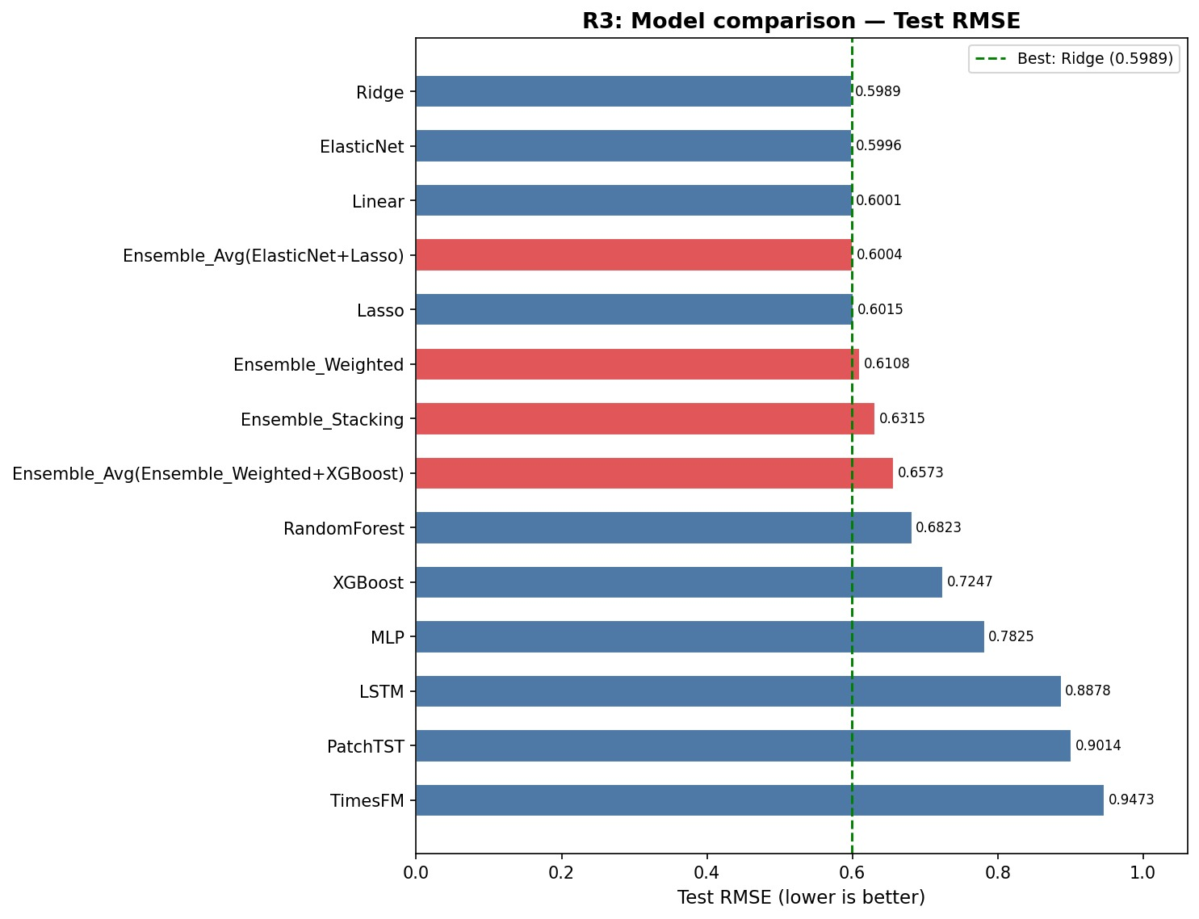
R3 — Forecasting Analysis
RQ 3: Can future CO₂ emissions be accurately forecast, and do deep learning models outperform classical baselines?

Slide 14
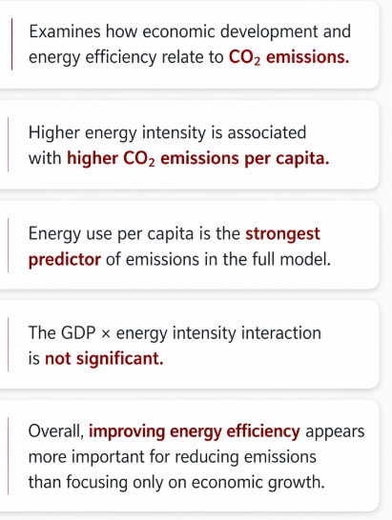
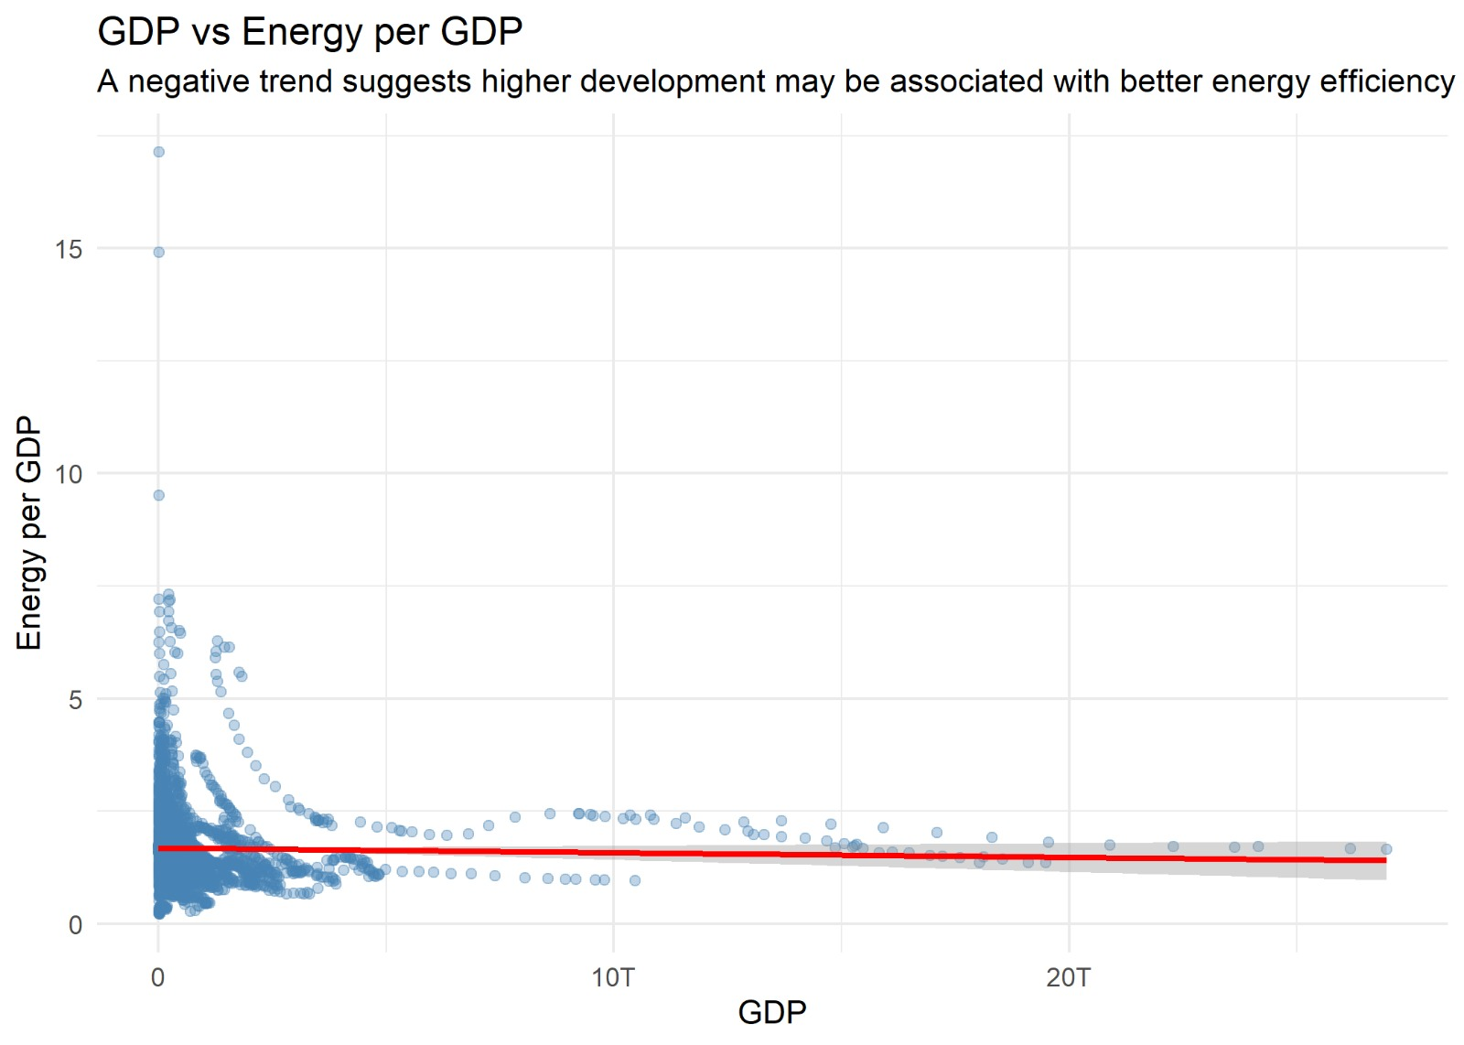
R4 — Energy Efficiency and Development Analysis
R4: Do countries become more energy-efficient as they develop, and how does this affect CO₂ emissions over time?

Slide 15
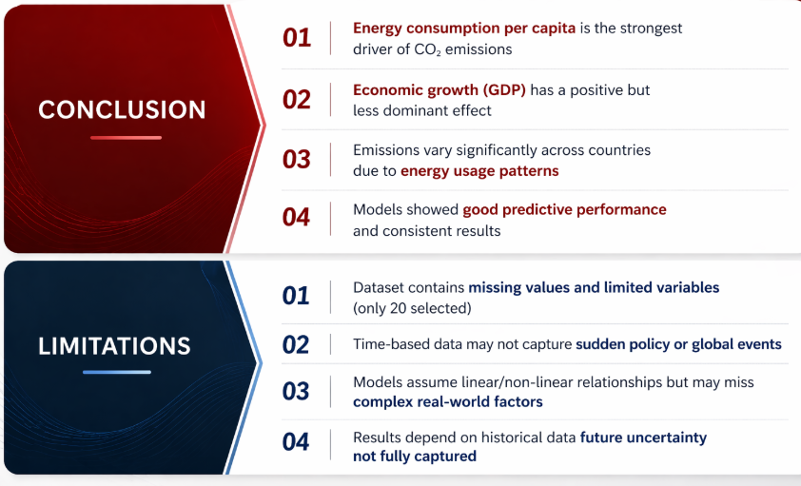
Summary

Slide 16
THANK YOU

