Slide 1






By Ajay Reddy
Bala Rathakrishnan and the CG team
http://bit.ly/setupgit
Images used with permission from Scott Chacon’s ProGit book
Powerpoint Templates
Copyright ©2010 Code Genesys, LLC. All Rights Reserved.
Notes:
Ajay, Founder of Code Genesys, An Agile Web and Mobile Consulting services company in Education, Insurance and Financial services sectors.
Web programmer Java, RubyRails, Python/Django
Co-Architect of ScrumDo.com
Bala is my fellow compatriot an IT Architect
I am here to present on a very basic topic of version control with a beginner tutorial on github.

Slide 2
Agenda
Intro to VCS, Central and Distributed
An overview of Git internals
Git/Github setup
Commonly used Git commands
Special not so obvious Github tips
Fork on Github
Github integrations- Jenkins and ScrumDo
Resources

Slide 3

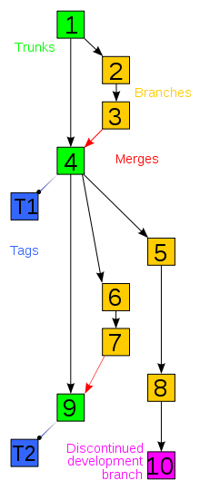
Introduction
What is Version Control?
Ref http://en.wikipedia.org/wiki/Revision_control
Notes:
I want to start at the very beginning.
Why version control
How many of you have at some point or another renamed files to filename-latest1 2, and so on?
What is Version Control?
It is a system that records changes to a file or set of files over time so that you can recall specific versions later.
Some of the features include:
Revert files back to a previous state
Revert the entire project back to a previous state
Compare changes over time
See who last modified something that might be causing a problem
See who introduced an issue and when, and more.

Slide 4
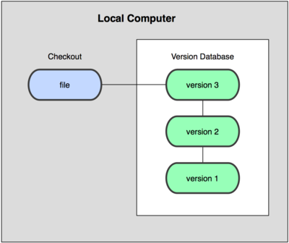
Version Control Variants
Local Version Control Systems -
Notes:
Example:
RCS
SCCS
Windows
Mostly linear

Slide 5
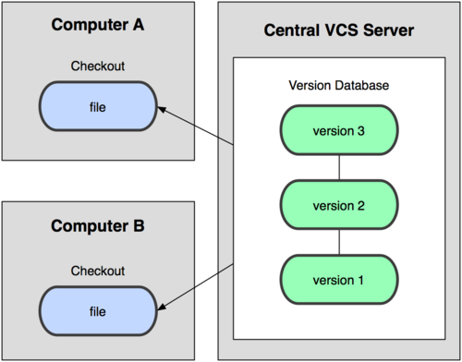
Version Control Variants
Centralized Version Control Systems -

Slide 6
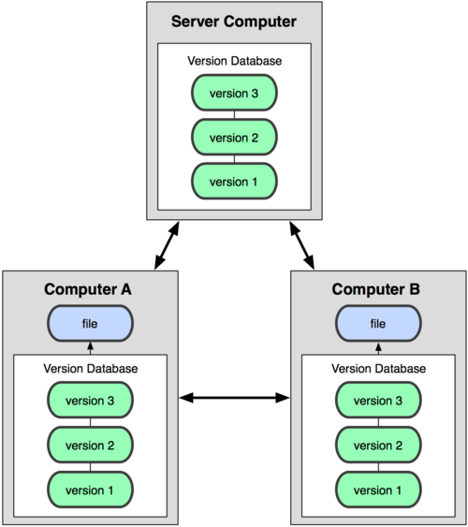
Version Control Variants
Distributed Version Control Systems -
Notes:
Distributed version control systems (DVCSs) solve different problems than Centralized VCSs. Comparing them is like comparing hammers and screwdrivers.
Centralized VCS systems are designed with the intent that there is One True Source that is Blessed, and therefore Good. All developers work (checkout) from that source, and then add (commit) their changes, which then become similarly Blessed. The only real difference between CVS, Subversion, ClearCase, Perforce, VisualSourceSafe and all the other CVCSes is in the workflow, performance, and integration that each product offers.
Distributed VCS systems are designed with the intent that one repository is as good as any other, and that merges from one repository to another are just another form of communication. Any semantic value as to which repository should be trusted is imposed from the outside by process, not by the software itself.
The real choice between using one type or the other is organizational -- if your project or organization wants centralized control, then a DVCS is a non-starter. If your developers are expected to work all over the country/world, without secure broadband connections to a central repository, then DVCS is probably your salvation. If you need both, you're fsck'd.

Slide 7
Bird's-Eye View
What's GIT?
And why GITHub?
Notes:
What's GIT?
Git is an extremely fast, efficient, distributed version control system ideal for the collaborative development of software.
Why is it fast t- because it maximizes uses of storage and pointer arithmentic.
And why GITHub?
GitHub is the best way to collaborate with others. Fork, send pull requests and manage all your public and private git repositories.
It blends agile scrum practices naturally with its local repository features that makes it stand tall among all version control tools in the market.

Slide 8
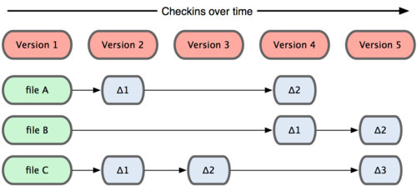
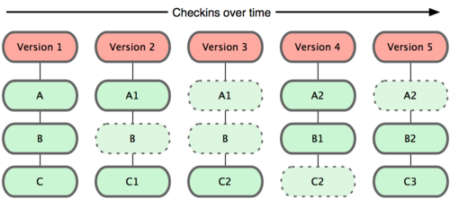
GIT Basics
Other VCSs
GIT VCS
Notes:
Other VCSs
Store information as a list of file-based changes.
GIT VCS
Considers data more like a set of snapshots of a mini file-system.
It basically takes a picture of what all your files look like at that moment and stores a reference to that snapshot.

Slide 9
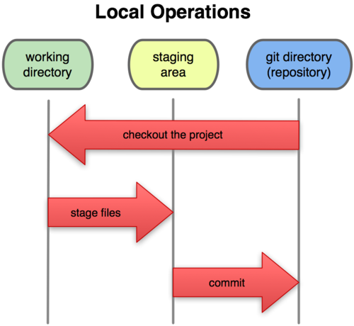
GIT Basics
- Nearly Every Operation Is Local
Git Has Integrity
Git Generally Only Adds Data
- Git 3-State Model
Notes:
- Nearly Every Operation Is Local
Most operations in Git only need local files and resources to operate – generally no information is needed from another computer on your network.
Because you have the entire history of the project right there on your local disk, most operations seem almost instantaneous.
- Git Has Integrity
Everything in Git is check-summed before it is stored and is then referred to by that checksum. This means it’s impossible to change the contents of any file or directory without Git knowing about it.
- Git Generally Only Adds Data
When you do actions in Git, nearly all of them only add data to the Git database. This makes using Git a joy because we know we can experiment without the danger of severely screwing things up.
- Git 3-State Model
The basic Git workflow goes something like this:
1) You modify files in your working directory.
2) You stage the files, adding snapshots of them to your staging area.
3) You do a commit, which takes the files as they are in the staging
area and stores that snapshot permanently to your Git directory.

Slide 10
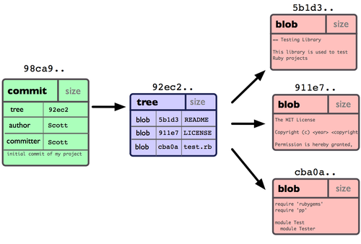
GIT Branch
Single commit repository data
Notes:
Branching means you diverge from the main line of development and continue to do work without messing with that main line.
In many VCS tools, this is a somewhat expensive process, often requiring you to create a new copy of your source code directory, which can take a long time for large projects.
The way Git branches is incredibly lightweight, making branching operations nearly instantaneous and switching back and forth between branches generally just as fast.
Unlike many other VCSs, Git encourages a workflow that branches and merges often, even multiple times in a day.
When you commit in Git, it stores a commit object that contains a pointer to the snapshot of the content you staged, the author and message metadata, and zero or more pointers to the commit or commits that were the direct parents of this commit. (Zero parents for the first commit, one parent for a normal commit, and multiple parents for a commit that results from a merge of two or more branches.)

Slide 11
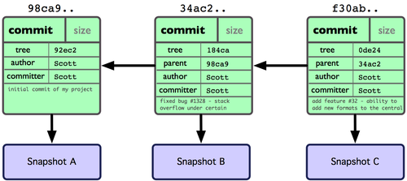
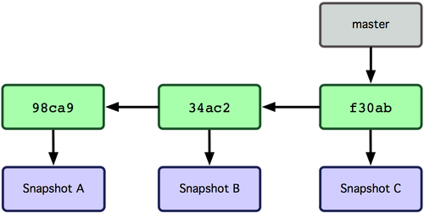
GIT Branch
Notes:
When you create the commit by running ’git commit’, Git checksums each subdirectory (in this case, just the root project directory) and stores those tree objects in the Git repository. Git then creates a commit object that has the metadata and a pointer to the root project tree so it can re-create that snapshot when needed.
If you make some changes and commit again, the next commit stores a pointer to the commit that came immediately before it. After 2 more commits, your history might look like this slide:
A branch in Git is simply a lightweight movable pointer to one of these commits. The default branch name in Git is master. As you initially make commits, you’re given a master branch that points to the last commit you made. Every time you commit, it moves forward automatically.

Slide 12
GITHUB.COM
Github.com is the most popular GIT repository hosting website on the Internet.
SASS Git tool
Great Integrations
Code Review Tools
Github issues
Comments on code
Forks
FREE on open source repos

Slide 13
GITHUB.COM- SETUP
You will need to create an account here in order to create your repository on this web space.
Follow these steps:
Go to www.github.com and click the “Signup and Pricing ” link.
Then click on “Create a free account”
Create a Repository
Notes:
Next create a remote public repository by clicking the “New repository” link on the right side near “Your Repositories”.
Then fill in the name, description, and web page for the repository and then click “Create Repository”.
Make a note of the “Clone URL” in the following page. You will need this to commit your application to the public repository on the web at github.com.

Slide 14
GIT Installation
Installer Platform Assistance:
LINUX
Git pre installed in most linux distributions.
CentOS 5
Configure the RPM forge repository by installing the correct RPMForge RPM from
. http://wiki.centos.org/AdditionalResources/Repositories/RPMForge#head-5aabf02717d5b6b12d47edbc5811404998926a1b
$ sudo yum install git
Ubuntu
$ sudo apt-get install git-core
Notes:
LINUX
Most Linux distributions come with “git” installed them. If you are running an older version of a Linux distribution you might have to install “git” from a third-party repository.
CentOS 5
First configure the RPM forge repository on your system. This can be done by simply installing the correct RPMForge RPM for you system from link below. http://wiki.centos.org/AdditionalResources/Repositories/RPMForge#head-5aabf02717d5b6b12d47edbc5811404998926a1b
Once that his done installing “git” by running the following command
$ sudo yum install git
Ubuntu
$ sudo apt-get install git-core

Slide 15
GIT Installation
Installer Platform Assistance:
Mac Users
http://code.google.com/p/git-osx-installer
Windows Users http://code.google.com/p/msysgit
Notes:
[Note: It is assumed that the user is comfortable with installing a basic application. Only the ones that require close attention are mentioned in the next few slides.
For a detailed installation manual please refer to the following link: http://help.github.com/win-set-up-git/
The installation screens shown here are for Windows machine and it is fairly similar for other non-windows systems.]
(If you’ve completed the installation then you can jump to GIT Setup)

Slide 16
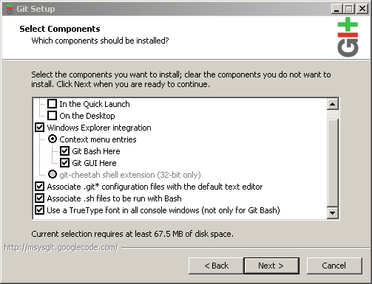
GIT Installation - Windows
GIT Component Selection:
Notes:
The context menu entries options give a user two new options on files when right-clicked in Windows Explorer.

Slide 17
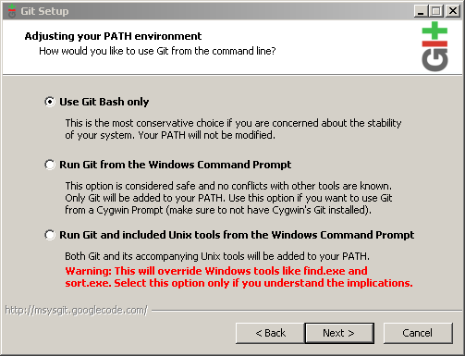
GIT Installation
Adjusting PATH variables:
Notes:
Use the “Git Bash only” option if you only want msysgit component. The other two options are tightly coupled to the operating system’s current setup.

Slide 18
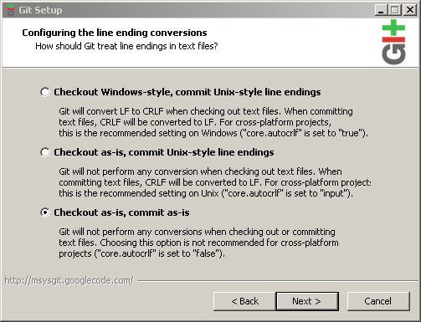
GIT Installation
Line-ending conversion configuration:
Notes:
Typical Windows developers won’t interact with other operating systems so choosing the 3rd option, in regards to non-handling of line-endings is usually best.

Slide 19
GIT Setup
Generate SSH keys:
$ ssh-keygen -t rsa –C “ userName@example.com "   
(Press ‘Enter’ key thrice to skip the passphrase questions)
Setup your identity:
$ git config --global user.name “firstName lastName“
$ git config --global user.email userName@example.com
Create local GIT Repositories:
$ git init
Notes:
If you’ve installed it successfully you will have both a command-line version (including an SSH client that will come in handy later) and the standard GUI. Open the GitBash program and follow the steps below.
Add your generated SSH to your account on the GitHub site. (Click “Account Settings” > “SSH Public Keys” > “Add another public key”)
Open the id_rsa.pub file, that contains your public SSH key, in a text editor. This file might be hidden so use appropriate action to get access to it.
It is important that you copy your SSH key exactly as it is written without adding any newlines or whitespace into the “Key” field.
Test your SSH key by typing the following in GitBash prompt:
$ ssh -T git@github.com 
Are you sure you want to continue connecting (yes/no)? yes 
Create local GIT Repositories:
Every time you make a commit with Git, it is stored in a repository (a.k.a. “repo”). To put your project up on GitHub, you’ll need to have a GitHub repository for it to live in.
Go to any folder which contains the application source code that you wish to convert as local repository. Right click on it and choose “Git Bash Here“. Then type the following: $ git init 
Voilà! You‘ve just created a local GitHub Rep in your system!

Slide 20
GIT Commands
gitignore
git status
git add
git commit
.
git remote
git push
Notes:
Create ‘.gitignore’ file to filter the commit operation by excluding the ones specific to local environment (like bin folder etc)
$ touch .gitignore
$ ls –al
[In this file you can enter partial or full names of files/folder that you don’t want to commit to the repo]
We can now view all the files that we can commit.
GIT Status
After committing our code to the repo we can run “git status” to see the status between staging area & working directory.
From the above example, (where a file ‘program.cs’ has been edited and changed) we get a message: “Changed but not updated”. It means that it’s changed in our working directory, but not staged (i.e. not in our staging area or ready for commit). If we tried to commit right now, nothing would be committed because nothing is in our staging area.
$ git status
This gives the status of all the files in the folder i.e. whether they are in the modified, staging or repo area.
In order to add files to staging area we execute:
$ git add .
And then execute ‘git status’ again to see the changes made.
Now its time to commit files from staging area to repo by typing:
$ git commit –m “Your Custom Message”
GIT Remote
We need to add the remote repository to be watched by your local GIT repository.
First goto your local repo folder.
Then type the following:
$ git remote add remote_repo_name your_clone_URL
Quick Tip: You can clear your Git Bash screen by pressing Ctrl+L on the keyboard. This works in most bash terminals.
Now you have told your local repository to watch your newly created github.com remote public repository.
Now we need to push this code up to the Github.com repository. (Look at the last step of the “Existing Git Repo?” information from Github.com)
Type the following:
$ git push remote_repo_name master
During the push, you will most likely get prompted for host authenticity. Make sure you type ‘yes’, not just ‘y’. This will add github.com’s public RSA key to your ~/.ssh/known_hosts file so that you won’t get prompted for this again on any future push. This let’s your system and github.com to trust each other. After you say ‘yes’ the files are pushed up to the remote repository.
Side Note: Your clone URL doesn’t look like a HTTP URL or a ssh:// protocol. But it is still SSH. The git protocol, usually using port 9418, is used for clone, fetch, or pull.

Slide 21
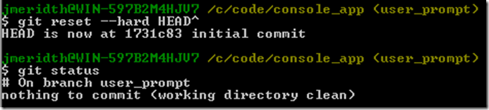
GIT Commands
git reset
git remote
git log
git clone
git diff
Notes:
GIT Add
Example of adding ‘Program.cs’ to our staging area with the “git add Program.cs” command:
GIT Reset
We can roll back one commit clearing our staging area and working directory with the following command:
$ git reset –hard HEAD^
The “HEAD^” portion of the command means that we want to reset the commits to one prior (^) to the HEAD (aka, the latest commit).
This branch has been rolled back to the previous commit. The new commit we just did was destroyed from history.
SIDE NOTE: If you just want to clear your working directory and staging area, but not the latest commit, just issue a “git reset –-hard” command without the “HEAD^”
GIT Remote
We can look at the remote repository that we’re watching by issuing the following command:
$ git remote -v
GIT Log
We can see all the commits we’ve made to the repository by issuing the following command:
$ git log
GIT Clone
If you want to get a copy of an existing Git repository — for example, a project you’d like to contribute to — the command you need is git clone.
$ git clone your_clone_URL local_foldername
GIT Diff
We can see all the unstaged files with the following command:
$ git diff

Slide 22
Branching
To create a local branch
$ git branch user_prompt
$ git checkout user_prompt
To create a local branch and checkout branch
$ git checkout -b user_prompt
To create a remote branch on github that is a replica of your local branch
To push all of the changes from your plugin branch to a plugin branch on the remote repository:
$ git push origin user_prompt
To delete a remote branch on github
git push origin :user_prompt
Notes:
Now let’s imagine that we have a task that states “Prompt user for their name and say hello back to them, including their name”. Let’s create a new branch locally so that we have a separate place to do our active development for this task.
Issue the command: $ git checkout -b user_prompt
A couple things to notice:
It says “Switched to a new branch ‘user_prompt’”. The “git checkout –b” command creates a new branch by the name following the command and then checks it out automatically. This is the shorthand version of doing “git branch user_prompt” and then “git checkout user_prompt”.
2. It shows the “(user_prompt)” text at the end of bash prompt which means that we’re on the user_prompt branch. To verify we can issue “git branch” command that lists all the local branches. Here the (*) next to name indicates the active branch.
GIT Branch
You can run “git branch” to see what branch you’re on, but msysgit let’s you know via the end of your bash prompt “(master)”. [For more information go here]
The branch name with the asterisk (*) next to it is the active branch. In this case I only have the one branch, master.
To create a remote branch on github that is a replica of your local branch
Suppose you created a local plugin branch that you want to expose to others through your GitHub repository but you are not yet confident enough to put it into the master branch.

Slide 23
To create a tracking branch
git branch -t javaClient
To create a local branch that is tracking an already existing remote branch
git fetch origin
git checkout --track origin/plugin

Slide 24
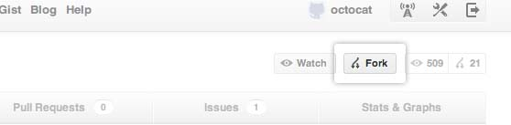
Fork a Repo
Step 1: Fork the “ScrumDo” repo available at https://github.com/ScrumDoLLC/ScrumDo
Step 2 : Set Up Your Local Repo
Step 2A: Clone the “ScrumDo” project
Step 2B: Configure remotes
Notes:
At some point you may find yourself wanting to contribute to someone else’s project, or would like to use someone’s project as the starting point for your own. This is known as “forking.”
For this tutorial, we’ll be using the Scrumdo project.
Step 1: Fork the “Scrumdo ” repo
To fork this project, click the “Fork” button.
Step 2 : Set Up Your Local Repo
You’ve successfully forked the Scrumdo repo, but so far it only exists on GitHub. To be able to work on the project, you will need to clone it to your local machine.
Step 2A: Clone the “Scrumdo” project
Run the following code: $ git clone git@github.com:username/Scrumdo.git
Step 2B: Configure remotes
When a repo is cloned, it has a default remote called origin that points to your fork on GitHub, not the original repo it was forked from. To keep track of the original repo, you need to add another remote named upstream:
$ cd Scrumdo
$ git remote add upstream git://github.com/ScrumDoLLC/ScrumDo.git
$ git fetch upstream
You’ve successfully forked a repo!

Slide 25
Fork a Repo
Then… More Things You Can Do
Push commits
Pull in upstream changes
If the original repo you forked your project from gets updated, you can add those updates to your fork by running the code:
$ git fetch upstream
$ git merge upstream/master
Pull requests
Delete your fork
Notes:
Push commits:
Once you’ve made some commits to a forked repo and want to push it to your forked project, you do it the same way you would with a regular repo:
$ git push origin master
Pull in upstream changes:
If the original repo you forked your project from gets updated, you can add those updates to your fork by running the code:
$ git fetch upstream
$ git merge upstream/master
Work with branches:
Branching allows you to build new features or test out ideas without putting your main project at risk. A Git branch is a small file that references the commit it was spawned from. This makes Git branches very small and easy to work with.
Pull requests:
If you are hoping to contribute back to the original fork, you can send the original author a pull request.
Unwatch the main repo:
When you fork a particularly popular repo, you may find yourself with a lot of unwanted updates about it. To unsubscribe from updates to the main repo, click the “Unwatch” button on the main repo.
Delete your fork:
At some point you may decide that you want to delete your fork. To delete a fork, just follow the same steps as you would to delete a regular repo.

Slide 26
GitHub Tools
JENKINS Integration
When there are changes checked Jenkins polls for these changes, auto build, tests and deploys.
SCRUMDO Integration
ScrumDo is a tool that allows you to easily manage your scrum projects. To learn more goto: www.scrumdo.com
Change story status with git hub commit messages
Github issues
Commit messages to scrum log
ScrumDo integration with GitHub video link: http://www.youtube.com/watch?v=Xsjk31wH0A4&feature=youtu.be

Slide 27
GIT Resource
For more information on the GIT commands and all the available options visit: http://progit.org/book/
Git Clients
MAC
Gitti - http://www.gittiapp.com/
Atlassian Source Tree - www.sourcetreeapp.com
Tower (Commercial) - http://www.git-tower.com/
Smart git (Commercial) - http://www.syntevo.com/smartgit/index.html
GitX - http://gitx.frim.nl/
Windows
Tortoise Git - http://code.google.com/p/tortoisegit/
Git Extension - http://code.google.com/p/gitextensions/
Smart git (Commercial) - http://www.syntevo.com/smartgit/index.html

Slide 28
Thank you
For questions and information contact:
Ajay Reddy
aj@codegenesys.com
www.codegenesys.com
Powerpoint Templates
Copyright ©2010 Code Genesys, LLC. All Rights Reserved.

