Slide 1
TRENDYY -Balaguru G

Slide 2
topics
Abstract
Languages and software used
Screenshot of the project with explanation
Conclusion
Advantage and Disadvantage

Slide 3
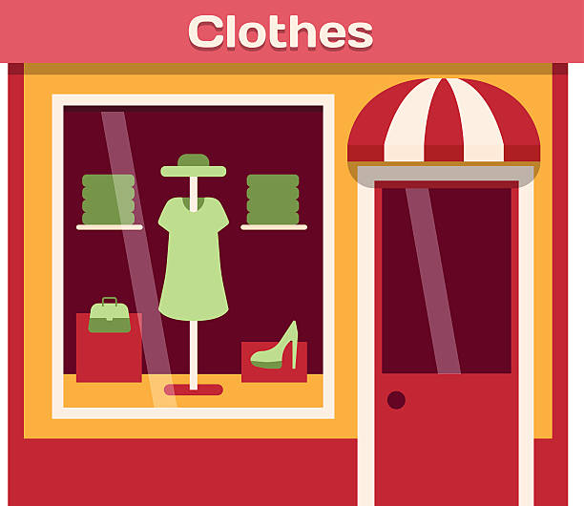
Abstract Explore fashionable finds at TRENDYY, your ultimate destination for stylish clothing . Enjoy seamless shopping with easy navigation and secure transactions, ensuring a hassle-free experience. Elevate your wardrobe today with our new collection, delivered straight to your door.

Slide 4
Languages and Software used
HTML (hypertext markup Language)
CSS (Cascading Style Sheets)
JAVASCRIPT
REACT JS
VS code

Slide 5
This my Navbar ,it contain logo , shop category ,login and cart icon by using react hooks and onclick event I decorate my category text when click the category it will change from one state to another state Login was created by using button tag and it design with css By using display flex I designed my hole navbar with justify content space around
Screenshot of the project with explanation

Slide 6
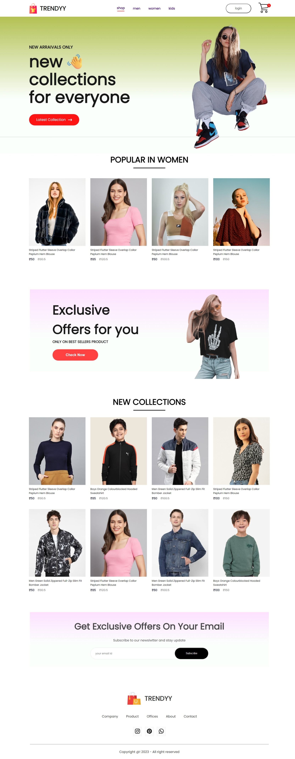
This my home page it will contain header in header I separated two portion left portion contain some text with button and icon and right portion contain hero image by using linear gradient in background I designed my header giving side heading as popular in women it will contain some popular product from women category by using props I collect all data from product after that it contain offer banner with gradient color and then I insert side heading as new collection in H1 tag ant it contain some new collect product by using display grid I separated all product evenly with the help of grid templete coloum

Slide 7
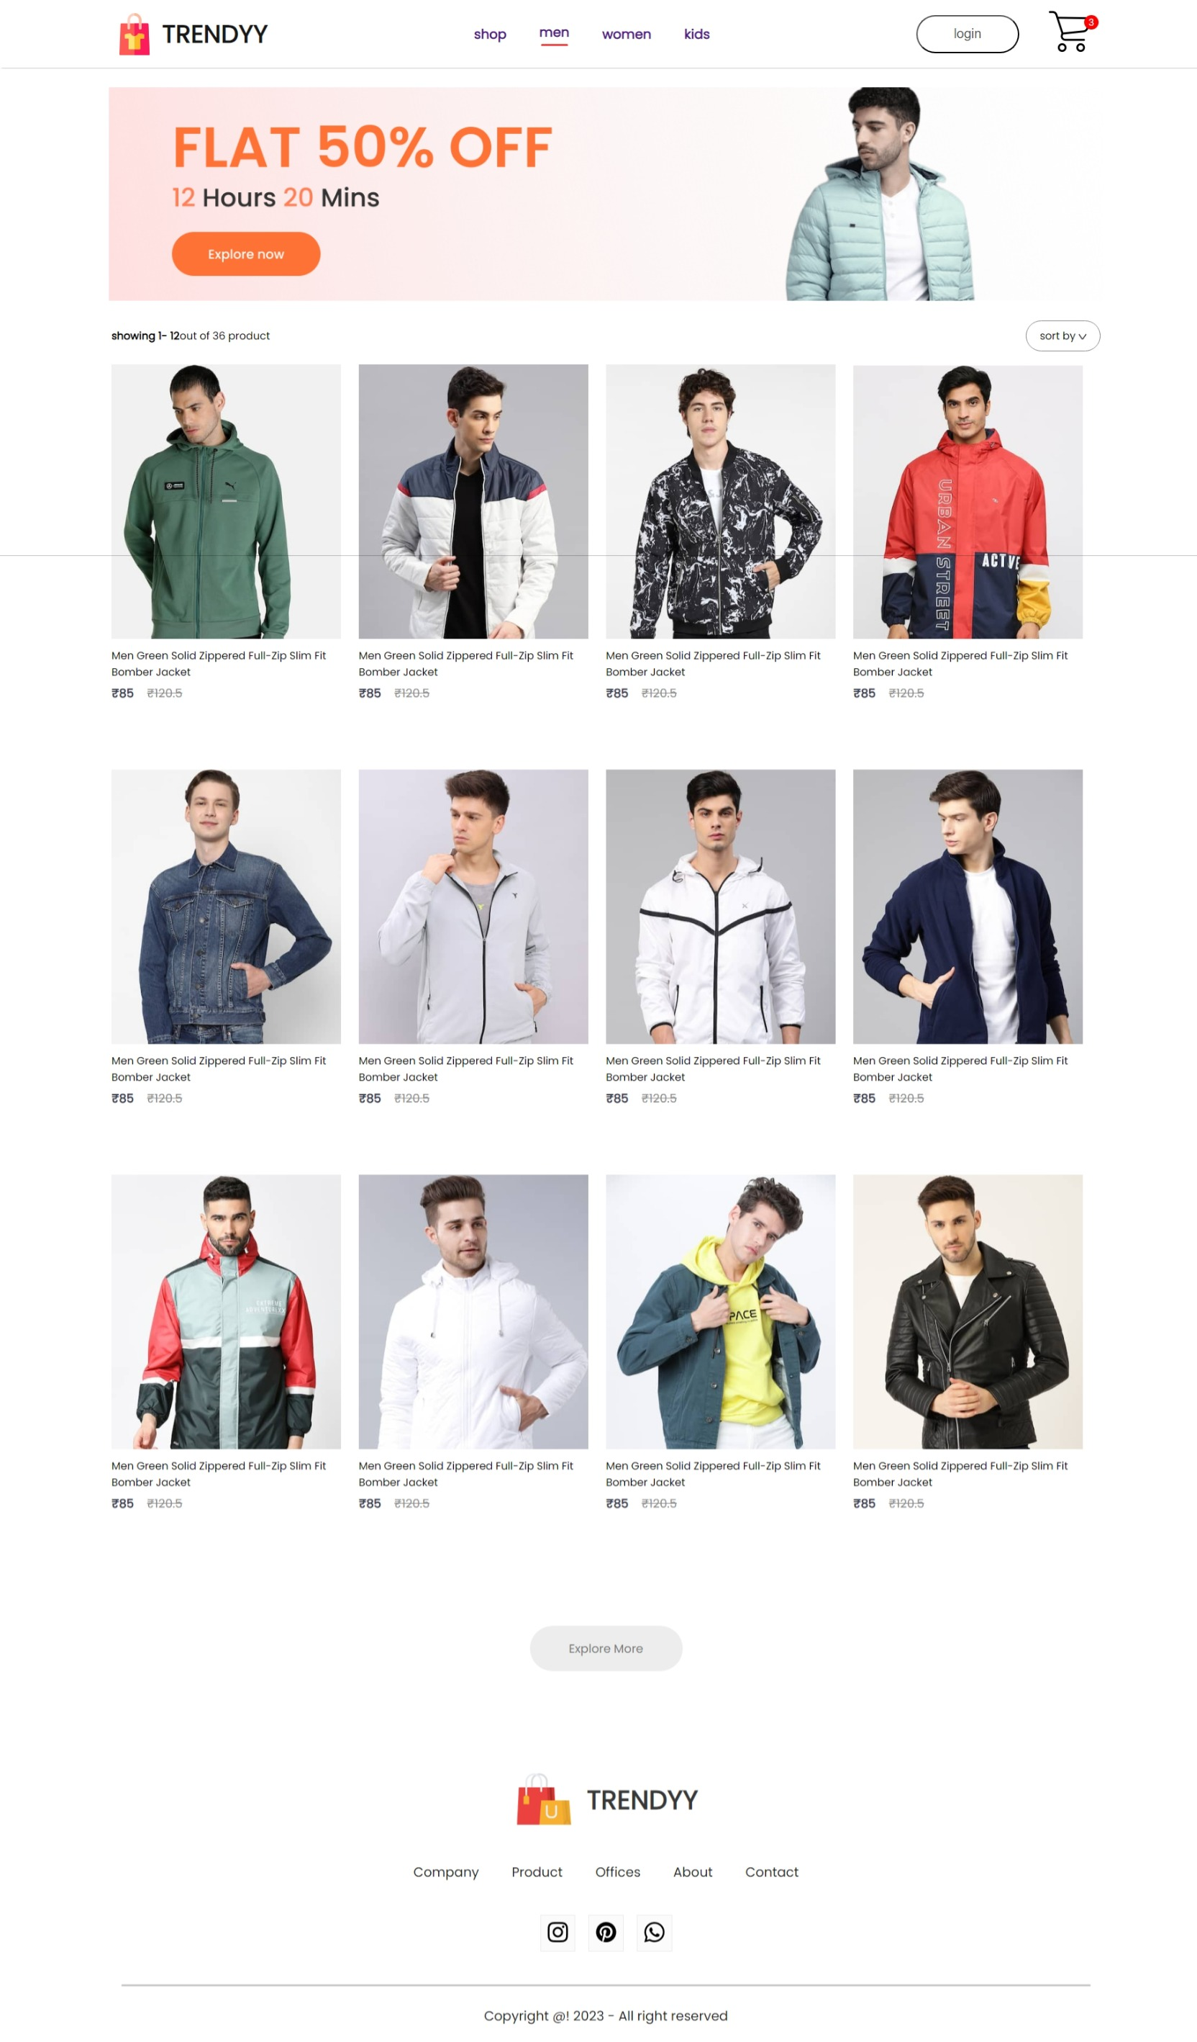
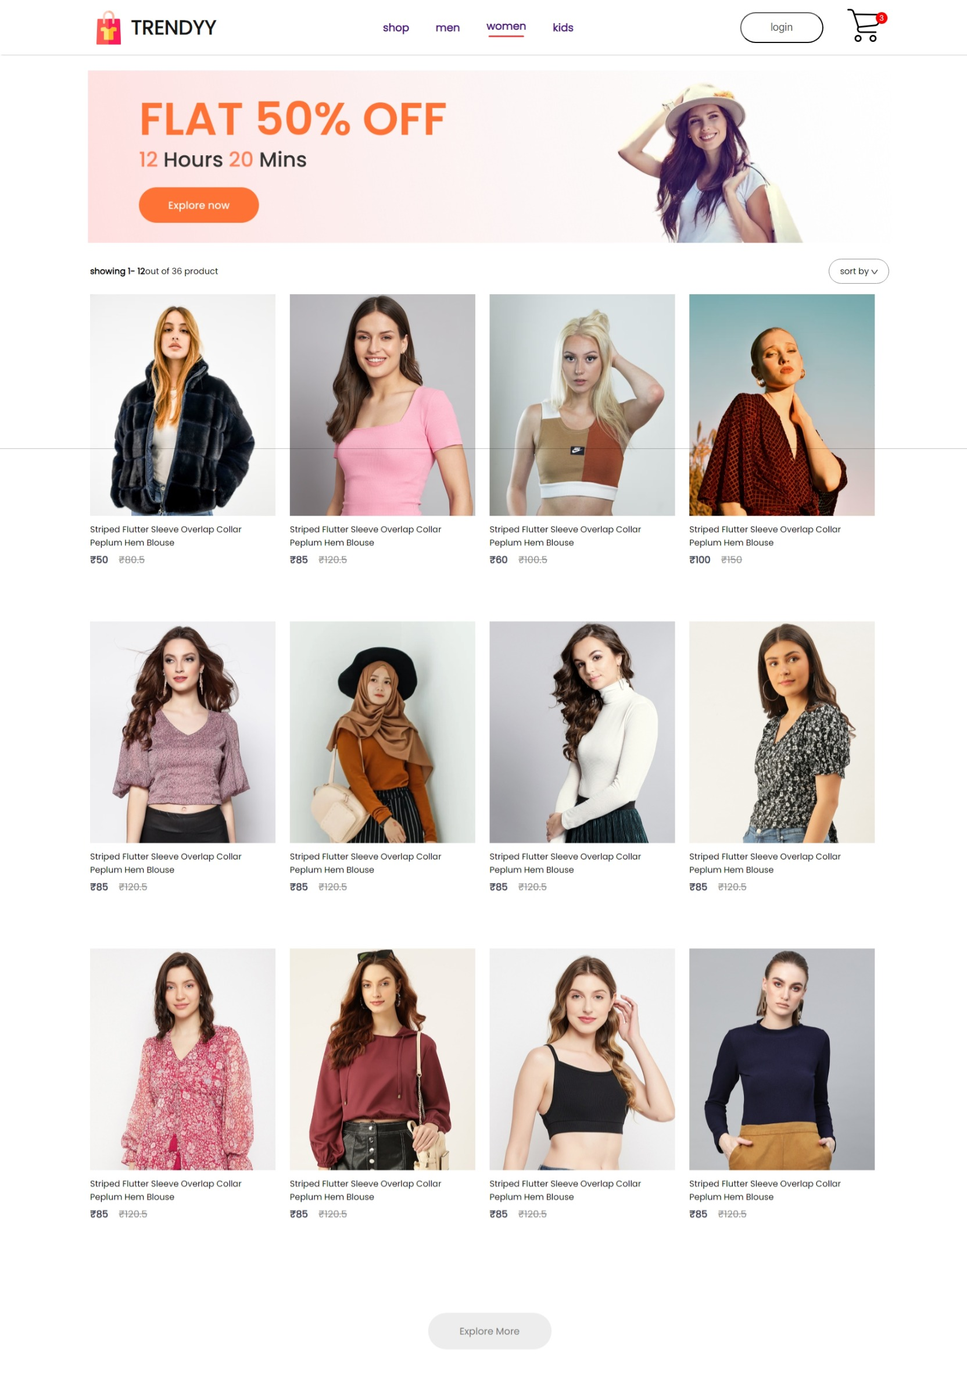
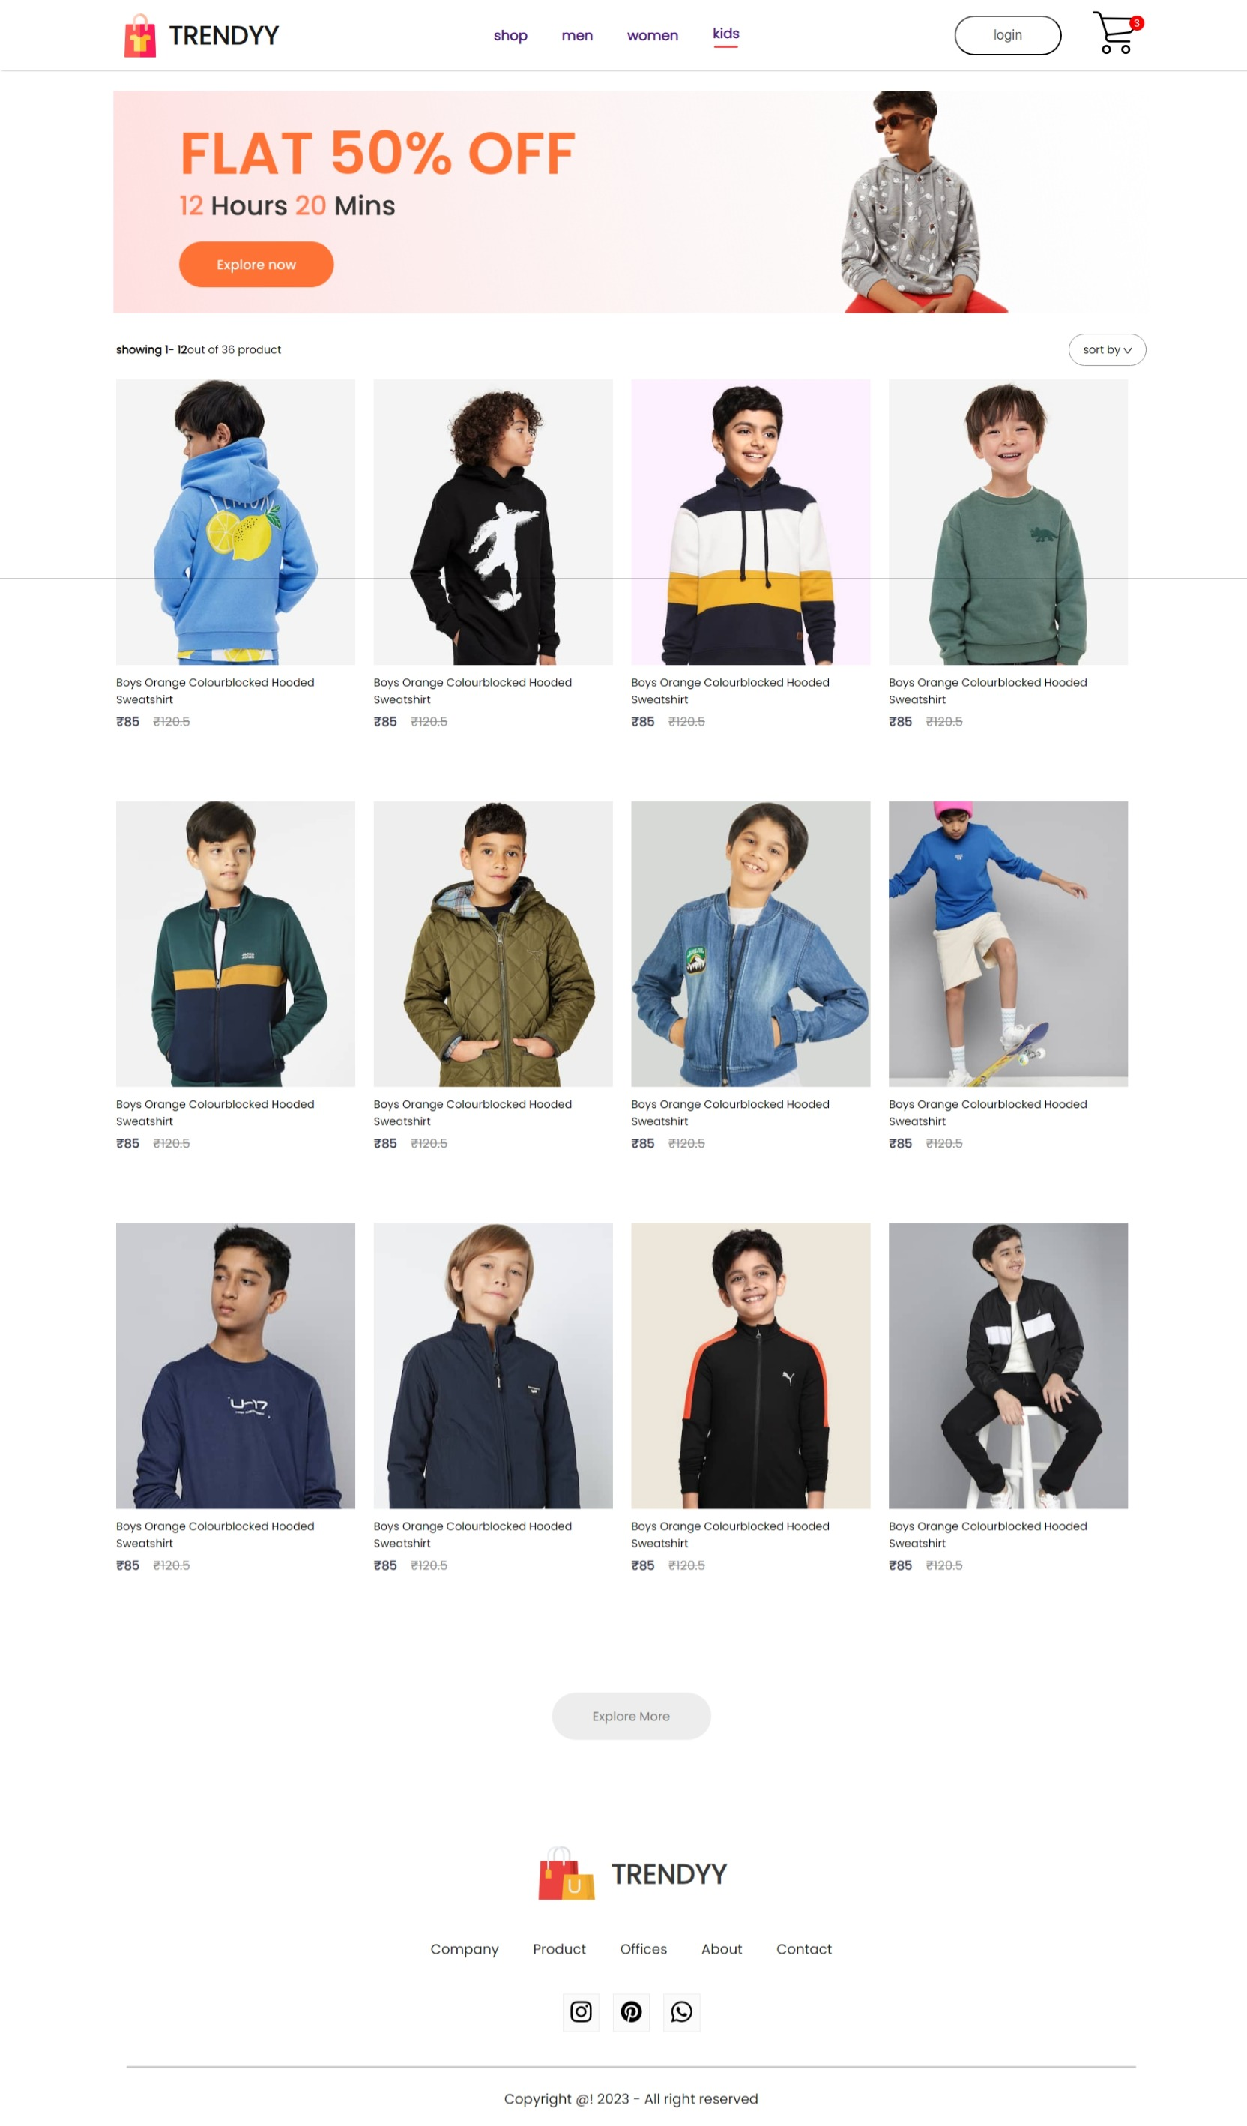
This is my category page it contain banner and all product based on category here I using props getting all data from product by using array of object I separated category based on men , women , kids . if I click men category it displayed men product ,if I click the women category it displayed women product , if I clicked kids category it displayed kids product , by selecting product add to cart button will available by clicking that button we can move item to cart.

Slide 8
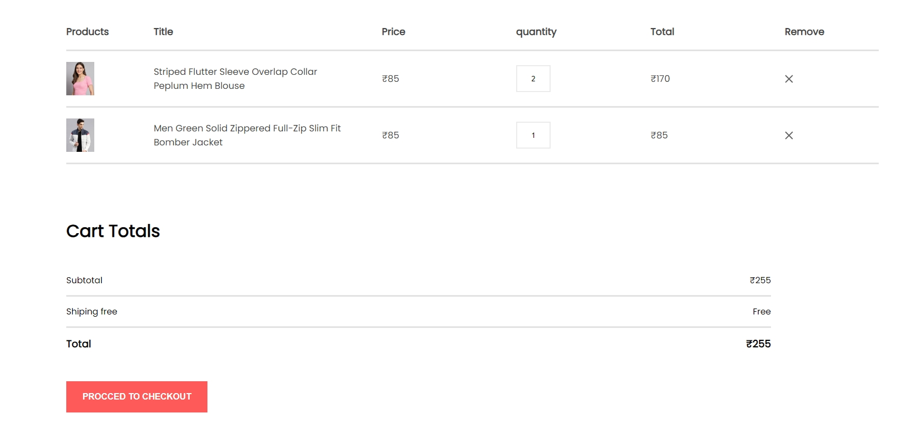
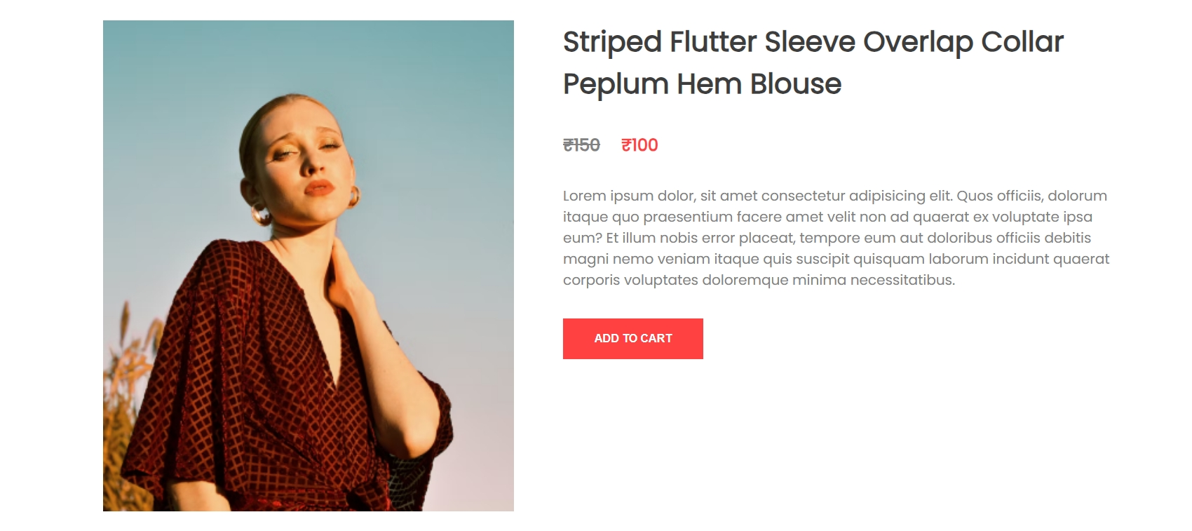
This my cart page ,it contain product , title, price, quantity, total, remove icon. By clicking product image , it contain add to cart button by clicking that button we can add product to this page if we click the button twice the quantity will increase, after that we can delete quantity by using X icon and based on product and price total amount will be calculated by using for loop and if clause
.

Slide 9
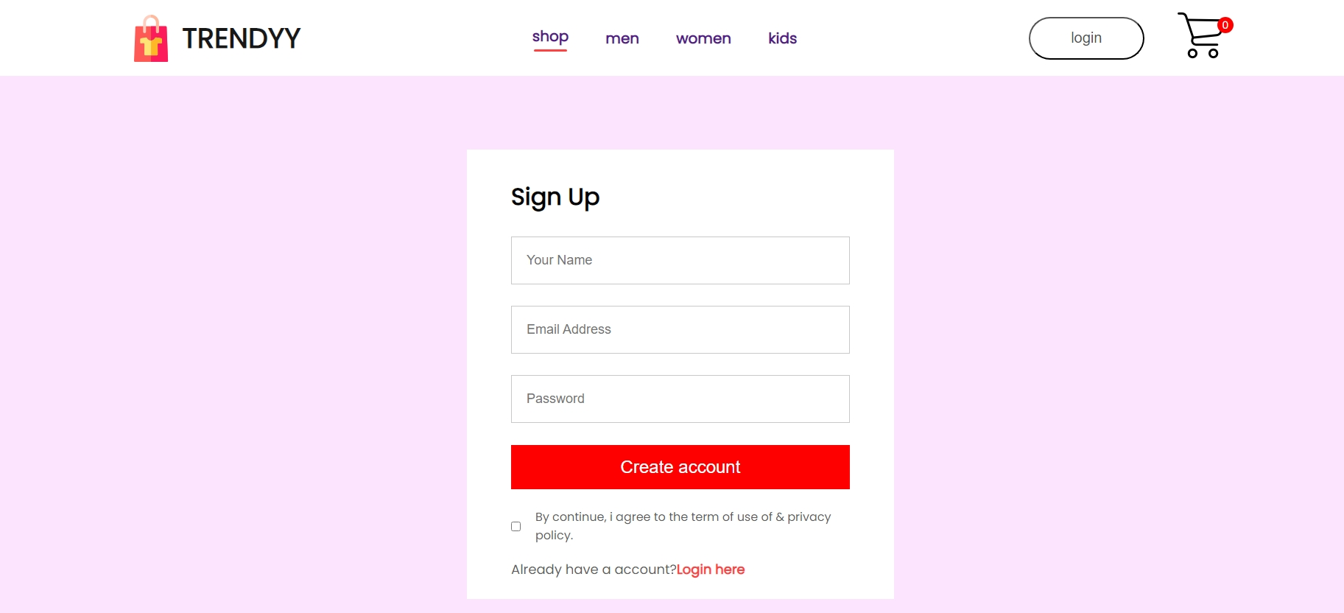
This is my signup page it contain name, email address and password .I create input tag with in that I used place holder attribute and created text box. After that “create account” button is add . If we already have a account you want to go login page by clicking “Login here” and login page was appeared it contain email address and password . I used if clause and ternary operator to switch” login” to “signup” and “signup” to “login” page
.

Slide 10
Advantages and Disadvantages
Convenience: Customers can browse and shop for clothes anytime and anywhere, without the constraints of store hours or physical location, making shopping more convenient.
Wide Selection: Online cloth shops can offer a vast range of products compared to physical stores, allowing customers to access a diverse selection of styles, sizes, and brands all in one place.
Ease of Comparison and Reviews: Shoppers can easily compare prices, styles, and reviews from other customers, making more informed purchasing decisions without the need to visit multiple stores physically.

Slide 11
Conclusion
Thank you for exploring our online clothing store. We offer trendy, affordable fashion with fast delivery and great customer service. Shop with us for a convenient and stylish experience!

Slide 12
thank you
…

