Slide 1
DBprocessing Overview
Brian Larsen, LANL Jon Niehof, UNH Myles Johnson, UNH Reiner Friedel, LANL
September 24, 2017

Slide 2
DBprocessing is…:
A rich version driven processing system
Parallel processing
Unattended operations
Written fully in python
Platform independent (mostly)
Configuration file setup
Soon to be open source (BSD 3 clause)
https://bitbucket.org/balarsen/dbprocessing (private for now)
Processing language agnostic
Able to run any processing that is command line runnable (C, IDL, Python, …)
In full use:
Production use for Van Allen Probes ECT Suite
Development use for Parker Solar Probe
Development use for LANL programmatic missions

Slide 3
DBprocessing is designed so you know exactly how a file was created
The philosophy is that every file has a unique pedigree and that can be tracked
As new files come in all dependencies are (re)created with a new version number
Files of the same level are created in parallel
Files are stored in standard directory structure with only relations stored in the database
User interaction is minimized
For Van Allen Probes manually interactions are rare (monthly or rarer)

Slide 4
DBprocessing uses a database to track the relations between files and codes
Database tracks products, files, processes, and codes
Processes use codes to make products (files)
Files are ingested (which product are they?)
Downstream (children) products are identified
Each child has its own dependencies and is run if they are all met (required and optional inputs)
Children are then parents in a recursive loop until all new processing is finished

Slide 5
User setup is configuration file driven
Setting up a processing chain involves
Identifying products and processing and their inputs and outputs
Creating config files
Writing external code to populate an “incoming” directory
Implementing an “inspector” for each product

Slide 6
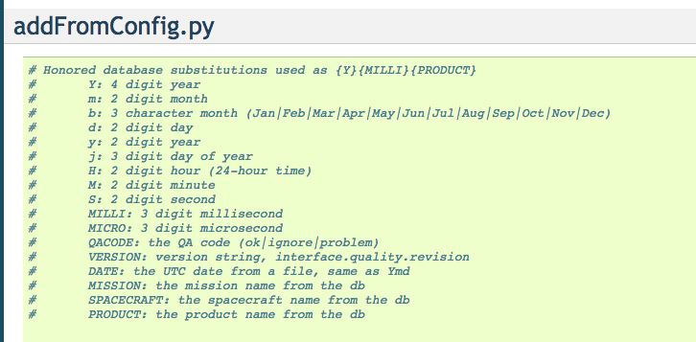
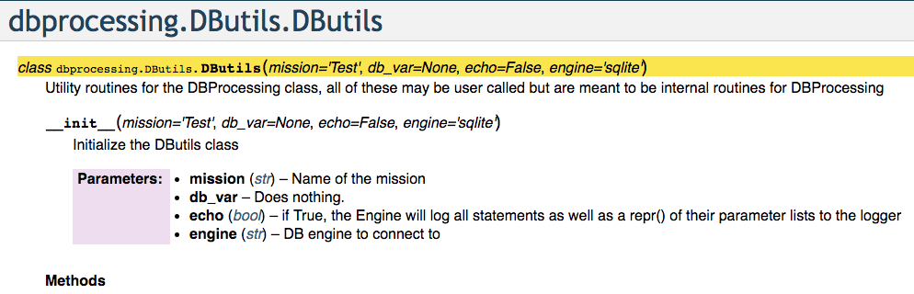
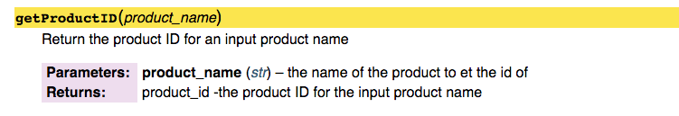
Developer documentation is in place

Slide 7
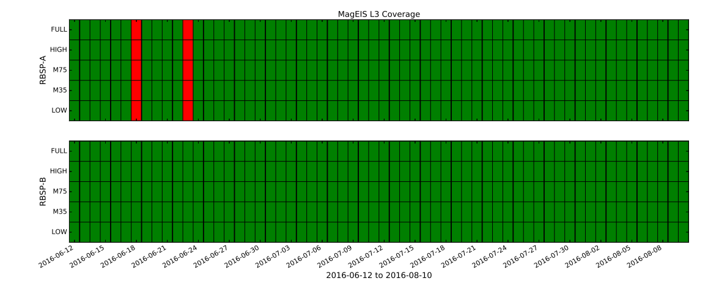
Utilities exist to identify failed processes
Van Allen Probes MagEIS level 3 data coverage report

Slide 8
Future work
Setup can always be easier, work to do here
User documentation need additional work
There are a few identified bugs and feature requests
DBprocessing interaction is currently command line, a use interface would be interesting
More more uses the better it will get

