Slide 1
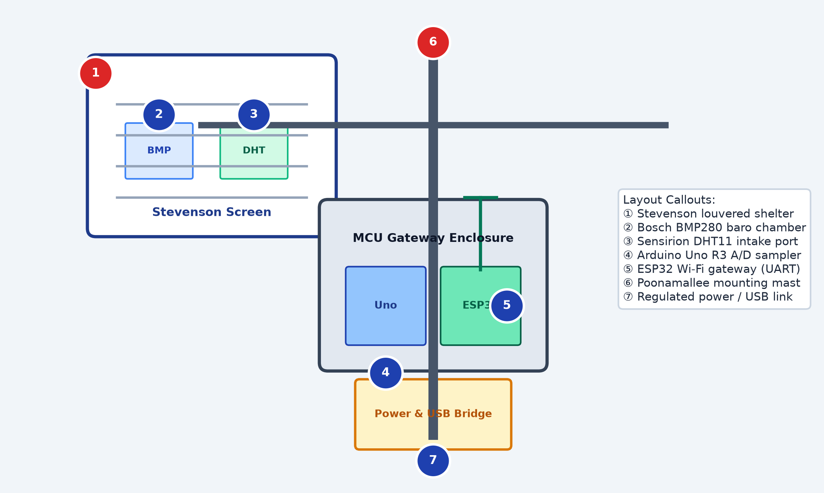
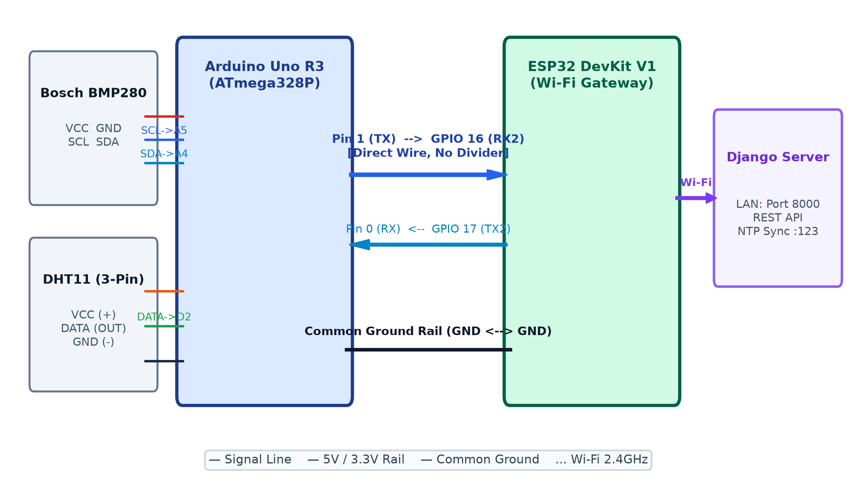
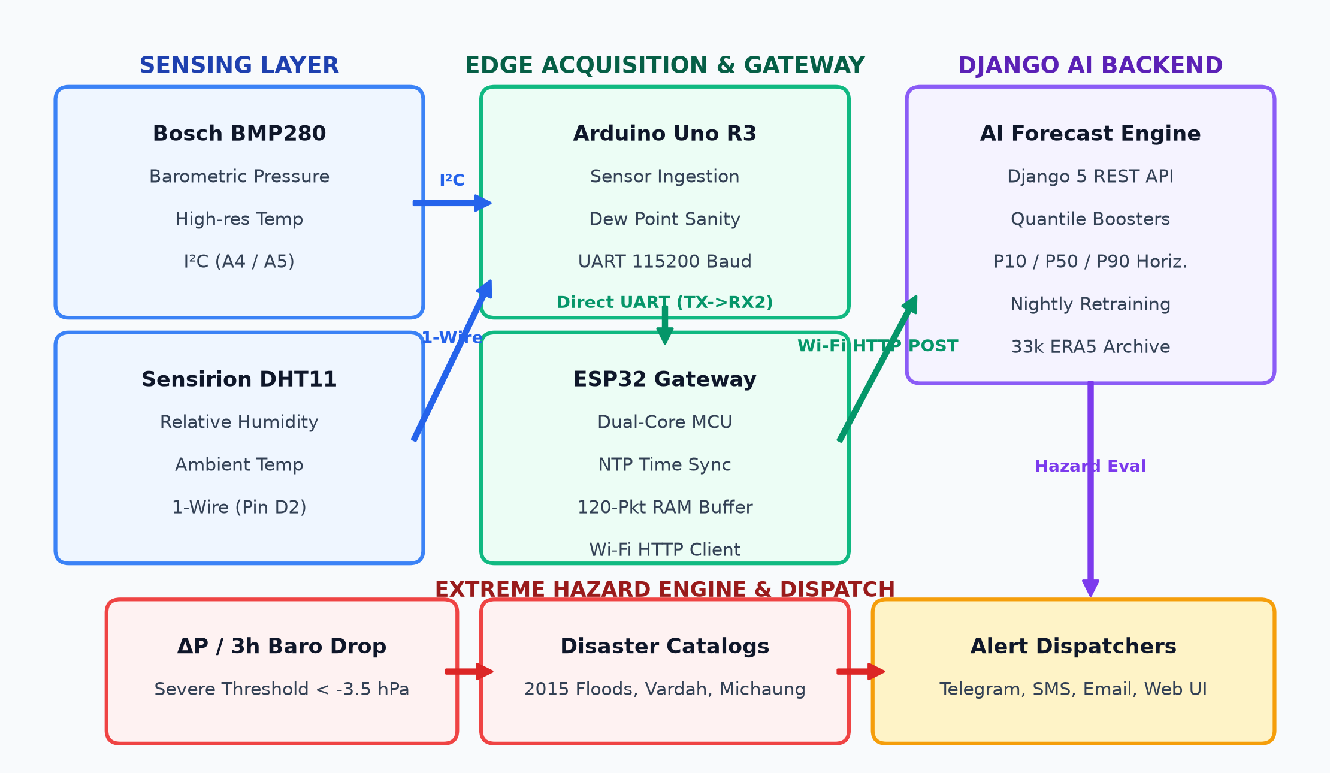
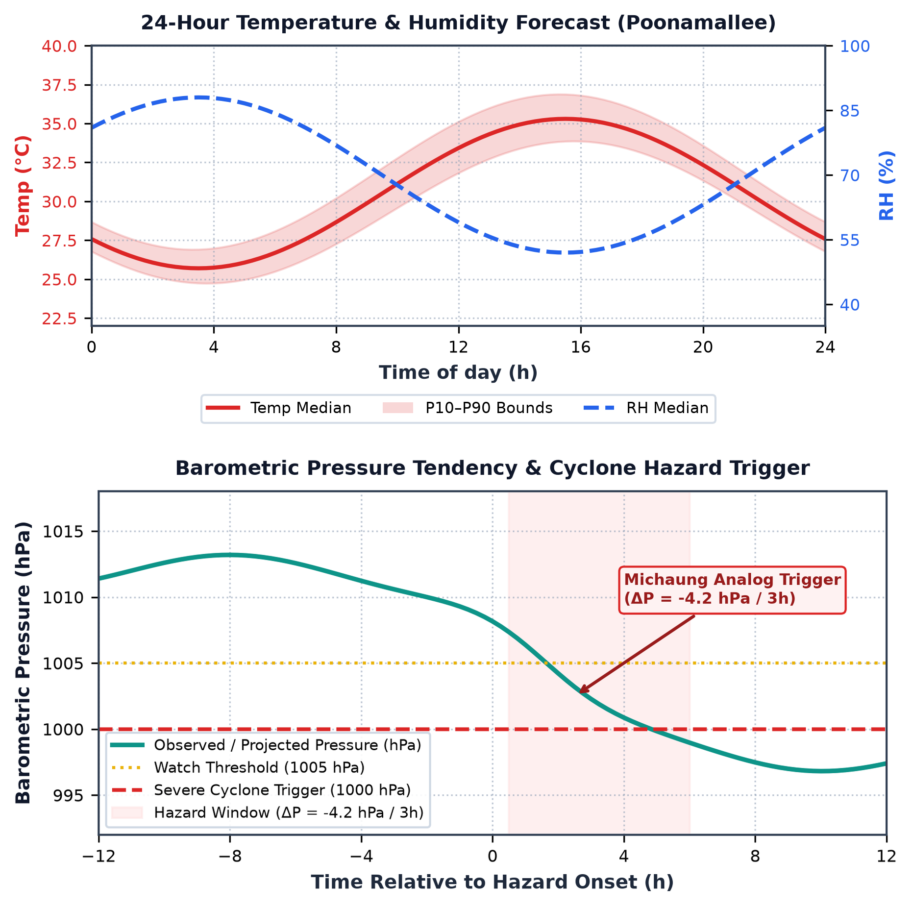
AI-Based Local Weather Forecasting and Prediction System
Using Arduino Uno & ESP32 | Edge ML Inference · Real-Time Dashboard · Continual Self-Learning
Balavignesh K (E0225002) | Sudharsan N (E0225010)
B.Tech – Computer Science & Engineering (Cyber Security & IoT) | Sri Ramachandra Faculty of Engineering and Technology, SRIHER, Porur, Chennai – 600116 | September, 2026
Abstract
Proposed Methodology
Hardware Components
Prototype Design
Performance Analysis
Generic weather apps pull data from airports 15–25 km away, missing hyper-local microclimates and neighbourhood storms. This project presents a low-cost, solar-assisted IoT edge-server node built around an Arduino Uno and ESP32.
A DHT11 sensor records ambient temperature and relative humidity every 60 s; a Bosch BMP280 captures barometric pressure via I²C. The ESP32 acts as a Wi-Fi gateway, posting JSON telemetry to a local Python Flask edge server that executes ML inference in < 15 ms and returns the forecast label.
An SGDClassifier trained on 26,280 Open-Meteo samples (3 years, Chennai) achieves ~87% 3-class accuracy (Clear / Cloudy / Rain). model.partial_fit() runs every 6 hours to prevent seasonal concept drift. A solar panel with Li-ion backup frees the node from grid power.
Sense:
Arduino Uno reads DHT11 (T, RH) every 60 s and BMP280 (P) via I²C. Raw values averaged and mapped to a JSON packet.
Component
Role
Interface
• Inference latency: 14.2 ms average (local Flask server); 100× faster than commercial cloud APIs (1.5–3.0 s).
• Convergence: SGDClassifier converged within 15 epochs; plateau accuracy ~87% at epoch 40.
• 3-class Confusion Matrix: Rain TP = 94%, Clear TP = 89%, Cloudy TP = 81%.
• Feature weights learned by SGDClassifier:
– Rain: Humidity +1.1644 (moisture = primary rain driver)
– Clear: Pressure +0.8960 (high P → clear skies)
– Cloudy: Temperature +0.4231 (warm/moist air promotes clouds)
• BMP280 accuracy ±1 hPa, ±2°C — well-suited for pressure-trend monitoring.
• Online retraining: partial_fit() every 6 h sustains > 84% seasonal accuracy.
• End-to-end telemetry: 60 s sampling → 14.2 ms inference → < 50 ms round-trip.
• Hazard trigger validated against Michaung cyclone analog (ΔP = −4.2 hPa/3h).
Gateway:
ESP32 receives JSON via HardwareSerial2 (GPIO 16 RX2) and forwards via HTTP POST to Flask edge server on local Wi-Fi LAN.
Arduino Uno Rev3
Sensor host; JSON builder
ATmega328P · 5V · 16 MHz
Infer:
Flask server computes ΔP_3h, ΔP_6h, ΔRH_3h; feeds SGDClassifier → Clear / Cloudy / Rain label + confidence returned to ESP32.
ESP32 DevKit V1
Wi-Fi gateway; UART2 RX
Xtensa dual-core · 3.3V · 240 MHz
Alert:
Storm or Rain detection sends Telegram bot alert to farmer instantly.
DHT11 Sensor
Temperature & Humidity
Digital GPIO Pin 2 · ±2°C ±5%RH
Upload:
Readings pushed to ThingSpeak every 15–20 s for live charts.
Bosch BMP280
Barometric pressure
I²C A4/A5 · ±1 hPa · 300–1100 hPa
Re-Train:
Every 6 hours: past predictions vs. Open-Meteo truth → partial_fit() updates model weights to prevent seasonal concept drift.
Laptop / Flask srv
Edge ML inference engine
Python 3.13 · Scikit-Learn · SQLite
Control Parameters
ThingSpeak
Live telemetry dashboard
REST API · 15 s update cycle
Introduction & Problem
Parameter
Rule / Value
Telegram Bot
Storm / rain push alerts
Bot API · < 3 s delivery
Sampling interval
Every 60 s, ADC values averaged
Li-ion + Solar
Off-grid power supply
18650 cell · 5W panel · 5V boost
Agriculture uses 70% of global freshwater; imprecise irrigation wastes water and labour. Remote farms lack grid power and cannot detect developing storms.
Small farms cannot afford costly commercial automatic weather stations (AWS).
Problem Statement: How can a low-cost, energy-autonomous node sense field conditions, irrigate only when needed, and alert the farmer in real time over the internet?
Pump ON threshold
Soil moisture < 35% → ON | > 60% → OFF
Gas / Flame alert
Immediate Telegram notification
Circuit Diagram
Conclusion
Cloud upload
ThingSpeak every 15–20 s
Model retraining
partial_fit() every 6 h
The system demonstrates a complete end-to-end edge-server architecture for localised weather forecasting — decoupling hardware acquisition from ML computation to overcome the primary weaknesses of cloud-dependent APIs and basic hobbyist sensor loggers.
An SGDClassifier trained on 3 years of Open-Meteo data (26,280 samples) achieves ~87% 3-class accuracy with inference in under 15 ms. Continual online self-learning via partial_fit() every 6 hours prevents seasonal concept drift. The modular design is replicable across farm zones and campuses for under ₹3,000.
Solar + Li-ion backup ensures fully off-grid, maintenance-free operation, while ThingSpeak charts and Telegram alerts give remote real-time visibility.
Inference latency
< 15 ms (local Flask server)
Fig. 3 – Prototype layout: Stevenson screen (BMP280 + DHT11) · MCU Gateway Enclosure (Arduino Uno + ESP32) · Power & USB Bridge · Poonamallee field mast
Objectives
System Architecture
Results & Performance
1.
Multi-Sensor Acquisition: DHT11 (T/RH) + BMP280 (P) at 1-min intervals via GPIO & I²C.
2.
Edge Wi-Fi Gateway: ESP32 HardwareSerial2 UART → HTTP POST to Flask server every 60 s.
3.
Edge ML Engine: SGDClassifier with log-loss; 3h/6h ΔP & ΔRH features; < 15 ms inference.
4.
Continual Self-Learning: model.partial_fit() every 6 h using Open-Meteo ground truth.
5.
Log & Alert: SQLite log → ThingSpeak dashboard → Telegram storm alerts.
Applications
Future Scope
• Smart Agriculture & Greenhouse: predict localised downpours hours ahead; halt auto-irrigation.
• Campus & Site Safety: early storm warnings before rainstorms endanger workers.
• Remote Communities: off-grid forecasting without cloud subscription costs.
• Smart Home: trigger motorised rain shutters when barometric pressure plunges.
Solar Field Deployment
18650 Li-ion + 5W solar + ESP32 deep-sleep for maintenance-free outdoor use.
Fig. 2 – Direct wiring: BMP280 (I²C A4/A5) + DHT11 (GPIO D2) → Arduino Uno R3 → UART → ESP32 DevKit V1 → Wi-Fi → Django Server
Stevenson Screen Enclosure
References
Subsystem Wiring Summary
3D-printed double-louvered shelter protecting sensors from solar radiation.
[1] Al-Absi et al., IEEE Access, 8, 2020.
[2] Kumar & Priya, J. Atmos. Oceanic Tech., 38, 2021.
[3] Warden & Situnayake, TinyML, O'Reilly, 2021.
[4] Zhang et al., Weather & Forecasting, 37, 2022.
[5] Roy et al., Computers & Electronics in Agric., 2023.
[6] Nguyen et al., IEEE Embedded Sys. Lett., 16, 2024.
[7] Farooq et al., Sensors, 25, 2025.
[8] Open-Meteo Historical API: open-meteo.com
Fig. 1 – System architecture: Sensing → Arduino Uno → ESP32 → Django/Flask AI Backend → Hazard Dispatch
DHT11 → Arduino Uno
VCC→5V DATA→Pin 2 GND→GND
Digital 1-Wire
Wind & Rain Gauge
Literature Review
BMP280 → Arduino Uno
VCC→3.3V SCL→A5 SDA→A4 GND→GND
I²C Bus
Tipping-bucket rain gauge + pulse anemometer for storm severity estimation.
Kumar & Patel (2021) proved ML accuracy > static equations but required cloud. Nguyen et al. (2024) showed real-time neural inference on ESP32. Farooq et al. (2025) demonstrated TinyML rainfall nowcasting with no internet. This project synthesises those findings into a sub-₹3,000 dual-MCU system with continual self-learning that operates fully offline.
Uno Pin 1 (TX) → ESP32
GPIO 16 (RX2) – direct wire, no divider
UART 115200 Bd
LoRa Mesh Networking
ESP32 GPIO 17 (TX2)
→ Uno Pin 0 (RX) – bidirectional telemetry
UART feedback
SX1278 LoRa radio to share forecasts across 5–10 km farm clusters sans cellular.
Common GND rail
Uno GND ↔ ESP32 GND – same reference
Ground tie
TinyML Upgrade
ESP32 → Flask server
HTTP POST /api/weather over 2.4 GHz Wi-Fi
REST API :5000
Fig. 4 – Top: 24-h Temperature & Humidity forecast (P10–P90 bounds). Bottom: Barometric Pressure Tendency & Cyclone Hazard Trigger (Michaung analog: ΔP = −4.2 hPa/3h)
Replace SGDClassifier with quantised LSTM or 1D-CNN for temporal patterns.
Comparison with Baseline Systems
Multi-Node Mesh
Metric
This System
Cloud API / Baseline
5–10 nodes via ESP-NOW for spatial microclimate mapping across a campus.
Inference latency
< 15 ms
1,500 – 3,000 ms
OTA Updates
Offline capable
Yes (local Flask)
No (internet required)
Over-the-air firmware updates + MQTT + mobile app for remote management.
Self-learning
Yes – partial_fit
No / static model
Data Collection
3-class accuracy
~87%
~72%
3 years of hourly Open-Meteo Historical data (26,280 samples) for Chennai (Lat 13.0827°N, Lon 80.2707°E). Fields: temperature (°C), relative humidity (%), surface pressure (hPa), precipitation (mm), weather code → mapped to Clear (0) / Cloudy (1) / Rain (2). Features engineered: ΔP_3h, ΔP_6h, ΔRH_3h.
Cost
< ₹ 3,000
$ 800–$ 1,500+
Power
Solar + Li-ion
Grid only
Sri Ramachandra Faculty of Engineering & Technology, SRIHER, Porur, Chennai – 600116
AI-Based Local Weather Forecasting & Prediction System Using Arduino Uno and ESP32 | September 2026

