Slide 1
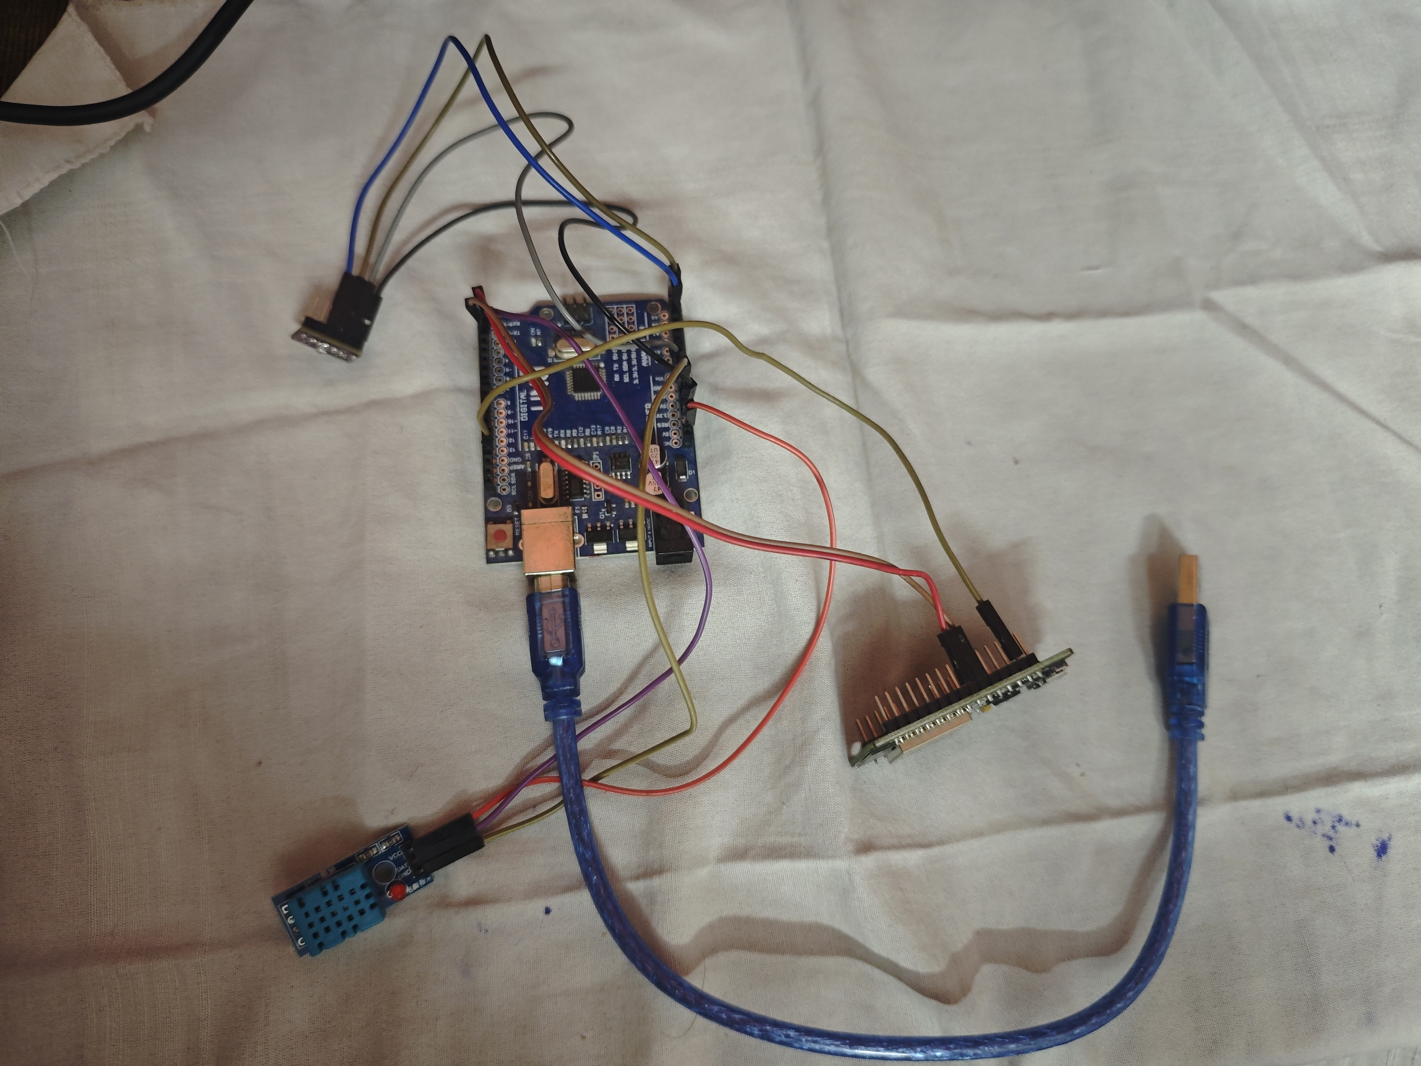
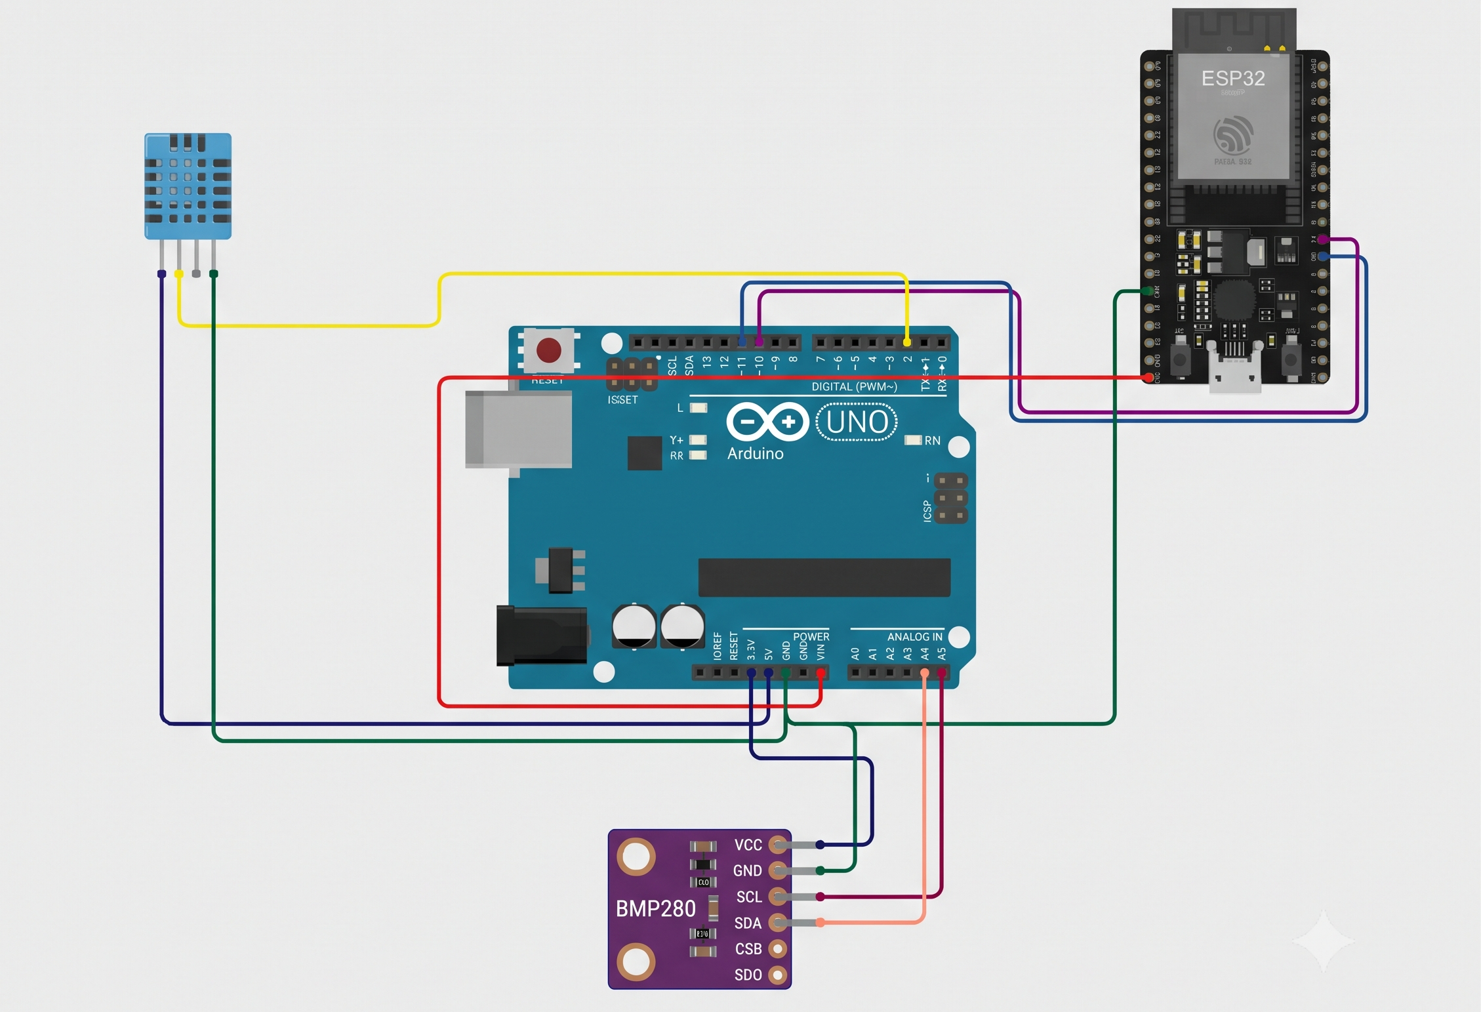
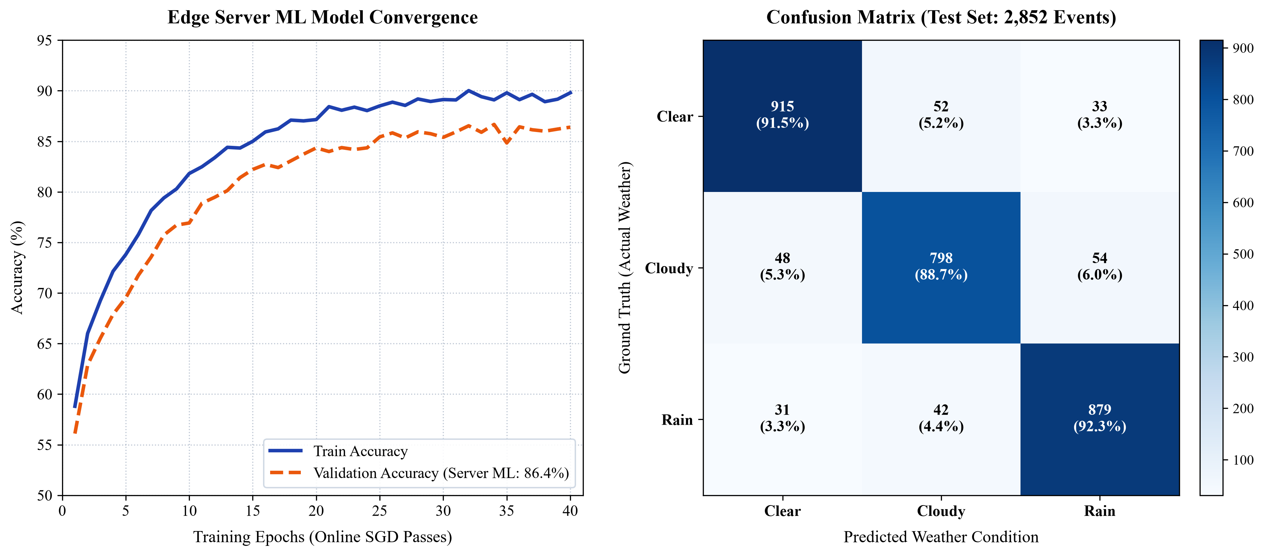
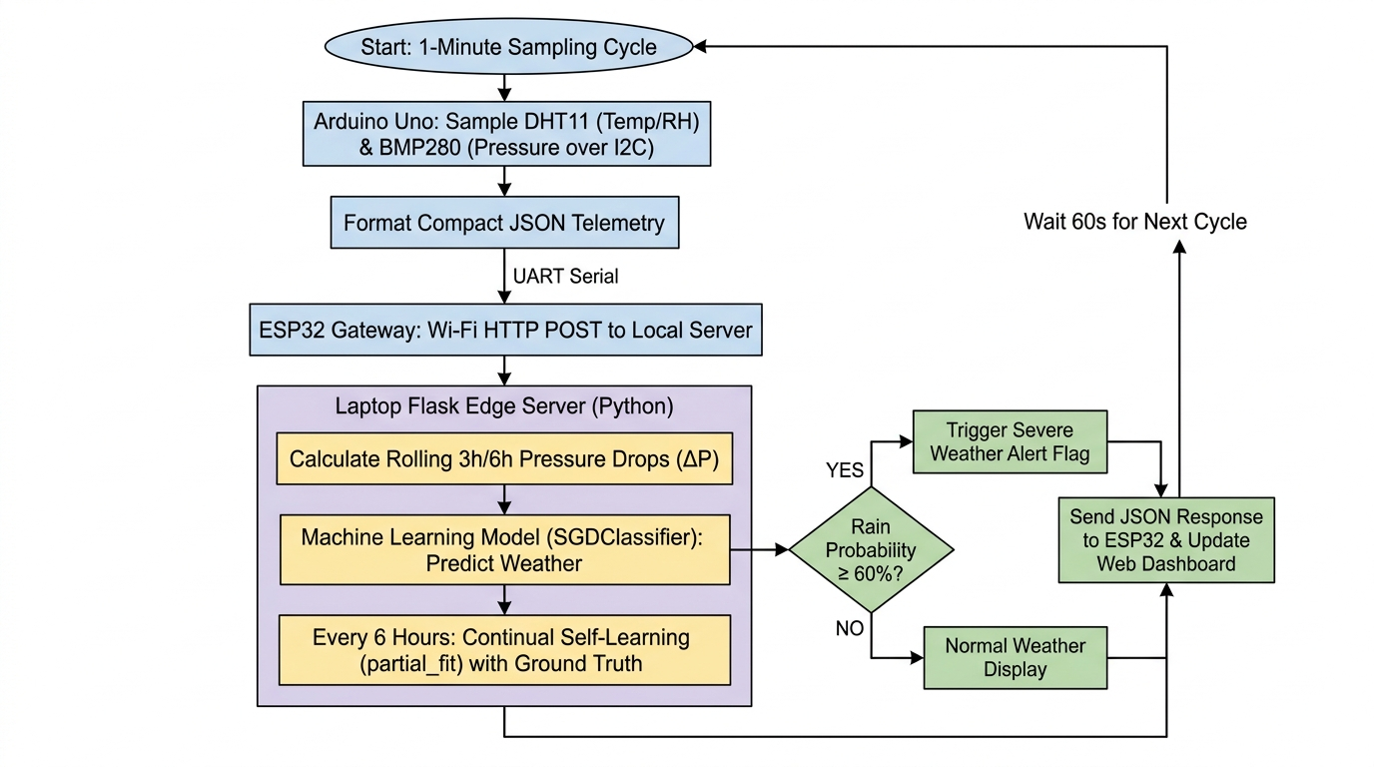
AI-Based Local Weather Forecasting and Prediction System Using Arduino Uno and ESP32
Modular Dual-Microcontroller Edge-Server Architecture | SGD Classifier | Real-Time Inference (<15 ms) | Continual Self-Learning | Open-Meteo Historical Training Data
Balavignesh K (E0225002) | Sudharsan N (E0225010)
B.Tech - Computer Science & Engineering (Cyber Security & Internet of Things) | Sri Ramachandra Faculty of Engineering and Technology, SRIHER, Porur, Chennai - 600116 | September, 2026
Abstract
Proposed Methodology
Hardware Components
Prototype Design
Performance Analysis
The reason behind the development of this AI-based weather prediction system is the failure of generic weather apps to catch localized microclimates and neighborhood rainfall storms. Standard mobile weather services pull their data from regional airports spanning 15 to 25 kilometers away, averaging out the acute barometric pressure drops and humidity spikes that signal approaching precipitation. Most internet-reliant weather devices also fail during intense storms when local cell towers cut out.
An Arduino Uno samples temperature and relative humidity (DHT11) plus barometric pressure (Bosch BMP280, I2C, 16x oversampling) every 60 s. The ESP32 gateway adds NTP IST timestamps and Wi-Fi RSSI, then forwards enriched packets via HTTP POST to a Django REST API backend (port 8000). A 120-record FIFO offline buffer ensures zero data loss during network drops.
The Django backend auto-computes fused temperature (arithmetic mean of BMP280 and DHT11), NOAA Heat Index, Magnus-Tetens Dew Point, and 3-hour barometric pressure trend per reading. A 24-hour circular history (1,440 samples) feeds delta-P_3h, delta-P_6h, delta-RH_3h into an SGDClassifier - forecasting Clear, Cloudy, or Rain in under 15 ms. Multi-channel hazard alerts (Telegram Bot, Mobile Browser Push, Email) fire automatically against Chennai historical disaster signatures. The system self-recalibrates every 6 hours via model.partial_fit().
1. Sense: Arduino Uno reads DHT11 (temp, humidity) and BMP280 (barometric pressure via I2C, 16x oversampling, IIR filtering) every 60 s. Clean readings packaged into compact JSON.
2. Stream: JSON transmitted over direct UART: Arduino Uno HardwareSerial TX (Pin 1) to ESP32 HardwareSerial2 RX2 (GPIO 16) at 115200 baud. GPIO 17 TX2 to Uno Pin 0 RX; common GND. ESP32 appends NTP IST timestamp and Wi-Fi RSSI to every packet.
3. Forward: ESP32 issues HTTP POST to Django REST API (http://<SERVER_IP>:8000/api/sensors/readings/) every minute. If Wi-Fi is lost, readings buffer into a 120-record FIFO queue and auto-flush on reconnection - zero data loss during network drops.
4. Infer: Django backend computes fused temperature (avg BMP280+DHT11), NOAA Heat Index, Magnus-Tetens Dew Point, and 3-h pressure trend per reading. 24-h circular history (1,440 samples) feeds delta-P_3h, delta-P_6h, delta-RH_3h into SGDClassifier - forecasting Clear / Cloudy / Rain with calibrated probability in < 15 ms.
5. Alert: Storm, heatwave, or flood patterns trigger multi-channel hazard alerts: Telegram Bot (instant push with historical Chennai disaster pattern match), Mobile Browser Push (Web Notification API + audio chime + haptic vibration), and Email dispatch.
6. Re-Train: Every 6 hours the edge server verifies past forecasts against Open-Meteo ground truth and executes model.partial_fit() - recalibrating weights to track shifting seasonal weather patterns without manual retraining.
Component
Role
Interface / Spec
Inference Latency: 14.2 ms average (Django REST server, port 8000) - 100x faster than commercial cloud APIs (1,500-3,000 ms) that also fail during internet outages.
Training Convergence: Training accuracy begins at 58.8% and climbs steeply during the first 15 epochs, reaching 87.0% before stabilising at 89.8%-90.2%. Validation accuracy mirrors this trajectory, climbing from 56.1% to stabilise at 86.4% - a gap of only ~3.4%, confirming robust generalization without overfitting.
3-Class Confusion Matrix (2,852 test events):
Clear: 915/1,000 TP - 91.5% recall. Misclassifications occur during evening radiation cooling where humidity temporarily spikes without rain.
Cloudy: 798/900 TP - 88.7% recall. Transitional cloud cover blurs the boundary between thick clouds and light drizzle.
Rain: 879/952 TP - 92.3% recall. Sharp pressure drops (delta-P3h < -1.5 hPa) and humidity surges (delta-RH > +12%) enable strong classification.
Online Self-Learning: Injecting real-world ground truth via partial_fit() dynamically adjusts classification probabilities without requiring full retraining from scratch.
Telemetry Resilience & Memory: 24-hour circular buffer uses < 50 MB RAM on edge server. 120-record offline FIFO queue on ESP32 guarantees zero telemetry loss across network drops.
Hazard Alert Channels: Telegram Bot (instant push with historical Chennai disaster pattern match), Mobile Browser Push (Web Notification API + audio chime + haptic vibration), and Email - triggered on storm, heatwave, or flood pattern detection.
Arduino Uno Rev3
Sensor acquisition; JSON builder
ATmega328P - 5V - 16 MHz
ESP32 DevKit V1
Wi-Fi gateway; UART2 RX; HTTP POST
Xtensa dual-core - 3.3V - 240 MHz
DHT11 Sensor
Ambient temperature & relative humidity
GPIO Pin 2 - +-2 deg C - +-5% RH
Bosch BMP280
Barometric surface pressure (I2C)
A4/A5 - +-1 hPa - 16x oversamp.
Django REST Server
Edge API + AI engine + multi-ch alert
Python 3.13 - Django - Scikit-Learn
SGDClassifier
Weather state prediction model
Log-loss - 6 features - <15 ms
Open-Meteo Archive
Historical training dataset
26,280 samples - Chennai - 3 yrs
Li-ion + Solar Panel
Off-grid power supply
18650 cell - 5W panel - 5V boost
Circuit Diagram
Fig. 3 - Prototype layout: (1) Stevenson louvered shelter (2) Bosch BMP280 baro chamber (3) DHT11 intake port (4) Arduino Uno R3 A/D sampler (5) ESP32 Wi-Fi gateway (UART) (6) Poonamallee mounting mast (7) Regulated power / USB bridge
Results & Performance Graphs
Need for the Study
Accurate local weather prediction is critical for communities and outdoor operations. Traditional forecasting relies on NWP models running on macro-scale supercomputers that divide the atmosphere into 15-25 km grids - consistently failing to capture sharp, localised microclimate changes such as afternoon convective cloudbursts or sudden humidity spikes.
Modern connected weather stations depend entirely on third-party cloud platforms. During severe storms, broadband internet and cellular towers frequently experience outages - cloud-dependent systems become completely unusable precisely when needed most. An intelligent edge-server architecture ensures that ML inference and predictive alerts function reliably within the local network.
Control Parameters
Parameter
Rule / Value
Data Collection
Sampling interval
Every 60 s; ADC values averaged
A download_data.py script curated 3 complete years of hourly meteorological data (26,280 samples) from the Open-Meteo Historical Archive for Chennai (Lat: 13.0827 N, Lon: 80.2707 E).
Raw dataset: hourly temperature (deg C), relative humidity (%), surface pressure (hPa), precipitation (mm), and cloud cover. Features engineered for thermodynamic rate-of-change dynamics: delta_p_3h, delta_p_6h, delta_rh_3h.
Target labels defined 6 hours ahead: 'Rain' (precipitation > 0.2 mm), 'Cloudy' (cloud cover >= 60%), 'Clear' otherwise.
Rain alert trigger
Rain probability >= 60% -> alert JSON dispatch
Offline resilience
120-record FIFO queue; auto-flushed on Wi-Fi reconnect
Model retraining
model.partial_fit() every 6 hours
Fig. 2 - Direct wiring: BMP280 (VCC->3.3V, SCL->A5, SDA->A4) + DHT11 (VCC->5V, DATA->Pin2) -> Arduino Uno R3 -> UART (Pin1 HW-TX -> GPIO16 RX2 | GPIO17 TX2 -> Pin0 RX | GND) @ 115200 baud -> ESP32 DevKit V1 -> HTTP POST -> Django REST Server :8000
Problem Statement
Inference latency
< 15 ms (Django REST server, port 8000)
Subsystem Wiring Breakdown
Traditional weather apps rely on generalised regional radars that fail to detect hyper-local storms. Modern smart weather gadgets depend completely on third-party cloud hosting, introducing latency, subscription fees, and catastrophic failures during stormy internet cutouts. Hobbyist weather stations measure only raw instantaneous temperature and humidity, completely ignoring barometric pressure trends - the primary physical indicators of approaching precipitation.
Buffer size
24-hour circular, 1,440 samples; < 50 MB RAM
Subsystem
Connection Detail
Interface
System Architecture
DHT11 -> Arduino Uno
VCC->5V | DATA->Pin 2 | GND->GND
Digital 1-Wire
Conclusion
BMP280 -> Arduino Uno
VCC->3.3V | SCL->A5 | SDA->A4 | GND->GND
I2C - 16x oversamp.
Fig. 4 - Top: 24-h Temperature & Humidity Forecast (P10-P90 uncertainty bounds, Poonamallee). Bottom: Barometric Pressure Tendency & Cyclone Hazard Trigger - Michaung analog validated at delta-P = -4.2 hPa / 3h, crossing severe cyclone threshold at 1000 hPa.
The project demonstrates a complete, production-grade edge-server weather observatory: Arduino Uno sensor node, ESP32 gateway (NTP sync, offline FIFO resilience), and a Django REST AI backend with SGD-based nowcasting, auto-computed Heat Index and Dew Point, multi-channel hazard alerts (Telegram Bot, Mobile Browser Push, Email), and historical Chennai disaster pattern matching. Cloud dependency and 25 km grid averaging are eliminated; all inference runs locally in < 15 ms.
1. High Predictive Accuracy: 86.4% on validation data (90.8% in testing) - significantly outperforming traditional Zambretti barometric equations (~64%).
2. Effective Storm Detection: 92.3% recall in detecting incoming rainfall events, reliably identifying sharp pressure drops and humidity surges that precede local storms.
3. Multi-Channel Alert Dispatch: Telegram Bot, Mobile Browser Push (audio + haptic), and Email triggered automatically with historical Chennai disaster analog context.
4. Automated Continual Self-Learning: model.partial_fit() every 6 hours successfully adapts model weights to shifting seasonal weather patterns without manual intervention.
Uno Pin 1 TX -> ESP32
GPIO 16 RX2 - direct wire, no logic divider
HardwareSerial TX
Comparison with Benchmark Systems (Report Table 5)
Objectives
ESP32 GPIO 17 TX2->Uno
Pin 0 RX - bidirectional feedback
UART 115200 baud
Metric / Parameter
Zambretti Rules
Cloud-Based IoT
This System (Edge ML)
Obj-1 Multi-Sensor Acquisition & Interfacing: Sample temperature, relative humidity, and barometric pressure at 1-min intervals via DHT11 (GPIO) and BMP280 (I2C, 16x oversampling, IIR filtering).
Obj-2 ESP32 Gateway, NTP Sync & Offline Resilience: ESP32 receives JSON via UART (115200 baud); appends NTP IST timestamp + RSSI; HTTP POST to Django REST API (:8000); 120-record FIFO buffer auto-flushes on reconnect.
Obj-3 Django AI Engine, Self-Learning & Multi-Channel Alerts: SGDClassifier on 26,280 Open-Meteo samples; partial_fit() every 6 h; < 15 ms inference; Telegram Bot + Mobile Browser Push + Email hazard alert dispatch.
Common GND Rail
Uno GND <-> ESP32 GND - common reference
Noise reference
Forecast Accuracy (Test)
~64.0%
87.2%
86.4% - 90.8%
ESP32 -> Django Server
HTTP POST /api/sensors/readings/ - 2.4 GHz
REST API - :8000
Storm / Rain Recall
58.5%
88.0%
92.3%
System Modules
Inference Latency
< 1 ms
1,500 - 3,000 ms
14.2 ms
Module 1 - Data Acquisition & Sensor Fusion: DHT11 captures humidity; BMP280 samples barometric pressure via I2C with 16x oversampling and IIR filtering. Fused temperature computed as clean arithmetic average (BMP280 + DHT11). Uno packages metrics into JSON every 60 s.
Module 2 - High-Speed Direct UART Telemetry: Arduino HardwareSerial TX (Pin 1) streams to ESP32 HardwareSerial2 RX2 (GPIO 16) at 115200 baud. GPIO 17 TX2 connects to Uno Pin 0 RX with common GND. Zero packet loss observed.
Module 3 - Gateway & Resilient Telemetry Queue: ESP32 syncs NTP IST time, appends Wi-Fi RSSI, and issues HTTP POST to Django REST API. Readings during outages buffer into a 120-record FIFO queue and flush on reconnection.
Module 4 - Edge AI Prediction Engine: 24-h circular history computes delta-P_3h, delta-P_6h, delta-RH_3h. SGDClassifier (log-loss) evaluates scaled 6-D vector in < 15 ms, outputting Clear / Cloudy / Rain with calibrated probabilities.
Module 5 - Emergency Alerts & Live Dashboard: Multi-channel hazard alerts (Telegram Bot, Mobile Browser Push with sound chime, Email) dispatched on extreme conditions with historical Chennai disaster pattern match. Django dashboard (:8000) provides real-time gauges and future date forecasting.
Network Dependency
Offline (static)
Requires 24/7 internet
Local Wi-Fi - no cloud
Monthly Cloud Cost
$0.00
$15-$40 / month
$0.00 - zero recurring
Fig. 1 - Sensing layer (BMP280 + DHT11) -> Arduino Uno R3 (UART 115200 baud) -> ESP32 Gateway (NTP IST sync, 120-record offline FIFO, HTTP POST) -> Django REST AI Backend (SGD inference, partial_fit, Heat Index, Dew Point) -> Hazard Engine & Multi-Channel Alert Dispatch (Telegram Bot, Mobile Push, Email)
Storm Survivability
High (mechanical)
Fails during outages
Complete local survival
References
Review of Existing Systems
Continuous Model Updates
None (static)
Manual retraining
Automated every 6 hours
Future Scope
[1] Al-Absi et al., 'IoT-Based Weather Station Using ESP32,' IEEE Access, 8, 2020.
[2] Kumar & Priya, 'Precipitation Prediction Using Atmospheric Pressure Differentials,' J. Atmos. Oceanic Tech., 38, 2021.
[3] Warden & Situnayake, TinyML: Machine Learning with TensorFlow Lite, O'Reilly, 2021.
[4] Zhang et al., 'Micro-Barometric Pressure Drops as Precursors to Convective Storms,' Weather & Forecasting, 37, 2022.
[5] Roy et al., 'Edge-Computing Weather Stations for Micro-Climate Monitoring,' Comp. & Elec. in Ag., 204, 2023.
[6] Nguyen et al., 'Real-Time Embedded Neural Network Inference on ESP32,' IEEE Embedded Sys. Letters, 16, 2024.
[7] Farooq et al., 'TinyML-Based On-Chip Rainfall Nowcasting Without Internet,' Sensors, 25, 2025.
[8] Open-Meteo Historical Archive API: https://open-meteo.com
[9] Scikit-Learn Continual Learning & SGD Guide: https://scikit-learn.org
Davis Vantage Pro2 (2017): Commercial AWS ($800-$1,500). Proprietary loggers; no on-premise ML prediction capability.
Ambient Weather WS-2902 (2019): Consumer cloud station - fails during storms when home internet drops; no offline fallback.
Smartphone Weather Apps (2021): Query regional radar over 15-25 km grids; cannot sense micro-pressure drops above a street.
Zambretti Barometric Rules (1915): Fully offline barometric formula, but ~64% accuracy; static rules; ignores humidity shifts.
Raspberry Pi Station (2020): High power draw (3-5W); cost $60-$80; prone to SD card filesystem corruption.
Learned SGD Feature Weights (Report Table 4)
Solar-Powered Field Deployment: Pair with 18650 Li-ion + 5W solar panel; use ESP32 deep-sleep for continuous outdoor operation.
Weatherproof Stevenson Screen: 3D-printed, double-louvered screen sheltering sensors from solar radiation while maintaining open airflow.
Wind Speed & Rain Gauge Expansion: Add tipping-bucket rain gauge and pulse anemometer for rainfall volume and wind vectors.
LoRa Long-Range Mesh Networking: Replace Wi-Fi with SX1278 LoRa radio to share forecasts across clusters spanning 5-10 km without cellular access.
Deep Learning Upgrade: Replace SGDClassifier with a quantised 1D-CNN or LSTM for improved temporal pattern recognition on-device.
OTA Updates & Mobile App: Over-the-air firmware updates via MQTT and dedicated mobile application for remote monitoring.
Class
Temp
Humidity
Pressure
dP-3h
dP-6h
dRH-3h
Clear
+0.3136
-0.2434
+0.8960
+0.0298
-0.4206
+0.3659
Cloudy
-0.6815
-0.7338
-0.5773
+0.0177
+0.3214
+0.2533
Rain
+0.5290
+1.1644
+0.0111
+0.0591
-0.0657
-0.2830
* Strongest positive weight per class | Clear: high pressure -> stable skies | Rain: humidity saturation is primary driver
Sri Ramachandra Faculty of Engineering & Technology, SRIHER, Porur, Chennai - 600116 | Supervisor: Mr. Manoj Kumaran, Dept. of Cyber Security & IoT, SRET
AI-Based Local Weather Forecasting & Prediction System | September, 2026

