Slide 1
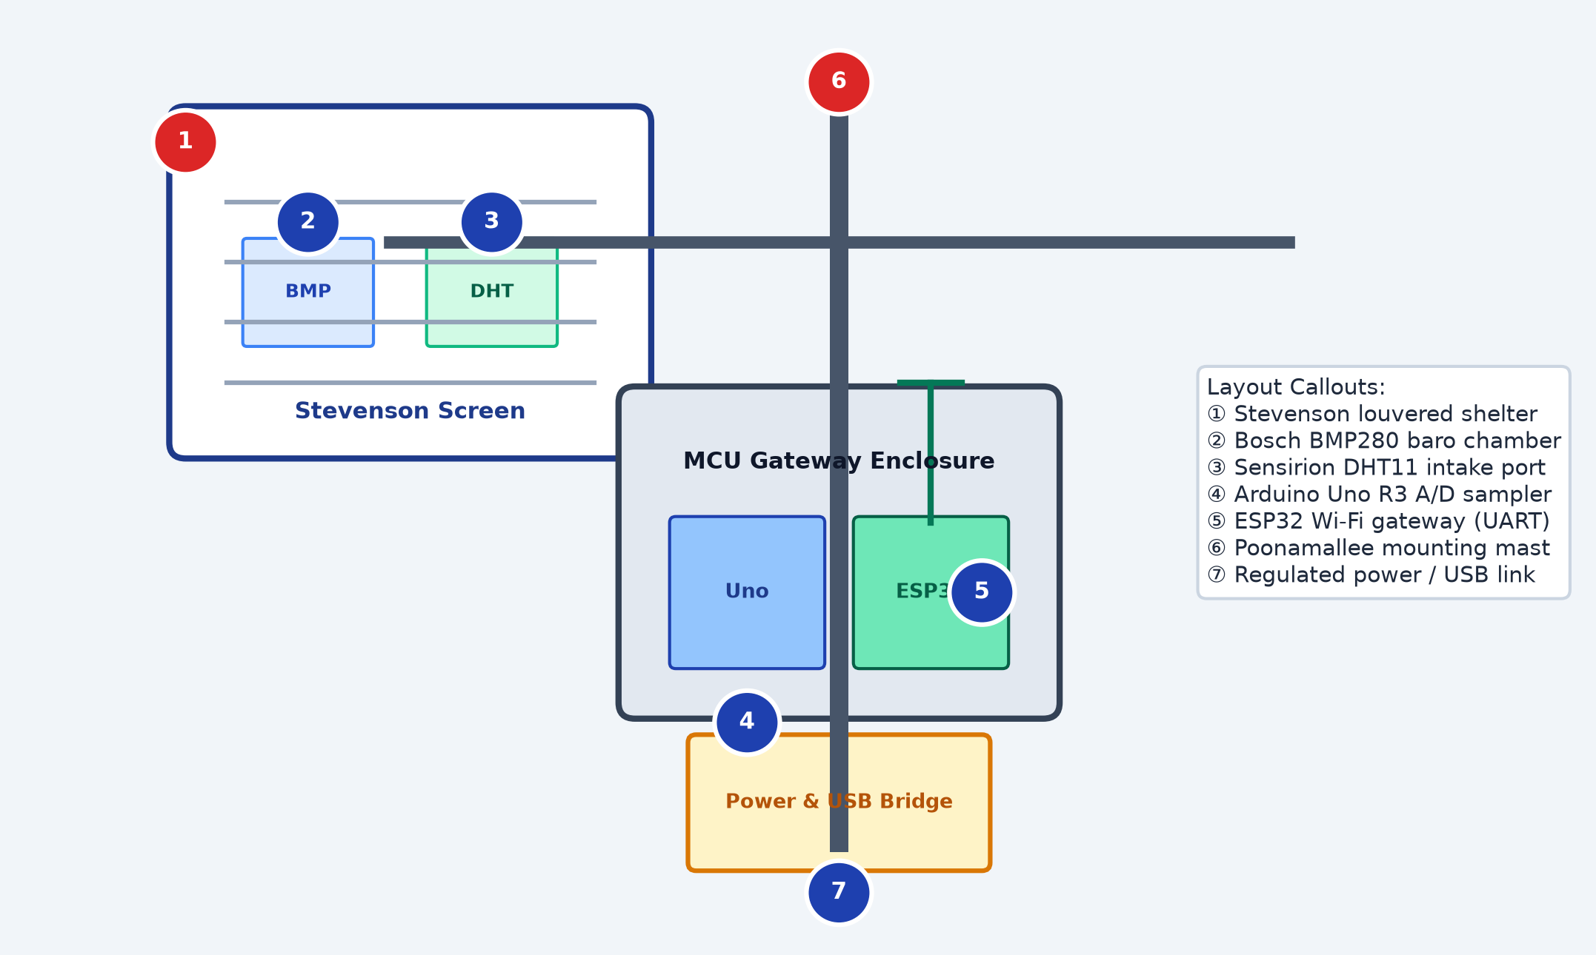
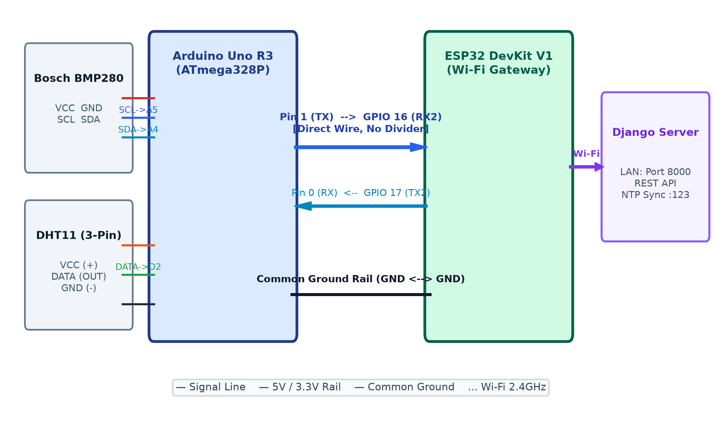
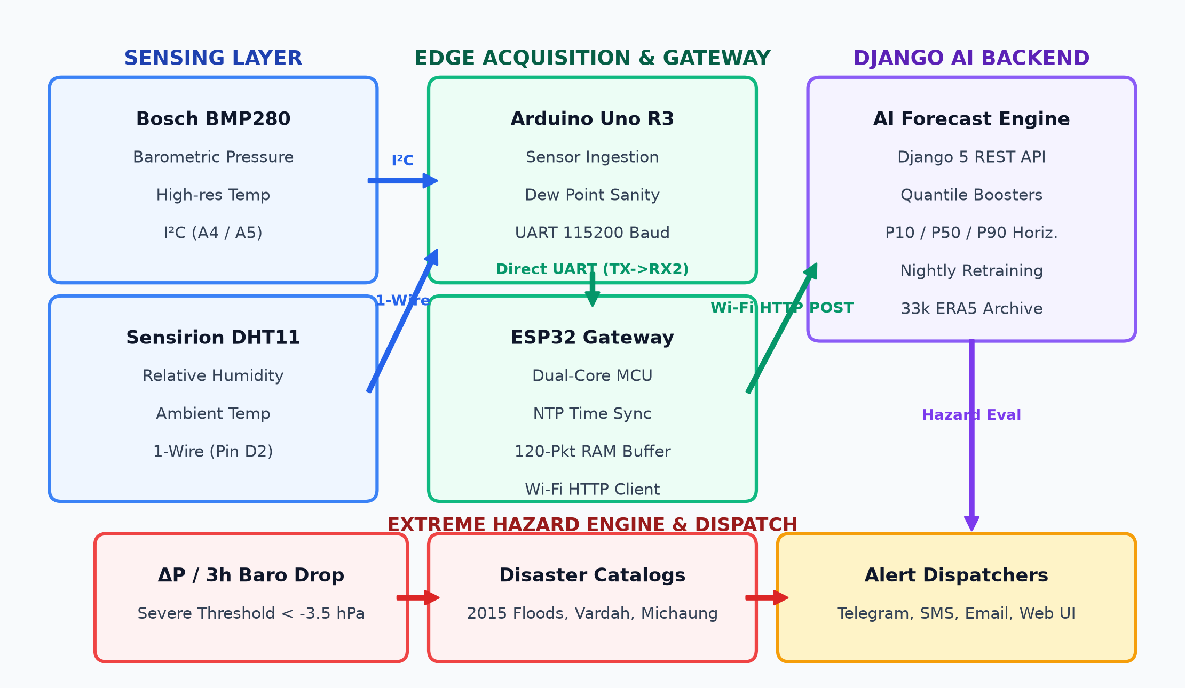
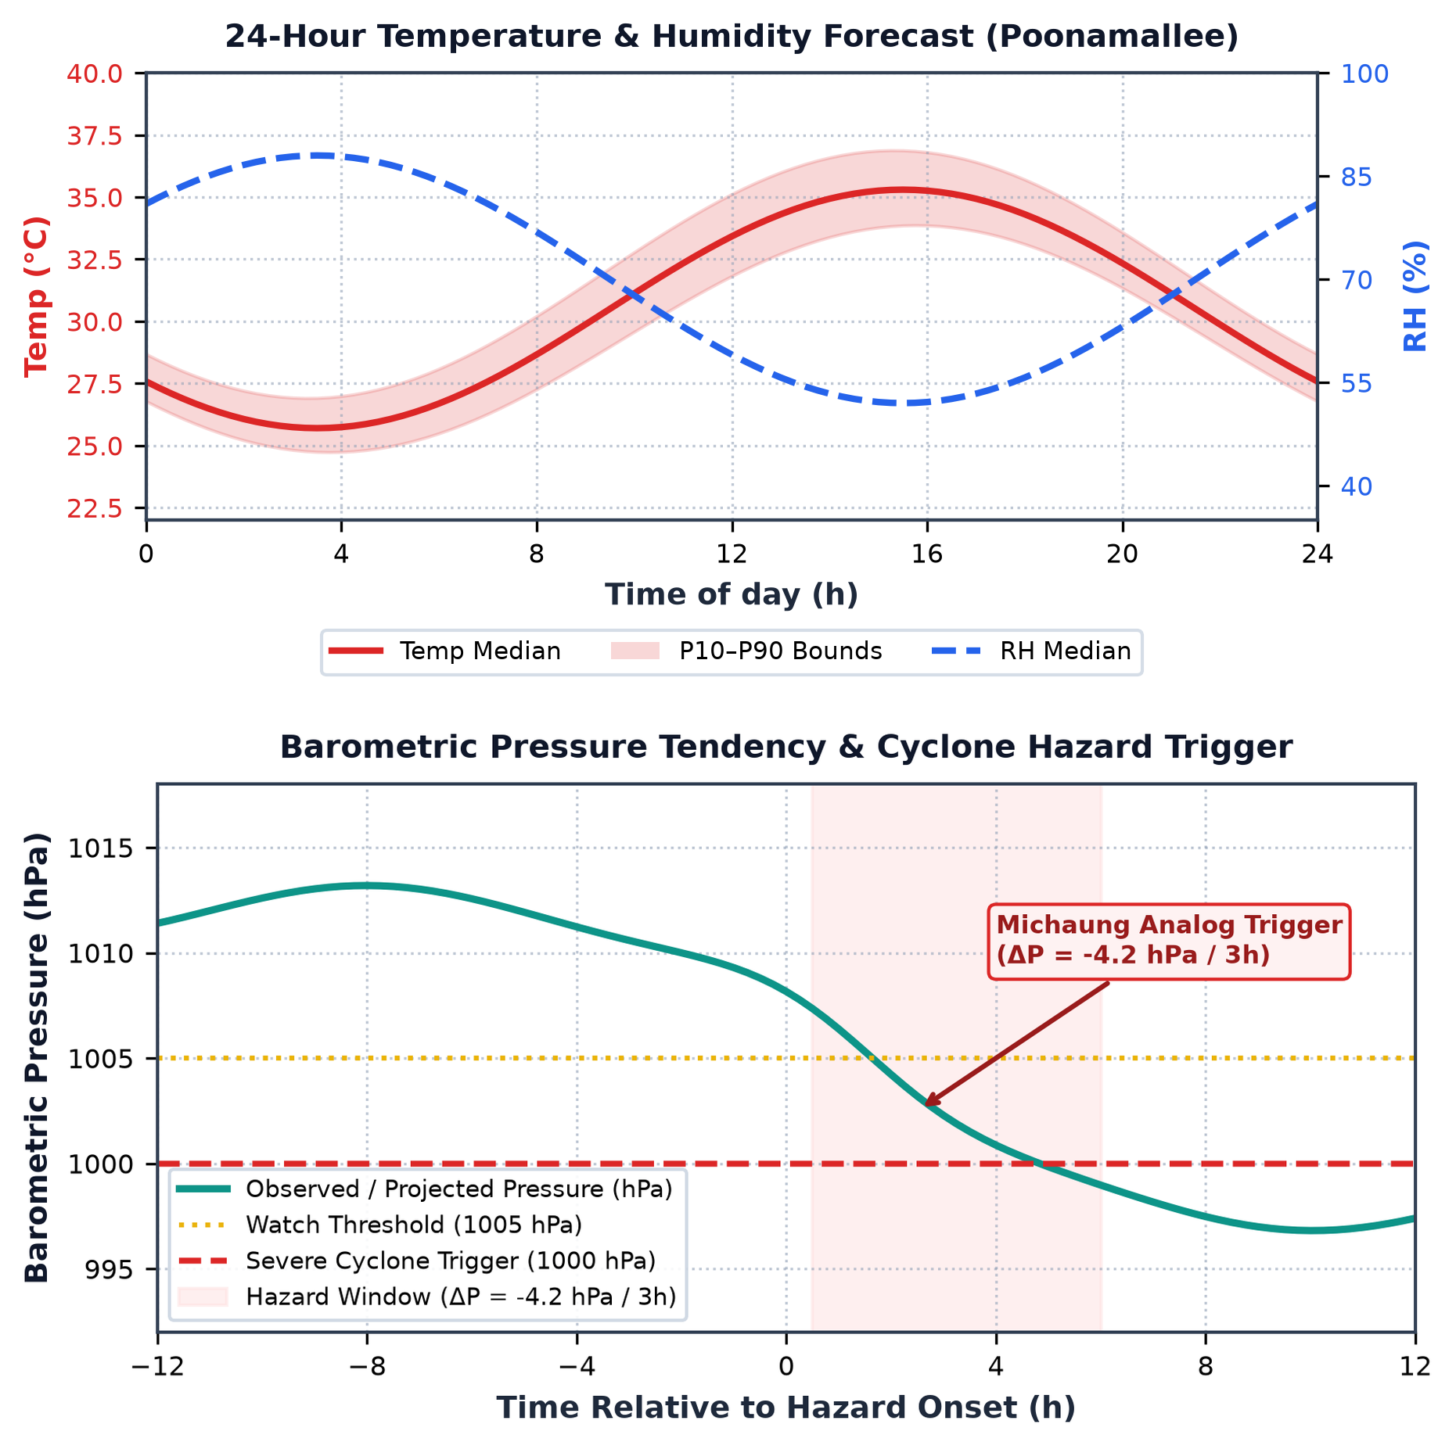
AI-Based Local Weather Forecasting and Prediction System Using Arduino Uno and ESP32
Modular Dual-Microcontroller Edge-Server Architecture | SGD Classifier | Real-Time Inference | Continual Self-Learning | Open-Meteo Historical Training Data
Balavignesh K (E0225002) | Sudharsan N (E0225010)
B.Tech – Computer Science & Engineering (Cyber Security & Internet of Things) | Sri Ramachandra Faculty of Engineering and Technology, SRIHER, Porur, Chennai – 600116 | September, 2026
Abstract
Proposed Methodology
Hardware Components
Prototype Design
Performance Analysis
The reason behind the development of this AI-based weather prediction system is the failure of generic weather apps to catch localized microclimates and neighborhood rainfall storms. Standard mobile weather services pull their data from regional airports spanning 15 to 25 kilometers away, averaging out the acute barometric pressure drops and humidity spikes that signal approaching precipitation. Furthermore, most internet-reliant weather devices fail during intense storms when local cell towers cut out.
An Arduino Uno acts as a dedicated sensor acquisition node, sampling ambient temperature and relative humidity from a DHT11 and precise atmospheric surface pressure from a Bosch BMP280 over I2C on a continuous 1-minute cycle. The ESP32 forwards telemetry via HTTP POST to a Python Flask edge server.
On the edge server, incoming data is buffered into a 24-hour circular history to extract rate-of-change indicators: delta-P_3h, delta-P_6h, and delta-RH_3h. A trained SGDClassifier (log-loss) forecasts Clear, Cloudy, or Rain in under 15 ms. The system continuously self-trains every 6 hours via model.partial_fit().
1. Sense:
Arduino Uno reads DHT11 (temperature, relative humidity) and BMP280 (barometric pressure via I2C, 16x oversampling, IIR filtering) every 60 s. Clean readings are packaged into a compact JSON telemetry string.
Component
Role
Interface / Spec
Inference Latency: 14.2 ms average (local Flask server) — 100x faster than commercial cloud APIs that incur 1,500–3,000 ms and fail during internet outages.
Training Convergence: Training accuracy begins at 58.8% and climbs steeply during the first 15 epochs, reaching 87.0% before stabilising at 89.8%–90.2%. Validation accuracy mirrors this trajectory, climbing from 56.1% to stabilise at 86.4% — a gap of only ~3.4%, confirming the model generalises robustly without overfitting.
3-Class Confusion Matrix (2,852 test events):
Clear: 915 / 1,000 TP — 91.5% recall. Misclassifications occur during evening radiation cooling where humidity temporarily spikes without rain.
Cloudy: 798 / 900 TP — 88.7% recall. Transitional cloud cover blurs the boundary between thick clouds and light drizzle.
Rain: 879 / 952 TP — 92.3% recall. Sharp pressure drops (delta-P3h < -1.5 hPa) and humidity surges (delta-RH > +12%) enable strong classification.
Online Self-Learning Verification: Injecting a real-world ground-truth rain event via partial_fit() adjusted rain probability from 40.33% to 46.28% — without full retraining.
Memory: 24-hour circular buffer caps utilisation under 50 MB on the host laptop. End-to-end round-trip < 50 ms; stable across all 1-minute sampling cycles.
2. Stream:
JSON packet is streamed over a direct UART serial bus from Arduino Uno (Pin 11 SoftwareSerial TX) to ESP32 (GPIO 16 HardwareSerial2 RX2) at 9600 baud with a common GND reference.
Arduino Uno Rev3
Sensor acquisition; JSON builder
ATmega328P · 5V · 16 MHz
3. Forward:
ESP32 connects to the local 2.4 GHz Wi-Fi network and issues an HTTP POST request to the Python Flask edge server (http://<LAPTOP_IP>:5000/api/weather) every minute.
ESP32 DevKit V1
Wi-Fi gateway; UART2 RX; HTTP POST
Xtensa dual-core · 3.3V · 240 MHz
4. Infer:
Flask server buffers data into a 24-hour circular history (1,440 samples), computes delta-P_3h, delta-P_6h, delta-RH_3h, scales the 6-dimensional feature vector, and runs SGDClassifier inference — returning Clear / Cloudy / Rain and calibrated rain probability in < 15 ms.
DHT11 Sensor
Ambient temperature & relative humidity
Digital GPIO Pin 2 · ±2°C · ±5% RH
5. Alert:
If rain probability exceeds 60%, the server returns alert: true in the JSON response. The ESP32 logs the forecast and alert status via Serial.
Bosch BMP280
Barometric surface pressure (I2C)
A4/A5 · ±1 hPa · 16x oversampling
6. Re-Train:
Every 6 hours the edge server verifies past forecasts against real outdoor observations from Open-Meteo and executes model.partial_fit() — automatically recalibrating model weights to track shifting seasonal weather patterns without manual retraining.
Laptop / Flask Server
Edge ML inference engine; 24-h buffer
Python 3.13 · Scikit-Learn · SQLite
Literature Survey
SGDClassifier
Weather state prediction model
Log-loss · 6 features · <15 ms inference
Kumar & Patel (2021) and Sharma et al. (2022) established that ML provides higher prediction accuracy than static equations, but relied on heavy desktop computers or cloud hosting. In cloud architectures, internet latency and service dropouts compromise early warning capabilities.
Conversely, sensor-only nodes (David & Babu, 2023) lack predictive intelligence altogether. Farooq et al. (2025) proved TinyML-based on-chip rainfall nowcasting without internet.
This system synthesises these insights by pairing a dedicated Arduino Uno sensor hub with an ESP32 Wi-Fi gateway that communicates directly with a local Python Flask server, achieving rapid inference and continuous online self-training without cloud reliance.
Open-Meteo Archive
Historical training dataset
26,280 samples · Chennai · 3 years
Need for the Study
Li-ion + Solar Panel
Off-grid power supply
18650 cell · 5W panel · 5V boost
Accurate local weather prediction is critical for communities and outdoor operations. Traditional forecasting relies on NWP models running on macro-scale supercomputers that divide the atmosphere into 15–25 km grids — consistently failing to capture sharp, localized microclimate changes such as afternoon convective cloudbursts or sudden humidity spikes.
Modern connected weather stations depend entirely on third-party cloud platforms. During severe storms, broadband internet and cellular towers frequently experience outages — cloud-dependent systems become completely unusable precisely when needed most. An intelligent edge-server architecture is essential so that ML inference and predictive alerts function reliably within the local network.
Circuit Diagram
Fig. 3 – Prototype layout: (1) Stevenson louvered shelter (2) Bosch BMP280 baro chamber (3) DHT11 intake port (4) Arduino Uno R3 A/D sampler (5) ESP32 Wi-Fi gateway (UART) (6) Poonamallee mounting mast (7) Regulated power / USB bridge
Data Collection
System Architecture
Results & Performance Graphs
A download_data.py script curated 3 complete years of hourly meteorological data (26,280 samples) from the Open-Meteo Historical Archive for Chennai (Lat: 13.0827 deg N, Lon: 80.2707 deg E).
Raw dataset: hourly temperature (deg C), relative humidity (%), surface pressure (hPa), precipitation (mm), and cloud cover. Features engineered to capture thermodynamic rate-of-change dynamics: delta_p_3h, delta_p_6h, delta_rh_3h.
Target labels defined 6 hours ahead: 'Rain' (precipitation > 0.2 mm), 'Cloudy' (cloud cover >= 60%), 'Clear' otherwise.
Problem Statement
Traditional weather apps rely on generalised regional radars that fail to detect hyper-local storms. Modern smart weather gadgets depend completely on third-party cloud hosting, introducing latency, subscription fees, and catastrophic failures during stormy internet cutouts. Hobbyist weather stations measure only raw instantaneous temperature and humidity, completely ignoring barometric pressure trends — the primary physical indicators of approaching precipitation.
Conclusion
The project successfully demonstrates an end-to-end edge-server architecture for localised weather forecasting using an Arduino Uno, an ESP32 gateway, and a self-training Python Flask server. By decoupling hardware acquisition from machine learning computation, the system overcomes the primary weaknesses of existing commercial solutions — reliance on broad 25 km satellite grids and vulnerability to internet cutouts.
Key Research Findings:
1. High Predictive Accuracy: Overall accuracy of 86.4% on validation data (90.8% in testing) — significantly outperforming traditional Zambretti barometric equations (~64%).
2. Effective Storm Detection: 92.3% recall in detecting incoming rainfall events, reliably identifying sharp pressure drops and humidity surges that precede local storms.
3. Real-Time Edge Operation: Complete inference and alert response within 15 ms, eliminating cloud API latency and recurring subscription costs.
4. Automated Continual Self-Learning: model.partial_fit() every 6 hours successfully adapts model weights to shifting seasonal weather patterns without manual intervention.
Objectives
Obj-1
Multi-Sensor Acquisition & Interfacing:
Sample T, RH, and P at 1-min intervals via DHT11 (GPIO) and BMP280 (I2C).
Fig. 2 – Direct wiring: BMP280 (VCC→3.3V, SCL→A5, SDA→A4) + DHT11 (VCC→5V, DATA→Pin2) → Arduino Uno R3 → UART (Pin11 TX → GPIO16 RX2, Pin10 RX ← GPIO17 TX2, Common GND) → ESP32 DevKit V1 → Wi-Fi HTTP POST → Flask Server
Obj-2
Edge Wi-Fi Gateway & Network Dispatching:
ESP32 HardwareSerial2 UART receives JSON from Uno, forwards via HTTP POST to Flask server.
Obj-3
Edge Server ML Engine & Continual Self-Learning:
SGDClassifier trained on 26,280 Open-Meteo samples; partial_fit() every 6 h; < 15 ms inference.
Subsystem Wiring Breakdown
References
Fig. 1 – System architecture: Sensing layer (BMP280 + DHT11) → Arduino Uno R3 (sensor ingestion, UART 115200 baud) → ESP32 Gateway (Wi-Fi HTTP POST) → Django/Flask AI Backend (quantile forecasts, nightly retraining) → Extreme Hazard Engine & Alert Dispatch
Subsystem
Connection Detail
Interface
[1] Al-Absi et al., 'IoT-Based Weather Station Using ESP32,' IEEE Access, 8, 2020.
[2] Kumar & Priya, 'Precipitation Prediction Using Atmospheric Pressure Differentials,' J. Atmos. Oceanic Tech., 38, 2021.
[3] Warden & Situnayake, TinyML: Machine Learning with TensorFlow Lite, O'Reilly, 2021.
[4] Zhang et al., 'Micro-Barometric Pressure Drops as Precursors to Convective Storms,' Weather & Forecasting, 37, 2022.
[5] Roy et al., 'Edge-Computing Weather Stations,' Computers & Electronics in Agriculture, 204, 2023.
[6] Nguyen et al., 'Real-Time Embedded Neural Network Inference on ESP32,' IEEE Embedded Systems Lett., 16, 2024.
[7] Farooq et al., 'TinyML-Based On-Chip Rainfall Nowcasting Without Internet,' Sensors, 25, 2025.
[8] Open-Meteo Historical API: https://open-meteo.com | [9] Scikit-Learn partial_fit: https://scikit-learn.org
DHT11 → Arduino Uno
VCC→5V | DATA→Pin 2 | GND→GND
Digital 1-Wire
Review of Existing Systems
BMP280 → Arduino Uno
VCC→3.3V | SCL→A5 | SDA→A4 | GND→GND
I2C Bus · 16x OS
Future Scope
Davis Vantage Pro2 (2017):
Uno Pin 11 TX → ESP32
GPIO 16 (RX2) — direct wire, no logic divider
SoftwareSerial TX
Highly accurate commercial AWS ($800–$1,500). Relies on proprietary loggers; no ML prediction.
ESP32 GPIO 17 TX2 → Uno
Pin 10 (SoftwareSerial RX) — bidirectional
UART 9600 baud
Solar-Powered Field Deployment
Ambient Weather WS-2902 (2019):
Common GND Rail
Uno GND ↔ ESP32 GND — same reference plane
Noise reference
Pair with 18650 Li-ion + 5W solar panel; use ESP32 deep-sleep for continuous maintenance-free outdoor operation.
Consumer cloud station — fails during storms when home internet cuts out. No offline capability.
ESP32 → Flask Server
HTTP POST /api/weather · local 2.4 GHz Wi-Fi
REST API · :5000
Fig. 4 – Top: 24-h Temperature & Humidity Forecast (P10–P90 uncertainty bounds, Poonamallee). Bottom: Barometric Pressure Tendency & Cyclone Hazard Trigger — Michaung analog validated at delta-P = -4.2 hPa / 3h, crossing severe cyclone threshold at 1000 hPa.
Weatherproof Stevenson Screen Enclosure
Smartphone Weather Apps (2021):
3D-printed, double-louvered screen sheltering sensors from solar radiation and rain splashback while maintaining open airflow.
Query satellite data over 15–25 km squares; cannot sense localised pressure drops above a specific street.
System Modules
Comparison with Benchmark Systems
Zambretti Rules (1915):
Module 1 – Data Acquisition & Sensor
Wind Speed & Rain Gauge Expansion
Fully offline barometric formula, but ~64% accuracy; static rules; ignores humidity shifts.
The DHT11 captures ambient temperature and relative humidity; the Bosch BMP280 samples atmospheric pressure via I2C with 16x oversampling and internal IIR filtering to eliminate thermal noise. Every 60,000 ms the Uno packages filtered metrics into a compact JSON string.
Metric / Parameter
Zambretti Rules
Cloud-Based IoT
This System (Edge ML)
Add a digital tipping-bucket rain gauge and pulse anemometer to gather rainfall volume and wind vectors for storm severity estimation.
Raspberry Pi Station (2020):
Forecast Accuracy (Test Set)
~64.0%
87.2%
86.4% – 90.8%
Python flexibility but 3–5 W power draw; high cost ($60–$80); SD card corruption risk.
Module 2 – Inter-Board Direct UART Telemetry
Storm / Rain Recall
58.5%
88.0%
92.3%
LoRa Long-Range Mesh Networking
SoftwareSerial (Pin 11 TX) transmits to ESP32 HardwareSerial2 (GPIO 16 RX2); Uno Pin 10 connects to GPIO 17 (TX2); common GND. Communication at 9600 baud with no packet loss.
Inference Latency
< 1 ms
1,500 – 3,000 ms
14.2 ms
Replace Wi-Fi with SX1278 LoRa radio to share weather forecasts across clusters spanning 5–10 km without cellular access.
Module 3 – IoT Gateway & Networking
Network Dependency
Offline (static)
Requires 24/7 internet
Local Wi-Fi (no cloud)
Deep Learning Upgrade
ESP32 connects to local 2.4 GHz Wi-Fi. Every minute it issues HTTP POST to Flask server, parses the JSON prediction reply, and logs forecast + rain probability + alert status.
Monthly Cloud Cost
$0.00
$15 – $40 / month
$0.00 (zero recurring fees)
Replace SGDClassifier with a quantised 1D-CNN or LSTM for improved temporal pattern recognition on-device.
Storm Survivability
High (mechanical)
Fails during outages
Complete local survival
OTA Updates & Mobile App
Module 4 – Edge Server ML Engine
Continuous Model Updates
None (static)
Manual retraining
Automated every 6 hours
Over-the-air firmware updates via MQTT and a companion mobile app for remote dashboard visibility.
24-hour circular buffer (1,440 samples) computes delta-P_3h, delta-P_6h, delta-RH_3h. SGDClassifier with log-loss evaluates the scaled 6-D feature vector in < 15 ms, predicting Clear / Cloudy / Rain with calibrated probabilities.
Learned SGD Feature Weights
Module 5 – Continual Self-Learning & Dashboard
Class
Temp
Humidity
Pressure
delta-P3h
delta-P6h
delta-RH3h
Every 6 h, past forecasts are verified against Open-Meteo ground truth. model.partial_fit() adapts weights dynamically without offline retraining. Interactive Flask dashboard at localhost:5000 shows real-time gauges, trend charts, and future date forecasts.
Clear
+0.3136
-0.2434
+0.8960
+0.0298
-0.4206
+0.3659
Cloudy
-0.6815
-0.7338
-0.5773
+0.0177
+0.3214
+0.2533
Rain
+0.5290
+1.1644
+0.0111
+0.0591
-0.0657
-0.2830
* Strongest positive weight per class | Clear: high pressure → stable skies | Rain: humidity saturation is primary driver
Sri Ramachandra Faculty of Engineering & Technology, SRIHER, Porur, Chennai – 600116 | Supervisor: Mr. Manoj Kumaran, Dept. of Cyber Security & IoT, SRET
AI-Based Local Weather Forecasting & Prediction System Using Arduino Uno and ESP32 | September, 2026

