Slide 1
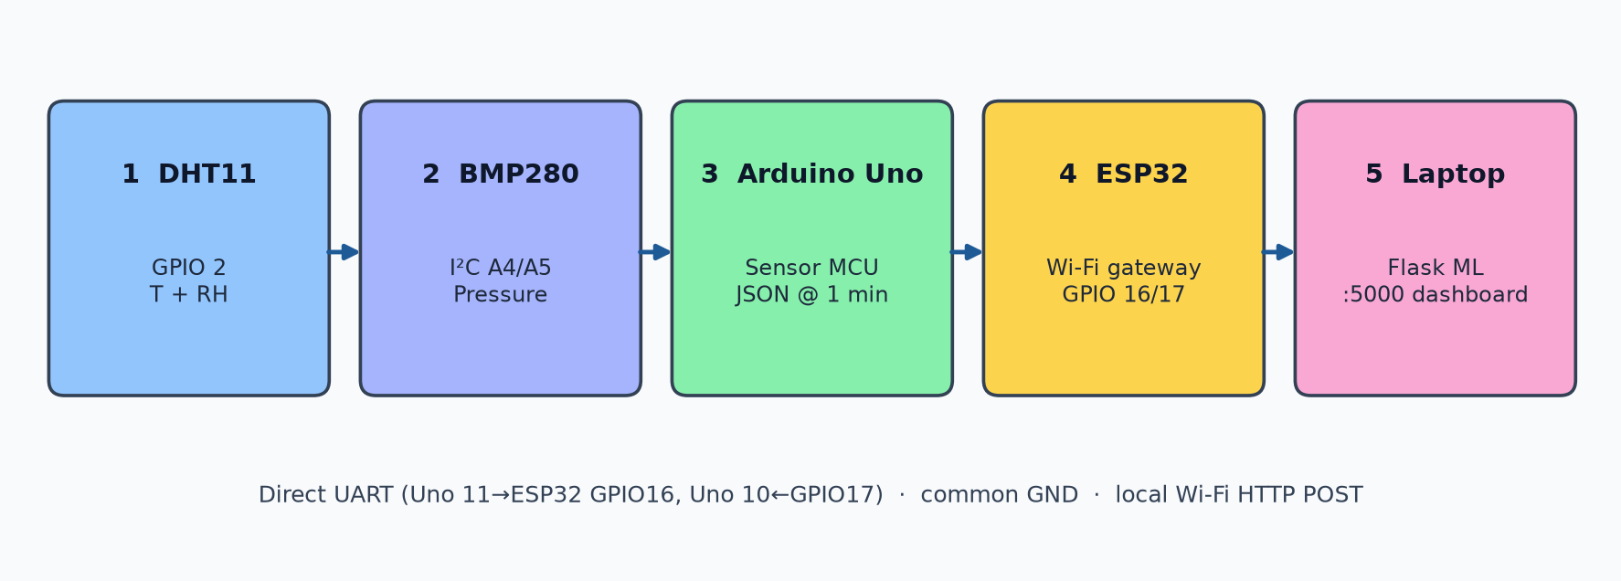
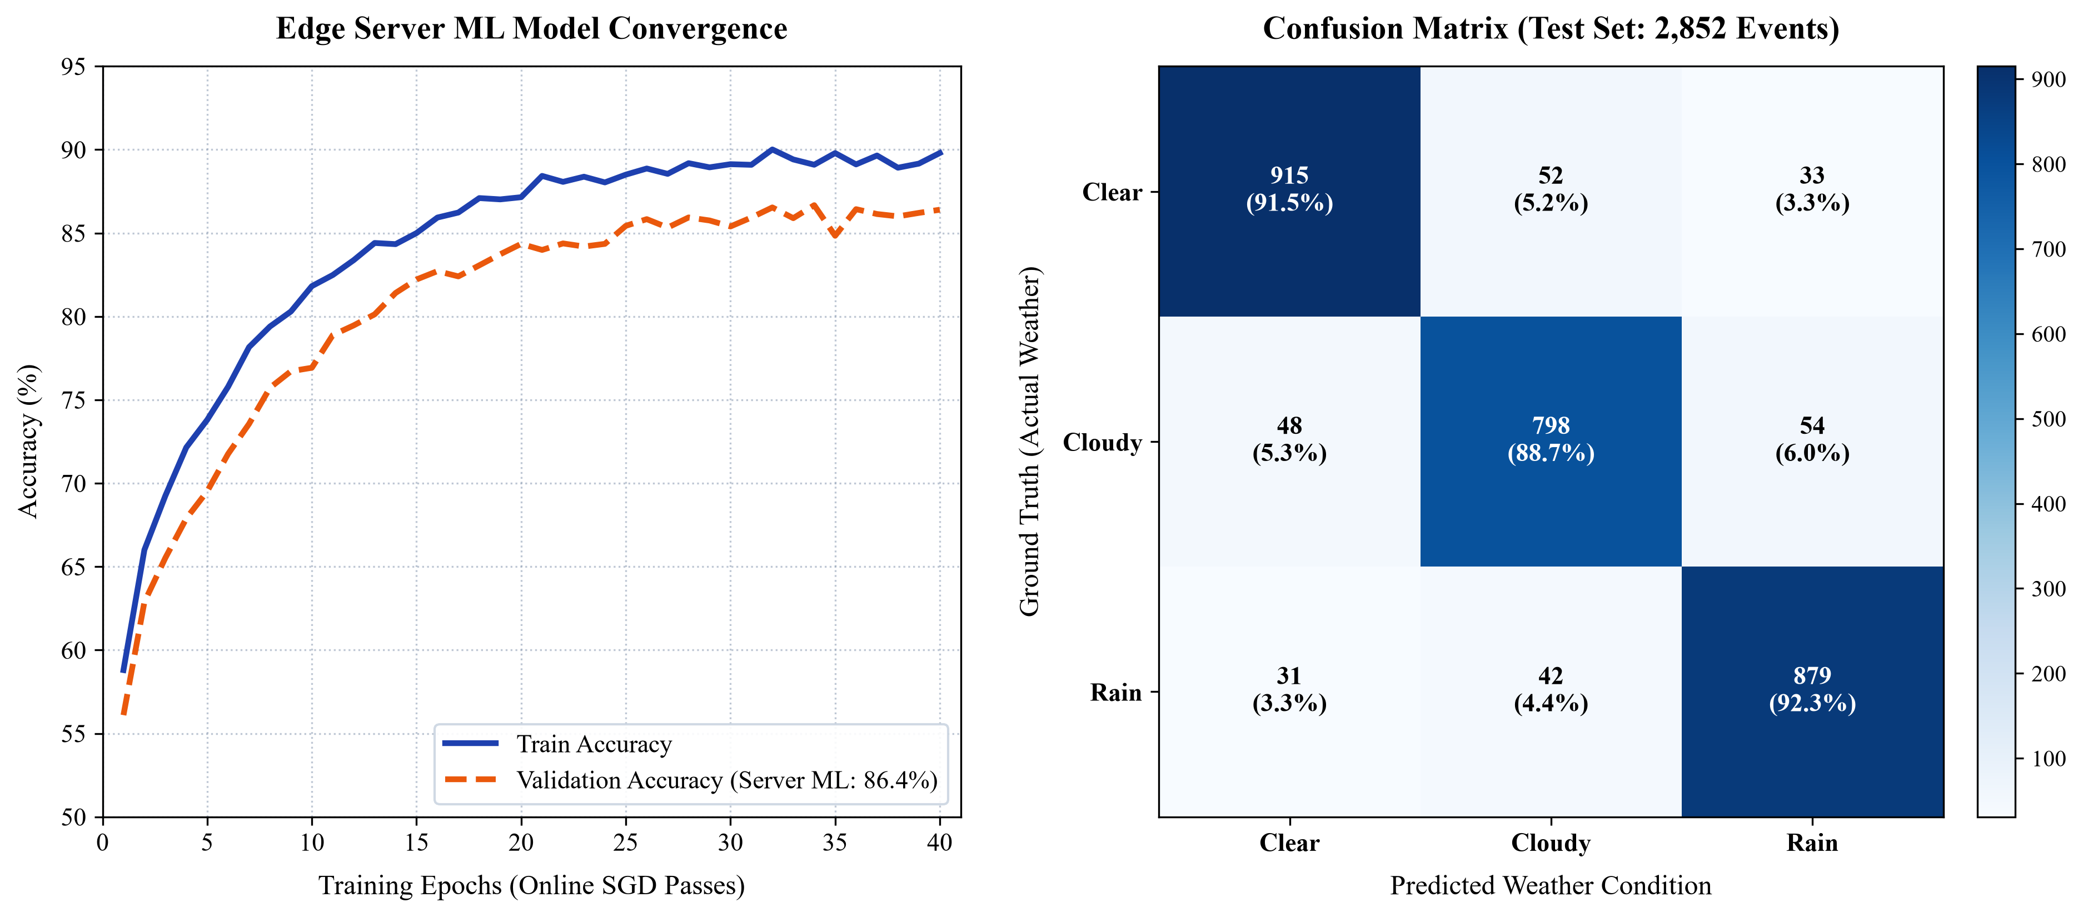
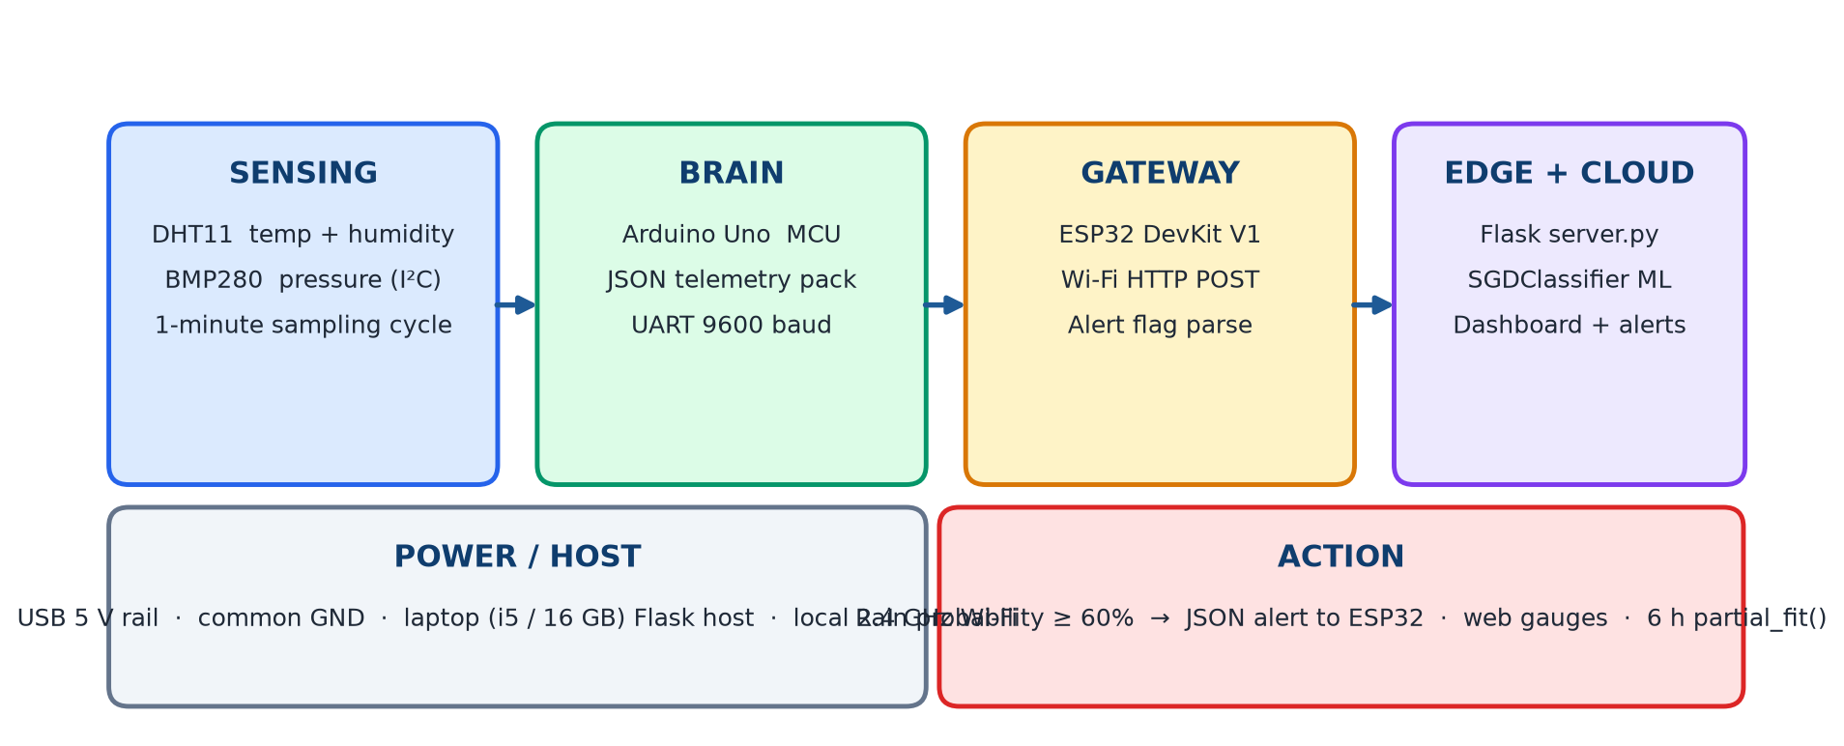
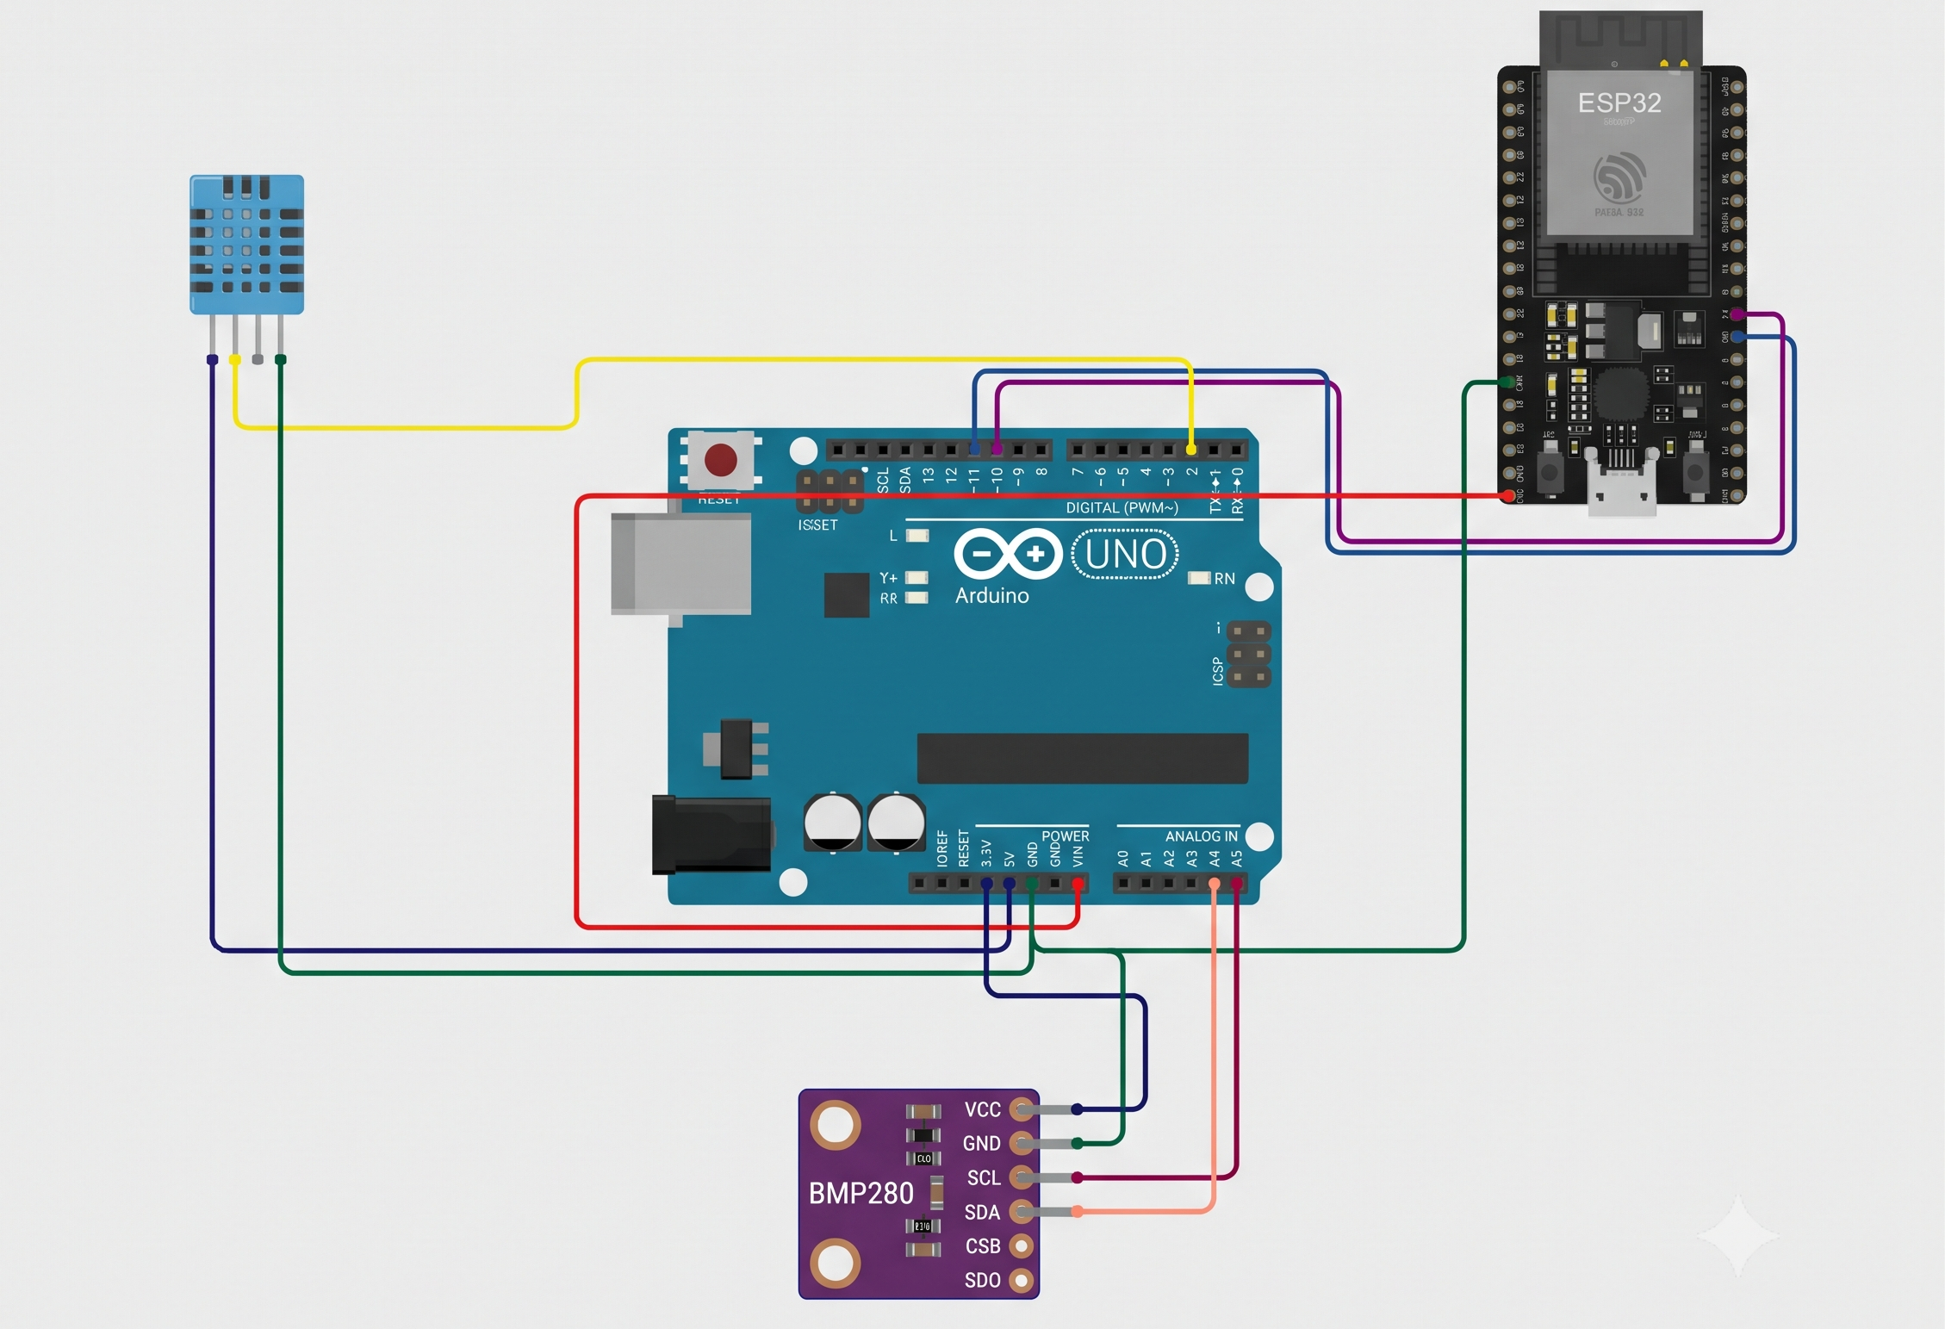
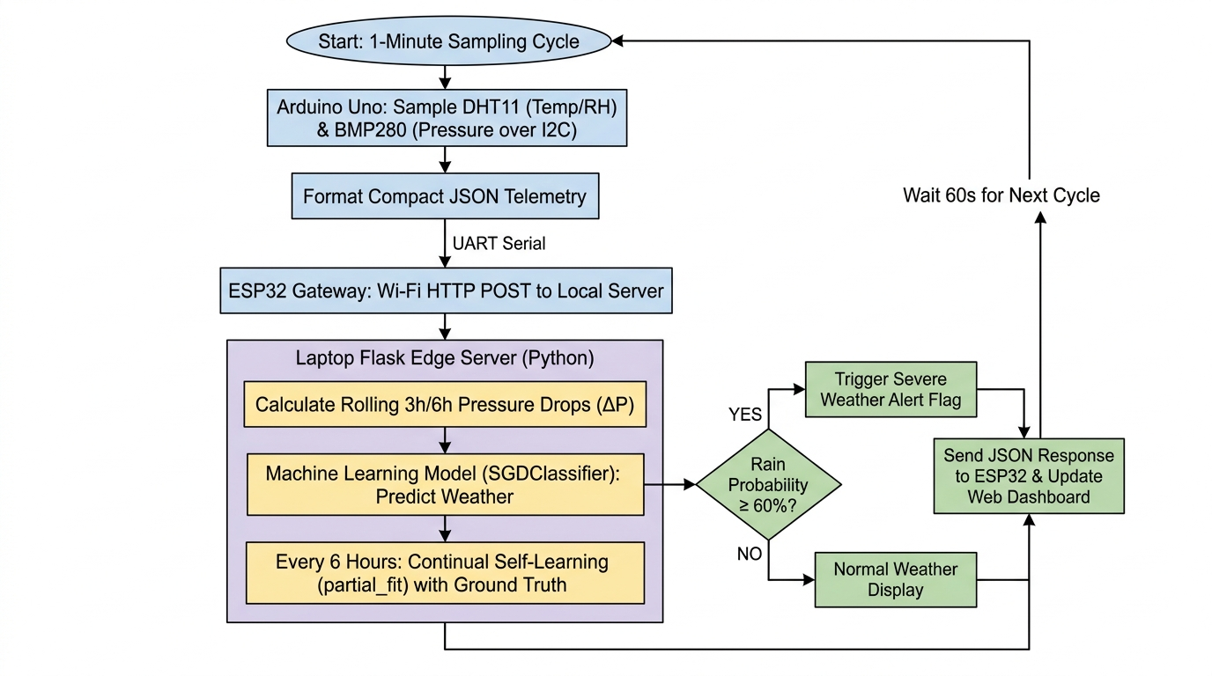
AI-Based Local Weather Forecasting and Prediction System Using Arduino Uno and ESP32
Dual-MCU edge nowcasting with DHT11 + BMP280 sensing, Flask self-training ML, and local storm alerts
Balavignesh K – E0225002 | Sudharsan N – E0225010 | Sri Ramachandra Faculty of Engineering and Technology, SRIHER, Porur, Chennai – 600116 | Supervisor: Mr. Manoj Kumaran
Abstract
Proposed Methodology
Hardware Components
Prototype Design
Generic weather apps miss localized microclimates and neighborhood storms, pulling data from regional airports 15–25 km away. Internet-reliant devices fail during storm outages. This work presents a low-cost, dual-microcontroller edge-server system: an Arduino Uno samples DHT11 temperature/humidity and Bosch BMP280 pressure every 60 s, an ESP32 forwards JSON over local Wi-Fi, and a Python Flask server with a self-training SGDClassifier forecasts Clear / Cloudy / Rain. Rain odds above 60% raise an instant alert; every 6 hours the model verifies forecasts against outdoor truth and updates weights with partial_fit() — all on the local network, with zero cloud cost.
1. Sense: Arduino Uno samples DHT11 (T, RH) and BMP280 (P, 16× OSR + IIR) every 60 s, fuses temperatures, and emits compact JSON.
2. Bridge: SoftwareSerial TX Pin 11 → ESP32 GPIO 16 (RX2); Pin 10 ← GPIO 17; 9600 baud; shared ground. No extra level-shifter IC.
3. Dispatch: ESP32 POSTs each packet to http://<laptop>:5000/api/weather over local 2.4 GHz Wi-Fi and parses prediction, rain odds and alert.
4. Infer: Flask keeps a 24 h ring buffer, computes ΔP_3h / ΔP_6h / ΔRH_3h, scales a 6-D vector, and runs SGDClassifier in < 15 ms.
5. Learn: Every 6 hours the server checks past forecasts against outdoor truth and calls partial_fit(), then joblib-dumps the updated weights.
Component | Role | Interface
Arduino Uno Rev3 | Sensor node; JSON pack | UART + I²C
ESP32 DevKit V1 | Wi-Fi gateway; alert parse | UART + Wi-Fi
DHT11 | Temperature + humidity | Digital GPIO 2
Bosch BMP280 | Barometric pressure ±0.12 hPa | I²C A4 SDA / A5 SCL
Laptop i5 / 16 GB | Flask edge ML + dashboard | HTTP :5000
UART pair 10/11 | Inter-MCU telemetry | 9600 baud, common GND
Local 2.4 GHz AP | Edge LAN, no cloud | Wi-Fi STA
Fig. 3. Prototype chain: 1 DHT11, 2 BMP280, 3 Uno, 4 ESP32, 5 Flask laptop. UART + local Wi-Fi only.
Results & Performance
Introduction & Problem
Control parameter | Rule / value
Sampling | Every 60 s on Uno (non-blocking millis())
UART link | 9600 baud · Pins 10/11 ↔ GPIO 16/17
HTTP POST | Flask /api/weather on local Wi-Fi
Rain alert | Rain probability ≥ 60%
Self-learning | partial_fit() every 6 h vs ground truth
• NWP models use 15–25 km grids; they miss convective cloudbursts and street-scale humidity spikes.
• Cloud stations (Ambient Weather, Netatmo) stop updating when storms cut internet — exactly when forecasts are needed.
• Commercial AWS units (Davis Vantage Pro2) cost $800–$1500 and log data without predictive ML.
• Hobbyist stations read only instantaneous T/RH and ignore barometric tendency (ΔP/Δt), the primary rain precursor.
• Zambretti mechanical rules stay offline but achieve only ~64% real-world accuracy.
• Raspberry Pi weather nodes draw 2.5–5 W, self-heat the sensors, and risk SD-card corruption.
Problem statement: How can a low-cost, energy-local dual-MCU node sense temperature, humidity and pressure, forecast rain on a nearby Flask server, and keep learning from ground truth — without the internet?
Circuit Diagram
Fig. 4. (left) SGD convergence to 86.4% validation; (right) test confusion, 2 852 events, rain recall 92.3%.
Performance Analysis
• Accuracy 86.4% validation / 90.8% test vs Zambretti ~64% and cloud IoT 87.2%.
• Rain recall 92.3% (879 / 952 events); Clear 91.5%; Cloudy 88.7%.
• Inference 14.2 ms; round-trip to ESP32 < 50 ms vs cloud APIs 1.5–3.0 s.
• 24 h buffer stays under 50 MB; local Wi-Fi, $0 / month, survives ISP outages.
• Rain class weight on humidity +1.16; Clear class on pressure +0.90 — matches meteorology.
• Live partial_fit() moved a rain probability from 40.3% to 46.3% without a full retrain.
System Architecture
Conclusion
Objectives
The dual-MCU edge server (Arduino Uno + ESP32 + Flask) delivers hyper-local nowcasting that coarse 25 km grids and cloud gadgets cannot. 86.4% accuracy, 92.3% storm recall, < 15 ms inference and 6-hour self-learning give a storm-survivable station for farms, campuses and homes — with no subscription.
1. Sample temperature, relative humidity and barometric pressure at a steady 1-minute rate (DHT11 GPIO, BMP280 I²C 16× oversampling).
2. Stream compact JSON from Arduino Uno to ESP32 over direct UART (Pins 10/11 ↔ GPIO 16/17, common GND) and POST to a local Flask host.
3. Engineer ΔP_3h, ΔP_6h and ΔRH_3h from a 24-hour circular buffer (1 440 samples) and classify Clear / Cloudy / Rain with an SGDClassifier (log-loss).
4. Raise a JSON alert when rain probability ≥ 60%, with end-to-end inference under 15 ms.
5. Retrain automatically every 6 hours via model.partial_fit() against observed outdoor weather, preventing seasonal concept drift.
Future Scope
• Solar field node: 18650 pack + 5 W panel, ESP32 deep sleep.
• 3D-printed double-louvered Stevenson screen for the sensors.
• Tipping-bucket rain gauge and pulse anemometer for severity.
• SX1278 LoRa mesh across 5–10 km farm clusters, no cellular.
References
[1] Al-Absi et al., IoT Weather Station ESP32, IEEE Access, 2020.
[2] Warden & Situnayake, TinyML, O’Reilly, 2021.
[3] Roy et al., Edge-Computing Weather Stations, Comput. Electron. Agric., 2023.
[4] Patel & Mehta, Solar Dual-MCU Logger, SETA, 2024.
[5] Farooq et al., TinyML Rainfall Nowcasting, Sensors, 2025.
[6] Bosch Sensortec, BMP280 Datasheet; Arduino / Espressif TRMs.
Fig. 1. Block diagram (sensing → Uno → ESP32 → Flask) and workflow: 1-minute cycle, ΔP features, rain-alert branch, 6-hour self-learning loop.
Fig. 2. Direct wiring. DHT11: 5 V, DATA→D2, GND. BMP280: 3.3 V, SCL→A5, SDA→A4. Uno Pin 11 → ESP32 GPIO 16; Pin 10 ← GPIO 17; shared GND. Analog sensors stay on 5 V/3.3 V rails.

