Slide 1
ARTIFICIAL INTELLIGENCE FOR HEART ATTACK PREDECTION

Slide 2
ABSTRACT
Day by day the cases of heart diseases are increasing at a rapid rate and it’s very Important and concerning to predict any such diseases beforehand.
This diagnosis is a difficult task i.e. it should be performed precisely and efficiently. This research paper mainly focuses on which patient is more likely to have a heart disease based on various medical attributes.
Here they have prepared a heart disease prediction system to predict whether the patient is likely to be diagnosed with a heart disease or not using the medical history of the patient and use of different algorithms of machine learning such as logistic regression and KNN to predict and classify the patient with heart disease.
The Given heart disease prediction system enhances medical care and reduces the cost. e. It is implemented on the .pynb format.

Slide 3
INTRODUCTION
“Machine Learning is a way of Manipulating and extraction of implicit, previously unknown/known and potential useful information about data”.
Machine Learning is a very vast and diverse field and its scope and implementation is increasing day by day.
Machine learning Incorporates various classifiers of Supervised, Unsupervised Learning which are used to predict and Find the Accuracy of the given dataset.
Cardiovascular diseases are very common these days, they describe a range of conditions that could affect your heart. World health organization estimates that 17.9 million global deaths from (Cardiovascular diseases) CVDs . It is the primary reason of deaths in adults.

Slide 4
This project focuses on mainly three data mining techniques namely:
(1) Logistic regression
(2) KNN
(3) Random Forest Classifier
The accuracy of our paper is 87.5% using more data mining techniques increased the HDPS accuracy and efficiency.

Slide 5
OBJECTIVE
The objective of this project is to check whether the patient is likely to be diagnosed with any cardiovascular heart diseases based on their medical attributes such as gender, age, chest pain, fasting sugar level, etc.
A dataset is selected from the UCI repository with patient’s medical history and attributes. By using this dataset, we predict whether the patient can have a heart disease or not.
To predict this, we use 14 medical attributes of a patient and classify him if the patient is likely to have a heart disease. These medical attributes are trained under three algorithms: Logistic regression, KNN and Random Forest Classifier.
Most efficient of these algorithms is KNN which gives us the accuracy of 88.52%. And, finally we classify patients that are at risk of getting a heart disease or not and also this method is totally cost efficient.

Slide 6
DATA SOURCE
According to World Health Organization (WHO), the greatest number of deaths in middle aged people are due to Cardiovascular s.
This dataset gives us the much-needed information i.e. the medical attributes such as age, resting blood pressure, fasting sugar level etc. of the patient that helps us in detecting the patient that is diagnosed with any heart disease or not.
This dataset helps us detecting if the patient is at risk of getting a heart disease or not and it helps us classify patients that are at risk of having a heart disease and that who are not at risk.
According to this dataset, the pattern which leads to the detection of patient prone to getting a heart disease is extracted. These records are split into two parts: Training and Testing. This dataset contains 303 rows and 14 columns,

Slide 7
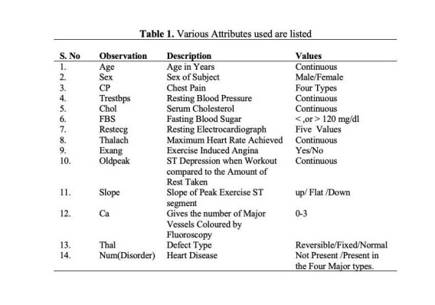
ATTRIBUTES

Slide 8
METHODOLOGY
The methodology is a process which includes steps that transform given data into recognized data patterns for the knowledge of the users.
The proposed methodology includes steps, where first step is referred as the collection of the data than in second stage it extracts significant values than the 3rd is the preprocessing stage where we explore the data. Data preprocessing deals with the missing values, cleaning of data and normalization depending on algorithms used .
After pre-processing of data, classifier is used to classify the pre-processed data the classifier used in the proposed model are KNN, Logistic Regression, Random Forest Classifier. Finally, the proposed model is undertaken, where we evaluated our model on the basis of accuracy and performance using various performance metrics.

Slide 9
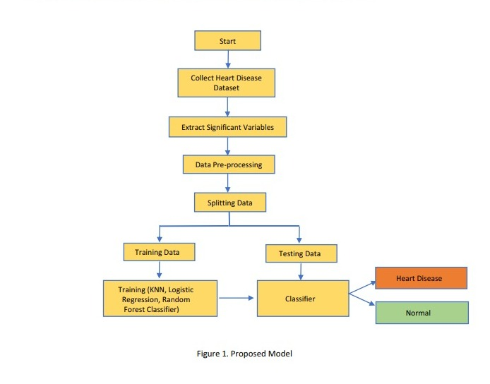
PROPOSED MODEL

Slide 10
CONCLUSION
A cardiovascular disease detection model has been developed using three ML classification modelling techniques. This paper predicts people with cardiovascular disease by extracting the patient medical history that leads to a fatal heart disease from a dataset that includes patients’ medical history such as chest pain, sugar level, blood pressure, etc.
This Heart Disease detection system assists a patient based on his/her clinical information of them been diagnosed with a previous heart disease. The algorithms used in building the given model are Logistic regression, Random Forest Classifier and KNN.

