Slide 1

Guided By
Faculty: Dr K . Madhavi

Slide 2
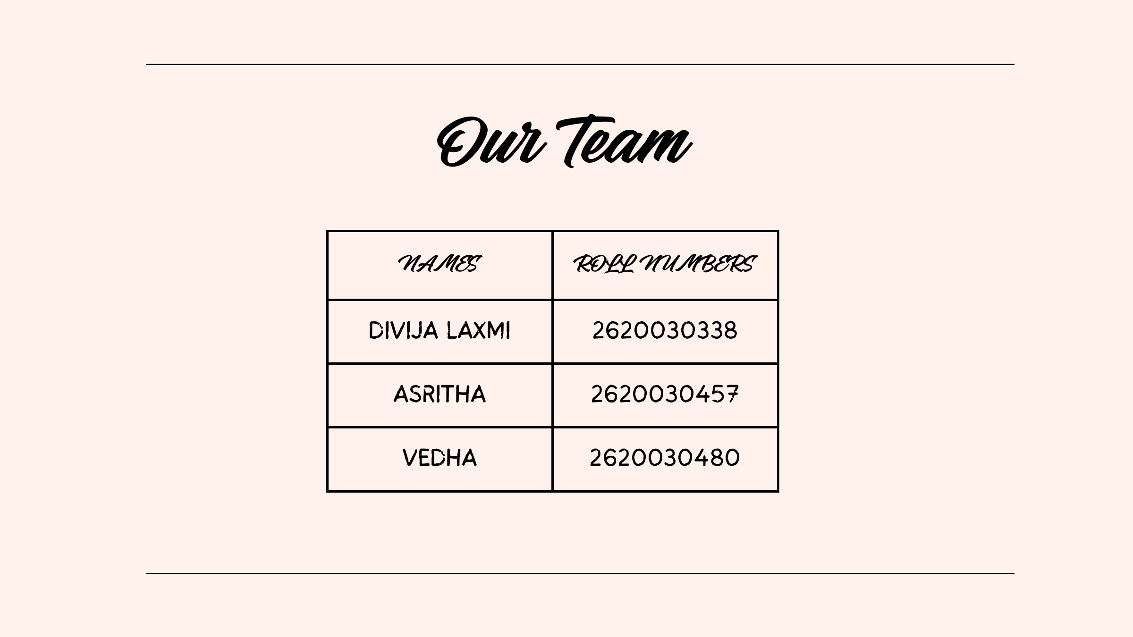
2620030340 B.Vaishnavi
2620030591 R.Harshitha

Slide 3
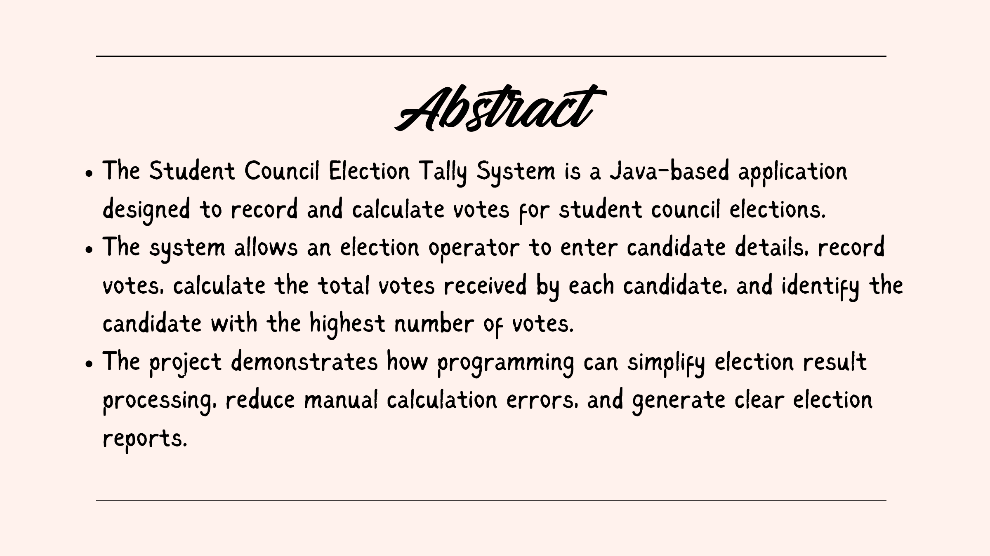

Slide 4
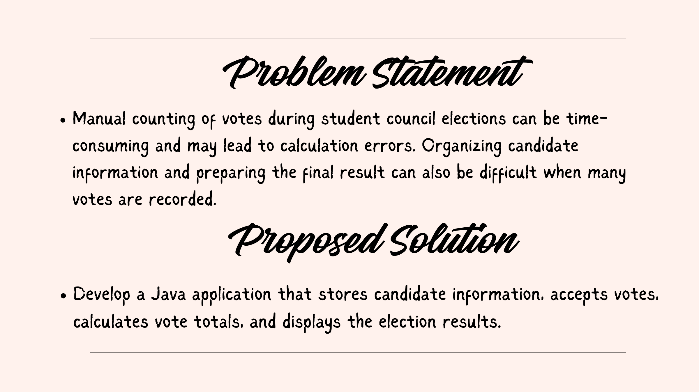

Slide 5
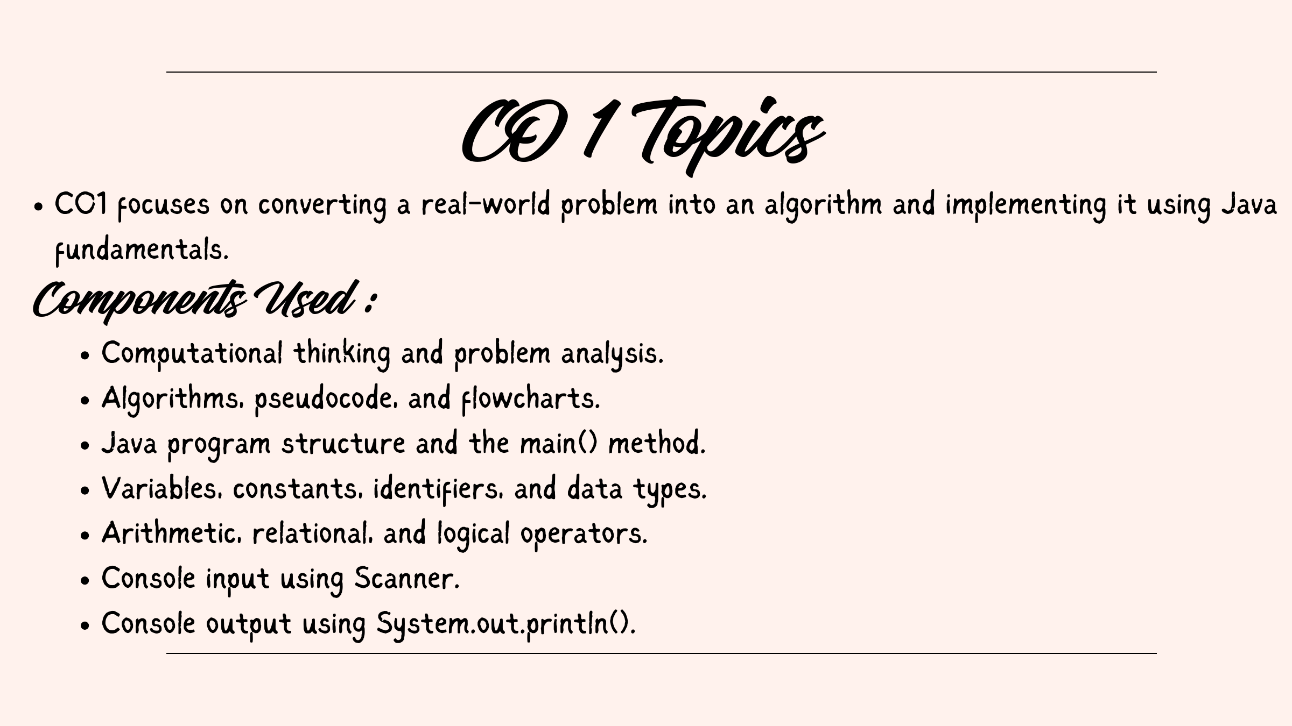

Slide 6
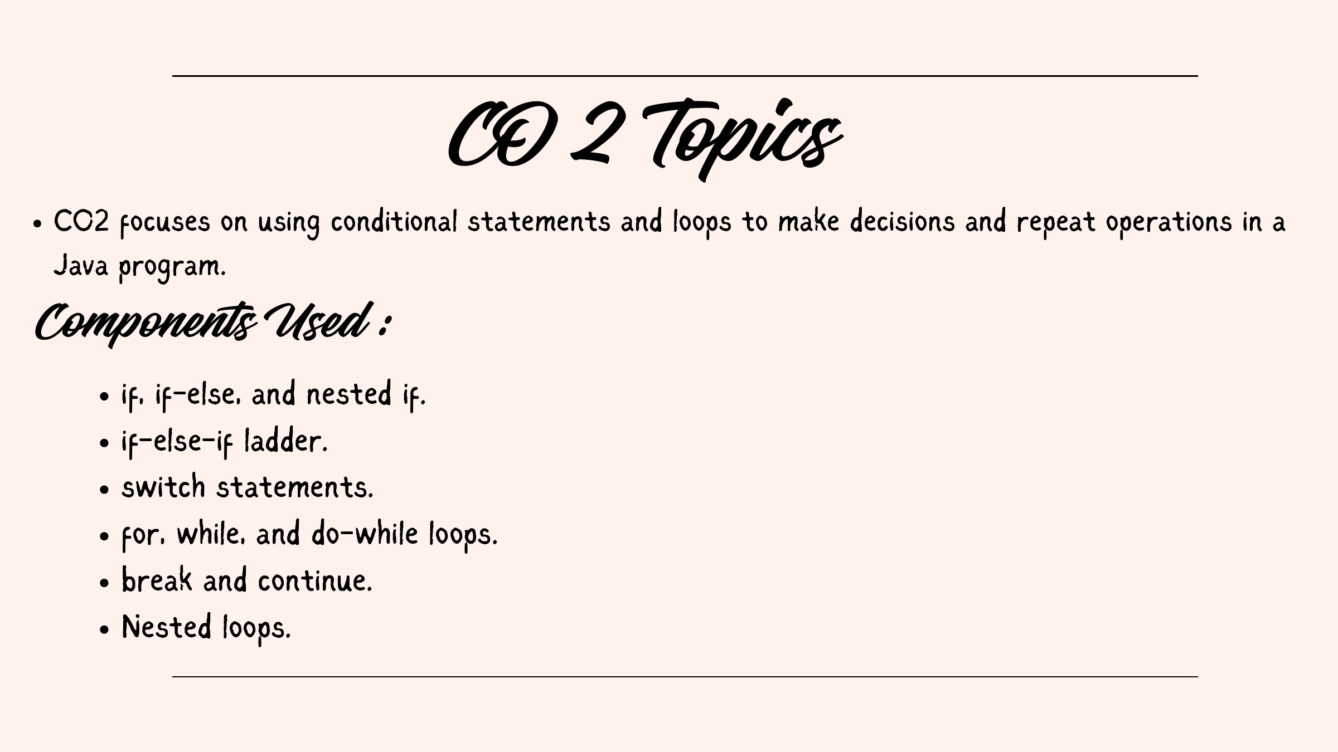

Slide 7
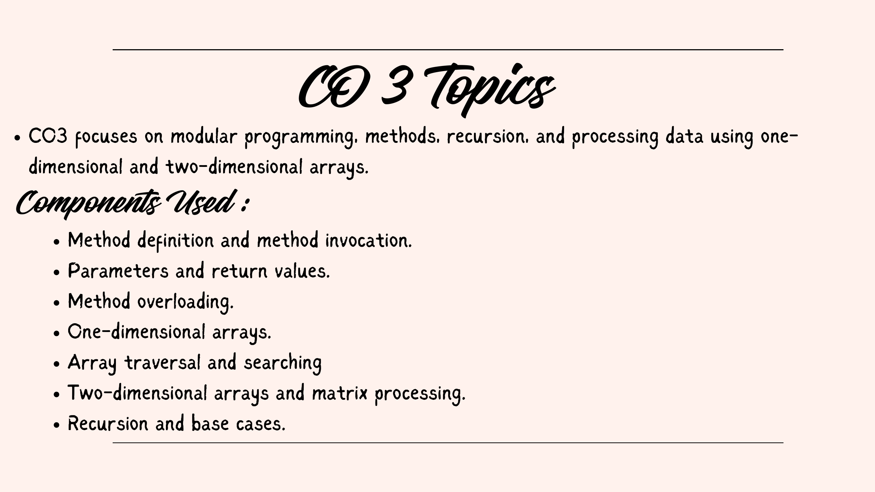

Slide 8
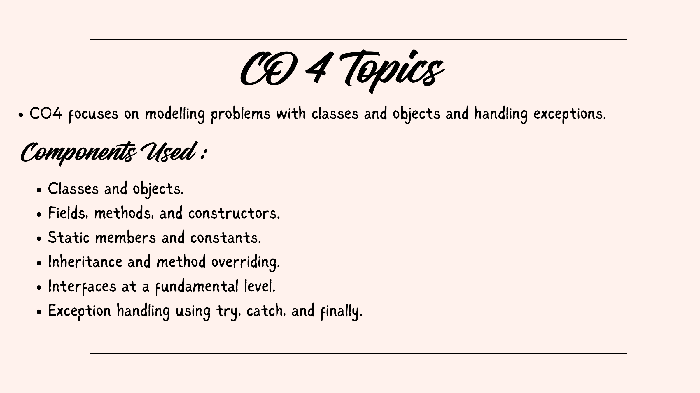

Slide 9
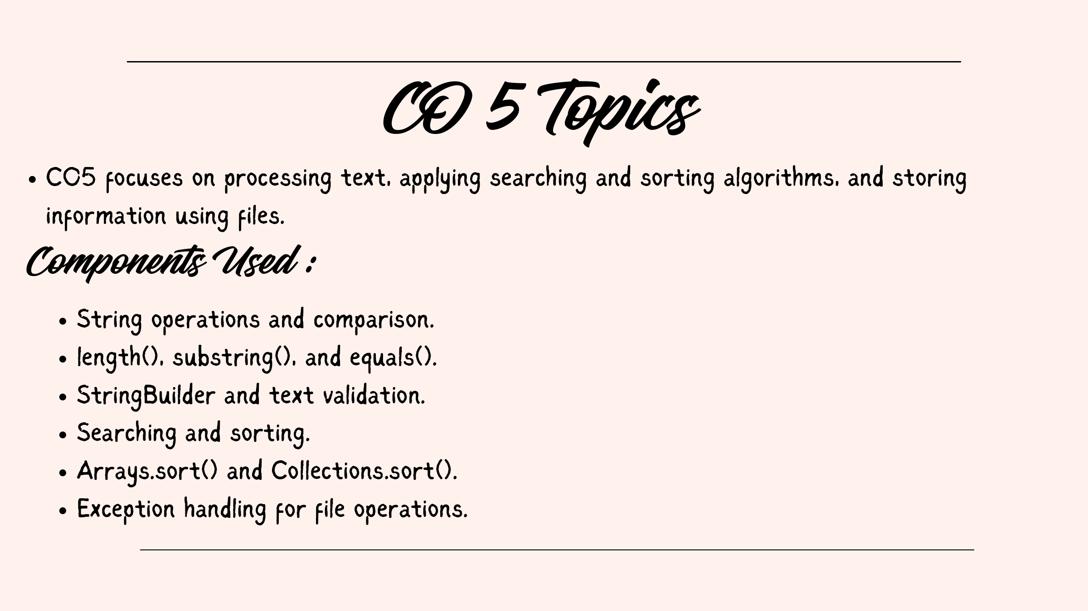

Slide 10
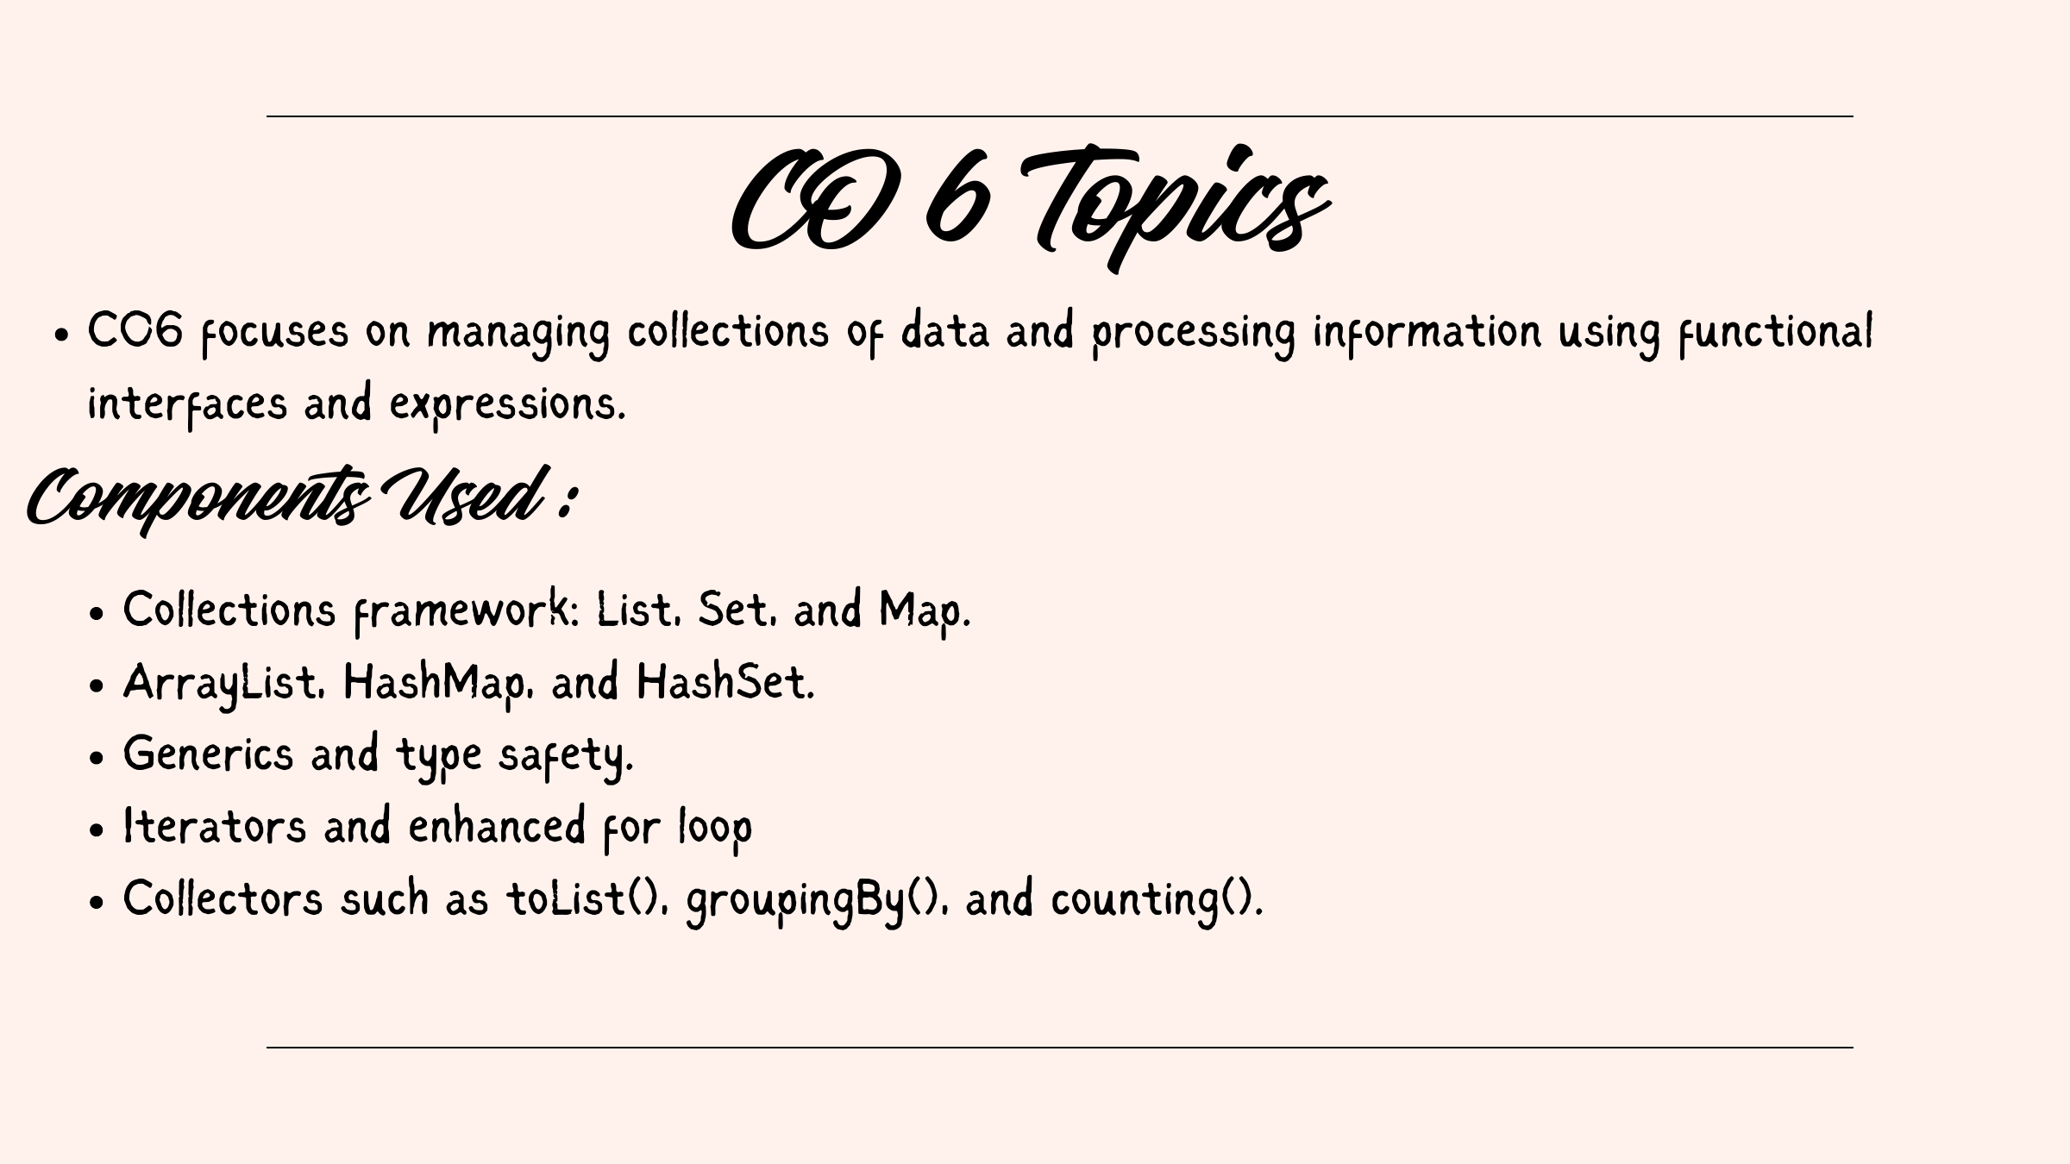

Slide 11


Slide 12
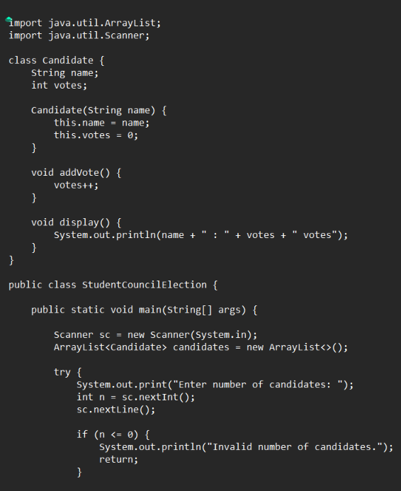
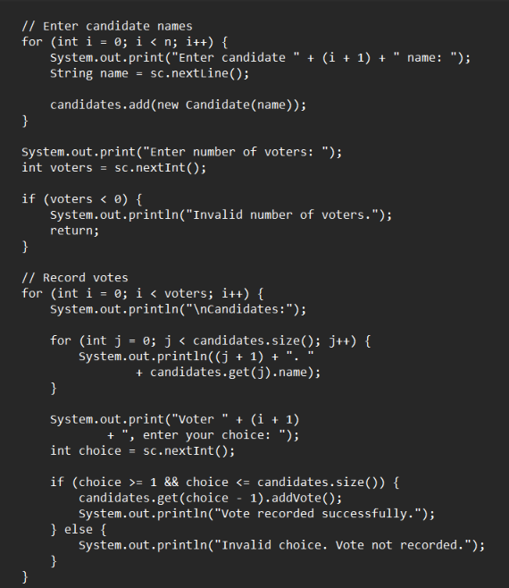
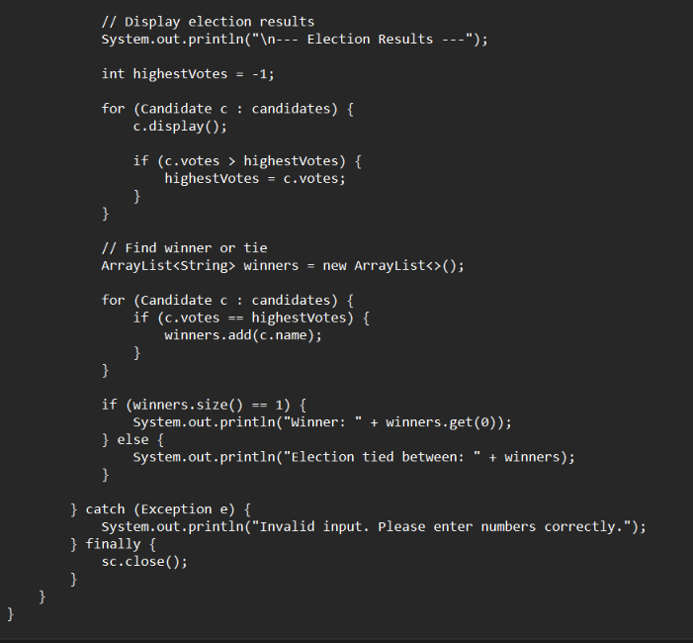
Java Code (Complete Program)

Slide 13
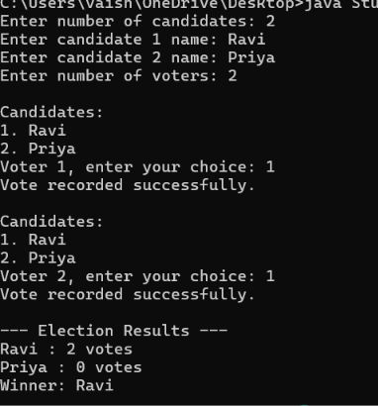
OUTPUT :

Slide 14
GitHub Profiles
Bala Sai Vaishnavi: https://github.com/balasaivaishnavi-alt
Harshitha: https://github.com/harshitha-591

Slide 15


