Slide 1
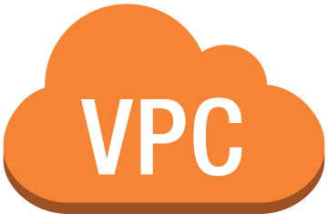





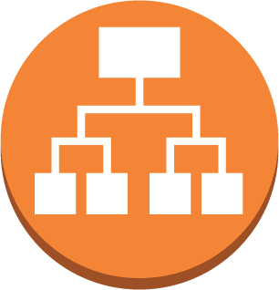






WebApp Architecture Diagram
Public subnet/AZ
private subnet/AZ
www.xxx.com
RDS DB instance replica (multi-AZ)
Web/ App server
Users
Public subnet/AZ
private subnet/AZ
Application & Network Load Balancer
Web/App server
RDS DB instance
CICD pipeline

